Slide 1
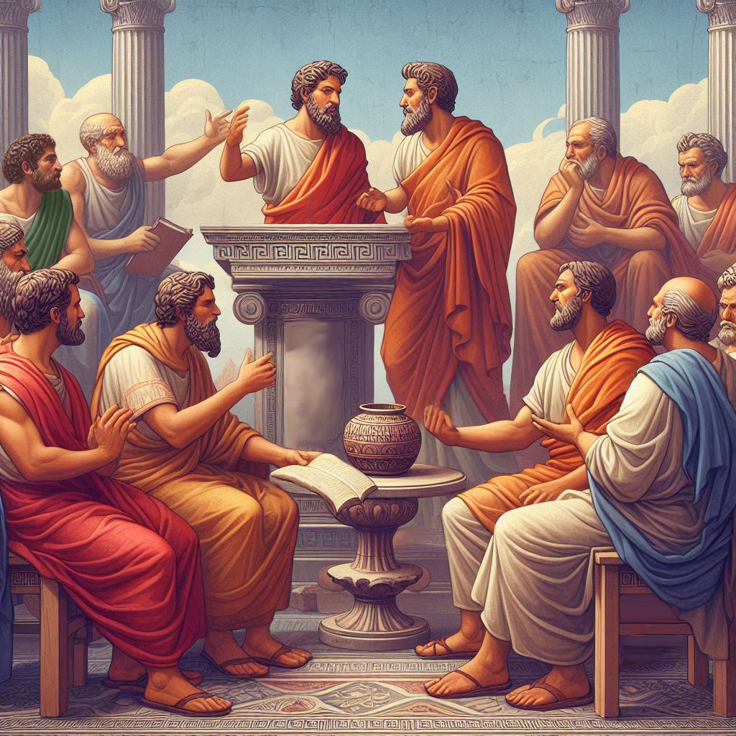
Eternalism Politics
Zion

Slide 2
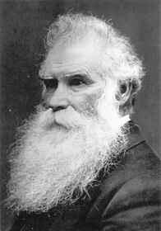
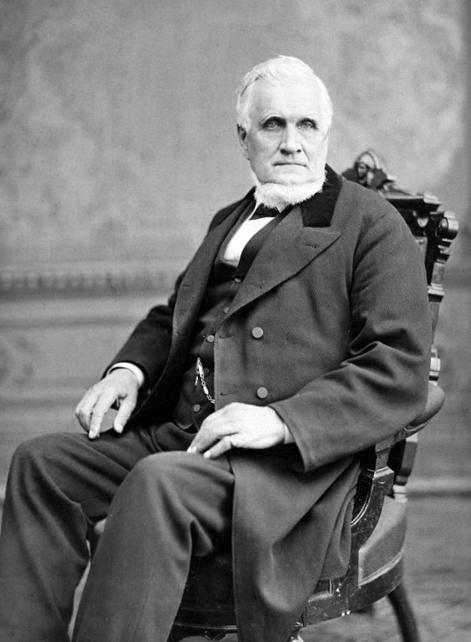
OVERVIEW
Elder Orson Pratt: “What is Zion? What are we to understand by its term?
Is it a city? Is it a people?” (JD 14:343)
What is Zion?
Who will build Zion?
How will Zion be built?
What is the Future of Zion?
President John Taylor: “The Zion of God. What does it mean? The pure in heart in the first place. In the second place those who are governed by the law of God - the pure in heart who are governed by the law of God. Shall we build up a Zion? We shall; but we shall not, every one of us, have our own way about it.” (JD 26:109)
1st Personal
2nd Society
3rd Place
President John Taylor: “There have been Zions before.” (JD 23:236)

Slide 3
What is Zion?
1st Zion is a Personal Spiritual State of Being (the pure in heart)
Individual
Society
D&C 97:21 “Therefore, verily, thus saith the Lord, let Zion rejoice, for this is Zion—the pure in heart;”
2nd Zion is a Society (of the pure in heart)
Individualism
Elder Bruce R. McConkie: “Zion is the name given by the Lord to his saints.” (Mormon Doctrine, p854)
Moses 7:18 “And the Lord called his people Zion, because they were of one heart and one mind, and dwelt in righteousness;
3rd Zion is Gathering Places, Central Dwelling Place (for the pure in heart)
President Brigham Young: “And where is the land of Zion? It is wherever the finger of the Lord has pointed out for His people to gather to. That is the place to go to. ” (JD 12:228-229)
President Brigham Young: “Where is Zion? Where the organization of the Church of God is.” (JD 8:205)
Enoch’s City: “And Enoch continued his preaching in righteousness unto the people of God. And it came to pass in his days, that he built a city that was called the City of Holiness, even Zion. (Moses 7:19)
Old Jerusalem: “At least from the days of King David, the name Zion was applied to one of the hills upon which Jerusalem is built or later, to the entire city.” (Mormon Doctrine, p854, 2 Sam. 5:6-7)
North and South America (Joseph Smith): “You know there has been great discussion in relation to Zion … The prophets have spoken and written upon it; but I will make a proclamation that will cover broader ground. The whole of America is Zion itself from north to south...” (TPJS, p362. see 1 Nephi 2:20)

Slide 4
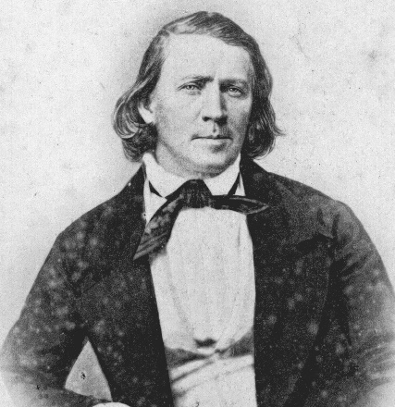
Gathering Place?
President Brigham Young: “The world is wrong and we have to right it under the direction of Heaven. For this purpose are we located upon the land of Zion, and the land of Zion is North
and South America—the land where our heavenly Father made his appearance and planted
the Garden of Eden. This land is choice above all other lands upon the face of the earth.” (JD 10:222)
President George A. Smith: “The time will come when the Latter-day Saints will build, in Independence, Missouri, a holy city. That will one day be the center stake of Zion, the center spot of the New Jerusalem which God is to build on this land. We can only be prepared for that work by being united.” (JD 16:281)
New Jerusalem: “The New Jerusalem to be built in Jackson county, Missouri, is also called the City of Zion or Zion. Dozens of revelations in the Doctrine and Covenants speak about this Zion. Isaiah and other of the ancient prophets have much to say about it and about the Jerusalem of old which shall be restored in grandeur and beauty in the last days.” (Mormon Doctrine, p855, Isaiah2:3)
The Whole Earth (President Brigham Young): “When Joseph first revealed the land where the Saints should gather, a woman in Canada asked if we thought that Jackson County would be large enough to gather all the people that would want to go to Zion. I will answer the question really as it is. Zion will extend, eventually, all over this earth. There will be no nook or corner upon the earth but what will be in Zion. It will all be Zion.” (JD 9:138)
Celestial Kingdom: “Paul uses the term Mount Zion to refer to the abode of exalted beings, those who overcome all things and inherit the fulness of the father’s kingdom.” (Mormon Doctrine, p855. Heb.12:22-24)

Slide 5
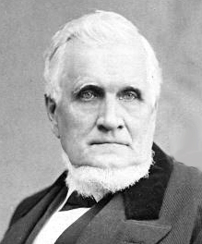
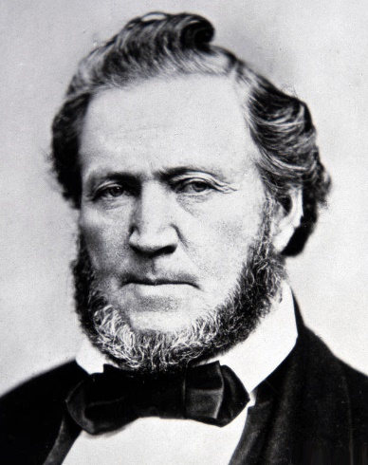
Who Will Build Zion?
President John Taylor: “We all believe somebody has got to do this Work, that it has to be done somehow and somewhere. … How shall these things be accomplished? The nations of the world will not do it, for they are opposed to God and his kingdom. … We are the only people under the heavens that are making an attempt at it, and a blundering one it is, no doubt.” (JD 10:148)
President Brigham Young: “We are not going to wait for angels, or for Enoch and his company to come and build up Zion, but we are going to build it.” (JD 9:284)
“If we are to build up the kingdom of God, or establish Zion upon the earth, we have to labor with our hands, plan with our minds, and devise ways and means to accomplish that object.” (JD 3:51)
“Do we realize that if we enjoy a Zion in time or in eternity, we must make it for ourselves? That all who have a Zion in the eternities of the gods organized, framed, consolidated, and perfected it themselves, and consequently are entitled to enjoy it.” (JD 9:282)
President Brigham Young: “The angels that now walk in their golden streets, and they have the tree of life within their paradise, had to obtain that gold and put it there. When we have streets paved with gold, we will have placed it there ourselves. When we enjoy a Zion in its beauty and glory, it will be when we have built it. If we live in the city of the New Jerusalem, it will be because we lay the foundation and build it.” (JD 8:354-355)

Slide 6
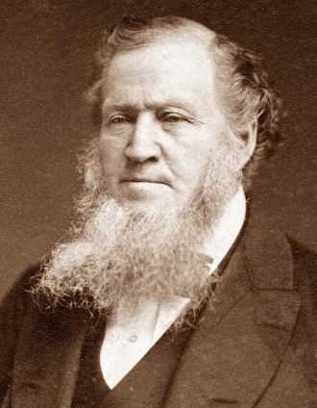
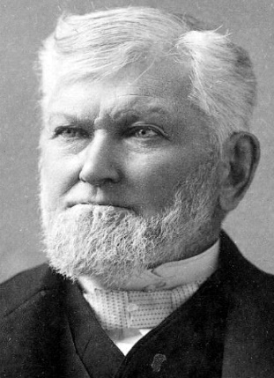
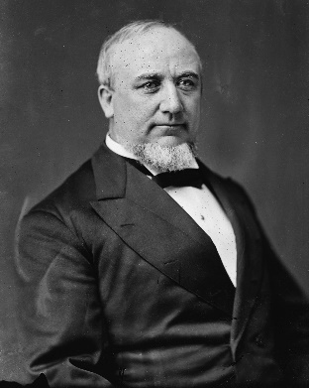
How Will Zion Be Built?
President Brigham Young: “The skill of building up and establishing the Zion of our God on the earth is to take the people and teach them how to take care of themselves.” (JD 18:354)
“When eternity comes I will be prepared to enter on the things of eternity. But I would not be prepared for that sphere of action, unless I could manage the things that are now within my reach. You must all learn to do this. … No man is going to inherit a celestial glory, who trifles with the principles thereof. The man who does not labor from day to day and from hour to hour for building up this Kingdom and bringing forth the fulness of the Kingdom of God on the earth, and the establishment of Zion, will sooner or latter, fall and go out of the Church.” (JD 5:3-4 , JD 10:338)
President Brigham Young: “Are the Latter-day Saints ready to receive Zion from above? Have they wisdom and knowledge to receive and conduct themselves properly in the society of angels? I think not.” (JD 7:143)
President Wilford Woodruff: “But I am satisfied there has got to be a great change with us in many respects before we are prepared for the redemption of Zion and the building up of the New Jerusalem.” (JD 16:36)
President John Taylor: “It is evident that some great revolution, some mighty change has got to transpire to revolutionize our minds, our feelings and judgment, our pursuits and action, and, in fact, to control and influence us throughout, before anything of this kind can take place.” (JD 10:147)
Elder George Q. Cannon: “But the time will come when there will be a separation, a final separation, of the righteous from the wicked, and that separation will be brought about by the exercise of the Priesthood which God has bestowed. That Priesthood will draw up from the earth the pure, the holy, the worthy. It will draw them up to the society of God. Everything that is not pure will be left behind.” (JD 26:251)

Slide 7
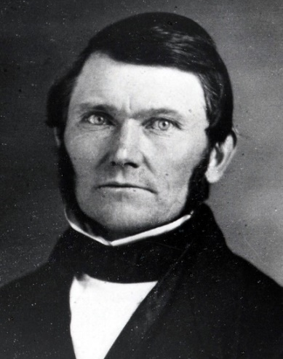
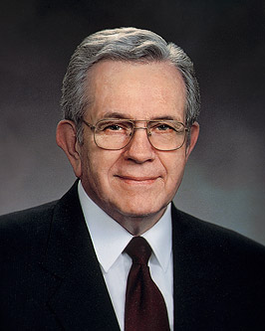
Saints in Zion or Saints in Babylon?
President Wilford Woodruff: “There are some prophecies pertaining
to these latter days that are unpleasant to contemplate.” (JD 16:271)
Elder Boyd K. Packer: “You are growing up in enemy territory. When you become mature spiritually, you will understand how the adversary has infiltrated the world around you.”
(How to Survive in Enemy Territory, Seminary Broadcast, Jan 22, 2012)
Elder George Q. Cannon: “When we came to these valleys, we thought we had left the world behind us. We thought that because these mighty mountains, which reared themselves on every hand as an impassable barrier between us and the rest of the world, Babylon was left behind. We thought we could live comparatively pure lives, and that we would be comparatively free from the associations of the world. But such ideas have been dispelled - very rudely dispelled - by that which has occurred. Babylon followed us. We find that these mountains are not sufficient to divide us from the rest of the world; that we must share with the rest of mankind the evils and the blessings that pertain to this mortal condition of existence. We have these circumstances to contend with. We are mixed with the wicked. The tares and the wheat grow together and will grow until the harvest.” (JD 26:251)

Slide 8
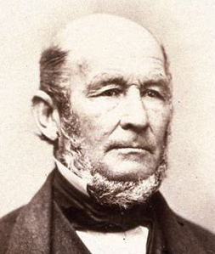
WARNING and WAKEUP CALL
President Brigham Young: “As individuals, we enjoy Zion at present, but not as a community; there is so much sin, darkness, and ignorance, and the veil of the covering which is over the nations of the earth is measurably over the Latter-day Saints. The same unrighteous principles, which becloud the minds of men universally, more or less becloud the minds of the Latter-day Saints.” (JD 3:191)
Elder George Q. Cannon: “Because as Zion increases there will be new temptations and circumstances thrown around us that will be a trial to us.” (JD 26:17)
D&C 105:5-6: “And Zion cannot be built up unless it is by the principles of the law of the celestial kingdom; otherwise I cannot receive her unto myself. And my people must needs be chastened until they learn obedience, if it must needs be, by the things which they suffer.”
Elder Heber C. Kimball: “Yes, we think we are secure here in the chambers of these everlasting hills ... But I want to say to you, my brethren, the time is coming when we will be mixed up in these now peaceful valleys to that extent that it will be difficult to tell the face of a Saint from the face of an enemy against the people of God. Then is the time to look out for the great sieve, for there will be a great sifting time, and many will fall. For I say unto you there is a test, a Test, a TEST COMING.” (Orson F. Whitney, The Life of Heber C. Kimball, p. 456-57)

Slide 9
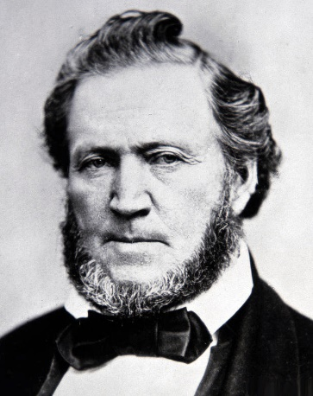
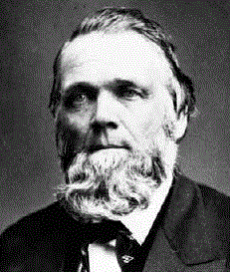
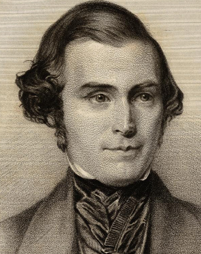
What is the Future of Zion?
President Brigham Young: “We have improved as fast as the church of Enoch. I trust we improve faster, for we have not as much time as they had.” (JD 12:210)
“Millions will come and live in Zion when the laws of Zion reign predominant over creation; but will all be prepared to be crowned kings and priests unto God? No.” (JD 9:138)
Elder Franklin D. Richards: “And it will come to pass before a great while that people will be so far from having peace that they must either take up the sword to contend against their neighbor, or flee to Zion and gather with God's people. You will see this come to pass. Mark my words. All kinds and conditions of people will desire to come here and make homes with us. You will see the day when it will be as hard to keep the wicked away from us as it ever has been to get people to join us. Mark that, too.” (JD 26:257)
Elder Orson Pratt: Those nations are trembling and tottering and will eventually crumble to ruin, and those men of wealth will come here, not to be baptized, but many of them will come that have never heard the servants of God; but they will hear that peace and health dwell among us, and that our officers are all peace officers, and our tax-gatherers men of righteousness. (JD 3:16)
“And the gates of Zion will be open day and night, and never be shut, to admit the forces that will come rushing in from all nations, to learn the wisdom, knowledge, and instruction that are poured out from the heavens upon the servants of the Most High.” (JD 2:61)

Slide 10
What is the Future of Zion?
Elder Orson Pratt: “There must be something wonderful, indeed, to attract the attention of all nations; unless there is to be a very great power manifested, it would not attract the attention of the people afar off; … What is an ensign? It is not only something unto which the people will gather, but it is something of divine appointment, something that the Lord organizes, something that will be a pattern to all peoples, nations and governments erected in the mountains, and He calls upon all the inhabitants of the earth to see it.” (JD 2:298, JD 24:31)
President Brigham Young: “Then we shall begin to rapidly collect the intelligence that is bestowed upon the nations, for all this intelligence belongs to Zion. All the knowledge, wisdom, power, and glory that have been bestowed upon the nations of the earth, from the days of Adam till now, must be gathered home to Zion. … We will have a nation that understands all things pertaining to the earth that it is possible for man to grasp. … So that all the world can say there is a pattern for us, not only in our business and worship, but in our knowledge of things that are, things that have been and of things that are yet to come, until the knowledge of Zion shall reach the uttermost parts of the earth, and the kings and great men shall say, ‘Let us go up to Zion and learn wisdom’. Will they come here to learn how to govern? Yes.” (JD 8:279, JD 12:257)
President John Taylor: “Now, this is what we are building up, and they built up a similar thing before the flood. … We are working for these things, and we will go on with the work and let the world wag. Let them get up a commotion once in a while. There is nothing new in that. It is the old trick. If we are faithful God will bless us, and Zion will arise and shine, and the glory of God will rest upon her. But woe to them that fight against Zion, for God will fight against them.” ” (JD 26:109, JD 24:356)

Slide 11
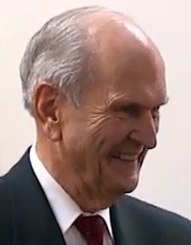
CONCLUSION
President Russel M. Nelson: “Do the spiritual work to find out for yourselves, and please do it now. Time is running out.” (“Come, Follow Me”, April 2019)
President Joseph F. Smith: “I feel that if Zion prospers all is well, and if Zion does not prosper, then my own happiness and prosperity is in jeopardy. For I expect nothing outside of the Gospel.” (JD 24:150)
Elder George Q. Cannon: “The prophecies concerning Zion which are on record are full of promises concerning the future growth of this people, concerning the glory that shall rest upon Zion. But these predictions and promises are all conditional. They will be fulfilled if we place ourselves in a position to merit their fulfillment, or to bring them about. If Zion fails to come up to the requirements which God has made of us, then the fulfillment of these glorious promises will undoubtedly be deferred.” (JD 26:316)
President John Taylor: “Eventually they will be enabled to erect cities that will be fit to be caught up—that when Zion descends from above, Zion will also ascend from beneath, and be prepared to associate with those from above. The people will be so perfected and purified, ennobled, exalted, and dignified in their feelings and so truly humble and most worthy, virtuous and intelligent that they will be fit, when caught up, to associate with that Zion that shall come down from God out of heaven.” (JD 10:147)

Slide 12
Questions?

