Slide 1
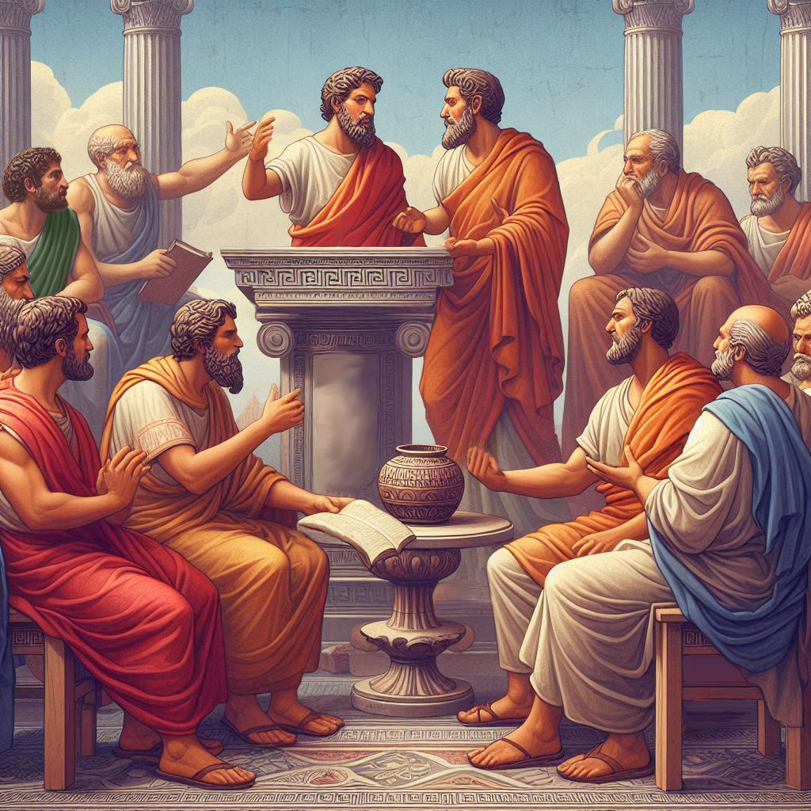
Eternalism Politics
Priesthood

Slide 2
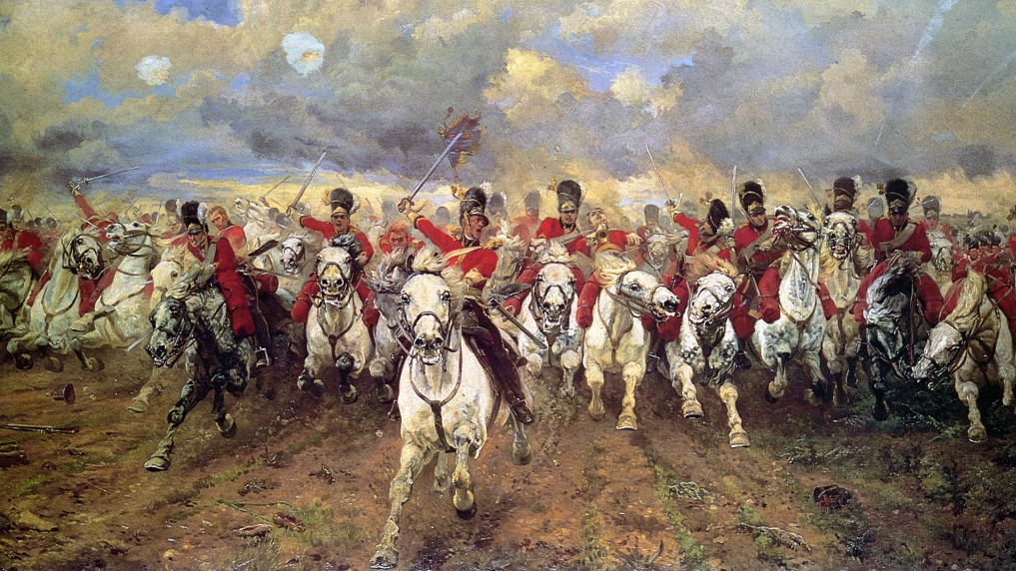
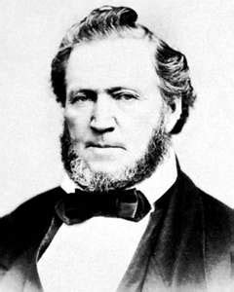
President John Taylor: “Read the history of nations and examine the paintings they have in their National Galleries, and you will find they represent, almost exclusively, scenes of blood, deadly struggles, triumphant victories, or sanguinary battles, and the groaning, troubles, sighs, sufferings, and death of the human family.” (JD 5:245)
THEOCRACY:
1. A country or state ruled by or subject to religious authority.
2. A form of government in which God is recognized as the supreme civil ruler
of the state, and his laws are taken as the statute-book of the kingdom.
(American Heritage Dictionary, 5th Ed.)
President Brigham Young: “People have reason to fear the bogus or spurious
theocracy.” (JD 7:147)

Slide 3
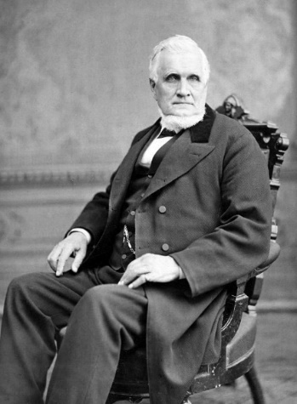
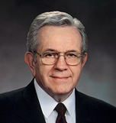
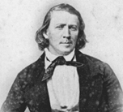
PRIESTHOOD OVERVIEW
President John Taylor: “What is His Priesthood? It is the rule, authority, administration, if you please, of the government of God on the earth or in the heavens; for the same Priesthood that exists upon the earth exists in the heavens, and that Priesthood holds the keys of the mysteries of the revelations of God;” (JD 6:25)
Elder Boyd K. Packer: “Priesthood is the authority and the power which God has granted to men on earth to act for Him. When we exercise priesthood authority properly, we do what He would do if He were present.” (A Primer on Principles of Priesthood Government, General Authority Training Session, April 1992)
President Brigham Young: “The Priesthood of the Son of God, which we have in our midst, is a perfect order and system of government, and this alone can deliver the human family from all the evils which now afflict its members and insure them happiness and felicity hereafter.” (JD 13:242)
(1) Priesthood Authority (Common Consent, Ordination, Setting Apart, Keys)
(2) Priesthood Order (Aaronic, Melchizedek, Patriarchal)
(3) Priesthood Power (Influence, Family, Ordinances)

Slide 4
PRIESTHOOD AUTHORITY
Elder Bruce R. McConkie: “Administrative affairs of the Church are handled in accordance with the law of common consent.” (Mormon Doctrine, p149, see also D&C 26:2)
Elder Boyd K. Packer: There is great safety to the Church in having the names of those called to offices in the Church presented in the proper meeting. Anyone who is a pretender or a deceiver will be recognized. If someone claims to have been secretly ordained to a special calling or higher order of the priesthood, you may know immediately that the claim is false!”
“The priesthood is always regulated by those who have the keys… While the word key has other meanings, like keys of wisdom or keys of knowledge, the keys of the priesthood are the right to preside and direct the affairs of the Church within a jurisdiction.”
“There are two ways authority is conferred in the Church: by ordination and by setting apart. Offices in the priesthood﻿—deacon, teacher, priest, elder, high priest, patriarch, seventy, and Apostle﻿—always come by ordination. The keys of presidency and the authority to act in callings in the priesthood are received by setting apart. The authority of a man set apart as president of a stake is limited to the boundaries of that stake. … When a man is ordained a bishop, he is also set apart to preside in a specific ward and has no authority outside its boundaries.” (A Primer on Principles of Priesthood Government, General Authority Training Session, April 1992)

Slide 5
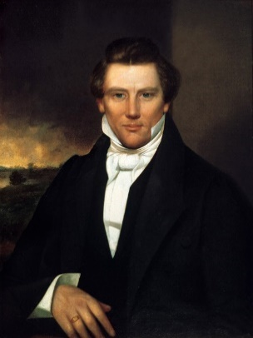
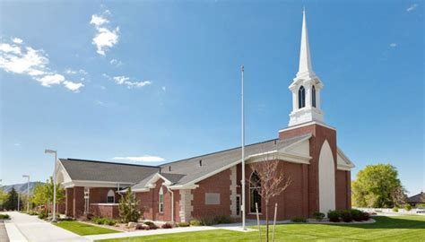
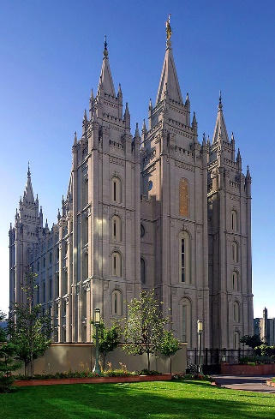
PRIESTHOOD ORDER
Joseph Smith: “All Priesthood is Melchizedek, but there are different portions or degrees of it.” (TPJS, p180)
“There are three grand orders of priesthood referred to here.” (TPJS, p322)
Aaronic Order (Lesser),
Melchizedek Order (Greater),
Patriarchal Order (Fullness)
ECCLESIASTICAL
D&C 107:1 “There are, in the church, two priesthoods, namely, the Melchizedek and Aaronic,
including the Levitical Priesthood.”
PATRIARCHAL
“Those holding the fulness of the Melchizedek Priesthood are kings and priests of the Most High God, holding the keys of power and blessings. … Go to and finish the temple, and God will fill it with power, and you will then receive more knowledge concerning this priesthood.” (TPJS, p322-323)
Elder Boyd K. Packer: “The patriarchal order is not a third, separate priesthood. Whatever relates to the patriarchal order is embraced in the Melchizedek Priesthood. … The patriarchal order is a part of the Melchizedek Priesthood which enables endowed and worthy men to preside over their posterity in time and eternity. (A Primer on Principles of Priesthood Government, General Authority Training Session, April 1992)

Slide 6
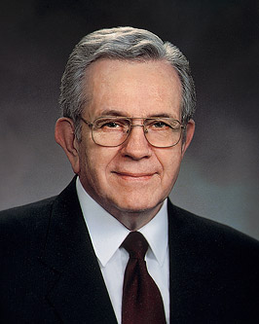
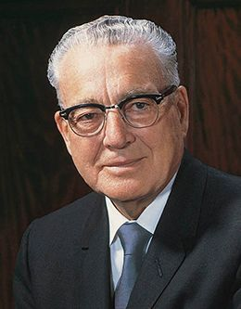
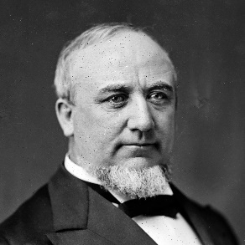
PATRIARCHAL ORDER
Elder Boyd K. Packer: “We have done very well at distributing the authority of the priesthood. We have priesthood authority planted nearly everywhere. We have quorums of elders and high priests worldwide. But distributing the authority of the priesthood has raced, I think, ahead of distributing the power of the priesthood. The priesthood does not have the strength that it should have and will not have until the power of the priesthood is firmly fixed in the families as it should be.” (The Power of the Priesthood, Apr. 2010)
President Harold B. Lee: “It seems clear to me that the Church has no choice﻿—and never has had﻿—but to do more to assist the family in carrying out its divine mission, not only because that is the order of heaven, but also because that is the most practical contribution we can make to our youth﻿—to help improve the quality of life in the Latter-day Saint homes. As important as our many programs and organizational efforts are, these should not supplant the home; they should support the home.” (Preparing Our Youth, Ensign, Mar. 1971)
Elder George Q. Canon: “Family government is the foundation of all government.” (JD 11:338)
The Family A Proclamation to the World: “Further, we warn that the disintegration of the family will bring upon individuals, communities, and nations the calamities foretold by ancient and modern prophets.”
Elder Boyd K. Packer: “Now, fathers, I would remind you of the sacred nature of your calling. You have the power of the priesthood directly from the Lord to protect your home. There will be times when all that stands as a shield between your family and the adversary’s mischief will be that power.” (The Power of the Priesthood, Apr. 2010)

Slide 7
PRIESTHOOD POWER: HOLY INFLUENCE
Elder Boyd K. Packer: “Authority in the priesthood comes by way of ordination; power in the priesthood comes through faithful and obedient living in honoring covenants. It is increased by exercising and using the priesthood in righteousness.” (The Power of the Priesthood, Apr. 2010)
Authority
Righteousness
Righteousness
Authority
Righteous Dominion
D&C 121:36-37 “That the rights of the priesthood are inseparably connected with the powers of heaven, and that the powers of heaven cannot be controlled nor handled only upon the principles of righteousness. That they may be conferred upon us, it is true; but when we undertake to cover our sins, or to gratify our pride, our vain ambition, or to exercise control or dominion or compulsion upon the souls of the children of men, in any degree of unrighteousness, behold, the heavens withdraw themselves; the Spirit of the Lord is grieved; and when it is withdrawn, Amen to the priesthood or the authority of that man.”
Unrighteous Dominion
Ethics
Politics
Politics
Ethics
Principled
Action
D&C 121:39-43 “We have learned by sad experience that it is the nature and disposition of almost all men, as soon as they get a little authority, as they suppose, they will immediately begin to exercise unrighteous dominion. Hence many are called, but few are chosen. No power or influence can or ought to be maintained by virtue of the priesthood, only by persuasion, by long-suffering, by gentleness and meekness, and by love unfeigned; By kindness, and pure knowledge, which shall greatly enlarge the soul without hypocrisy, and without guile— Reproving betimes with sharpness, when moved upon by the Holy Ghost; and then showing forth afterwards an increase of love toward him whom thou hast reproved, lest he esteem thee to be his enemy;
Exploitation
Right
Might
Might
Right
Justice
Tyranny
President Brigham Young: “Who, then, has the greatest power? Those who best do the will of God.” (JD 9:93)

Slide 8
PRIESTHOOD POWER: ORDINANCES
Article of Faith 3: “We believe that through the Atonement of Christ, all mankind may be saved, by obedience to the laws and ordinances of the Gospel.”
Joseph Smith: “There are certain ordinances which belong to the Priesthood, from which flow certain results … If there is no change of ordinances, there is no change of Priesthood. Wherever the ordinances of the Gospel are administered, there is the Priesthood.”
(Teachings of the Prophet Joseph Smith, p111, p158)
Wikipedia: “The use of the term ‘ordinance’ in Latter-day Saint parlance is distinct from the use of the term in other branches of Christian tradition, where ‘ordinance’ is often used to imply that the act is merely symbolic and does not convey grace.”
D&C 84:19-20: “… Therefore, in the ordinances thereof, the power of godliness is manifest. And without the ordinances thereof, and the authority of the priesthood, the power of godliness is not manifest unto men in the flesh;”
SAVING ORDINANCES: Baptism, Confirmation, Priesthood Ordination, Temple (Endowment, Seal to Parent, Seal to Spouse)
NON-SAVING ORDINANCES: Setting Apart, Dedications (home, grave, country), Naming a Child, Patriarchal Blessing, etc.

Slide 9
PRIESTHOOD SUMMARY
President Brigham Young: “You see mankind running to and fro, like ants upon an ant-hill,—now forward, now wheeling and taking the back track; then to the right and to the left, seemingly in a perfect state of excitement and confusion. They are seeking they know not what. They possess the foundation for eternal intelligence, and they do not know how to obtain that which will satisfy their minds. Nothing can satisfy, except being perfectly subject to the law that will preserve them in their identity to all eternity, and that is the holy Priesthood.” (JD 7:202)
Elder Boyd K. Packer: “We can and in due time certainly will influence all of humanity.” (The Power of the Priesthood, Apr. 2010)
“Gideon had an interesting way of selecting his recruits. When the men drank water at a stream, most ‘bowed down … to drink.’ Those he passed over. A few scooped up water in their hands and drank, remaining completely alert. They were the ones chosen. … Gideon’s small force succeeded because, as the record states, ‘they stood every man in his place.’” (The Power of the Priesthood, Apr. 2010)

Slide 10
Questions?

