Slide 1
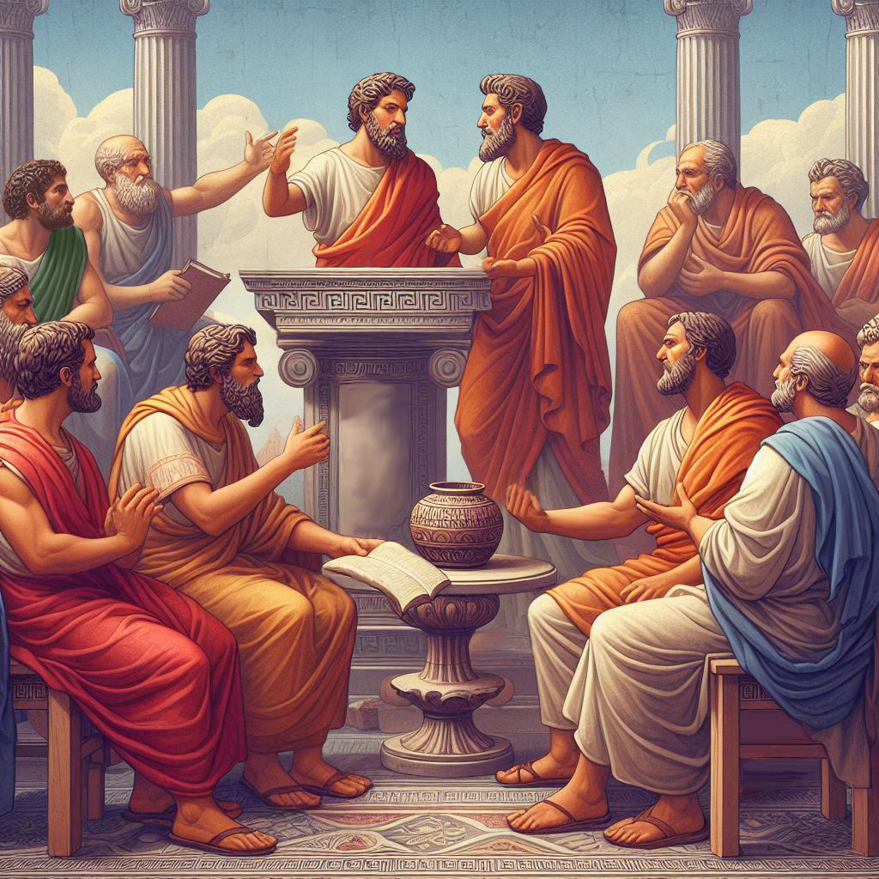
Eternalism Politics
Welfare
Principles

Slide 2
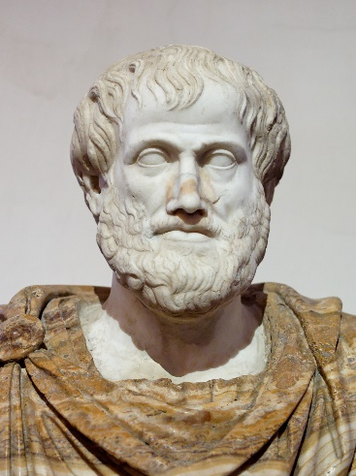
Providing In The Lord’s Way
Charitable Giving
Provident
Living
Provident Living
Charitable
Giving
Aristotle: “Anyone can give … but to do this to the right person, to the right extent, at the right time, and with the right motive, and in the right way, that is not for everyone, nor is it easy.” (Nicomachean Ethics, Book II, Ch. 9)
D&C 104:15-16 “And it is my purpose to provide for my saints, for all things are mine. But it must needs be done in mine own way;…”
“The leaders who read this guide should teach the principles and responsibilities…to the leaders and members under their jurisdiction. They should encourage the members to fulfill their welfare responsibilities and suggest ways in which they can do so. They should encourage parents to teach welfare principles to their families.” (“Providing In The Lord’s Way”, Introduction)
(1) What is the Lord’s Way of providing?
(2) What are these Welfare Principles?

Slide 3
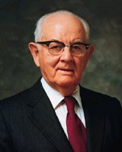
Provident Living
President Spencer W. Kimball “No true Latter-Day Saint, while physically or emotionally able will voluntarily shift the burden of his own or his family's well-being to someone else. So long as he can, under the inspiration of the Lord and with his own labors, he will supply himself and his family with the spiritual and temporal necessities of life.”
("Welfare Services: The Gospel in Action", Ensign, Nov 1977)
Elder Robert D. Hales “Priesthood-based welfare principles are both temporal and spiritual. They are also Eternal and apply in every circumstance. The first building block may be described as provident living. This means joyfully living within our means and preparing for the ups and downs of life so that we can be ready for the rainy-day emergencies when they come into our lives.” (“Basic Principles of Welfare and Self-Reliance”, p1)
CHURCH GENERAL HANDBOOK
FINANCE: Avoid Unnecessary Debt, Plan, Budget, Build Reserve, Tithe
EDUCATION: Knowledge, Skills, Continued Learning, Staying Current
HEALTH: Word of Wisdom, Sleep, Exercise, Nutritious Diet, Hygiene
SPIRITUAL: Testimony, Pray, Scripture Study, Doctrinal Study, Callings
CARE FOR THE POOR: Providing in The Lord’s Way

Slide 4
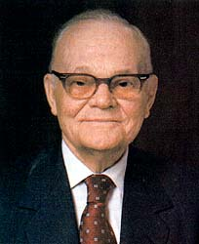
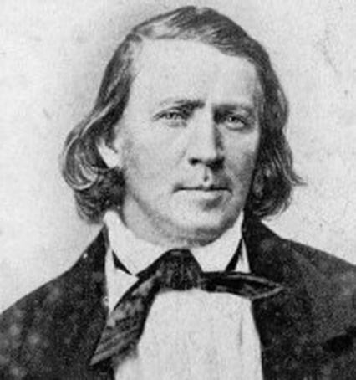
The Lord’s Stewards
D&C 104:11-12 It is wisdom in me; therefore, a commandment I give unto you, that ye shall organize yourselves and appoint every man his stewardship; That every man may give an account unto me of the stewardship which is appointed unto him.
Elder Marion G. Romney: “Food for the hungry cannot come from empty shelves. Money to assist the needy cannot come from an empty purse. Support and understanding cannot come from the emotionally starved. Teaching cannot come from the unlearned. And most important of all, spiritual guidance cannot come from the spiritually weak.” (Conference Report, Oct. 1982, p.135)
President Brigham Young: “I collect means around me, the poor must have it, and I make them work and pay for it; that makes me wealthy, and I cannot help it.” (Journal of Discourses 3:4, “Gathering The Poor”)

Slide 5
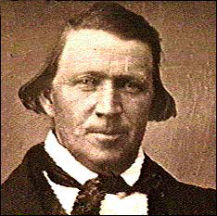
Various Types of Poor
Brigham Young: “Before we arrived in Winter Quarters we held obligations and accounts, against the poor Saints we had emigrated to America, to the amount of about thirty-five thousand dollars, and that too out of our own individual pockets — it was not Church money. But while we were in Winter Quarters, I do not think there could have been ten persons counted, old and young, who were brought from England by our liberality. Is this fact encouraging or discouraging?
The honest poor are still suffering, I mean the Lord's poor. But you may take the devil's poor and the poor devils, and they will plead a thousand times harder to be brought out of England, to have their feet placed upon American soil, than the Lord's poor, or the honest poor. The devil's poor and the poor devils will manage to get here, while very many of the Lord's poor stay there and suffer, and continue to suffer until they lay down their bodies and sleep in the tomb. Thousands and thousands of them will do this, while that portion who call so loudly for help are those who will come here and then go to the devil.”
(Journal of Discourses 3:1-2, “Gathering The Poor”)

Slide 6
UNWORTHY
WORTHY
Devil’s
Poor
Lord’s
Poor

Slide 7
UNWILLING: Devil’s Poor
WILLING: Lord’s Poor
ABLE
UNABLE

Slide 8
UNWILLING: Devil’s Poor
WILLING: Lord’s Poor
Idle Poor
(Unwilling but Able)
Industrious Poor
(Willing and Able)
ABLE
Ruinous Poor
(Unwilling and Unable)
Poor Devils
Hapless Poor
(Willing but Unable)
UNABLE

Slide 9
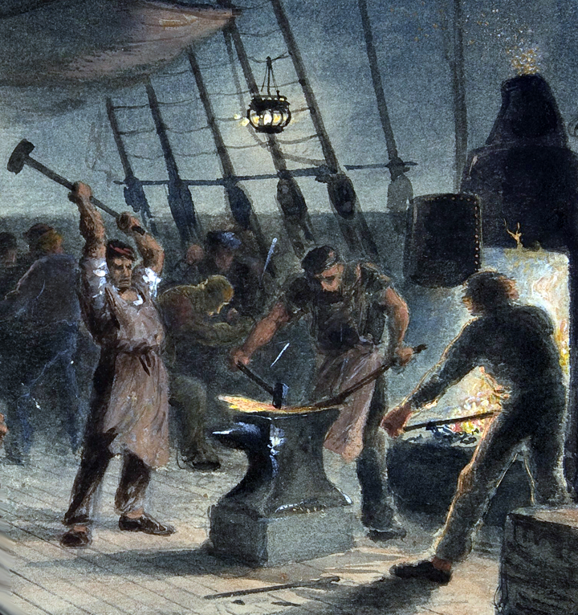
The Lord’s Industrious Poor
Unwilling
Willing
Industrious
Poor
Elder Erastus Snow: Those who are the Lord’s poor always prefer to provide for their own necessities than to be dependent upon others.
(JD, Vol. 11, p. 297)
Able
Unable
President Brigham Young: The Lord's poor do not forget their covenants, while the devil's poor pay no regard to their promises. (JD 3:2, “Gathering The Poor”)
President Brigham Young: “My experience has taught me, and it has become a principle with me, that it is never any benefit to give, out and out, to man or woman, money, food, clothing, or anything else, if they are able-bodied, and can work and earn what they need, when there is anything on the earth for them to do. This is my principle, and I try to act upon it. To pursue a contrary course would ruin any community in the world and make them idlers.” (JD, Vol. 11, p. 297)

Slide 10
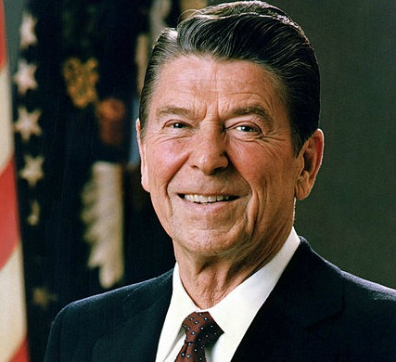
The Lord’s Hapless Poor
Unwilling
Willing
President Spencer W. Kimball: The responsibility for each person's social, emotional, spiritual, physical, or economic well-being rests first upon himself, second upon his family, and third upon the Church if he is a faithful member thereof. ("Welfare Services: The Gospel in Action", Ensign, Nov 1977)
Able
Unable
Hapless
Poor
“There will be times in our lives when we will not be able to meet our needs without the help of others.” …The receiver accepts the offered help with gratitude. He uses it to release himself from the bondage and limitations of his need and become more able to rise to his full potential, both temporally and spiritually. He then reaches out to help others.”
(“Providing In The Lord’s Way”, p5, p3)
President Brigham Young: A certain portion of the human family have to be looked after and taken care of. [“For ye have the poor with you always, and whensoever ye will ye may do them good” Mark 14:7]. (JD, Vol. 11, p. 328)
Ronald Reagan: Welfare's purpose should be to eliminate, as far as possible, the need for its own existence. (Interview, Los Angeles Times, 7 January 1970)

Slide 11
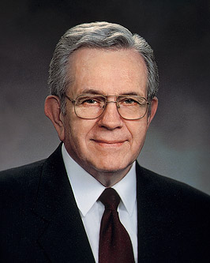
The Devil’s Idle Poor
Unwilling
Willing
Elder Erastus Snow: “They who are able to provide for themselves but would rather have others bear the burdens of life for them, are not the Lord’s poor, they are the devil’s poor.” (JD 13:11)
Able
Idle
Poor
Unable
D&C 43:42 “Thou shalt not be idle; for he that is idle shall not eat the bread nor wear the garments of the laborer.”
Elder Boyd K. Packer: “When people are able but unwilling to take care of themselves, we are responsible to employ the dictum of the Lord that the idler shall not eat the bread of the laborer.” ("Solving Emotional Problems in the Lord’s Own Way", April 1978 General Conference)
President Brigham Young: “…find them something to do that will enable them to sustain themselves; but don’t relieve the idle, for relieving those who are able but unwilling to work is ruinous to any community.” (JD 14:107)
Alfred Doolittle From “My Fair Lady”

Slide 12
Alfred Doolittle: “Well. Look at it my way. What am I? I ask you what am I? I’m one of the undeservin’ poor, that’s what I am. Now think what that means to a man. It means he’s up against middle class morality for all of time. If there’s anything going and I puts in fer’ a bit of it, it’s always the same story. Your undeservin' so you can’t have it. But my needs is as great as the most deservin' widows that ever got money out of six different charities in one week for the death of the same husband. Heh. I don’t need less than a deservin’ man. I need more. I don’t eat less hardy than he does. And I drink…oh a lot more. I’m playin’ strait with you. I ain’t pretending to be deserving. No. I’m undeserving. And I mean to go on being undeserving. I like it and that’s the truth.” (My Fair Lady, Warner Bros., 1964, Video Timeline 56:30-57:22)

Slide 13
Unwilling
Willing
President Spencer W. Kimball: “This is demonstrated in the story of the lark. Sitting in the high branches of a tree safe from harm, he saw a traveler walking through the forest carrying a mysterious little black box. The lark flew down and perched on the traveler’s shoulder. ‘What do you have in the little black box?’ he asked.
‘Worms,’ the traveler replied.
‘Are they for sale?’
Able
Poor
Devils
Unable
‘Yes, and very cheaply, too. The price is only one feather for a worm.’
The lark thought for a moment. ‘I must have a million feathers. Surely, I’ll never miss one of them. Here is an opportunity to get a good dinner for no work at all.’ So he told the man he would buy one. He searched carefully under his wing for a tiny feather. He winced a bit as he pulled it out, but the size and quality of the worm made him quickly forget the pain. High up in the tree again he began to sing as beautifully as before.
The next day he saw the same man and once again he exchanged a feather for a worm. What a wonderful, effortless way to get dinner! Each day thereafter the lark surrendered a feather, and each loss seemed to hurt less and less. In the beginning he had many feathers, but as the days passed he found it more difficult to fly. Finally, after the loss of one of his primary feathers, he could no longer reach the top of the tree, let alone fly up into the sky. In fact he could do no more than flutter a few feet in the air, and was forced to seek his food with the quarrelsome, bickering sparrows.
The man with the worms came no more, for there were no feathers to pay for the meals. The lark no longer sang because he was so ashamed of his fallen state.
This is how unworthy habits possess us—first painfully, then more easily, until at last we find ourselves stripped of all that lets us sing and soar. This is how freedom is lost. This is how we become enmeshed in sin.” (The Miracle of Forgiveness, p.214–15)

Slide 14
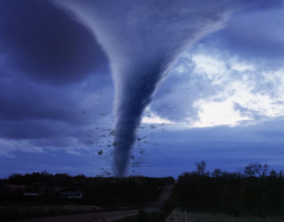
What about natural disasters?
Soup
Kitchen
CHURCH GENERAL HANDBOOK SHORT-TERM needs vs LONG-TERM needs.
“My principle for helping others is to always ask, ‘How will my potential help influence their future behavior?’ This question is crucial because if you really want to help, your goal should not just be to alleviate present suffering, but future suffering as well.”
(Joseph Grenny, Crucial Skills, Sep 2, 2015)
President Kimball: “So often, secular leaders rush in to solve problems by seeking to stop the present pain, and thereby create even greater difficulty and pain later on.” ("Jesus: The Perfect Leader", Ensign August 1979)

Slide 15
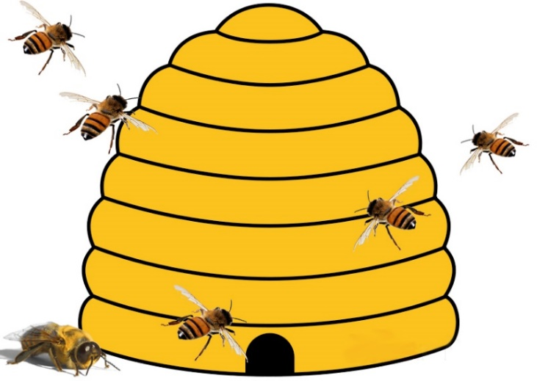
The Hive
President Brigham Young: “Dare any of you come and buy property? I can furnish as much as you can buy…Walk up and buy my beautiful situation on the hill and I will put the proceeds into the Perpetual Emigrating Fund, if you will pay me the money, and gather the Saints, the Lord's poor, and the devil's poor, and the poor devils, and when we have got them here we will make Saints of them, if we can, and if we cannot, we will cast them out of the kingdom.” (JD 3:5)
President Brigham Young: “But it seems that there are many drones in the hive, who are determined to tie up the hands of those who rule the affairs of this kingdom, and the quicker they are thrown out the better.” (JD 3:5)
Elder Heber C. Kimball: “May the Lord our God bless the bees in the hive of Deseret, and root out the drones; for they only eat out the honey, while the bees go out and gather it in.” (JD 5:9)

Slide 16
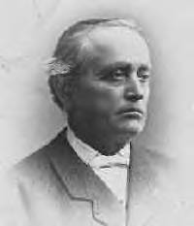
Providing In The Lord’s Way
President Brigham Young: “My policy is to keep every man, woman, and child busily employed, that they may have no idle time for hatching mischief in the night, and for making plans to accomplish their own ruin.” (JD 2:144, 19:76)
“The bishop may assist members or others who are transients, but he should be discerning about the type and amount of assistance he gives.” (“Providing In The Lord’s Way”, p.15)
“Teach members that transients, panhandlers and the poor are best served by following the principle of the Law of the Fast and by paying a generous Fast Offering.”
(Local multi-stake training to transient Bishop Advisors)
Elder Erastus Snow: “To continue to hand out your food and your substance to the beggar who comes to your doors without putting him in a position to help himself and to supply his own wants is to encourage him in folly and wickedness, and is throwing away the blessings of heaven which God has placed in your hands.” (JD, 17:365)

Slide 17
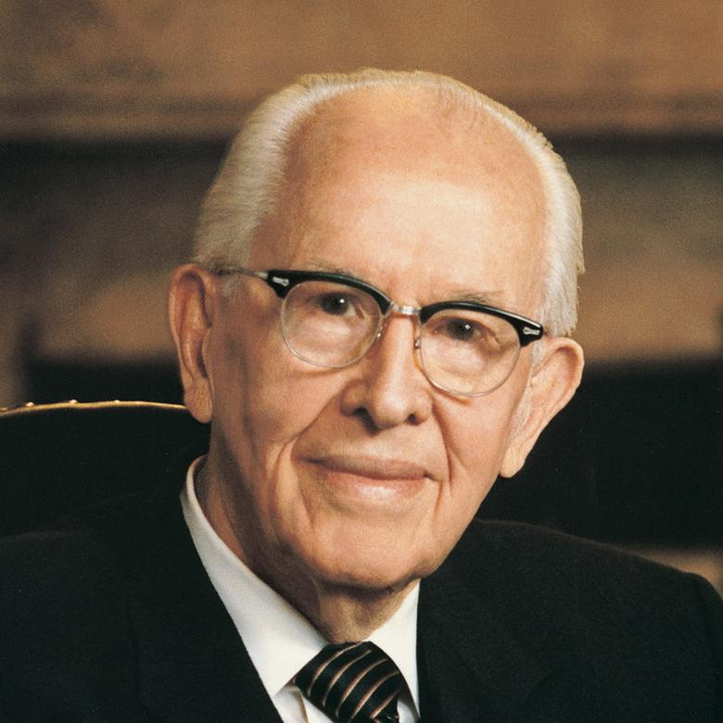
Inside Out
Unwilling
Willing
Idle
Poor
Industrious
Poor
“We cannot be self-reliant without being willing to work. Work is physical, mental, or spiritual effort. He never forsakes us, but he does not do for us what we can do for ourselves.” (“Providing In The Lord’s Way”, p.5)
Able
Unable
Ruinous
Poor
Hapless
Poor
President Ezra Taft Benson: “The Lord works from the inside out. The world works from the outside in. The world would take people out of the slums. Christ takes the slums out of people, and then they take themselves out of the slums. The world would mold men by changing their environment. Christ changes men, who then change their environment. The world would shape human behavior, but Christ can change human nature … Yes, Christ changes men, and changed men can change the world.”
(The Teachings of Ezra Taft Benson, p.79)

Slide 18
Questions?

