Slide 1
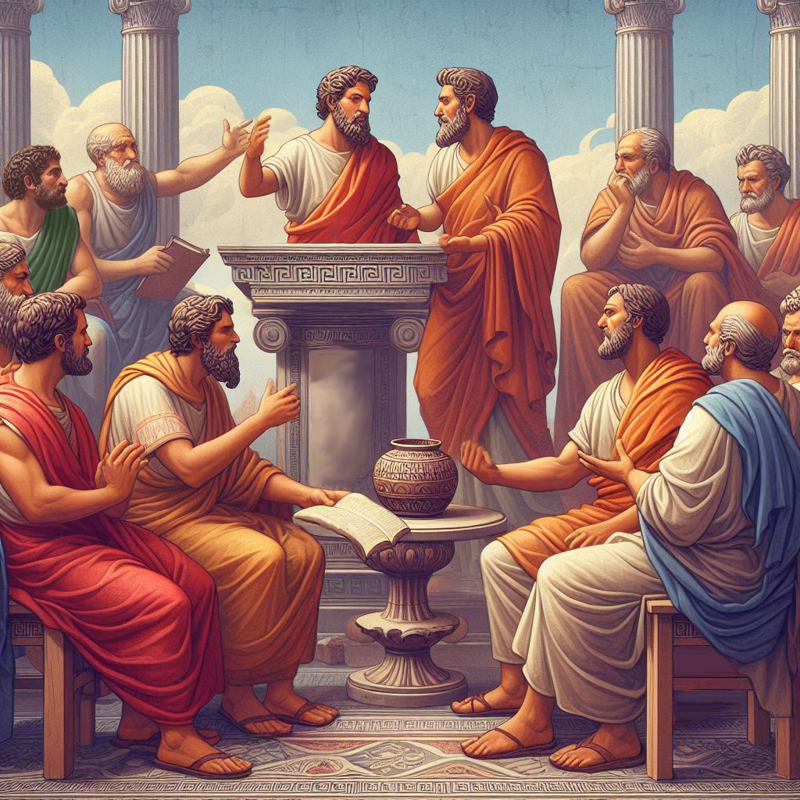
Eternalism Politics
Course Summary

Slide 2
Politics Course Summary
(1) What guidance have we been given on discussing politics in Church?
(2) What universal test can we apply to know what is appropriate to discuss in Church?
(3) What four major political primacy issues are key to understanding politics?
(4) What are the three competing definitions of justice?
(5) How can we achieve unity among the 3 definitions of justice?
(6) What two institutions are in the Lord’s plan for implementing the Kingdom of God?
(7) What issues separate persons in the various resurrections?
(8) How do we befriend and defend The Constitution?
(9) How is The Constitution under attack?
(10) What are the three safeguards of freedom?

Slide 3
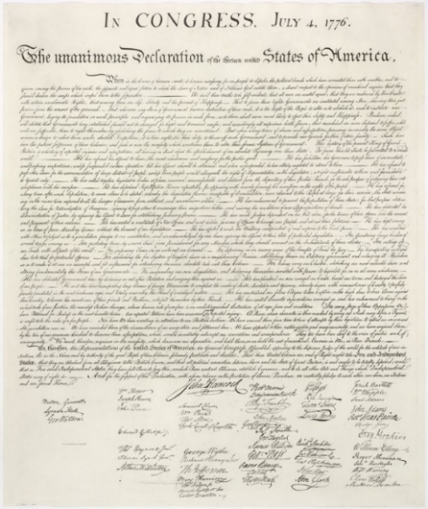
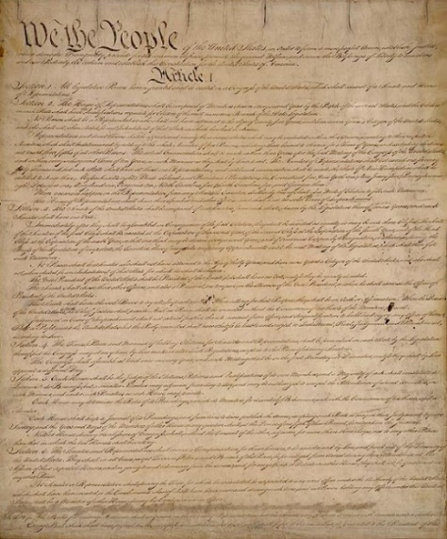
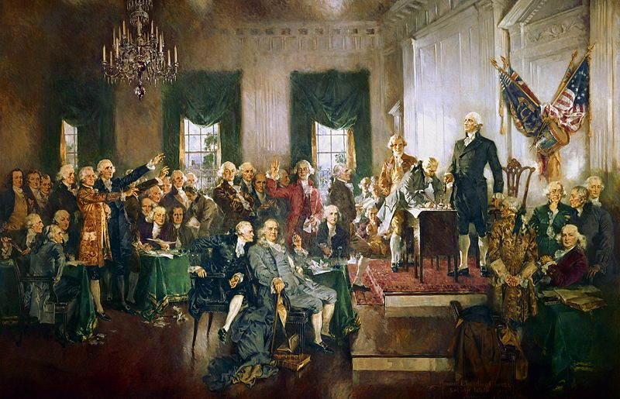
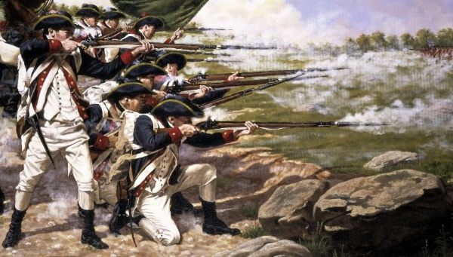
(1) What guidance have we been given on discussing politics in Church?
Partisan Politics: Specific Parties, Platforms, and Candidates
Moral Political Issues: Directly affects the interests of the Church
Political Philosophy: The proper role of government
(2) What universal test can we apply to know what is appropriate to discuss in Church?
Can we tie the topic directly
to Christ?
D&C 101:80 And for this purpose have I established the Constitution of this land, by the hands of wise men whom I raised up unto this very purpose, and redeemed the land by the shedding of blood.

Slide 4
(3) What four major political primacy issues are key to understanding politics?
1
State / Man
2
Might / Right
3
Individual / Group
4
Liberty / Equality
State
Man
Man
State
Might
Right
Right
Might
Individual
Group
Group
Individual
Equality
Liberty
Liberty
Equality
Statism / Authoritarianism
Dictatorship / Anarchy
Collectivism / Socialism
Egalitarianism
(4) What are the three competing definitions of justice?
POSITIVE LAW: Whatever the ruler dictates is just.
SOCIAL GOOD: The greatest good for the greatest number is just.
NATURAL RIGHTS: Securing individual NATURAL RIGHTS is just.

Slide 5
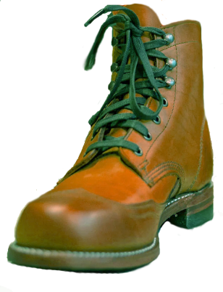
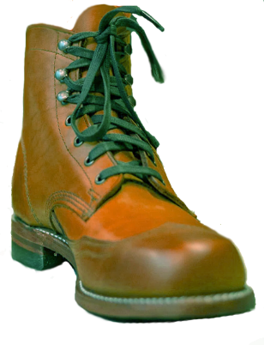
(5) How can we achieve unity among the 3 definitions of justice?
Natural Right
Tier 1
Tier 2
Tier 3
Mortimer Adler: “The reconciliation of the three conflicting theories of justice can be accomplished by avoiding the excessive claim each makes and by putting what is true in each of them together in a well-ordered manner.” (Six Great Ideas, p237, p238)
Social Good
Positive Law
 | JUSTICE THEORY | KEY TERM | ADHERENTS
 | Positive Law | Legality
 | Social Good | Utility
 | Natural Right | Rights
It obliges us to render to each person their natural right, in order to promote the social good, through the means of just laws.
Positivists
Socialists
Naturalists
(6) What two institutions are in the Lord’s plan for implementing the Kingdom of God?
Authoritarian Government
D&C 76:56 (Priests and Kings)
Kingdom
of god
Establish
Justice
Promote
Benevolence
socialism
Liberty
Rights
Social
Equality
Constitutional
Republic
Zion
Two Feet
One Boot
Two Boots

Slide 6
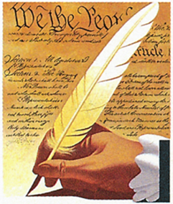
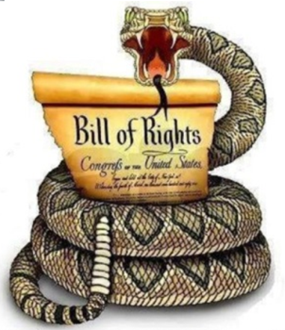
(7) What issues separate persons in the various resurrections?
FIRST RESURRECTION
SECOND RESURRECTION
Benevolence
Just
Unjust
Malevolence
CELESTIAL
TERRESTRIAL
TELESTIAL
DARKNESS
RIGHTEOUS DOMINION
Uphold Agency: Liberty, Justice, Mercy
UNRIGHTEOUS DOMINION
War on Agency: Tyranny, Injustice, Cruelty
(8) How do we befriend and defend The Constitution?
A
(1) PREAMBLE
(7) ARTICLES
(27) AMENDMENTS
Form
Establish
Insure
Provide
Promote
Secure
Articles
Sections
Clauses
WE THE PEOPLE
ARE SOVEREIGN!
DON’T TREAD ON ME!
ARTICLE I
ARTICLE II
ARTICLE III
ARTICLE IV
ARTICLE V
ARTICLE VI
ARTICLE VII
Legislative
Branch
Executive
Branch
Judicial
Branch
State
Relations
Amendment
Process
Constitutional
Supremacy
Ratification
Process
PURSE
SWORD
GAVEL
UNIFY
ADAPT
OATH
ADOPT

Slide 7
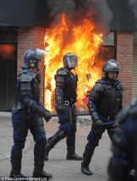
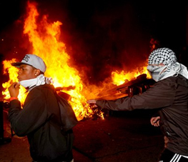
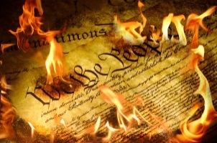
(9) How is The Constitution under attack?
“Therefore, I, the Lord, justify you, and your brethren of my church, in befriending that law which is the constitutional law of the land; And as pertaining to law of man, whatsoever is more or less than this, cometh of evil.” (Doctrine and Covenants 98:6-7)
Less Government
Power of the State
More Government
UNDERSHOOTING
TARGET
OVERSHOOTING
LESS
CONSTITUTION
MORE
Anarchy
RIGHTS
Tyranny
“Cometh of Evil”
UNLIMITED AUTONOMY
MAXIMAL AUTONOMY
MINIMAL AUTONOMY
“Cometh of Evil”
Evolving meaning,
revisionist history,
cancelling the Founders,
rise of welfare state,
deficit spending,
lack of enforcement…
Battle between two definitions of justice.
“At its core, this debate is about the meaning of the first three words of the constitution: "We the People."
Government
Rights
Collective:
Social Good
Individual:
Natural Rights
Rights
Government

Slide 8
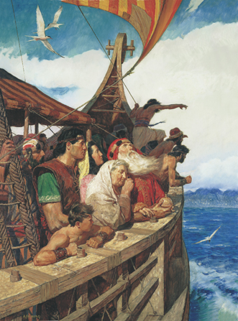
(10) What are the three safeguards of freedom?
Bill of Rights: “A written guarantee”
1
Constitutional Republic: “A structural guarantee”
2
Moral Majority: “A foundational guarantee”
3
2 Nephi 1:7 “Wherefore, this land is consecrated unto him whom he shall bring. And if it so be that they shall serve him according to the commandments which he hath given, it shall be a land of liberty unto them; wherefore, they shall never be brought down into captivity; if so, it shall be because of iniquity; for if iniquity shall abound cursed shall be the land for their sakes, but unto the righteous it shall be blessed forever.”

Slide 9
Questions?

