Slide 1
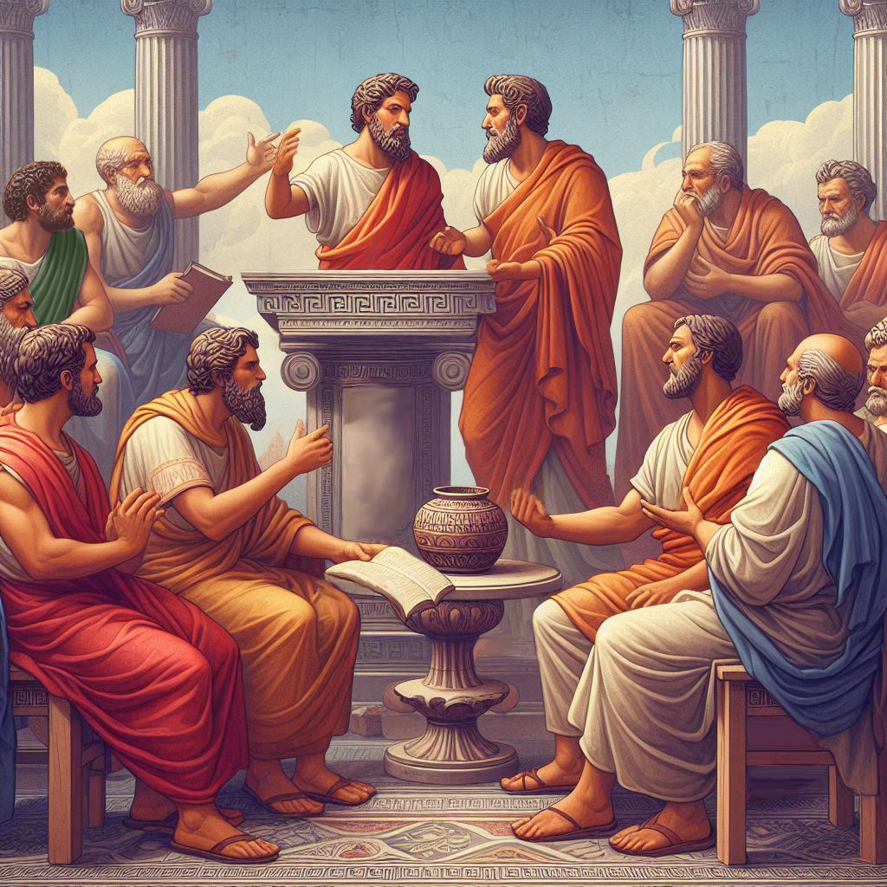
Eternalism Politics
Safeguards

Slide 2
President John Taylor: “We see a policy being introduced to listen to the clamor of mobs and of unprincipled men who know not of what they speak, nor whereof they affirm, and when men begin to tear away with impunity one plank after another from our Constitution by and by we shall find that we are struggling with the wreck and ruin of the system which the forefathers of this nation sought to establish in the interests of humanity. But it is for us still to sustain these glorious principles of liberty bequeathed by the founders of this nation, still to rally round the flag of the Union, still to maintain all correct principles, granting the utmost extent of liberty to all people of all grades and of all nations.” (JD 22: 144)

Slide 3
Three American Safeguards of Freedom
1
Bill of Rights: “A written guarantee”
2
Constitutional Republic: “A structural guarantee”
3
Moral Majority: “A foundational guarantee”

Slide 4
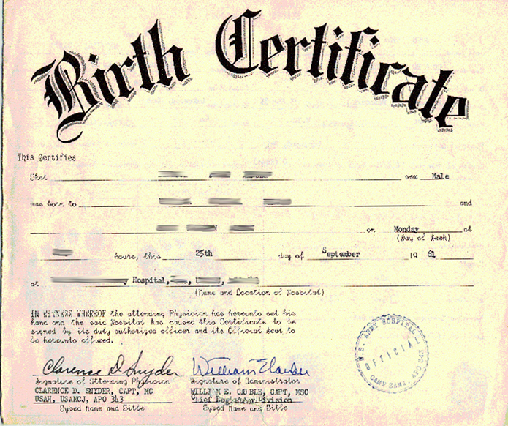
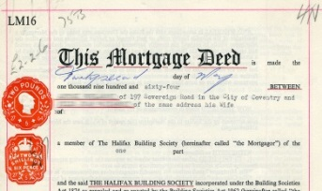
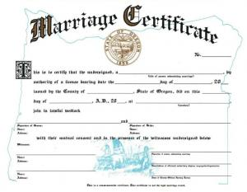
Written Guarantees
Written guarantees play an important role in a civil society. They provide legal and tangible evidence of rights such as citizenship, marriage relations, ownership of property, business licenses and many other legally binding documents.
Bill of Rights
“Written Guarantee”
“Congress shall pass no law respecting an establishment of religion, or prohibiting the free exercise thereof.”
(First Amendment, 1789)

Slide 5
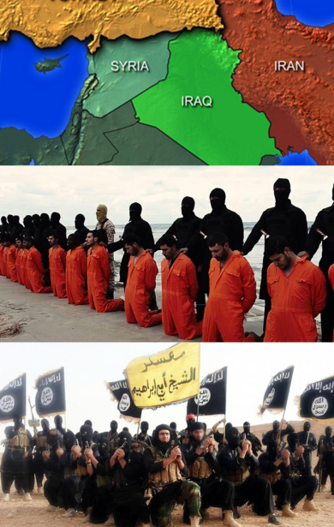
Written Guarantees
Print out a copy of the Bill of Rights, fold it up and put it in your pocket. Now purchase a one-way ticket to North Korea, Iran, or Syria and see how long you and your folded up Bill of Rights lasts in these hostile lands where such rights are not recognized.
Notice, that the instructions did not include purchasing a round-trip ticket because, obviously you won’t be needing it.
Now ask yourself “What, is missing in such authoritarian regimes?”

Slide 6
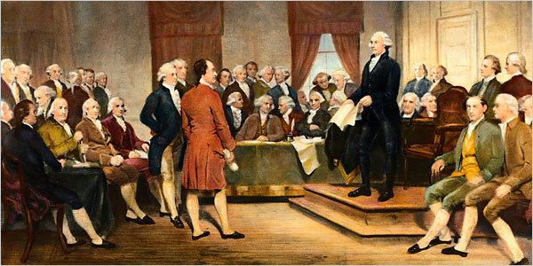
Structural Guarantees
Without a proper underlying governmental authority or enforcement power undergirding the civil society, no “written guarantee” would be worth the paper it was written on.
Bill of Rights
“Written Guarantee”
Constitutional
Republic
“Structural Guarantee”
Two Structural Guarantees

Slide 7
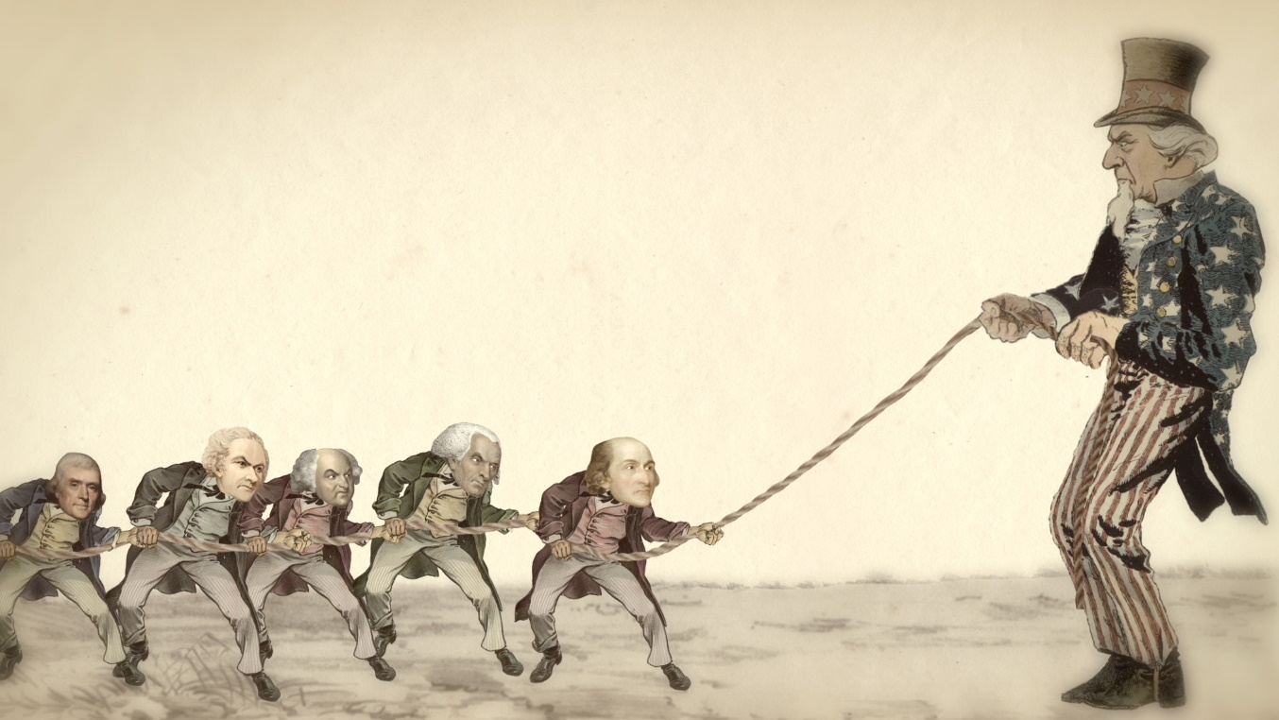
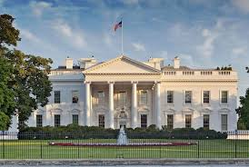
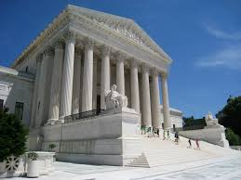
Two Structural Guarantees
Executive Branch
Judicial Branch
State
Governments
National
Government
Bill of Rights
Checks and Balances
Legislative Branch

Slide 8
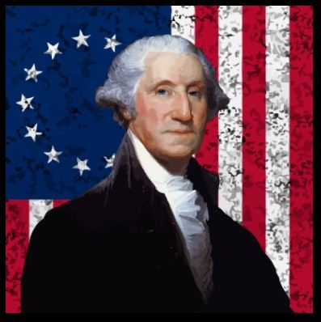
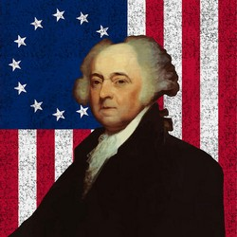
Foundational Guarantee
Philadelphia Woman: "Well, Doctor, what have we got—a Republic or a Monarchy?"
Ben Franklin: "A Republic, if you can keep it.“
(From the notes of Dr. James McHenry, Maryland delegate to the Convention)
George Washington: “…the foundations of our National policy will be laid in the pure and immutable principles of private morality.” (First Inaugural Address, 1789)
Bill of Rights
“Written Guarantee”
Constitutional
“…the preservation of the sacred fire of liberty, and the destiny of the Republican model of Government, are justly considered as deeply, perhaps as finally staked, on the experiment entrusted to the hands of the American people.” (First Inaugural Address, 1789)
Republic
“Structural Guarantee”
Moral Majority
John Adams: “Our Constitution was made only for a moral and religious people. It is wholly inadequate to the government of any other.”
(Letter to the militia of Massachusetts, 11 October 1798)
“Foundational Guarantee”

Slide 9
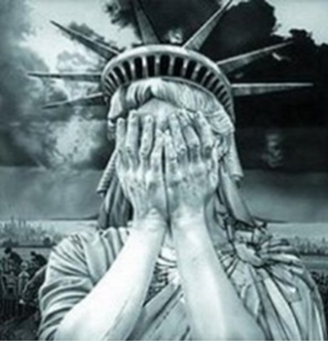
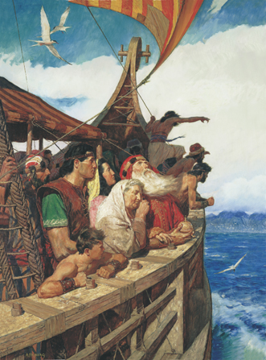
WARNING and PROMISE
Mosiah 29:26-27 “Now it is not common that the voice of the people desireth anything contrary to that which is right… And if the time comes that the voice of the people doth choose iniquity, then is the time that the judgments of God will come upon you; yea, then is the time he will visit you with great destruction even as he has hitherto visited this land.”
2 Nephi 1:7 “Wherefore, this land is consecrated unto him whom he shall bring. And if it so be that they shall serve him according to the commandments which he hath given, it shall be a land of liberty unto them; wherefore, they shall never be brought down into captivity; if so, it shall be because of iniquity; for if iniquity shall abound cursed shall be the land for their sakes, but unto the righteous it shall be blessed forever.”

Slide 10
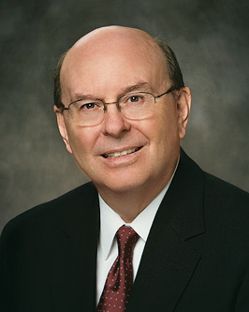
POSITIVE ENGAGEMENT
Elder Quentin L. Cook: “When allegations are made that are detrimental and often false to either faith or religious liberty, the members of that faith and their friends of other faiths, who feel accountable to God, need to defend them in a positive statesman-like manner. … Too many do not make their positive views known when their engagement is sorely needed.”
“I would suggest that for people of your capability and training, engagement to defend religious liberty is essential... Please do this on your own volition, understanding that you will not always get things exactly right. But also understanding, that the far bigger mistake would be to sit silently by.” (Symposium on Religious Liberty and the Law, Los Angeles, Nov. 3, 2017)

Slide 11
POSITIVE ENGAGEMENT
Elder Oaks: “Our belief in divine inspiration gives Latter-day Saints a unique responsibility to uphold and defend the United States Constitution and principles of constitutionalism wherever we live. We should trust in the Lord and be positive about this nation’s future.” (Defending Our Divinely Inspired Constitution, Apr. 2021)

Slide 12
Questions?

