Slide 1
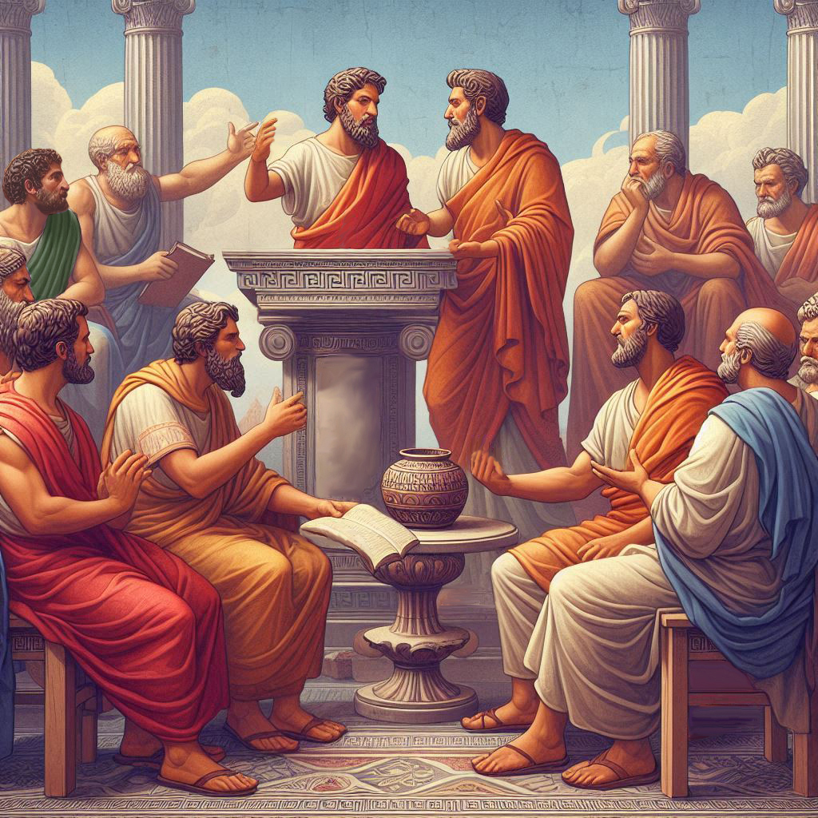
Eternalism Politics
House Divided

Slide 2
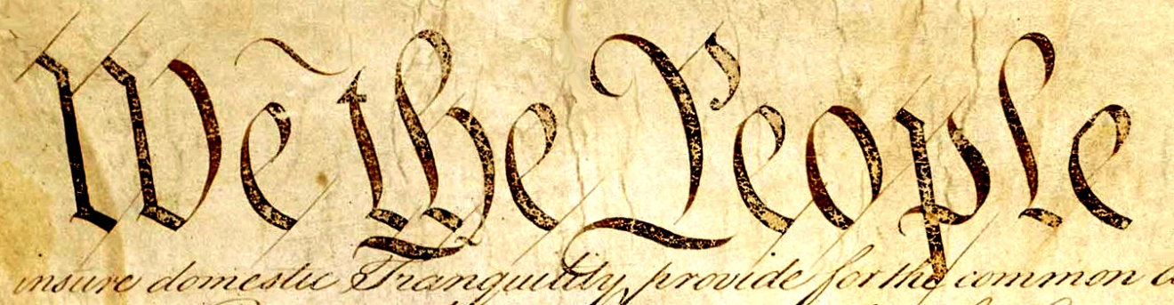
A HOUSE DIVIDED
Matthew 12:25 ”And Jesus knew their thoughts, and said unto them, Every kingdom divided against itself is brought to desolation; and every city or house divided against itself shall not stand”
Randy Barnett: “Americans today are divided politically, ideologically, and culturally … Americans are also divided about the constitution itself.” (Our Republican Constitution, p18)
Randy Barnett: “At its core, this debate is about the
meaning of the first three words of the constitution:
"We the People." Those who favor the Democratic
Constitution view "We the People" as a group, as a
body, as a collective entity. Those who favor the Republican Constitution view "We the People" as individuals. This choice of visions has enormous real-world consequences.” (Our Republican Constitution, p19)
Does government grant rights or does government protect rights?
Rights
Government
Tier 1
Tier 2
Government
Rights

Slide 3
Popular Sovereignty: Noun, the doctrine that sovereign power is vested in the people and that those chosen to govern, as trustees of such power, must exercise it in conformity with the general will. (Dictionary.com)
Government
Rights
DEMOCRATIC CONSTITUTION
REPUBLICAN CONSTITUTION
Rights
Government
Popular sovereignty means rule by the people as a collective.
Popular sovereignty resides in people as individuals.
Starts with a collective vision of We the People which in practice can only be the will of the majority.
Starts with the natural and inalienable rights of equal sovereign individuals as preceding the formation of governments.
First comes government, then comes individual rights granted by government.
First comes individual rights and then comes government to protect those rights.
“A Democratic Constitution is a living constitution whose meaning evolves to align with contemporary popular desires, so that today's majority is not bound by what is called "the dead hand of the past." The will of yesterday's majority cannot override the will of the majority today.”
(Our Republican Constitution, p21)
“Under a Republican Constitution, to ensure that these servants remain within their just powers, this lawmaking power itself must be limited by law. The Republican constitution then provides the law that governs those who govern us … each of whom must swear a solemn oath to obey "this constitution."… In short, under a republican Constitution, the meaning of the written constitution must remain the same until it is properly changed - which is another way of saying that the written constitution must be interpreted according to its original meaning until it is properly amended. (Our Republican Constitution, p24)

Slide 4

DEMOCRATIC ELEMENTS
“The fact that our Republican Constitution has democratic elements does not make it what I am calling a Democratic Constitution. The bare fact that a particular form of government has elected legislators or an elected president does not by itself tell us whether it is a democracy or a republic. Representative government is consistent with both conceptions of popular sovereignty.” (Our Republican Constitution, p27)
“It is important to recognize that the Democratic and Republican views of popular sovereignty and We the People are ultimately incompatible.” (Our Republican Constitution, p.25)
“Were the founders really against democracy? You bet. They blamed the problems in the states under the Articles of Confederation on an excess of democracy.”
(Our Republican Constitution, p.27)

Slide 5
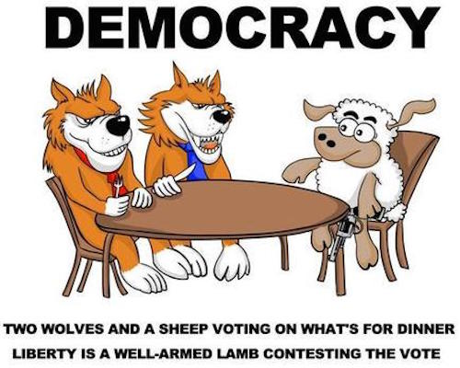
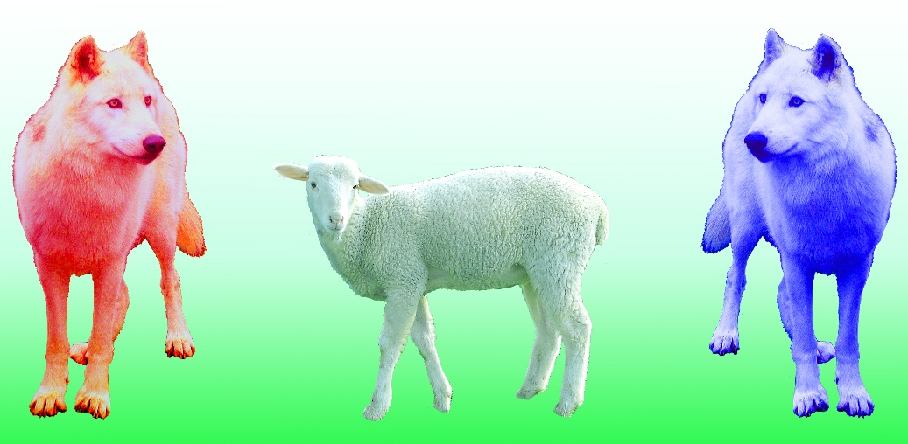
TYRANNY OF MAJORITY RULE
“A democracy is two wolves and a lamb voting on what to have for lunch.”
(Gary Strand, Usenet group sci.environment, 23 April 1990)
“A democracy cannot exist as a permanent form of government. It can only exist until the majority discovers it can vote itself largess out of the public treasury. After that, the majority always votes for the candidate promising the most benefits with the result the democracy collapses because of the loose fiscal policy ensuing, always to be followed by a dictatorship, then a monarchy.“
("This is the Hard Core of Freedom“, Elmer T. Peterson, The Daily Oklahoman, Dec. 9, 1951)

Slide 6
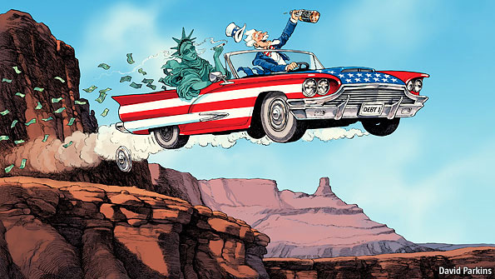
NATIONAL DEBT
“DEBT CEILING: A statutorily imposed debt ceiling has been in effect since 1917 when the US Congress passed the Second Liberty Bond Act. Before 1917 there was no debt ceiling in force, but there were parliamentary procedural limitations on the amount of debt that could be issued by the government”. (Wikipedia.org, History of United States debt ceiling)
Welfare State
“Congress has lifted or suspended the limit more than 84 times since its establishment…”
(Brookings Institute:The Hutchins Center Explains: The debt limit, March 15, 2019)
“The chart shows that the debt ceiling didn't even hit $1 trillion until 1982 … Since then, it's increased exponentially.”
(The U.S. Debt Ceiling: A Historical Look”, The Atlantic.com, April 29, 2011)

Slide 7
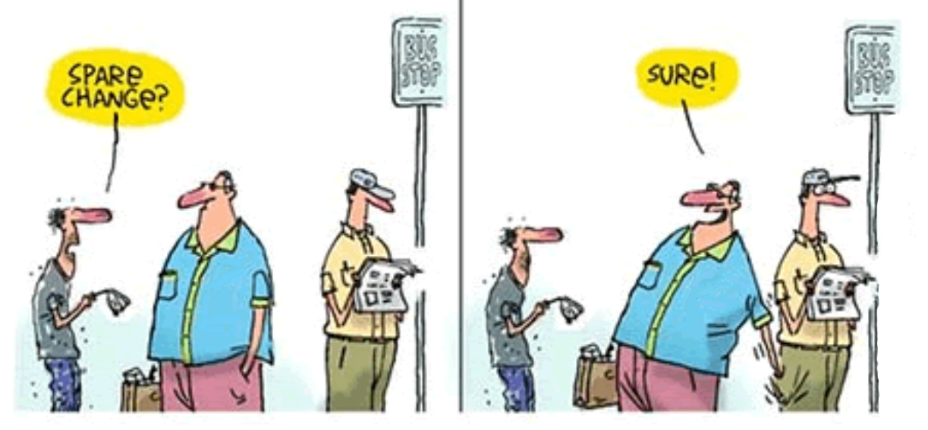
RISE OF THE WELFARE STATE
George Bernard Shaw: “A government that robs Peter to pay Paul can always depend on the support of Paul.” (Everybody's Political What's What, 1944, Ch. 30, p. 256)
Vote
For
Me
Vote
For
Me
Frederic Bastiat: “But how is this legal plunder to be identified? Quite simply. See if the law takes from some persons what belongs to them and gives it to other persons to whom it does not belong. See if the law benefits one citizen at the expense of another by doing what the citizen himself cannot do without committing a crime.” (The Law, by Frederic Bastiat)

Slide 8
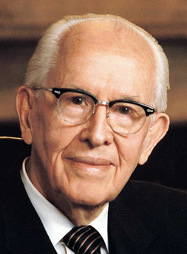
RISE OF THE WELFARE STATE
President Ezra Taft Benson: “I fear for the future when I realize that our once-free institutions —political, economic, educational, and social—have been drifting into the hands of those who favor the welfare state, and who would ‘centralize all power in the hands of the political apparatus in Washington. This enhancement of political power at the expense of individual rights, so often disguised as ‘democracy’ or ‘freedom’ or ‘civil rights,’ is ‘socialism,’ no matter what name tag it bears.’” (The Teachings of Ezra Taft Benson, p. 693)
License: Lack of due restraint, excessive freedom, an excuse or justification to do something wrong. (TheFreeDictionary.com)
The difference between liberty and license?
License = When individuals infringe on the rights of each other.
The difference between liberty and tyranny?
Tyranny = When the government infringes on the rights of its citizens.

Slide 9
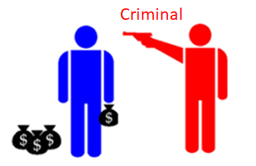
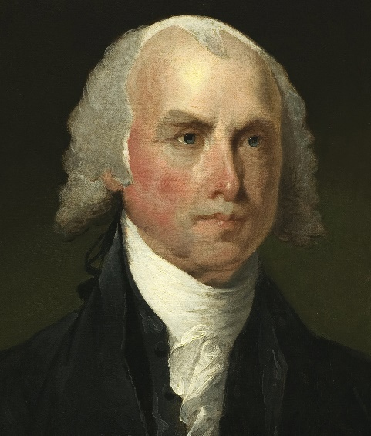
LIBERTY, LICENSE, TYRANNY
Street Thug
Welfare State
Government
Liberty vs License
Liberty vs Tyranny
James Madison: “The essence of government is power; and power, lodged as it must be in human hands, will ever be liable to abuse.”
(Speech in the Virginia Constitutional Convention, 2 December 1829)

Slide 10
GREAT IS THE INDIVIDUAL
John A. Widtsoe: “The gospel is concerned with individual salvation, not mass salvation ... Lucifer proposed mass salvation, willy nilly, without individual effort. Every man should be saved, irrespective of his desire or fitness. The Lord also offered salvation to all, but on the condition that each individual, by accepting the conditions imposed under God’s never-ending love, must earn his salvation. Lucifer ignored the individual; the gospel makes the individual paramount ... Great is the individual man in the plan of the Lord!.”
(Man and the Dragon, pp. 30-31)
Man
State
Tier 1
Tier 2
State
Man
Individual
Collective
Tier 1
Tier 2
Collective
Individual
Individualism
Collectivism

Slide 11
Questions?

