Slide 1
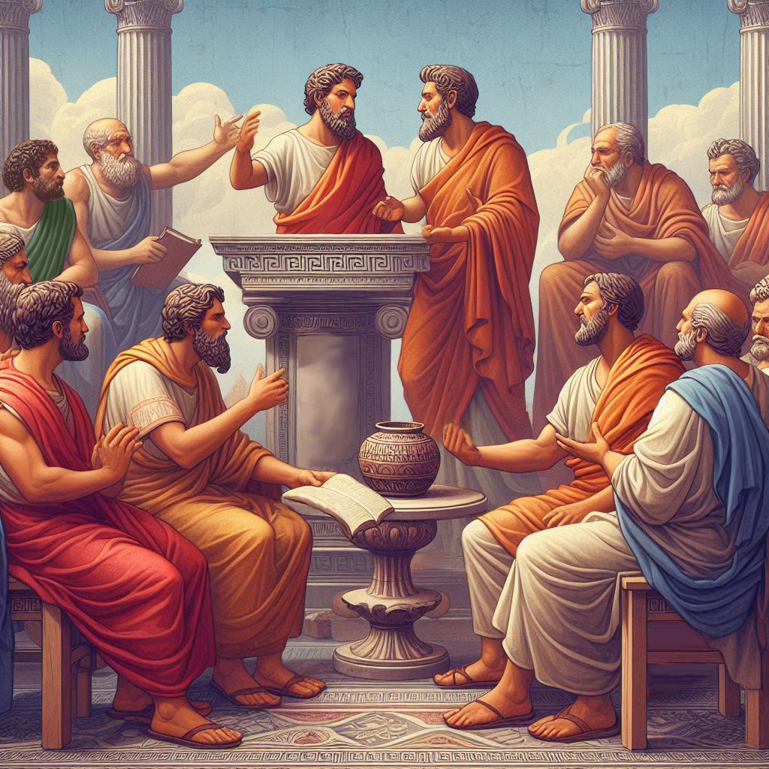
Eternalism Politics
Constitutional
Crisis

Slide 2
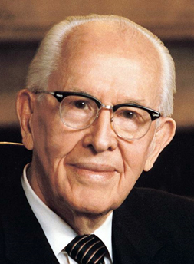
A CONSTITUTIONAL REPUBLIC
“More or Less than this Cometh of Evil”
D&C 98:4-10: “Therefore, I, the Lord, justify you, and your brethren of my church, in befriending that law which is the constitutional law of the land; And as pertaining to law of man, whatsoever is more or less than this, cometh of evil.”
President Ezra Taft Benson: “The fight for freedom cannot be divorced from the gospel – the plan of salvation.” (BYU Devotional, October 25, 1966)
President Ezra Taft Benson: “From the time I was a small boy I was taught that the American Constitution is an inspired document. I was also taught that the day will come when the Constitution will be endangered and hang as it were by a single thread. I was taught that we should study the Constitution, preserve its principles, and defend it against any who would destroy it.” (An Enemy Hath Done This, p. 37, 313)
President Ezra Taft Benson: “For years we have heard of the role the elders could play in saving the Constitution from total destruction. But how can the elders be expected to save it if they have not studied it and are not sure if it is being destroyed or what is destroying it?” (An Enemy Hath Done This, p312-313)

Slide 3
EVOLVING MEANING
Constitutional Originalism vs. Living Constitution
“The earliest mentions of the Constitution as "living", particularly in the context of a new way of interpreting it, comes out of Woodrow Wilson's book Constitutional Government in the United States where he wrote: ‘Living political constitutions must be Darwinian in structure and in practice.’” (Wikipedia: Living Constitution)
“During the progressive era, many initiatives were promoted and fought for, but were prevented from coming to full fruition in either legislative bodies or judicial proceedings. One case in particular, Pollock v. Farmers' Loan & Trust Co., enraged early progressive activists hoping to achieve an income tax. This led progressives to the belief that the Constitution was unamendable, and ultimately to find a new way to achieve the desired level of progress.” (Wikipedia: Living Constitution)
“According to the pragmatist view, the Constitution should be seen as evolving over time as a matter of social necessity. Looking solely to original meaning, when the original intent was largely to permit many practices universally condemned today, is under this view cause to reject pure originalism out of hand.” (Wikipedia: Living Constitution)
“Another common view of the Living Constitution is as synonymous with ‘judicial activism’ a phrase generally used to accuse judges of resolving cases based on their own political convictions or preferences.” (Wikipedia: Living Constitution)
PEW Research: “A majority of Americans (55%) now say the U.S. Supreme Court should base its rulings on what the Constitution “means in current times,” while 41% say rulings should be based on what it “meant as originally written,” according to a recent Pew Research Center report on American democratic values.” (PEW Research Article, May 11, 2018)

Slide 4
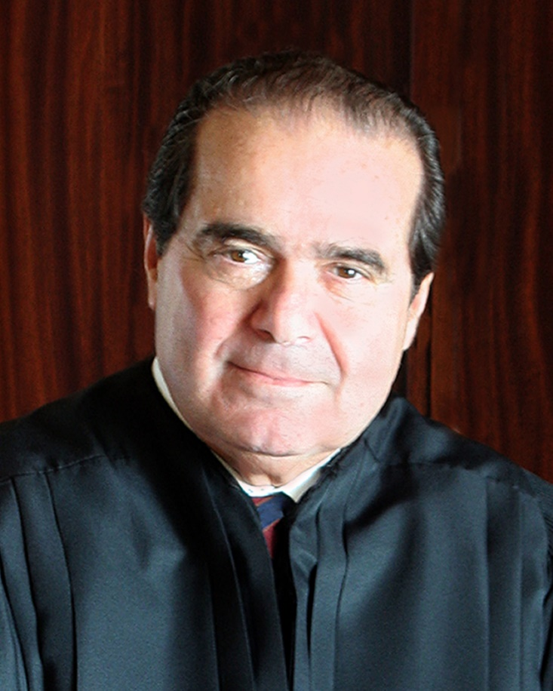
CONSTITUTIONAL ORIGINALISM
Justice Antonin Scalia: “[There's] the argument of flexibility and it goes something like this: The Constitution is over 200 years old and societies change. It has to change with society, like a living organism, or it will become brittle and break. But you would have to be an idiot to believe that; the Constitution is not a living organism; it is a legal document. It says something and doesn't say other things...” (“Scalia jeers fans of 'living' charter“, Washington Times, 2006-02-14).
“Economist Thomas Sowell argues in his book Knowledge and Decisions that since the original designers of the Constitution provided for the process of changing it, they never intended for their original words to change meaning.” (Wikipedia: Living Constitution)

Slide 5
CONSTITUTIONAL ORIGINALISM
Elder Oaks: “There are other threats that undermine the inspired principles of the United States Constitution. The stature of the Constitution is diminished by efforts to substitute current societal trends as the reason for its founding, instead of liberty and self-government.”
(Defending Our Divinely Inspired Constitution, Apr. 2021 General Conference)

Slide 6
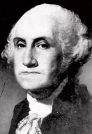
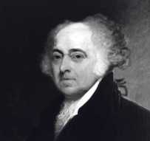
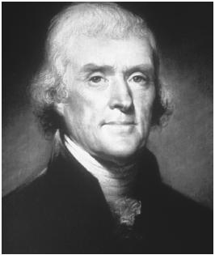
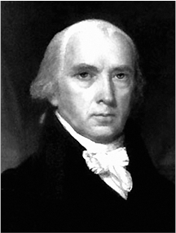
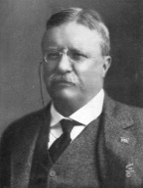
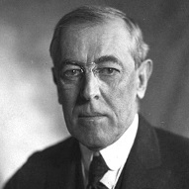
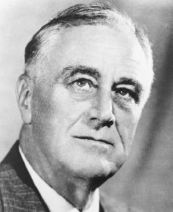
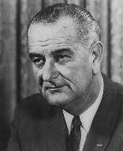
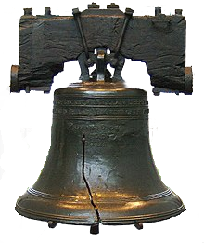
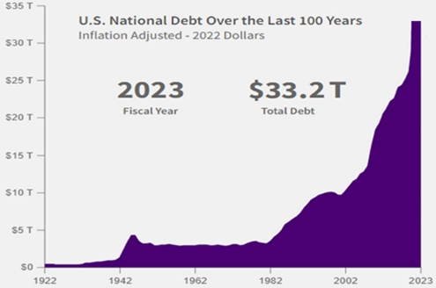
AMERIKA
A House Divided
INDIVIDUAL
STATE
STATE
INDIVIDUAL
FOUNDER’S ERA (1776 – 1900)
PROGRESSIVE ERA (1900 – Today)
Federalism
Individualism
Capitalism
Statism
Collectivism
Socialism
Governing Principle
Liberty
Governing Principle
Equality
Originalist
Limited Government, Enumerated Powers
Statist
Unlimited Government, Implied Powers
Constitutional
Republic
Americans Educated in Europe
Post-Constitutional
Welfare State
Declaration of
Independence
1776
1900
TODAY
Proper Role of Government
Secure Natural Rights
Proper Role of Government
Impose Social Justice

Slide 7
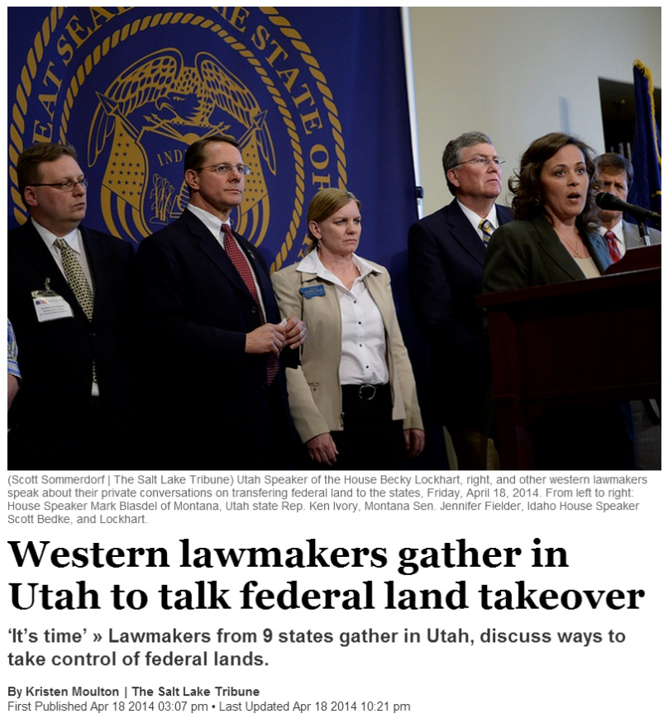
A HOUSE DIVIDED
PROGRESSIVE ERA
Second 100 Years
FOUNDER’S ERA
First 100 Years

Slide 8
A HOUSE DIVIDED
The Proper Role of Government
WELFARE STATE
Collectivism / Socialism
Impose Social Justice
REPUBLIC
Individualism / Capitalism
Secure Natural Rights
STATE
INDIVIDUAL
INDIVIDUAL
STATE
Moral Justification
Moral Justification
DUTY ETHICS
Altruism: “Otherism”
Primacy of Others
VALUE ETHICS
Egoism: “Selfulness”
Primacy of Self
OTHERS
SELF
SELF
OTHERS

Slide 9
THE CONSTITUTION PROTECTS FREEDOM
1ST AMENDMENT: FOUR PILLAR FREEDOMS
SECURE
NATURAL RIGHTS
FREEDOM OF ASSEMBLY
FREEDOM OF RELIGION
FREEDOM OF THE PRESS
FREEDOM OF SPEECH
CONSENT OF THE GOVERNED
UNITED STATES CONSTITUTION

Slide 10
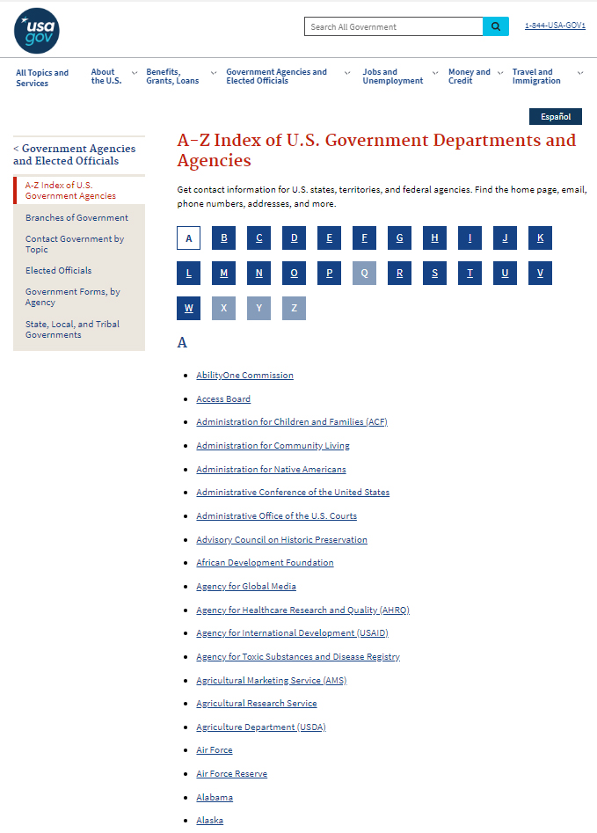
POST-CONSTITUTIONAL ERA
Freedoms Collapsing under the Weight of a Massive and Ever-Growing Administrative State
Pile
On
HUNDREDS
Federal Agencies
We the Special Interest Groups
Vote
MODERN
ADMINISTRATIVE
STATE
Vote
Vote
Vote
Special Interest Groups
Soft Tyranny
SECURE
NATURAL RIGHTS
REPRESENTATIVE GOV T
SEPARATION OF POWERS
FEDERALIST GOV T
LIMITED GOV T
2,714,897
Federal Employees
(Not Including Military)
the
People
Representation
We
CONSENT OF THE GOVERNED

Slide 11
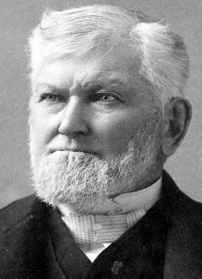
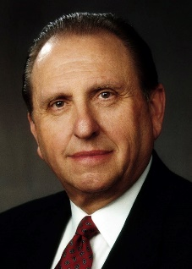
THE FOUNDERS
Ayn Rand: “The basic premise of the Founding Fathers was man’s right to his own life, to his own liberty, to the pursuit of his own happiness – which means: man’s right to exist for his own sake. Neither sacrificing himself to others nor sacrificing others to himself; and that the political implementation of this right is a society where men deal with one another as traders, by voluntary exchange to mutual benefit.” (For the New Intellectual, p62)
President Wilford Woodruff: “…those men who laid the foundation of this American government and signed the Declaration of Independence were the best spirits the God of heaven could find on the face of the earth. They were choice spirits, not wicked men.” (Conference Report, April 1898, p89-90)
President Thomas S. Monson: Let us pause and reflect upon the many blessings we as Americans have received from our Constitution and the debt of gratitude we owe those heroic signers. As we do so, we might also recognize that freedom is not free. Sacrifice has been required to protect and to preserve the very freedoms we cherish.” (Celebrate America, Sep. 17, 2002. 6:00-6:26)
President Ezra Taft Benson: “The temple work for the 56 signers of the Declaration of Independence and other Founding Fathers has been done. … When one casts doubt about the character of these noble sons of God, I believe he or she will have to answer to the God of heaven for it.”
(God’s Hand in Our Nation’s History, BYU Speech, March 28, 1977)

Slide 12
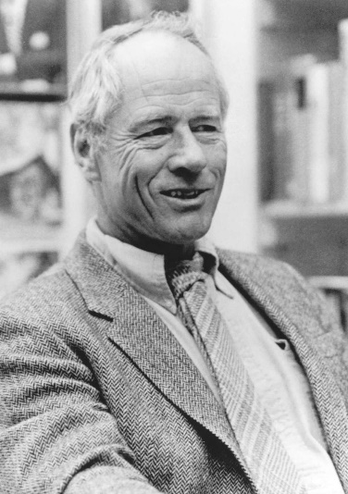
CANCELLING THE FOUNDERS
Stephen E. Ambrose: “In 1996 I was a visiting professor at the University of Wisconsin. The History Club there asked me to participate in a panel discussion on "Political Correctness and the University." The professor seated next to me taught American political thought. I remarked to her that when I began teaching I had required students to read five or six books each semester, but I had cut that back to three or four or else the students would drop my course. She said she had the same problem. She had dropped Thomas Jefferson’s writings from the required reading list.
‘You are … being paid by the citizens of Wisconsin to teach their children American political thought, and you leave out Tom Jefferson?’
‘Yes,’ she replied. ‘He was a slaveholder.’ More than half the large audience applauded.”
(Founding Fathers and Slaveholders, Smithsonian Magazine, November 2002)
Thomas West: “Liberals condemn the Founders because they supposedly did not believe that all human beings are created equal, or because they supposedly betrayed their own stated belief in human equality. ‘Jefferson didn’t mean it when he wrote that all men are created equal,’ writes historian John Hope Franklin. ‘We’ve never meant it. The truth is we’re a bigoted people and always have been.’ We have seen that such falsehoods are incessantly repeated and broadcast by many of today’s leading scholars and textbooks. Historian Paul Finkelman writes that Jefferson committed ‘treason against the hopes of the world’ because he failed to do more to abolish slavery ... Leading sophisticates—writers, professors, and journalists, whatever their political persuasion—seem convinced that there was something profoundly wrong with the origins of America.” (Vindicating the Founders, p. 175)

Slide 13
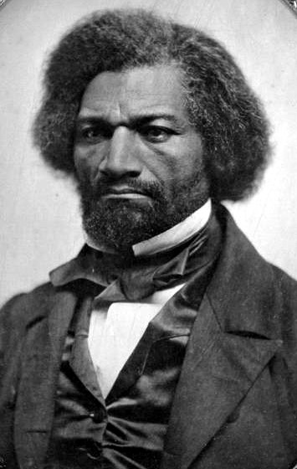
DEFINITION OF GREATNESS
Eric Holder (Attorney General): "I hear these things about 'let’s make America great again' and I think to myself, exactly when did you think America was great? It certainly wasn’t when people were enslaved. It certainly wasn’t when women didn’t have the right to vote. It certainly wasn’t when the LGBT community was denied the rights to which it was entitled.
Ari Melber (MSNBC Interviewer): Does that phrase echo as discrimination in your ears?
Eric Holder: "It takes us back to, I think, an American past that never in fact really existed…"
(MSNBC Interview, The Beat with Ari, March 27, 2019)
Frederick Douglass: “I have said that the Declaration of Independence is the ring-bolt to the chain of your nation’s destiny; so, indeed, I regard it. The principles contained in that instrument are saving principles. Stand by those principles, be true to them on all occasions, in all places, against all foes, and at whatever cost.” (“What to the Slave Is the Fourth of July?” July 5, 1852)
Frederick Douglass: “Fellow Citizens, I am not wanting in respect for the fathers of this republic. The signers of the Declaration of Independence were brave men. They were great men too — great enough to give fame to a great age. It does not often happen to a nation to raise, at one time, such a number of truly great men. … I cannot contemplate their great deeds with less than admiration. … for the good they did, and the principles they contended for, I will unite with you to honor their memory. … They seized upon eternal principles, and set a glorious example in their defense. Mark them!” (“What to the Slave Is the Fourth of July?” July 5, 1852)
Frederick Douglass: Are the great principles of political freedom and of natural justice, embodied in that Declaration of Independence, extended to us [slaves]? … There is not a nation on the earth guilty of practices, more shocking and bloody, than are the people of these United States, at this very hour.” (“What to the Slave Is the Fourth of July?” July 5, 1852)

Slide 14
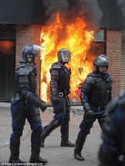
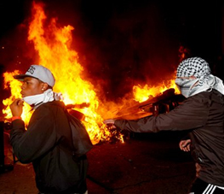
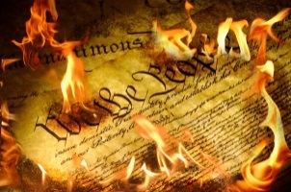
Less
Power of the State
More
UNDERSHOOTING
TARGET
OVERSHOOTING
LESS
CONSTITUTION
MORE
Anarchy
RIGHTS
Tyranny
“Cometh of Evil”
UNLIMITED AUTONOMY
“Cometh of Evil”
MAXIMAL AUTONOMY
“Justified”
MINIMAL AUTONOMY
“Cometh of Evil”
“Cometh of Evil”
LIBERTY
Anarchy
Tyranny
TOO MUCH
AUTONOMY
TOO LITTLE
AUTONOMY
PROPORTIONAL AUTONOMY
NO
GOVERNMENT
Libertarians
Egalitarians
TOTAL
GOVERNMENT
TRIBALISM
LIMITED
GOVERNMENT
WELFARE STATISM
Law of Jungle
Might Makes
Right
Socialism
Communism
Fascism
Militants, Nomads, Tribes, Gangs
Special Interest Groups
Europe &
America Today

Slide 15
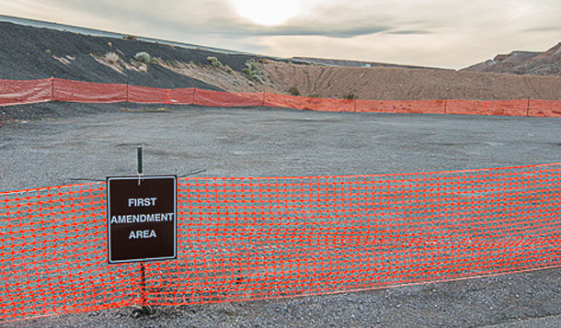
A CONSTITUTIONAL CRISIS
Post-Constitutional Era
SECOND
AMENDMENT
AREA
FIFTH
AMENDMENT
AREA
NINTH
AMENDMENT
AREA

Slide 16
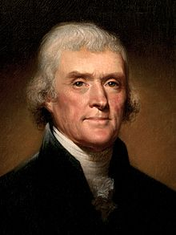
RESPONSIBILITY
Thomas Jefferson: “But rightful liberty is unobstructed action according to our will within limits drawn around us by the equal rights of others. I do not add "within the limits of the law" because law is often but the tyrant's will, and always so when it violates the rights of the individual.”
(Letter to Isaac H. Tiffany, 4 April 1819)
President Ezra Taft Benson: “No greater immediate responsibility rests upon members of the Church , upon all citizens of this Republic and of neighboring Republics than to protect the freedom vouchsafed by the Constitution of the United States.” (An Enemy Hath Done This, p. 322)
Thomas B. Griffith: “What does it mean to "support and defend" the Constitution in this environment? At the very least, it means that we will support and defend the rights protected by the Constitution. But it means much more than that. It means we will "support and defend" the values that gave life to the process by which the Constitution was created.”
(Vox Humana, Winter 2024, p32)

Slide 17
Questions?

