Slide 1
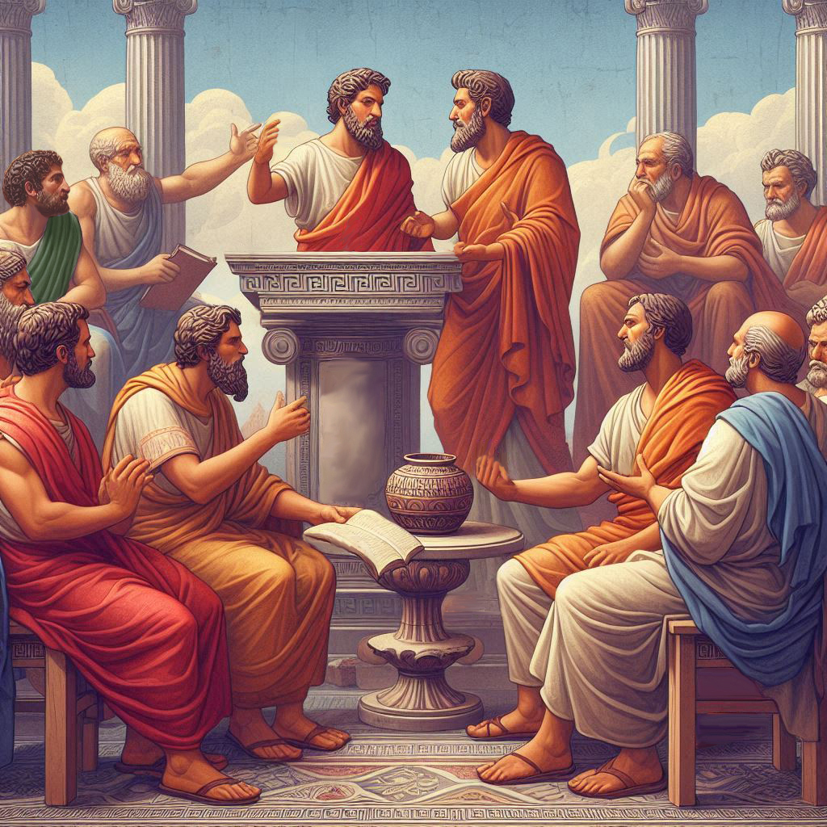
Eternalism Politics
The Constitution

Slide 2
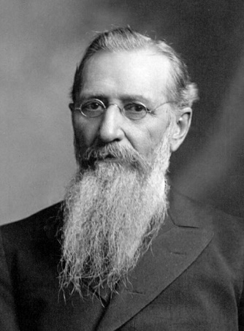
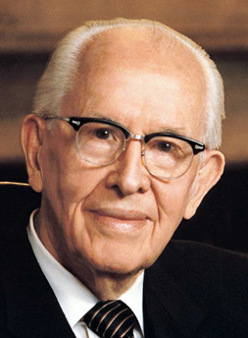
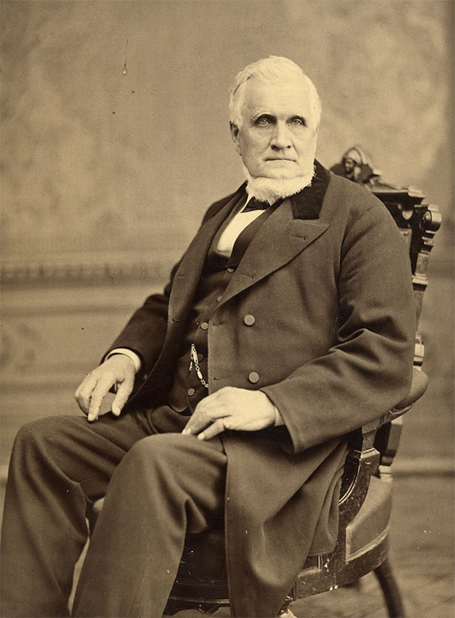
WHY STUDY THE CONSTITUTION?
President John Taylor: “….As we have progressed the mist has been removed, and in relation to these matters, the Elders of Israel begin to understand that they have something to do with the world politically as well as religiously, that it is as much their duty to study correct political principles as well as religious, and to seek to know and comprehend the social and political interests of man, and to learn and be able to teach that which would be best calculated to promote the interest of the world.” (JD 9:340)
President Joseph F. Smith: “I believe that the Constitution of the United States was and
still is an inspired instrument. The Lord God Almighty inspired the minds that framed it, and I believe it ought to be most sacredly preserved. It is worthy of the defense and should be upheld by all the people of our land.” (Improvement Era, May 1918. 21:634-35)
D&C 101:80 And for this purpose have I established the Constitution of this land, by the hands of wise men whom I raised up unto this very purpose, and redeemed the land by the shedding of blood.
President Ezra Taft Benson: “According to Norman Vincent Peale, ‘There was a time when the American people roared like lions for liberty; now they bleat like sheep for security.’ … It is the devil’s desire that the Lord’s priesthood stay asleep while the strings of tyranny gradually and quietly entangle us until, like Gulliver, we awake too late and find that while we could have broken each string separately as it was put upon us, our sleepiness permitted enough strings to bind us to make a rope that enslave us. … For years we have heard of the role the elders could play in saving the Constitution from total destruction. But how can the elders be expected to save it if they have not studied it and are not sure if it is being destroyed or what is destroying it?” (An Enemy Hath Done This, p312-313)

Slide 3





THE CONSTITUTION PROTECTS FREEDOM
1ST AMENDMENT: FOUR PILLAR FREEDOMS
SECURE
NATURAL RIGHTS
FREEDOM OF ASSEMBLY
FREEDOM OF RELIGION
FREEDOM OF THE PRESS
FREEDOM OF SPEECH
UNITED STATES CONSTITUTION
9th, 10th AMENDMENTS: ENUMERATED POWERS

Slide 4

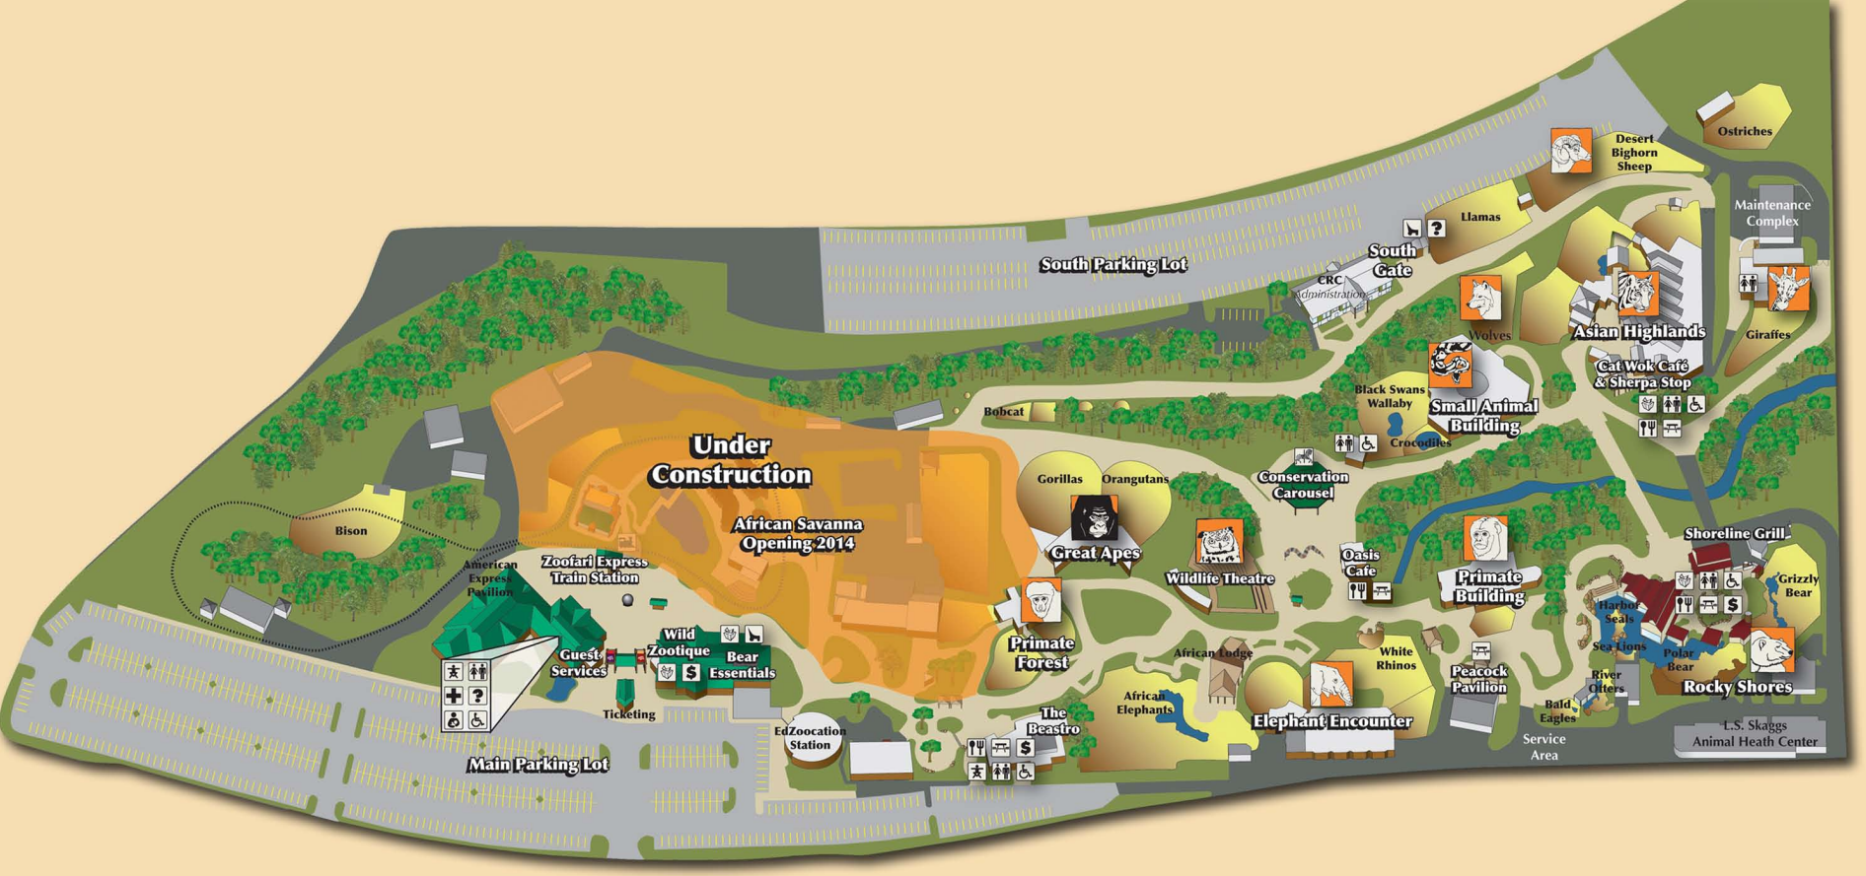

HOW TO STUDY THE CONSTITUTION?

Slide 5

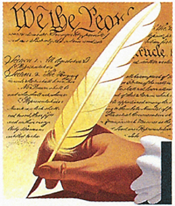
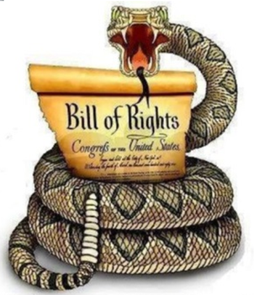
Mastering the Constitution in Thirty Minutes or Less
Creating a Constitutional Map to Build Your Understanding Around
(1)
(7)
(27)
PREAMBLE
ARTICLES
AMENDMENTS
Form
Establish
Insure
Provide
Promote
Secure
WE THE PEOPLE
ARE SOVEREIGN!
DON’T TREAD ON ME!
“We the People of the United States, in Order to form a more perfect Union, establish Justice, insure domestic Tranquility, provide for the common defense, promote the general Welfare, and secure the Blessings of Liberty to ourselves and our Posterity, do ordain and establish this Constitution for the United States of America.”

Slide 6
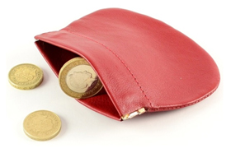
Mastering the Constitution in Thirty Minutes or Less
Creating a Constitutional Map to Build Your Understanding Around
(1)
(7)
(27)
PREAMBLE
ARTICLES
AMENDMENTS
Form
Establish
Insure
Provide
Promote
Secure
Articles
Sections
Clauses
WE THE PEOPLE
ARE SOVEREIGN!
DON’T TREAD ON ME!
ARTICLE I
ARTICLE II
ARTICLE III
ARTICLE IV
ARTICLE V
ARTICLE VI
ARTICLE VII
Legislative
Branch
PURSE
Article 1, SECTION 1: All legislative Powers herein granted shall be vested in a Congress of the United States, which shall consist of a Senate and House of Representatives.
Article 1, Section 8, Clause 1: Power To lay and collect Taxes …

Slide 7
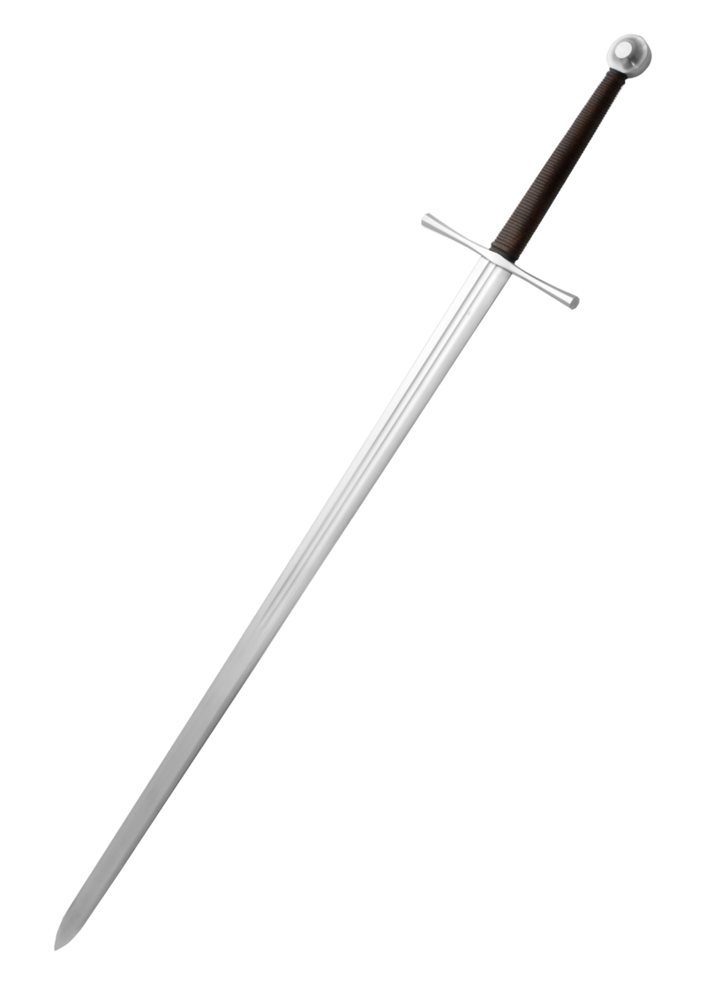
Mastering the Constitution in Thirty Minutes or Less
Creating a Constitutional Map to Build Your Understanding Around
(1)
(7)
(27)
PREAMBLE
ARTICLES
AMENDMENTS
Form
Establish
Insure
Provide
Promote
Secure
Articles
Sections
Clauses
WE THE PEOPLE
ARE SOVEREIGN!
DON’T TREAD ON ME!
ARTICLE I
ARTICLE II
ARTICLE III
ARTICLE IV
ARTICLE V
ARTICLE VI
ARTICLE VII
Legislative
Branch
Executive
Branch
PURSE
SWORD
ARTICLE 2, SECTION 1: The executive Power shall be vested in a President of the United States of America. He shall hold his Office during the Term of four Years, and, together with the Vice President, chosen for the same Term, be elected, as follows …
Article 2, Section 2, Clause 1: The President shall be Commander in Chief of the Army and Navy of the United States, and of the Militia of the several States …

Slide 8
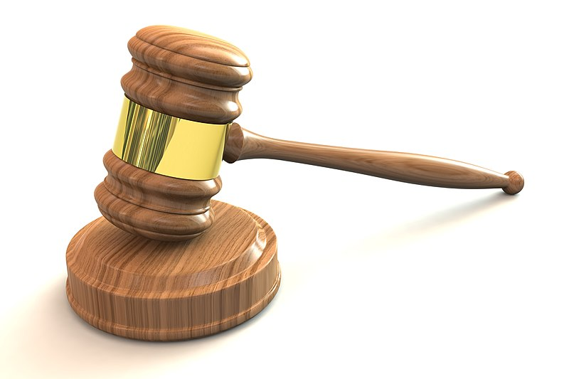
Mastering the Constitution in Thirty Minutes or Less
Creating a Constitutional Map to Build Your Understanding Around
(1)
(7)
(27)
PREAMBLE
ARTICLES
AMENDMENTS
Form
Establish
Insure
Provide
Promote
Secure
Articles
Sections
Clauses
WE THE PEOPLE
ARE SOVEREIGN!
DON’T TREAD ON ME!
ARTICLE I
ARTICLE II
ARTICLE III
ARTICLE IV
ARTICLE V
ARTICLE VI
ARTICLE VII
Legislative
Branch
Executive
Branch
Judicial
Branch
PURSE
SWORD
GAVEL
ARTICLE 3, SECTION 1 The judicial Power of the United States, shall be vested in
one supreme Court, and in such inferior Courts as the Congress may from time
to time ordain and establish.

Slide 9


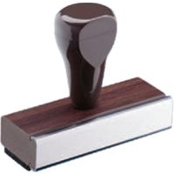

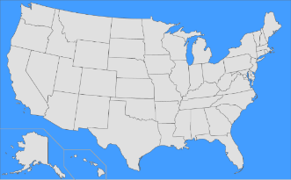
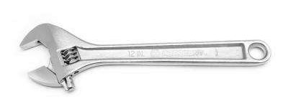
A
Mastering the Constitution in Thirty Minutes or Less
Creating a Constitutional Map to Build Your Understanding Around
(1)
(7)
(27)
PREAMBLE
ARTICLES
AMENDMENTS
Form
Establish
Insure
Provide
Promote
Secure
Articles
Sections
Clauses
WE THE PEOPLE
ARE SOVEREIGN!
DON’T TREAD ON ME!
ARTICLE I
ARTICLE II
ARTICLE III
ARTICLE IV
ARTICLE V
ARTICLE VI
ARTICLE VII
Legislative
Branch
Executive
Branch
Judicial
Branch
State
Relations
Amendment
Process
Constitutional
Supremacy
Ratification
Process
PURSE
SWORD
GAVEL
UNIFY
ADAPT
OATH
ADOPT
ADOPTED

Slide 10
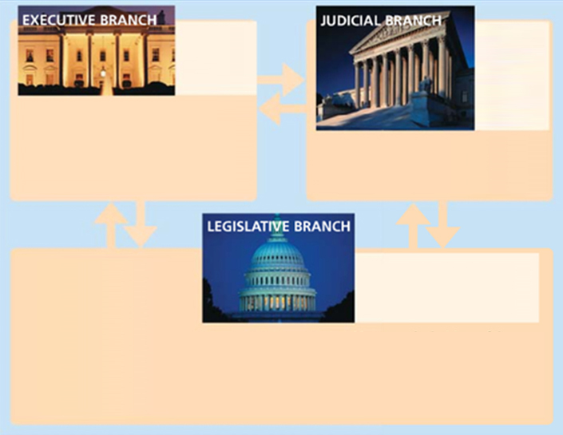
A
AMENDMENTS
CHECKS AND BALANCES
# | Date | Overview
1 | 1791 | Rights of religion, speech, and the press
2 | 1791 | Right to bear arms
3 | 1791 | Housing of Soldiers
4 | 1791 | Protection from searches and seizures
5 | 1791 | Protections involving double jeopardy, self-Incrimination, due process
6 | 1791 | Rights of accused persons (counsel, jury trial, confront opposing witnesses)
7 | 1791 | Rights in Civil Cases
8 | 1791 | Protections against excessive bail, cruel and unusual punishment
9 | 1791 | Non-enumerated rights are kept by the people
10 | 1791 | Undelegated powers kept by the States and the people
11 | 1795 | Lawsuits against a state
12 | 1804 | Election methods of President and Vice-President
13 | 1865 | Abolition of slavery and involuntary servitude
14 | 1868 | Federal protections against infringements by the States (equal protection)
15 | 1870 | Voting rights
16 | 1913 | Federal income tax
17 | 1913 | Popular election of senators
18 | 1919 | Prohibition of alcohol consumption
19 | 1920 | Women's right to vote
20 | 1933 | Definition of presidential term and succession
21 | 1933 | Repeal of 18th amendment (prohibition)
22 | 1951 | Two-Term limitation on president
23 | 1961 | District of Columbia presidential vote
24 | 1964 | Abolition of poll tax requirement in federal elections
25 | 1967 | Presidential vacancy, disability and inability
26 | 1971 | Right to vote at age 18
27 | 1992 | Congressional compensation
President
Supreme
Court,
(Other
Federal
Courts)
* Presidential pardon
* Appoint Federal Judges
* Veto Laws Passed by Congress
* Call Special Session of Congress
Declare Unconstitutional:
* Presidential Actions
* Congressional Laws
* Override Presidential
Veto
* Refuse to Approve
Presidential Treaties
* Refuse Presidential Appointments
* Remove President From Office If
Guilty of Wrongdoing (impeachment)
Congress
(Senate, House of Representatives)
* Overrule Court Decisions Via
Constitutional Amendments
* Remove Judges If Guilty of
Wrongdoing (impeachment)

Slide 11
Mastering the Constitution in Thirty Minutes or Less
Creating a Constitutional Map to Build Your Understanding Around
(1)
(7)
(27)
PREAMBLE
ARTICLES
AMENDMENTS
Form
Establish
Insure
Provide
Promote
Secure
Articles
Sections
Clauses
WE THE PEOPLE
ARE SOVEREIGN!
DON’T TREAD ON ME!
ARTICLE I
ARTICLE II
ARTICLE III
ARTICLE IV
ARTICLE V
ARTICLE VI
ARTICLE VII
Legislative
Branch
Executive
Branch
Judicial
Branch
State
Relations
Amendment
Process
Constitutional
Supremacy
Ratification
Process
PURSE
SWORD
GAVEL
UNIFY
ADAPT
OATH
ADOPT
Sweeping or Elastic Clauses
General Welfare Clause
ARTICLE I, SECTION 8, CLAUSE 1
Commerce Clause
ARTICLE I, SECTION 8, CLAUSE 3
Necessary & Proper Clause
ARTICLE I, SECTION 8, CLAUSE 18
Supremacy Clause
ARTICLE VI, CLAUSE 2
CONTENT
The Congress shall have Power to lay and collect Taxes, Duties, Imposts … and provide for the common Defence and general Welfare of the United States …
The Congress shall have Power to … make all Laws which shall be necessary and proper for carrying into Execution the foregoing Powers …
The Constitution, and the Laws of the United States … and all Treaties made, under the Authority of the United States, shall be the supreme Law of the Land …
The Congress shall have Power to … regulate Commerce … among the several States.
ORIGINALIST (Founders Era) Constitutional Republic, Natural Rights Definition of Justice, Limited Gov’t with Enumerated Powers
STATIST (Progressive Era) Post-Constitutional Administrative State, Social Good Definition of Justice, Unlimited Gov’t with Implied Powers
General Welfare of Whole Country
Unleash Power of Free Market
Limited Enumerated Powers
Ensure a Constitutional Republic
INTENT
Individual Welfare of Whomever
Regulatory Power Over Economy
Unlimited Bureaucratic Powers
Gradually Usurp States Rights
Expansion of the
Welfare State
Socialization of
The Economy
Rise of Bureaucratic
Administrative State
Consolidation of
Centralized Power

Slide 12
BEFRIENDING THE CONSTITUTION
President Ezra Taft Benson: “I reverence the Constitution of the United States as a sacred document. To me its words are akin to the revelations of God, for God has placed his stamp of approval on the constitution of this land.” (Ensign, Sept. 1987)
Joseph Smith: “The Constitution of the United States is a glorious standard; it is founded in the wisdom of God. It is a heavenly banner ... It is like a great tree under whose branches men from every clime can be shielded from the burning rays of the sun.” (TPJS, p. 187)
D&C 109:54 “May those principles, which were so honorably and nobly defended, namely, the Constitution of our land, by our fathers, be established forever.” (D&C 109:54…Prayer given at the dedication of the Kirtland Temple)

Slide 13
Questions?

