Slide 1
Christian Eternalism
Liberty
vs
License
Abide
and
Abound

Slide 2
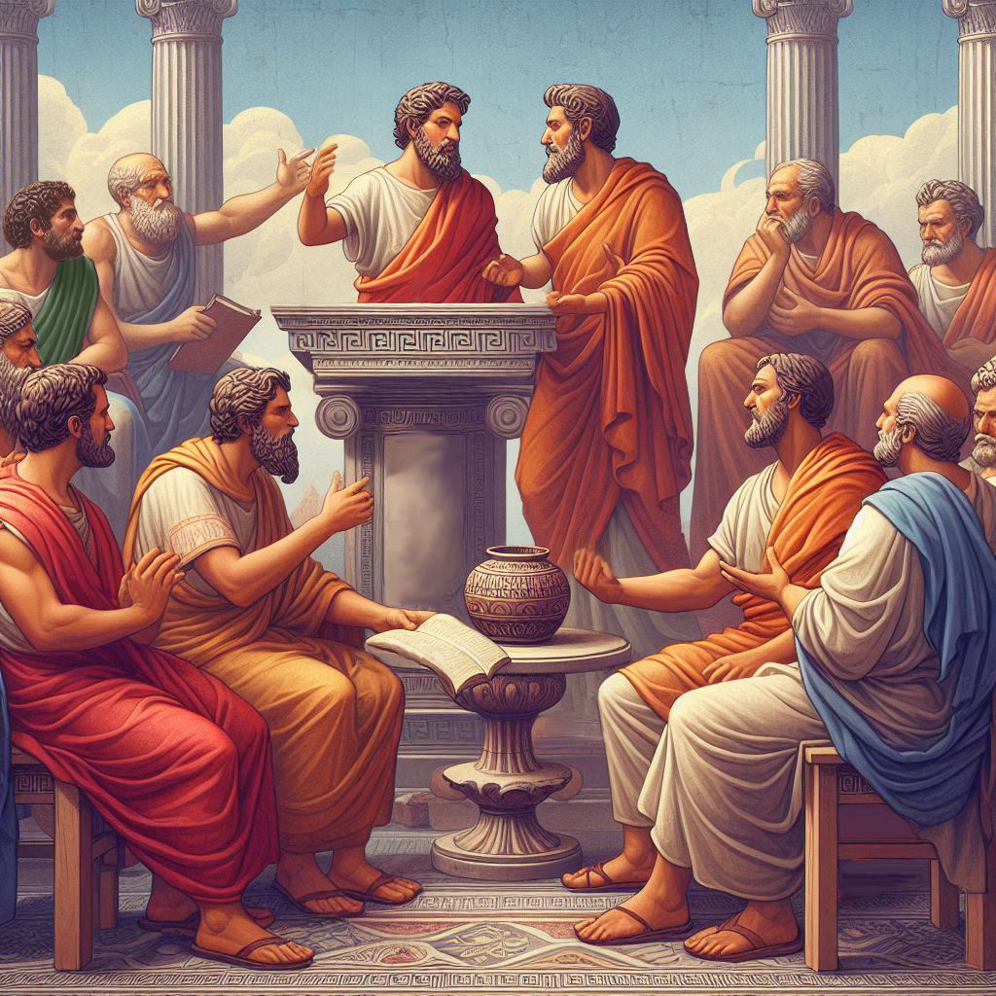
Eternalism Politics
Liberty
vs
License

Slide 3
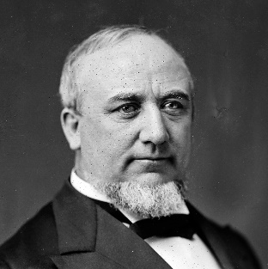
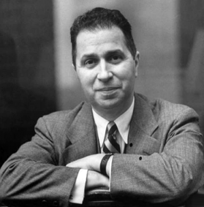
LIBERTY vs LICENSE
LICENSE (LICENTIOUS): “Unrestrained by law or general morality; lawless; immoral. Going beyond customary or proper bounds or limits; disregarding rules.” (Dictionary.com: Licentious)
Mortimer Adler: “Using the word ‘license’ to designate an illegitimate, unlawful, or unjust exercise to do as one pleases. … Otherwise is to ask anarchic freedom which is not compatible with living in a society cooperatively with other human beings. (Six Great Ideas, p.143)
Elder Erastus Snow: “…license was never liberty nor can be. … The Gospel of Christ, and all of the revelations of God to man have sought to mark the line of distinction between liberty and license, between correct principles of government and anarchy or oppression and slavery. (JD 22:150, 22:149)
Elder George Q. Cannon: “Liberty cannot be permitted to degenerate into license, but the utmost liberty can be enjoyed so long as it does not overstep that boundary. … All sects and all people should have this liberty, that is, liberty of conscience, liberty of speech and liberty of the press, as long as it does not degenerate into license, and interfere with the rights of others.” (JD 24:58-59, 23:123)
Mortimer Adler: “As Aristotle said, the virtuous man does freely what the criminal does only from fear of the law….The criminal, however, does not suffer any loss of liberty when he refrains from breaking the law, for what he wishes to do being unlawful and unjust, is something he ought not to do anyway, even if he were not constrained by law. His license to do as he wishes, not his liberty, has been taken away. Where our conduct does fall under the commands or prohibitions of law, the virtuous man is still able to do as he pleases, since he pleases to do what he ought. (Six Great Ideas, p.147)

Slide 4
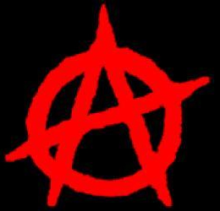
ANARCHY
License
The absence of government and absolute freedom of the individual. (Wikipedia.org)
Justice
Ayn Rand: “Anarchy, as a political concept, is a naïve floating abstraction … a society without an organized government would be at the mercy of the first criminal who came along and who would precipitate it into chaos of gang warfare.” (The Virtue of Selfishness, p.131)
Elder Dallin H. Oaks: “…even an oppressive government that limits freedom is preferable to a state of lawlessness and anarchy in which the only ruling principle is force and every individual citizen has a thousand oppressors.”
(I Have a Question, Ensign, June 1976, p61–62)
LIBERTARIANISM
Liberty
Libertarianism: “A political philosophy that takes individual liberty to be the primary political value.”
(Encyclopedia Britanica: libertarianism-politics)
Justice
Mortimer Adler: “In short, should an individual have more liberty than he can exercise justly?” (Six Great Ideas, p.138)
Libertarianism: Libertarians strongly oppose any government interference into their personal, family, and business decisions. (Libertarian Party, lp.org)
Mortimer Adler: “Where he [the Libertarian] is wrong is in failing to see that such curtailments of freedom made in the interests of justice, are proper limitations on liberty. His error lies in asking for more liberty than justice allows.” (Six Great Ideas, p.170)

Slide 5
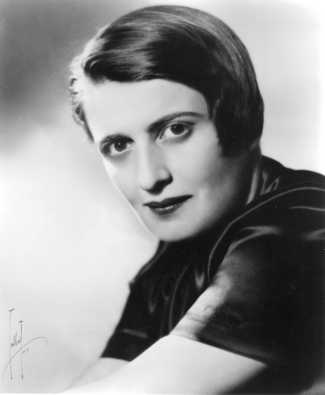
COERCIVE FORCE (JUST RESTRAINTS)
Mortimer Adler: “…the distinction between liberty and license cannot be dismissed or disregarded. When that distinction is understood and accepted, it follows that the individual who is prevented from doing what he pleases by just restraints suffers no loss of liberty.” (Six Great Ideas p.144)
“The laws of the state, when they are just, apply coercive force and constraints to secure us from infringements upon our freedom by other individuals who would use illegitimate or unlawful force to interfere with it. Where just laws do not exist or where they are not effectively enforced, individuals are subject to all sorts of depredations and invasions that diminish their freedom. When just laws are enforced, they enlarge the liberty of the individual.” (Six Great Ideas, p.147)
Ayn Rand: “If one upholds freedom, one must uphold man’s individual rights ; if one upholds man’s individual rights, one must uphold his right to his own life, to his own liberty, to the pursuit of his own happiness – which means one must uphold a political system which guarantees and protects these rights …” (Capitalism: The Unknown Ideal, p.215)
“The difference between political power and any other kind of social power … is the fact that a government holds a legal monopoly on the use of physical force. … The nature of governmental action is: coercive action. The nature of political power is: the power to force obedience under threat of physical injury – the threat of property expropriation, imprisonment, or death.”
(Capitalism: The Unknown Ideal, p.42-43)
“A private individual may do anything except that which is legally forbidden; a government official may do nothing except that which is legally permitted.” (Capitalism: The Unknown Ideal, p.42-43)

Slide 6
BEFRIENDING THE CONSTITUTION
D&C 98:5-7
5 And that law of the land which is constitutional, supporting that principle of freedom in maintaining rights and privileges, belongs to all mankind, and is justifiable before me.
6 Therefore, I, the Lord, justify you, and your brethren of my church, in befriending that law which is the constitutional law of the land;
7 And as pertaining to law of man, whatsoever is more or less than this, cometh of evil.
UNDERSHOOTING
TARGET
OVERSHOOTING
LESS
CONSTITUTION
MORE
State of Anarchy
RIGHTS
Totalitarian State

Slide 7
Happiness (The Ultimate End)
Life, Liberty, and the Pursuit of Happiness (Abide and Abound)
ETHICS
Right Habits
POLITICS
Right Habitat
Virtue
Good Fortune
Morality to Guide Individual Choices
Moral
Freedom
(Ethics)
Circumstantial
Freedom
(Politics)
Governments to Secure
Individual Rights
Moral Freedom
Inner Freedom
Ethical Freedom
Circumstantial Freedom
Environmental Freedom
Political Freedom
Via Agency
Via Force
Natural
Freedom
(Metaphysics)
METAPHYSICS
Unchosen Free Will
Reality (The Ultimate Start)

Slide 8
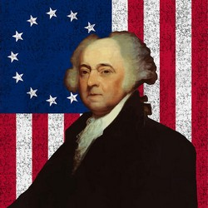
Happiness (The Ultimate End)
Life, Liberty, and the Pursuit of Happiness (Abide and Abound)
LICENSE
Addicts
Thieves
Corrupt Businessmen
Corrupt Politicians
Good Fortune
Circumstantial
Freedom
(Politics)
LESS
Spinoza: “Human infirmity in moderating and checking the emotions I name bondage: for, when a
Natural
Freedom
(Metaphysics)
man is a prey to his emotions, he is not his own master, but lies at the mercy of fortune: so much so, that he is often compelled, while seeing that which is better for him, to follow that which is worse.” (Ethics, 1677, Part IV, Preface)
John Adams: “Our Constitution was made only for a moral and religious people. It is wholly inadequate to the government of any other.”
(Letter to the militia of Massachusetts, 11 Oct. 1798)
Reality (The Ultimate Start)

Slide 9
Happiness (The Ultimate End)
Life, Liberty, and the Pursuit of Happiness (Abide and Abound)
AUTHORITARIANISM
Slavery
Political Prisoners
Disenfranchised Citizens
Virtue
Moral
Freedom
(Ethics)
MORE
Natural
Freedom
(Metaphysics)
Reality (The Ultimate Start)

Slide 10
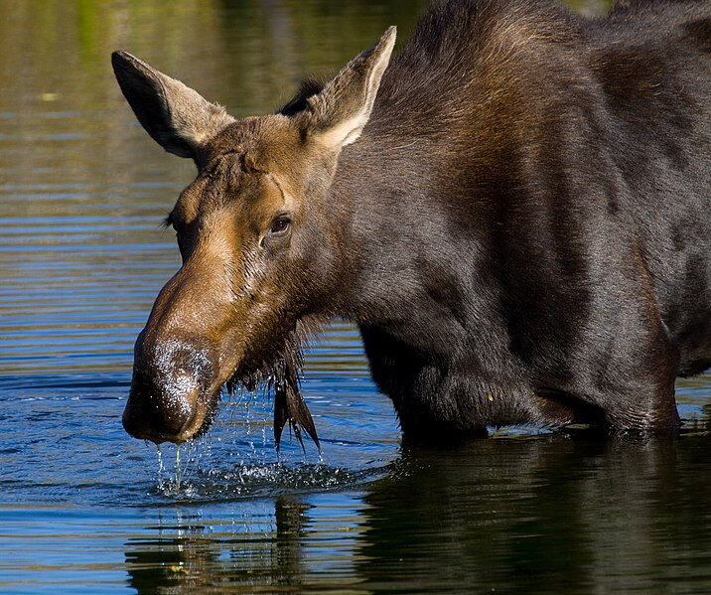
Happiness (The Ultimate End)
Life, Liberty, and the Pursuit of Happiness (Abide and Abound)
LICENSE
Addicts
Thieves
Corrupt Businessmen
Corrupt Politicians
AUTHORITARIANISM
Slavery
Political Prisoners
Disenfranchised Citizens
Virtue
Good Fortune
Moral
Freedom
(Ethics)
Circumstantial
Freedom
(Politics)
LESS
MORE
Natural
Freedom
(Metaphysics)
Reality (The Ultimate Start)

Slide 11
Questions?

