Slide 1
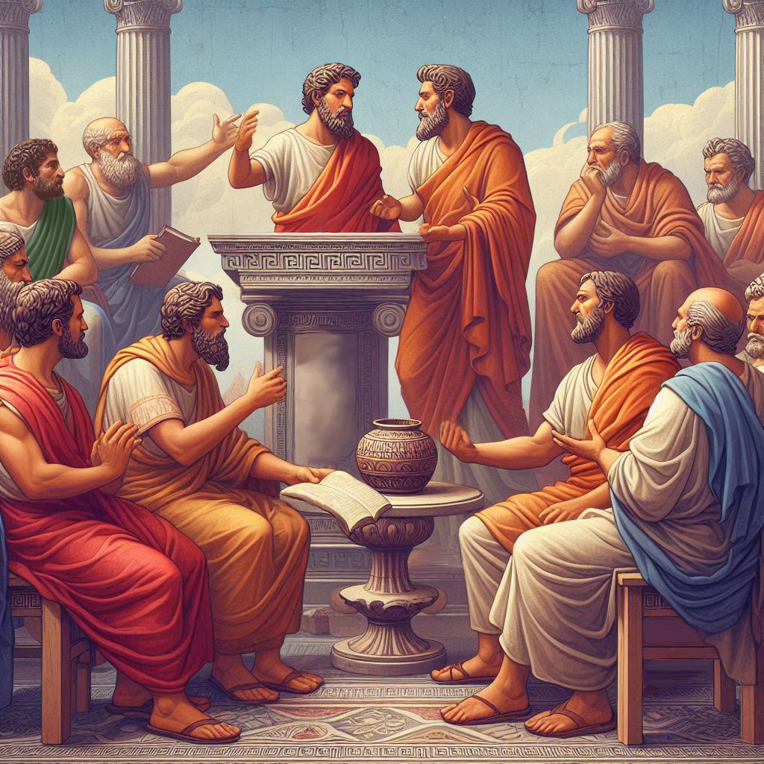
Eternalism Politics
Liberty
(Freedom, Agency)

Slide 2
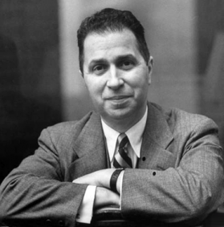
LIBERTY (FREEDOM)
Greg Wright: “Satan has twisted many words into alternate meanings in order to deceive us, and the words ‘free’ and ‘freedom’ are no exception.” (Satan’s War on Free Agency, p.11)
Three Types of Freedom:
1st
Natural
Metaphysics: Free Will, Freedom of Choice, Agency
Ethics: Inner Free Will, Moral Agency. Correspondence between what we desire and what we ought to desire.
2nd
Moral
Politics: External freedom within a societal environment.
Individual Freedom: An individual is free to do as they wish within the larger society.
3rd
Circumstantial
Political Freedom: Granted citizenship and suffrage (voting and representation). A
share in the sovereignty of the state.
Mortimer Adler: “Of these three major forms of freedom or liberty, the only one that needs to be regulated by justice is circumstantial freedom because what one wishes to do may be injurious to someone else.”
(Six Great Ideas, p.143)
Justice
Liberty

Slide 3
1st NATURAL FREEDOM (metaphysics)
Agency
Free Will
Freedom of Choice Metaphysical Liberty
Mortimer Adler: “We are born with it in our possession. … It is freedom of choice – the liberty of being able to choose otherwise than we did. …There would be no sense at all in saying that we are entitled to have free will or freedom of choice. That is a good conferred on us by nature [whether we like it or not] … The lower animals are deprived of it, but we cannot say they are deprived of something they are entitled to.” (Six Great Ideas, p.140, 141, 149)
DETERMINISM: “The theory that all events,
including human action, are ultimately
determined by causes external to the will.
Some philosophers have taken determinism to imply that individual human beings have no free will and cannot be held morally responsible for their actions.” (Google Dictionary)
PREDESTINATION: “The false doctrine that from all eternity God has ordered whatever comes to pass, having particular reference to the salvation or damnation of souls … and there is said to be nothing any individual can do to escape his predestined inheritance in heaven or in hell as the case may be.” (Bruce R. McConkie, Mormon Doctrine, p588)

Slide 4
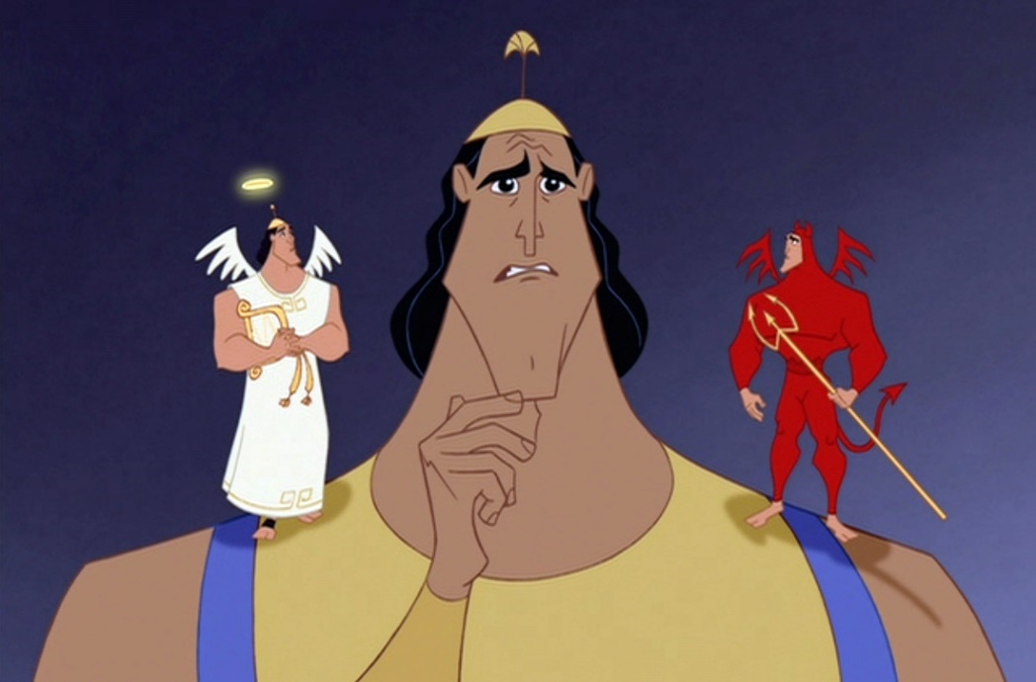
2nd MORAL FREEDOM (ethics)
Inner freedom, Acquired Freedom, Ethical Liberty
Mind
Heart
Mortimer Adler: “It would be equally devoid of sense to say that we are entitled to the moral freedom that consists of being able to will as we ought. We either acquire or fail to acquire such freedom through choices we ourselves have freely made.” (Six Great Ideas, p.149)
POTENTIAL
VIRTUE
VICE
President Brigham Young: “Man is prone to wander as the sparks are to fly upwards. The spirit is warring with the flesh continually, and the flesh against the spirit. Which will come off victorious? This will decide the destiny of all the inhabitants of the earth. If the spirit reigns triumphant and overcomes the body and its passions, that character will receive glory; but if the passions and sin, within the flesh, overcome the spirit and subdue it, that character will be lost.” (JD 12:263)
Mortimer Adler: “Moral liberty lies in reason’s control of the passions. … It is possessed only by those who, in the course of their personal development, have acquired some measure of virtue and wisdom. … Moral freedom consists in our having a will that is habitually disposed by virtue to will as it ought. Human bondage is our enslavement by appetites and passions of our lower nature.” (Six Great Ideas, p.141-2)
Elder Daniel H. Wells: “The Gospel makes men and women free—free from sin—the greatest of all tyrants; and there is no greater slave on the earth than the man who is under the control of his own passions…” (JD 16:125)
Spinoza: “Philosophers conceive of the passions which harass us as vices into which men fall by their own fault…”
(Political Treatise - 1677, Ch. 1, Introduction; section 1)

Slide 5
3rd CIRCUMSTANTIAL FREEDOM: INDIVIDUAL
External Freedom Within a Societal Environment
Mortimer Adler: “An individual in prison with bars or chains prevent him from going elsewhere or doing otherwise. The restraints imposed by imprisonment impair his freedom of action, not his freedom of choice and not his moral liberty. “ (Six Great Ideas, p.143)
Mortimer Adler: “Circumstances that confirm enabling means upon individuals also give them the freedom to do what they wish. Sufficient wealth enables me to dine at the Ritz if I wish to. Deprived of such enabling means, the poor man is not free to dine at the Ritz. (Six Great Ideas, p.146)
Mortimer Adler: “An individual’s possession of it may vary from time to time and from place to place. … Our circumstantial freedom consists in our being able to do as we please – our ability to carry out an action (rightly or wrongly). Such freedom can be possessed and exercised by individuals of good or bad moral character. The person’s decision about an action to take may be morally virtuous or the opposite, but in either case, circumstances either permit or prevent him from carrying out the action.” (Six Great Ideas, p.141-142)

Slide 6
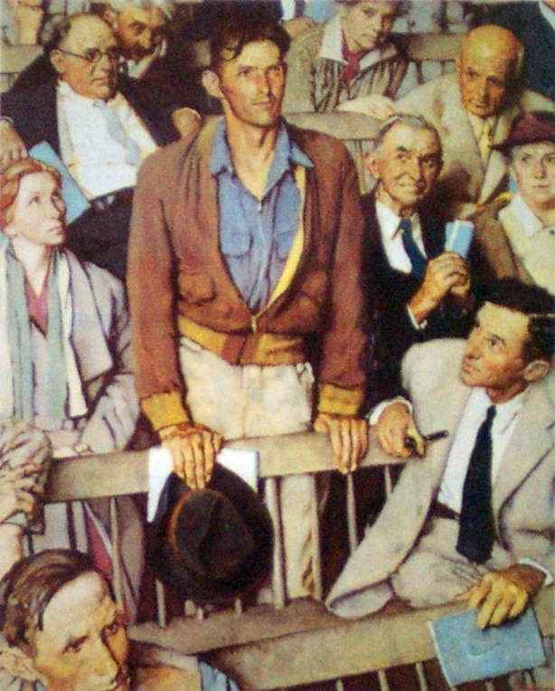
3rd CIRCUMSTANTIAL FREEDOM: POLITICAL
Granted citizenship and suffrage under a constitutional government.
Mortimer Adler: “The only liberty to which we can make a claim upon society is the freedom to do as we please within the limits imposed by justice and that variant of circumstantial freedom that is the political liberty enjoyed by enfranchised citizens of a republic.” (Six Great Ideas, p.150)
Elder Erastus Snow: “All the revelations which God ever gave to man from the beginning of the world tended to liberty. The government which our heavenly Father has exercised, or attempted to exercise over His children on the earth or in the heavens, has not in the least tended to restrain or abridge them in their liberty, but rather to enlarge it, to extend it, to insure, to preserve and maintain it.” (JD 22:149)
Mortimer Adler: “The constitution to which the citizen has given consent by exercising his suffrage provides for a decision by the vote of the majority. He has accepted the principle of majority rule and, having done so, the citizen has also accepted, in advance the result of majority rule, whether or not the voting places him in the majority or in an adversely affected minority.” (Six Great Ideas, p.148)
Mosiah 29:26-27 “Now it is not common that the voice of the people desireth anything contrary to that which is right; but it is common for the lesser part of the people to desire that which is not right; therefore this shall ye observe and make it your law—to do your business by the voice of the people. And if the time comes that the voice of the people doth choose iniquity, then is the time that the judgments of God will come upon you; yea, then is the time he will visit you with great destruction even as he has hitherto visited this land.”

Slide 7
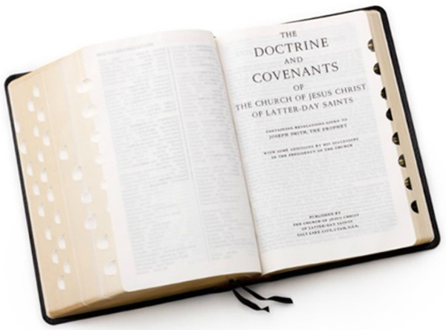
Freedom Defined in Different Contexts
D&C 98:8 “I, the Lord God, make you free, therefore
ye are free indeed; and the law also maketh you free.”
Metaphysical Freedom = Natural Freedom
Ethical Freedom = Moral Freedom
Political Freedom = Circumstantial Freedom

Slide 8
Questions?

