Slide 1
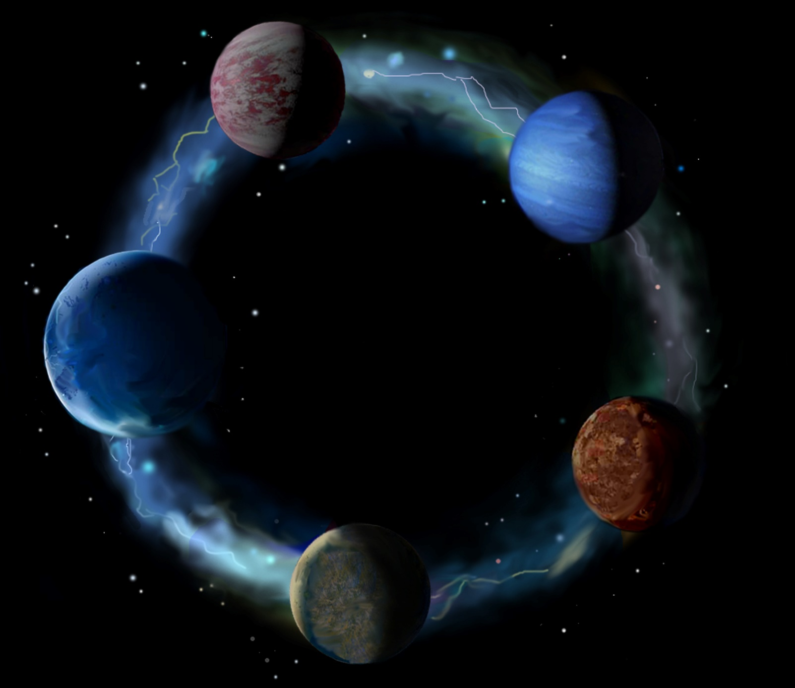
Christian Eternalism
Abide
and
Abound
Equality

Slide 2
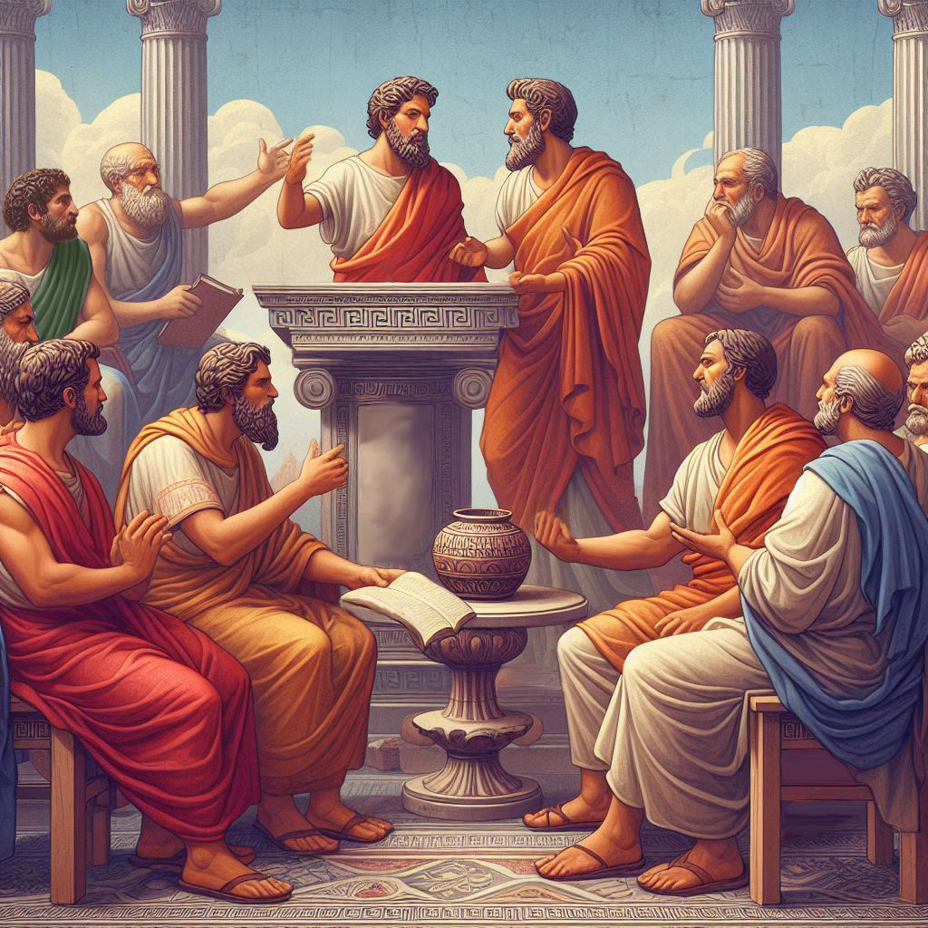
Eternalism Politics
Equality

Slide 3
EQUALITY?
0 1 2 3 4 5 6 7 8 9
Are these numbers equal?
Are these people equal?
Are these snowflakes equal?
The answer is:
YES
and NO

Slide 4
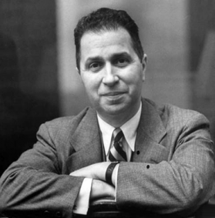
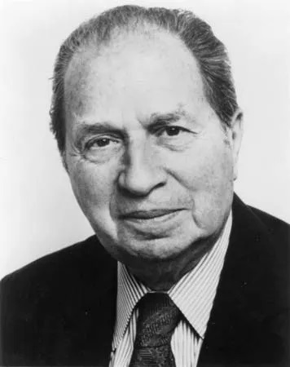
TWO MEANINGS OF EQUALITY (Nature, Nurture)
NATURE = EQUALITY OF KIND = NATURAL EQUALITY: The involuntary native endowment given to all members of the species.
Mortimer Adler: “By being human we are equal - equal as persons, equal in our humanity. One individual cannot be more or less human than another, more or less of a person. The dignity we attribute to being a person rather than a thing is not subject to difference in degree. … The factual basis for the correct view is biological. All members of any biological species, human or otherwise, are alike in possessing the properties or powers that are genetically determined attributes of that species of living organism.” (Six Great Ideas, p165)
“The truth of the proposition that all human beings are by nature equal is confined to the one respect in which that equality can be truly affirmed … their having species specific properties … There is no other respect in which all human beings are equal.” (Six Great Ideas, p166-167)
NURTURE = EQUALITY OF CONDITION = CIRCUMSTANTIAL EQUALITY: The voluntary equality or inequality of attainment.
“Individual members of a species differ from one another either by innate endowment, genetically determined, or by voluntary attainment, individually acquired. From the individual differences arise the inequalities in degree that make one individual superior or inferior to another in some particular respect.” (Six Great Ideas, p167)
“These differences come, first of all, from differences in native endowment. … Another explanation of the different degrees of ability looks to what use individuals make of their inborn talents and aptitudes – the degree to which, by their own efforts, they fulfill their innate capacities. … Still another explanation lies in the favorable or unfavorable circumstances under which individuals make the effort to develop themselves.” (Six Great Ideas, p184)

Slide 5
EGALITARIANISM (EQUITY)
“A Theory of Justice is a 1971 work of political philosophy and ethics by John Rawls,
in which the author addresses the problem of distributive justice (the socially just
distribution of goods in a society). The theory utilizes an updated form of Kantian
philosophy and a variant form of conventional social contract theory.” (Wikipedia: A Theory of Justice)
Equality
Justice
John Rawls: “No one deserves his greater natural capacity nor merits a more favorable starting place in society.” (“A Theory of Justice”, Chapter II, Section 17, p102)
“Rawls develops what he claims are principles of justice through the use of an artificial device he calls the original position; in which, everyone decides principles of justice from behind a veil of ignorance. This "veil" is one that essentially blinds people to all facts about themselves so they cannot tailor principles to their own advantage. According to Rawls, ignorance of these details about oneself will lead to principles that are fair to all.” (Wikipedia: A Theory of Justice)
Group
Individual
John Rawls: “Among the essential features of this situation [original position] is that no one knows his place in society, his class position or social status, nor does anyone know his fortune in the distribution of natural assets and abilities, his intelligence, strength, and the like. I shall even assume that the parties do not know their conceptions of the good or their special psychological propensities. The principles of justice are chosen behind a veil of ignorance.” (“A Theory of Justice”, Chapter I, Section 3, p12)
State
Man
John Rawls: “Social and economic inequalities are to be arranged so that they are to be of the greatest benefit to the least-advantaged members of society, consistent with the just savings principle.” (A theory of Justice, p266)

Slide 6
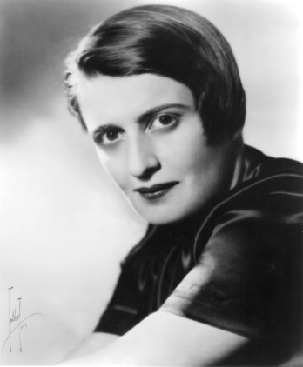
EQUALITY MUST BE TEMPERED BY JUSTICE
Justice
Equality
Equality
Justice
Ayn Rand: “The new theory of justice demands that men counteract the ‘injustice’ of nature by instituting the most obscenely unthinkable injustice among men: deprive ‘those favored by nature’ (the talented, the intelligent, the creative) of the right to the rewards they produce – and grant to the incompetent, the stupid, the slothful a right to the effortless enjoyment of the rewards they could not produce, could not imagine, and would not know what to do with.” (Philosophy: Who Needs It, p147-148)
“Of special significance to the present discussion is the egalitarians’ defiance of the Law of Causality: their demand for equal results from unequal causes – or equal rewards for unequal performance.” (Philosophy: Who Needs It, p163)
Mortimer Adler: “Should [society] ignore the fact that human beings are unequal as well as equal, in both their endowments and attainments, and that they make unequal contributions to the welfare of the community? …
One individual may put his native endowments to work in the production of wealth or other goods, while another with equal endowments, may squander his talents producing less. …
With regard to individuals who make unequal contributions by the work they do or the goods they produce, justice may call for an inequality of results in the rewards they receive.”
(Six Great Ideas, p138, p156, p161)

Slide 7
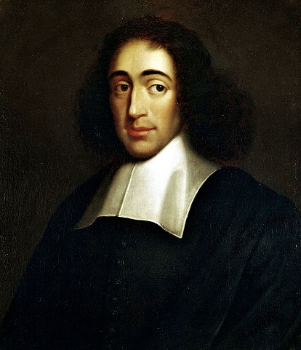
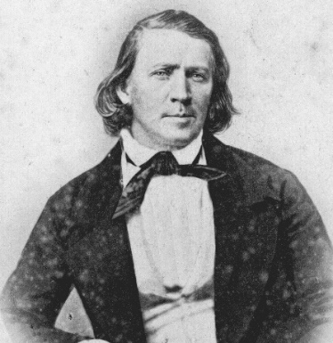
EGALITARIANISM: AN IMPRACTICAL ABSURDITY
Spinoza: “He who seeks equality between unequals seeks an absurdity.”
(Political Treatise 1677, Ch. 9, Of Aristocracy, Continuation)
Mortimer Adler: “All members of a society may be equal in kind as haves in a certain respect, but they may also be unequal in degree, one being a have-more, another a have-less. … There is no sense in saying that human beings ought to regard themselves as personally equal in all important respects when they know the fact to be quite the contrary.” (Six Great Ideas, p163, p159)
Mortimer Adler: “A second reason for rejecting the extremism of the egalitarian is its practical unfeasibility. … If all individuals or all families were somehow to come into possession of the same amount of wealth, the absolute equality would not last long. A magic wand would be needed, not only to bring it into existence, but also to make it endure. No one has ever worked out a plan whereby, short of magic, this extreme form of economic equality might become feasible.” (Six Great Ideas, p173)
Brigham Young: "Supposing that the property of the whole community were divided today equally amongst all, what might we expect? Why a year from today we should need another division, for some would waste and squander it away, while others would add to their portion.“ (JD 18:354)

Slide 8
Questions?

