Slide 1
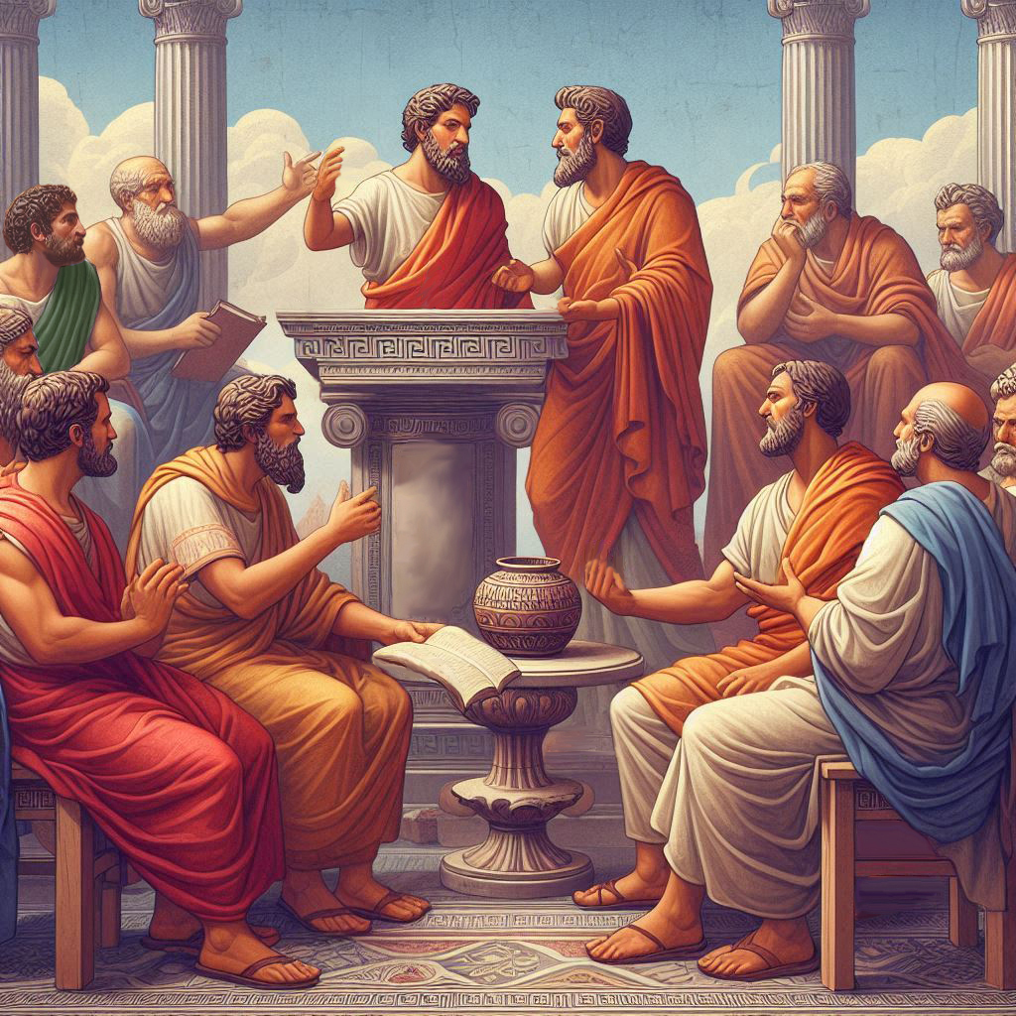
Eternalism Politics
Kingdom of God

Slide 2
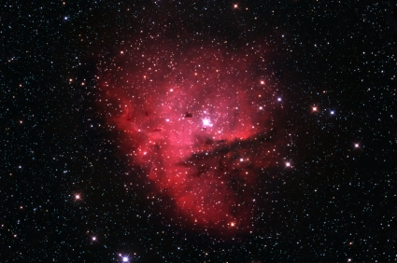
KINGDOM OF GOD
King
Law
Law
King
GOD OUTSIDE THE BOX
GOD INSIDE THE BOX
APOSTASY
RESTORATION
Might
Right
Right
Might
creatio ex nihilo
creatio ex materia
Absolutism of God
Primacy of Consciousness
Absolutism of Reality
Primacy of Existence
Dictator enforcing his authoritarian will
Just judge abiding natural law
Elder Boyd K. Packer: “He does not have to be spiteful or vengeful in order that punishment will come from the breaking of the moral code. The laws are established of themselves.” ("Why Stay Morally Clean", April 1972 General Conference)
Alma 43:13 “Therefore, according to justice, the plan of redemption could not be brought about, only on conditions of repentance of men in this probationary state, yea, this preparatory state; for except it were for these conditions, mercy could not take effect except it should destroy the work of justice. Now the work of justice could not be destroyed; if so, God would cease to be God.”

Slide 3
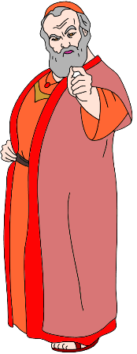


Devil’s Plan
Lord’s Plan
Establish
Justice
Promote
Benevolence
Two
Feet
Liberty
Rights
Social
Equality
socialism
One
Boot
Authoritarian Government

Slide 4


Devil’s Plan
Lord’s Plan
Establish
Justice
Promote
Benevolence
Establish
Justice
Promote
Benevolence
Two
Feet
Two
Feet
Liberty
Rights
Social
Equality
Liberty
Rights
Social
Equality
D&C 76:56 (Priests and Kings)
socialism
One
Boot
Two
Boots
Kingdom
of god
Authoritarian Government
Constitutional Republic
Zion

Slide 5
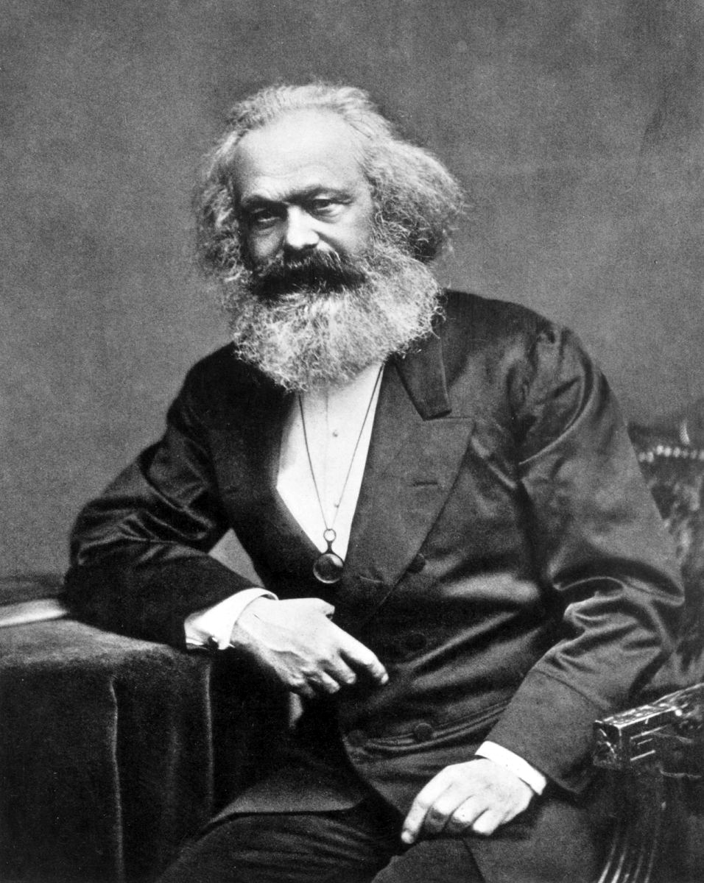
“Religion is the sigh of the oppressed creature, the heart of a heartless world, and the soul of soulless conditions. It is the opium of the people. The abolition of religion as the illusory happiness of the people is the demand for their real happiness.”
(Contribution to the Critique of Hegel's Philosophy of Right, 1843)

Slide 6
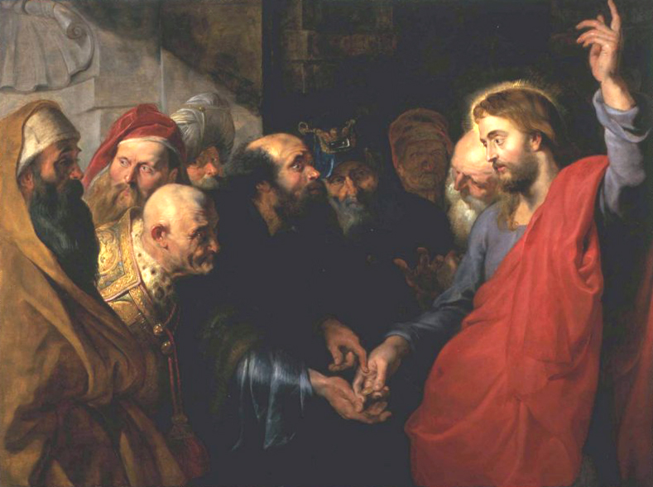
SEPARATION OF CHURCH AND STATE
D&C 134:9: “We do not believe it just to mingle religious influence with civil government, whereby one religious society is fostered and another proscribed in its spiritual privileges, and the individual rights of its members, as citizens, denied.”
Mark 12:17: “And Jesus answering said unto them, Render to Cæsar the things that are Cæsar’s, and to God the things that are God’s. And they marvelled at him.
Constitutional
Republic
Religious
Society
D&C 134:10 “We believe that all religious societies have a right to deal with their members for disorderly conduct, according to the rules and regulations of such societies; provided that such dealings be for fellowship and good standing; but we do not believe that any religious society has authority to try men on the right of property or life, to take from them this world’s goods, or to put them in jeopardy of either life or limb, or to inflict any physical punishment upon them. They can only excommunicate them from their society, and withdraw from them their fellowship.”
Constitutional Republic
Zion
D&C 76:56 “They are they who are priests and kings, who have received of his fulness, and of his glory;

Slide 7

JUSTICE AND BENEVOLENCE
Justice
Benevolence
Benevolence
Justice

Slide 8






JUSTICE AND BENEVOLENCE
Justice
Benevolence
Benevolence
Justice
D&C 76:17 And shall come forth; they who have done good, in the resurrection of the just; and they who have done evil, in the resurrection of the unjust.
D&C 88:22 For he who is not able to abide the law of a celestial kingdom cannot abide a celestial glory.
D&C 93:22 And all those who are begotten through me are partakers of the glory of the same, and are the church of the Firstborn.
Hebrews 12:23 To the general assembly and church of the firstborn, which are written in heaven, and to God the Judge of all, and to the spirits of just men made perfect
D&C 88:23 And he who cannot abide the law of a terrestrial kingdom cannot abide a terrestrial glory.
D&C 88:24 And he who cannot abide the law of a telestial kingdom cannot abide a telestial glory; therefore he is not meet for a kingdom of glory. Therefore he must abide a kingdom which is not a kingdom of glory.
FIRST RESURRECTION
SECOND RESURRECTION
Benevolence
Just
Unjust
Malevolence
CELESTIAL
TERRESTRIAL
TELESTIAL
DARKNESS
RIGHTEOUS DOMINION
Uphold Agency: Liberty, Justice, Mercy
UNRIGHTEOUS DOMINION
War on Agency: Tyranny, Injustice, Cruelty

Slide 9
Questions?

