Slide 1
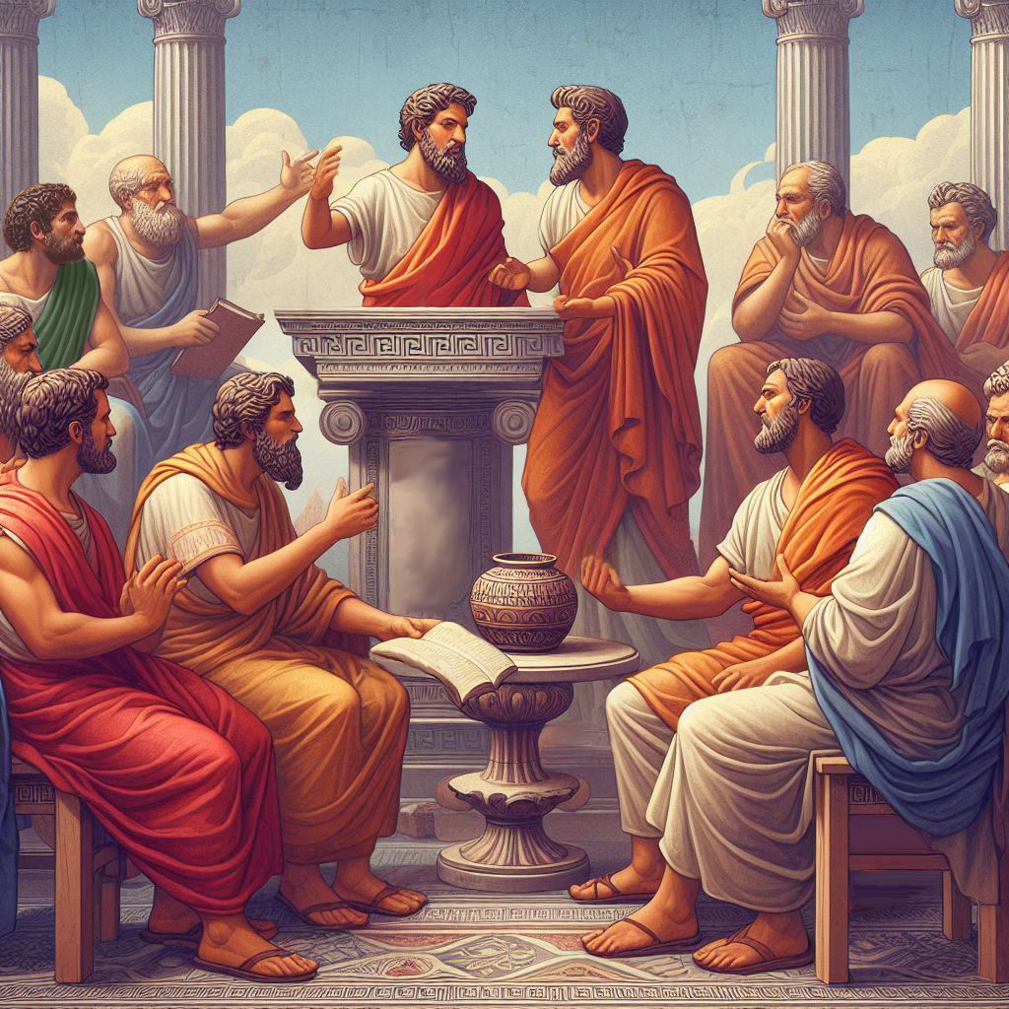
Eternalism Politics
Political Unity

Slide 2
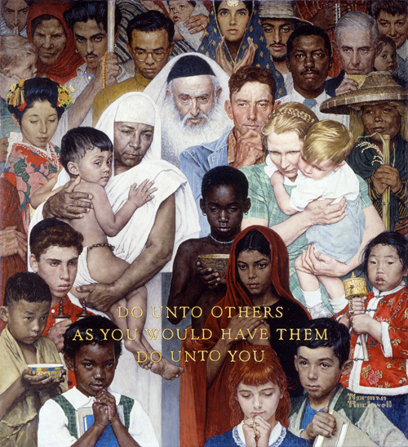
FALLACY OF INTRINSICISM (REVISITED)
OPPOSITION
KNOW
(Epistemology)
DO
(Ethics)
2 Nephi 2:11 For it must needs be, that there is an opposition in all things...
Helaman 14:31 He hath given unto you that ye might know good from evil, and he hath given unto you that ye might choose life or death; and ye can do good and be restored unto that which is good, or have that which is good restored unto you; or ye can do evil, and have that which is evil restored unto you.
Good
Life
Evil
Death
DIVERSITY
Metaphysics
Epistemology
Ethics
Politics
Aesthetics
YES
Biodiversity
Lion, Lamb, etc.
Chemistry,
Math, Physics
City of
Enoch
Free
Men
Statue of David,
Hymns
NO
Smallpox, Polio
Guinea-worm
Your Truth
My Truth
Sodom
Gomorrah
King
Men
Pornography, Depraved Music

Slide 3
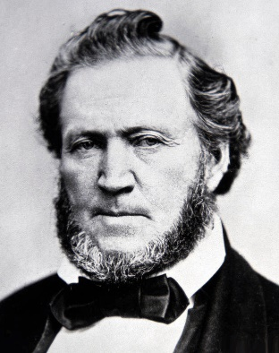
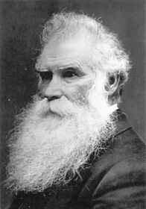
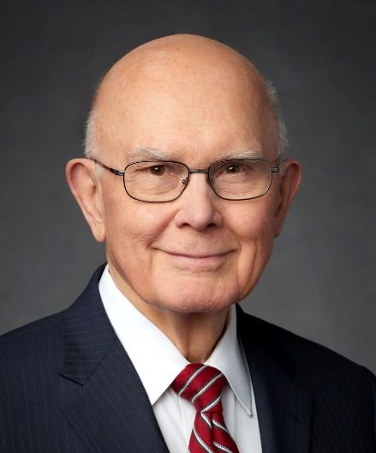
UNITY
President Brigham Young: “There is no such thing as confusion, division, strife, animosity, hatred, malice, or two sides to the question in the house of God; there is but one side to the question there. ... On a certain occasion there was a little confusion in heaven. … What was the result? One-third part of the hosts of heaven walked out. (JD 13:219)
“It has been told me from my youth up that opposition is the life of business, especially in the political arena. It is opposition that has ruined our nation, and has been, is and will be the ruin of all nations.” (JD 14:92-93)
Elder Orson Pratt: “This union exists in the eternal worlds. If you should dwell there for the period of ten millions of ages, you would see no dissension among those who dwell in yonder celestial worlds.” (JD 19:333)
Christ: “…I say unto you, be one; and if ye are not one ye are not mine.” (D&C 38:27)
“On contested issues, we should seek to moderate and unify.”
(Defending Our Divinely Inspired Constitution, April 2021 General Conference)

Slide 4
ARE LATTER-DAY SAINTS POLITICALLY UNITED?
Positive Law?
Article of Faith 12 “We believe in being subject to kings, presidents, rulers, and magistrates, in obeying, honoring, and sustaining the law.
Heber J. Grant “Latter-day Saints should support their government leaders and obey the laws of their lands…I am convinced beyond the shadow of a doubt that it is the duty of every Latter-day Saint to sustain and live the law.” (Teachings of Heber J. Grant, p158)
Social Good?
D&C 49:20 ”But it is not given that one man should possess that which is above another, wherefore the world lieth in sin.”
D&C 104:16 ”…this is the way that I, the Lord, have decreed to provide for my saints, that the poor shall be exalted, in that the rich are made low.”
D&C 134:1 ”We believe that governments were instituted of God for the benefit of man; and that he holds men accountable for their acts in relation to them, both in making laws and administering them, for the good and safety of society.”
President Brigham Young: “The earth is here, and the fullness thereof is here. It was made for man; and one man was not made to trample his fellow man under his feet, and enjoy all his heart desires, while the thousands suffer. We will take a moral view, a political view, and we see the inequality that exists in the human family. ... The Latter-day Saints will never accomplish their mission until this inequality shall cease on the earth.” (JD, Vol. 19, pp. 46-47)
Natural Rights?
D&C 42:42 ”…for he that is idle shall not eat the bread nor wear the garments of the laborer.”
D&C 134:2 “We believe that no government can exist in peace, except such laws are framed and held inviolate as will secure to each individual the free exercise of conscience, the right and control of property, and the protection of life.
D&C 134:5 ”We believe that all men are bound to sustain and uphold the respective governments in which they reside, while protected in their inherent and inalienable rights by the laws of such governments; and that sedition and rebellion are unbecoming every citizen thus protected…”

Slide 5
SUMMARY OF JUSTICE DEFINITIONS
Otto A. Bird: “The relative complexity of the three theories can be manifested by displaying in summary fashion how each theory would interpret justice with reference to its … three privileged terms, [legality, utility, right]…
(1) It obliges us to obey the law. LEGALITY
(2) It obliges us to do what promotes the social good. UTILITY
(3) It obliges us to render to each what belongs to him as a natural right.” RIGHT
(The Idea of Justice, pp. 167-168)
“The Positive Law theory is the simplest in that it asserts only the first proposition: Justice obliges us to obey the law, but not to promote the common good or render another his natural right as something that could be separate and distinct from obeying the law.” (The Idea of Justice, pp. 167-168)
“The Social Good theory asserts the first and second but denies the third, claiming as it does that there is no such thing as a natural right. Implicitly, it also claims that the first proposition depends upon the second, since the justice of a law is held to depend on its serving for the social good.” (The Idea of Justice, pp. 167-168)
“The Natural Right theory is the most complex of the three theories because it alone asserts all three propositions. The third, of course, is the controlling one, since it is implicit in both the first and second in the sense that it asserts them only on the understanding that neither [the first or the second] violates natural right.”
(The Idea of Justice, pp. 167-168)

Slide 6
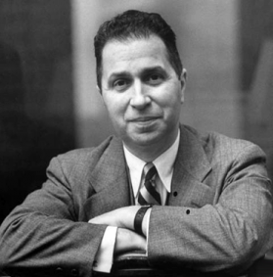
THREE TIER RESOLUTION
Mortimer Adler: “In my view of the matter, each of these three theories of justice is false when it claims to be the whole truth, excluding what is sound in the other two theories. … The reconciliation of the three conflicting theories of justice can be accomplished by avoiding the excessive claim each makes and by putting what is true in each of them together in a well-ordered manner.” (Six Great Ideas, p237, p238)
Natural Right
Tier 1
Tier 2
Tier 3
Social Good
Positive Law
Natural Rights Includes All Justice Types
It obliges us to render to each person their natural right, in order to promote the social good, through the means of just laws.
 | JUSTICE THEORY | KEY TERM | ADHERENTS
 | Natural Right | Rights
 | Social Good | Utility
 | Positive Law | Legality
Tier 1
Tier 2
Tier 3
Naturalists
Socialists
Positivists

Slide 7
Questions?

