Slide 1
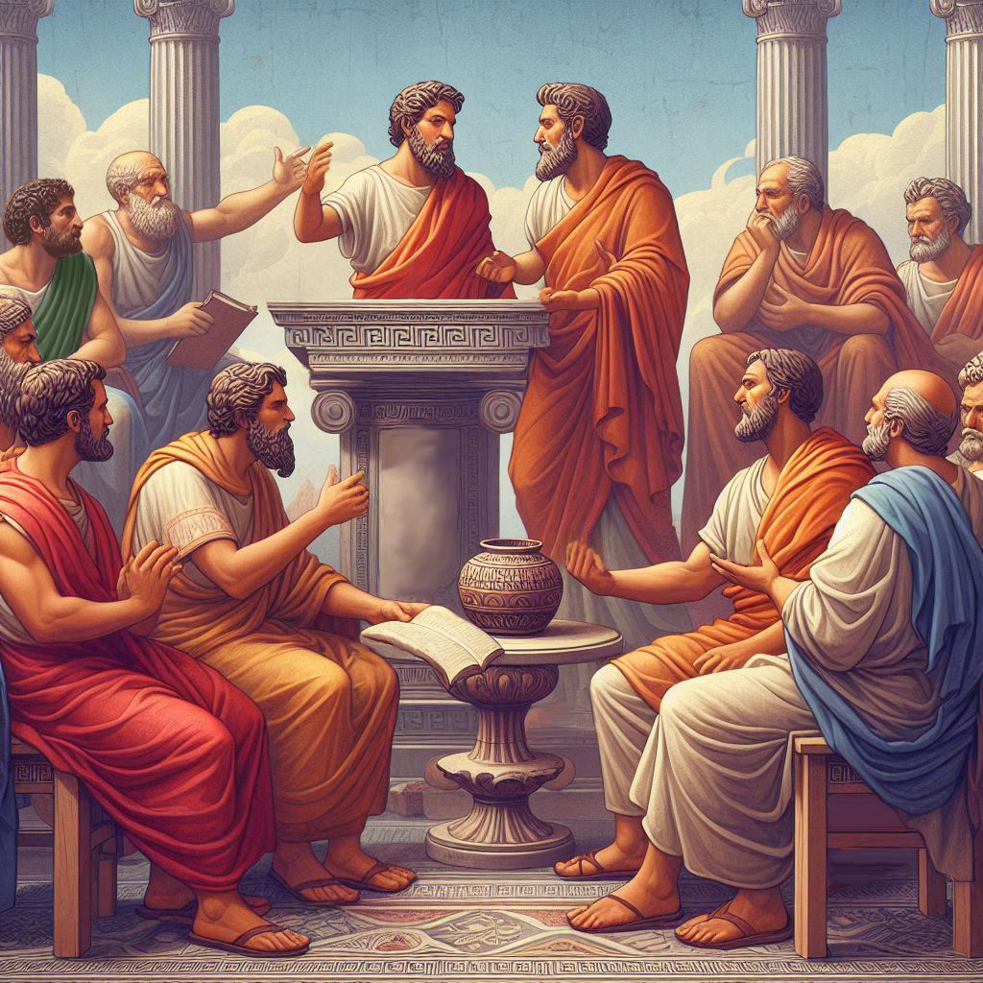
Eternalism Politics
Justice

Slide 2
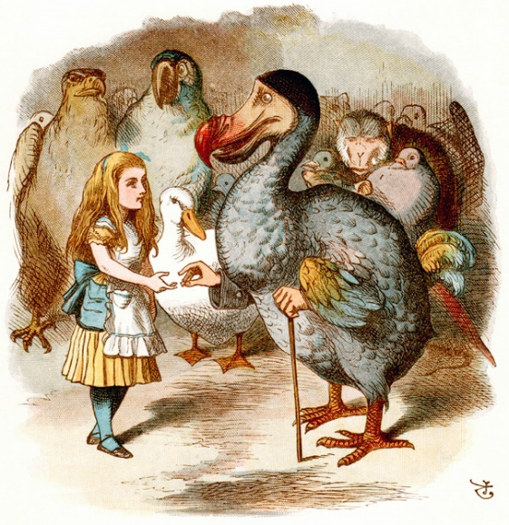
The Dodo Race
(Alice in Wonderland, CHAPTER III, A Caucus-Race and a Long Tale)
(1) A race with no structure, rules, or accountability.
First (Dodo) marked out a race-course, in a sort of circle (“the exact shape doesn’t matter,” it said) and then all the party were placed along the course, here and there. There was no “One, two, three, and away,” but they began running when they liked, and left off when they liked, so that it was not easy to know when the race was over.
(2) A race with an arbitrary finish.
However, when they had been running half an hour or so … the Dodo suddenly called out “The race is over!” and they all crowded round it, panting, and asking, “But who has won?”
(3) A race where the referee makes it up as it goes along.
This question the Dodo could not answer without a great deal of thought, and it sat for a long time with one finger pressed upon its forehead … while the rest waited in silence.
(4) A race where everyone wins (equality of outcome) regardless of effort.
At last the Dodo said, “Everybody has won, and all must have prizes.”
(5) A race that may sound great to some, unless they have to provide the prizes.
“But who is to give the prizes?” quite a chorus of voices asked. “Why, she, of course,” said the Dodo, pointing to Alice with one finger; and the whole party at once crowded round her, calling out in a confused way, “Prizes! Prizes!”

Slide 3
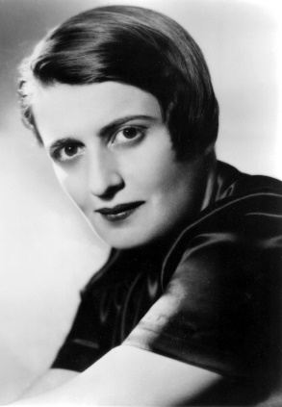
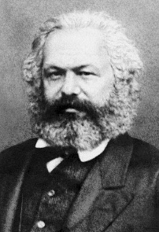
Utilitarianism, Socialism, Collectivism, Statism
Socialist Politics
Wikipedia: “Utilitarianism is an ethical and philosophical theory that states that the best action is the one that maximizes utility, which is usually defined as that which produces the greatest well-being of the greatest number of people. … Jeremy Bentham, the founder of utilitarianism, described utility as the sum of all pleasure that results from an action, minus the suffering of anyone involved in the action.”
Group
Individual
Might
Right
Collectivism
Social Justice
Ayn Rand: “Collectivism holds that the individual has no rights, that his life and work belong to the group … and that the group may sacrifice him at its own whim to its own interests. The only way to implement a doctrine of that kind is by means of brute force – and Statism has always been the political corollary of collectivism.” (The Virtue of Selfishness, p149)
“The absolute state is merely an institutionalized form of gang-rule, regardless of which particular gang seizes power.” (The Virtue of Selfishness, p149)
Karl Marx: “Society is undergoing a silent revolution, which must be submitted to, and which takes no more notice of the human existences it breaks down than an earthquake regards the houses it subverts. The classes and the races, too weak to master the new conditions of life, must give way.“
(Forced Emigration, New York Daily Tribune, 22 March 1853)

Slide 4
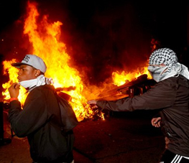
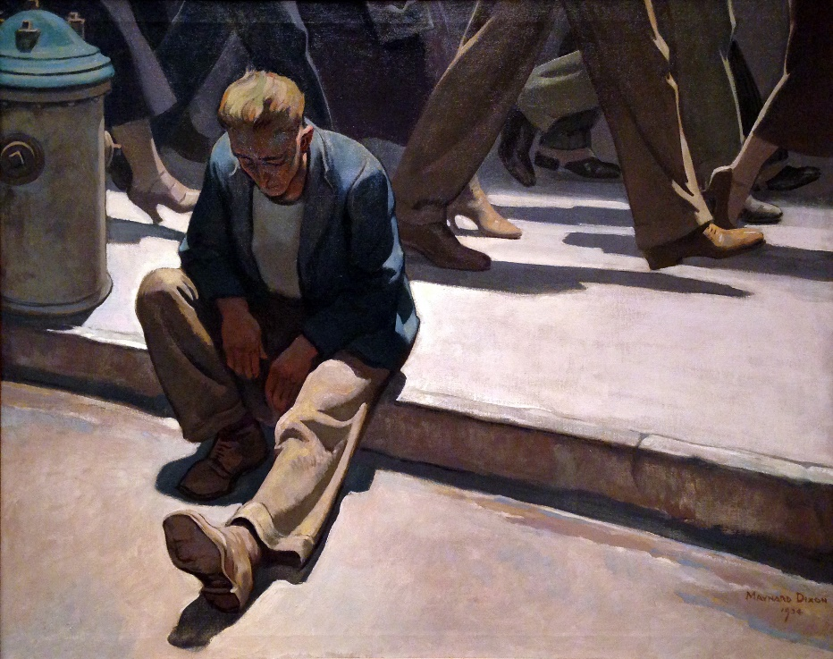
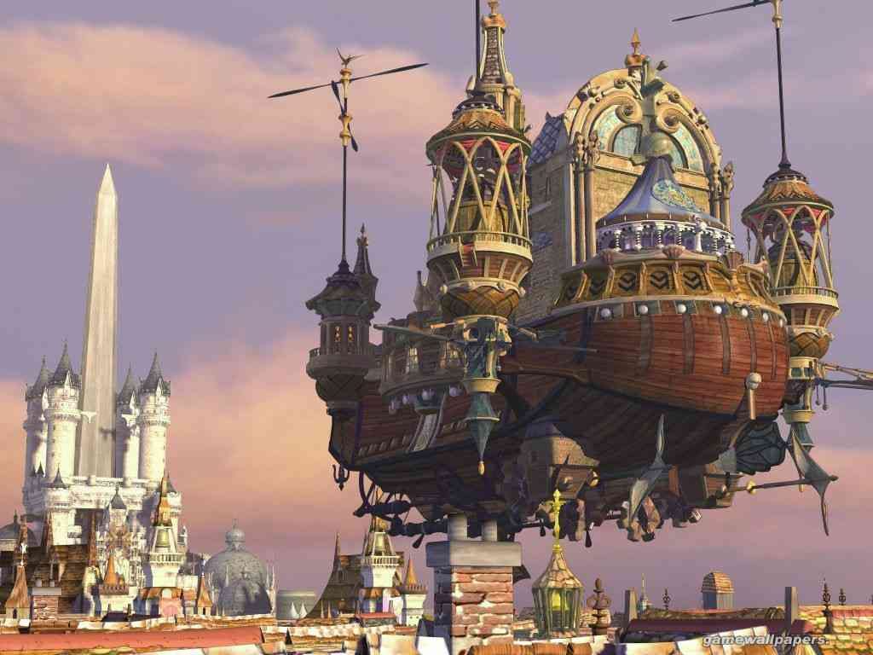
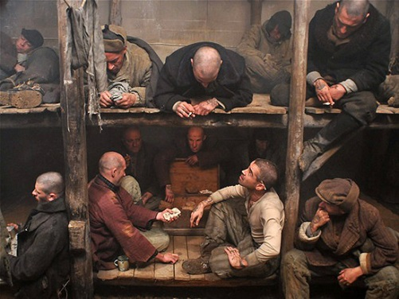
THE SOCIALIST REALITY
Revolt
The Socialist Mission
The Socialist Vision
Gap
Societal Problems
Utopia
Repression

Slide 5
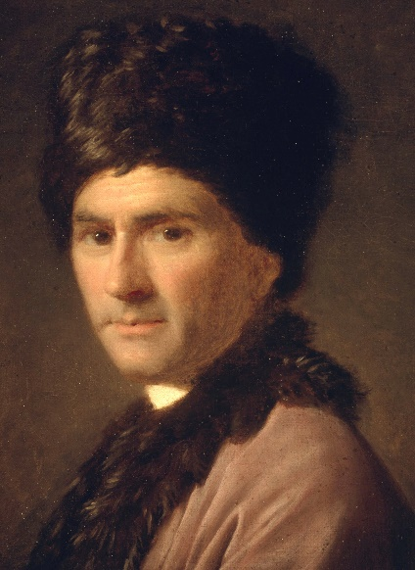
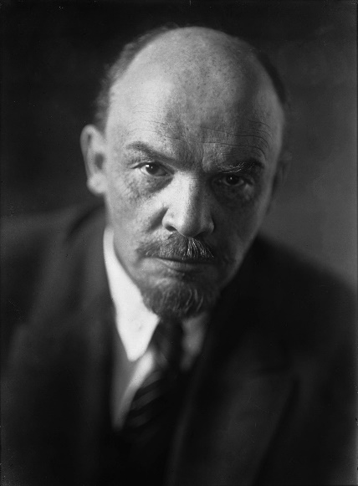
Collective Rights = Equality of Outcome
Jean-Jacques Rousseau: “The first man who, having enclosed a piece of land, thought of saying ‘This is mine’ and found people simple enough to believe him, was the true founder of civil society. How many crimes, wars, murders; how much misery and horror the human race would have been spared if someone had pulled up the stakes and filled in the ditch and cried out to his fellow men: ‘Beware of listening to this impostor. You are lost if you forget that the fruits of the earth belong to everyone and the earth itself belongs to no one!” (A Discourse on the Origin of Inequality, M. Cranston trans., p. 109)
Vladimir Lenin: “The whole of society will have become a single office and a single factory with equality of work and equality of pay.” (Essential Works of Lenin, 5.4, 1966)
Amitabh Behar: “The gap between rich and poor can't be resolved without deliberate inequality-busting policies, and too few governments are committed to these. (Wealth of India's richest 1% more than 4-times of total for 70% poorest: Oxfam)

Slide 6
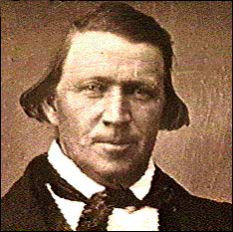
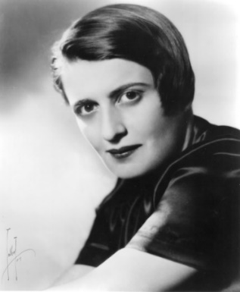
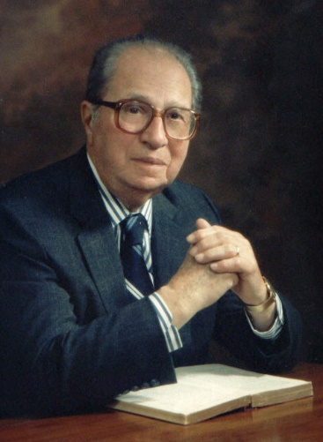
PRIMACY OF NATURAL RIGHTS
Brigham Young: "Supposing that the property of the whole community were divided today equally amongst all, what might we expect? Why a year from today we should need another division, for some would waste and squander it away, while others would add to their portion.“ (JD 18:354)
Ayn Rand: “Of special significance to the present discussion is the egalitarians defiance of the Law of Causality: their demand for equal results from unequal causes – or equal rewards for unequal performance. (Philosophy: Who Needs It? p146)
“Mortimer Adler: Only justice is an unlimited good…One can want too much liberty and too much equality – more than is good for us to have in relation to our fellowmen, and more than we have any right to. Not so with justice. No society can be too just; no individual can act more justly than is good for him or for his fellowmen.” (Six Great Ideas, p.137)
“…justice is the supreme value, a greater good than either liberty or equality, and one that must be appealed to for the rectification of errors with regard to liberty and equality.” (Six Great Ideas, p.136)

Slide 7
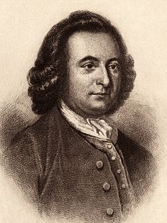
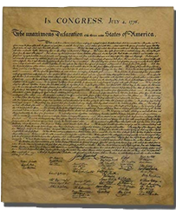
Natural Rights Definition of Justice
Mortimer Adler: “Our natural needs are the basis for distinguishing between the real goods to which we have a natural right and the apparent goods to which we do not have a natural right. That is the acquirement of which we may be privileged on condition that our seeking them does not interfere with anyone else’s acquirement of real goods.” (Six Great Ideas, p151)
George Mason: “That all men are born equally free and independent, and have certain inherent natural rights, of which they cannot, by any compact, deprive or divest their posterity; among which are, the enjoyment of life and liberty, with the means of acquiring and possessing property, and pursuing and obtaining happiness and safety.”
(Virginia Declaration of Rights, May 27, 1776)
“We hold these truths to be self-evident, that all men are created equal, that they are endowed by their Creator with certain unalienable Rights, that among these are Life, Liberty and the pursuit of Happiness.” (Declaration of Independence, second paragraph)

Slide 8
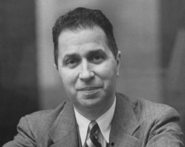
Natural Rights = Equality Under The Law
Naturalist Politics
Individual
Society
Rights
Government
Man
State
Right
Might
Individualism
Natural Rights
Democracy
Justified Force
Declaration of Independence: “When in the Course of human events it becomes necessary for one people to dissolve the political bands which have connected them with another and to assume among the powers of the earth, the separate and equal station to which the Laws of Nature and of Nature's God entitle them, a decent respect to the opinions of mankind requires that they should declare the causes which impel them to the separation.” (Declaration of Independence, opening paragraph)
Mortimer Adler: “Being by nature equal (in kind), they are all endowed by nature with certain unalienable rights, unalienable because they are inherent in man’s specific nature, not merely bestowed upon man by legal enactment. Legal enactment may be necessary to secure these rights, but it does not constitute their unalienability.” (Six Great Ideas, p168)

Slide 9
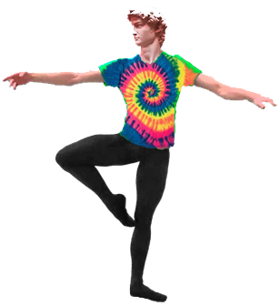
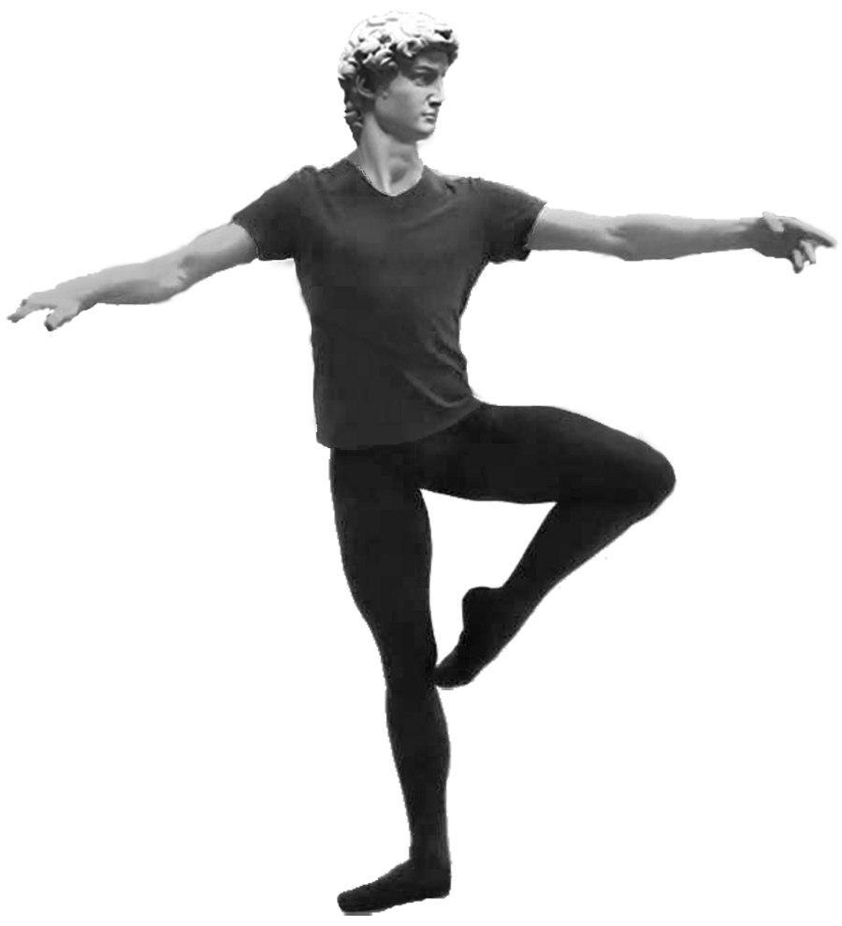
NATURAL RIGHTS DEFINITION OF JUSTICE
Everything from Ethics and Above Is COLORED…For Me, Against Me…Government Itself Is a Value
CONSTITUTIONAL REPUBLIC
POLITICS
POLITICS
PRESCRIPTIVE
TRUTHS
“OUGHT”
AESTHETICS
Individual Rights
Individual Rights
“To Secure These Rights Governments Are Instituted Among Men”
ETHICS
Our MORAL Right to Life, Liberty, Property and the Pursuit of Happiness
EPISTEMOLOGY
DESCRIPTIVE
TRUTHS
“IS”
METAPHYSICS
Our MORAL Rights
Becomes LEGAL Rights
When Protected
1
AXIOMS
AXIOMS
MY LIFE
YOUR LIFE

Slide 10
Questions?

