Slide 1
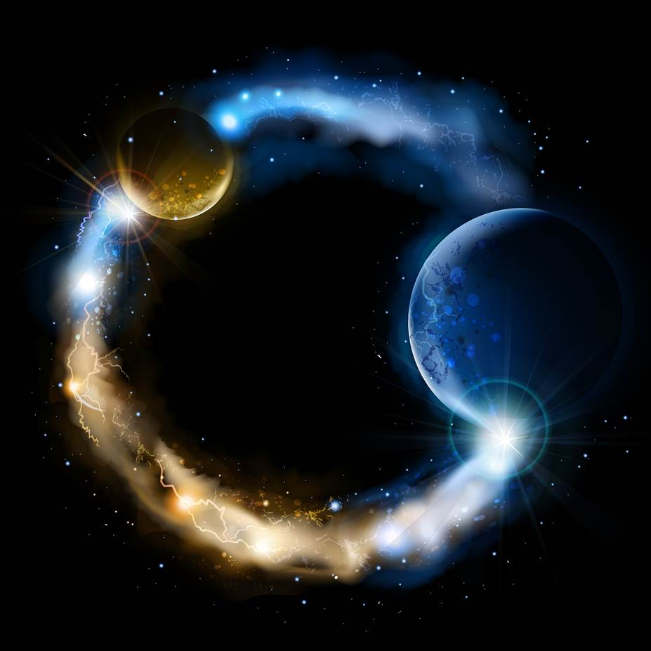
ETERNALISM MODULE 29
Ethics
Abide
and
Abound
Chapter 31: Eternal Progression

Slide 2
Is it true that our philosophy and our
theology center on Jesus Christ?
John 14:6 “I am the way, the truth, and the life: no man cometh unto the Father, but by me.”
METAPHYSICS
EPISTEMOLOGY
VALUE ETHICS
Reality
God
Reason
Faith
Observation
Revelation
Mind
Heart
Life
Love
Self
Others
Good
Right
Happiness
Duty
The Life: Creation
The Truth: Revelation
The Way: Salvation
Metaphysical Source
of All Organized Life
Epistemological Source of
All Revealed Truth
Ethical Source of All
Eternal Values
Acts 4:12 “Neither is there salvation in any other: for there is none other name under heaven given among men, whereby we must be saved.”

Slide 3
HIGHER WAYS
Carl Sagan: “What would beings who are thousands of years ahead of us be capable of? Or millions? As a philosopher in our part of the world once said: 'The artifacts of a sufficiently advanced extraterrestrial civilization would be indistinguishable from magic'.” (Contact, p191)
Isaiah 55:8-9 “For my thoughts are not your thoughts, neither are your ways my ways, saith the LORD. For as the heavens are higher than the earth, so are my ways higher than your ways, and my thoughts than your thoughts.”
Moses 1:39 For behold, this is my work and my glory—to bring to pass the immortality and eternal life of man.

Slide 4
LINE UPON LINE
2 Nephi 28:30 For behold, thus saith the Lord God: I will give unto the children of men line upon line, precept upon precept, here a little and there a little; and blessed are those who hearken unto my precepts, and lend an ear unto my counsel, for they shall learn wisdom; for unto him that receiveth I will give more; and from them that shall say, We have enough, from them shall be taken away even that which they have.
Elder Charles C. Rich: “When we have learned one truth [epistemology], we are prepared to learn another; for every truth seems to unfold some other truth. … and the longer we live in this way, the more we know of our Father and the principles that pertain to his kingdom [politics], and the less disposition we will have to do wrong [Ethics]: we will be more inclined to do right [ethics], and to carry out the principles of his government [politics].” (JD 5:298)
Elder Richard G. Scott: “When we seek inspiration to help make decisions, the Lord gives gentle promptings [metaphysics]. These require us to think [epistemology], to exercise faith, to work, to struggle at times, and to act [ethics]. Seldom does the whole answer to a decisively important matter or complex problem come all at once. More often, it comes a piece at a time, without the end in sight.” (General Conference, October 1989)

Slide 5
PITFALLS, BLINDSPOTS, WEAKNESSES, SHORTCOMINGS
D&C 82:5 Therefore, what I say unto one I say unto all: Watch, for the adversary spreadeth his dominions, and darkness reigneth;
D&C 93:39 “And that wicked one cometh and taketh away light and truth, through disobedience, from the children of men, and because of the tradition of their fathers.”
Elder George Q. Cannon: “Our only preservation is in living near to God, day by day, and serving him in faithfulness, and having the light of revelation and truth in our hearts continually, so that, when Satan approaches, we will see him and understand the snare that he has laid for us. Can we do this without the light of the Spirit? No … but when the light of the Spirit of God illuminates our minds and we are enlightened by it, we plainly see the results; and if we do not see them at the time, the Lord soon reveals them to us, and shows us that if we continue to take that course we will grieve his Spirit and fall victims to the adversary.” (JD:11:173-174)
Beliefs, Values, Desires
Snares
Pitfalls
Blind Spots
Weaknesses
Shortcomings
President John Taylor: A good man is willing to have his deeds brought to light. He don't care how big a light it is.” (JD 7:196)
Gospel Illumination

Slide 6
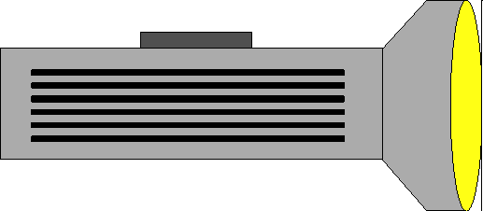
PROGRESIVE ILLUMINATION
President Brigham Young: “I will not say, as do many, that the more I learn the more I am satisfied that I know nothing; for the more I learn the more I discern an eternity of knowledge to improve upon.” (JD 7:162)
Elder D. Todd Christofferson: “With a deepening reverence for sacred things, your understanding grows. The scriptures speak of it as a light that grows “brighter and brighter until the perfect day”. That process is also described as progressing from grace to grace. The Savior Himself progressed in that way until He received a fullness, and you may follow in His footsteps.
(A Sense of the Sacred, Nov. 7, 2004)
Candle
All Mankind
Basic Knowledge, Understanding, Light, Intelligence
Numerous Blind Spots
1
Light of Christ
40 Watt
Baptized Latter-day Saints
Working Knowledge, Understanding, Light, Intelligence
Blind Spots
2
Holy Ghost
100 Watt
Temple Worthy Latter-day Saints
Higher Knowledge, Understanding, Light, Intelligence
Fewer Blind Spots
3
Endowment
Full Spectrum
Exaltation
Resurrected Celestial Being
Perfect Knowledge, Understanding, Light, Intelligence
No Blind Spots
4

Slide 7
LIGHT OF CHRIST
Snares
Pitfalls
Blind Spots
Weaknesses Shortcomings
1
Light of Christ
Candle
This first illustration depicts the “light of Christ” which constitutes the mental and spiritual illumination granted unto all mankind to guide their actions.
D&C 84:45-46
45. For the word of the Lord is truth, and whatsoever is truth is light, and whatsoever is light is Spirit, even the Spirit of Jesus Christ.
46. And the Spirit giveth light to every man that cometh into the world; and the Spirit enlighteneth every man through the world, that hearkeneth to the voice of the Spirit.
President John Taylor: “The world, as I have told you, unaided by the gift of the Holy Ghost, unaided by the Gospel and the light of revelation, are left to grope a good deal in the dark.” (JD:23:372)

Slide 8
THE HOLY GHOST
Snares
Pitfalls
Blind Spots
Weaknesses Shortcomings
2
Holy Ghost
40 Watt
This second illustration depicts “the gift of the Holy Ghost” which constitutes the greater mental and spiritual illumination granted unto all worthy Latter-day Saints.
Moroni 10:5 “And by the power of the Holy Ghost ye may know the truth of all things.”
Elder Charles W. Penrose: “If the inhabitants of the earth will walk according to the light that God has given to them, whether by the spirit that came to them naturally in their birth, or by that higher endowment called the gift of the Holy Ghost, they will receive a still greater degree of power and light, and their pathway will become brighter and brighter even to the perfect day. If there be any darkness in them, it is because they walk in the ways of darkness, because they do the deeds of evil. No man can come unto God unless he has put away his sins and his follies and is willing to be taught of God. If he thinks that God will come to his terms and accept his whims and notions, he will make a failure of it.” (JD:23:352-353)

Slide 9
TEMPLE ORDINANCES
Snares
Pitfalls
Blind Spots
Weaknesses Shortcomings
3
Endowment
100 Watt
The third illustration depicts the additional mental and spiritual illumination promised the Saints through sacred Temple ordinances.
Joseph Smith: “God requires of His Saints to build Him a House wherein His servants may be instructed, and endowed with power from on high.” (History of the Church IV, p.449; D&C 38:32, D&C 95:8-9)
Elder Daniel H. Wells: “...the way has been opened through the ordinances of the House of God, for the full flow of His Spirit...” (JD:12:235)

Slide 10
ETERNAL LIFE, THE PERFECT DAY
Full
Spectrum
Resurrection
No
Blind
Spots
4
The fourth illustration depicts the perfect spiritual illumination enjoyed by the faithful Saints at that “great and last day”.
D&C 50:24 “That which is of God is light; and he that receiveth light, and continueth in God, receiveth more light; and that light groweth brighter and brighter until the perfect day.”
D&C 93:28 He that keepeth his commandments receiveth truth and light, until he is glorified in truth and knoweth all things.
D&C 76:94 They who dwell in his presence are the church of the Firstborn; and they see as they are seen, and know as they are known, having received of his fulness and of his grace;
President John Taylor: “We have not all of us learned to submit our will to the law and word of God, yet God is introducing Temples and ordinances and blessings, and light, revelations and intelligence, to lift us up, to exalt us, that we may be a city set upon a hill that cannot be hid; that we may progress from intelligence to intelligence, from knowledge to knowledge, until we shall see as we are seen and know as we are known.” (JD:25:184)

Slide 11
BECOME DEFENDERS OF THE FAITH
D&C 88:81-82 “…and it becometh every man who hath been warned to warn his neighbor. Therefore, they are left without excuse, and their sins are upon their own heads.”
D&C 82:3 “For of him unto whom much is given much is required; and he who sins against the greater light shall receive the greater condemnation.”
Elder Parley P. Pratt “The sooner the present generation lose all reverence and respect for modern "Christianity" with all its powerless forms and solemn mockeries, the sooner they will be prepared to receive the kingdom of God.” (Key to the Science of Theology, p.111)
BECOME PHILOSOPHERS
AND
PROFOUND THEOLOGIANS
Eternalists
Faithful Saints
Philosophy
Theology
“Abide and Abound” Philosophy of
“A Crown of Righteousness” Theology of
Eternalism
Eternal Glory

Slide 12
Questions?

