Slide 1
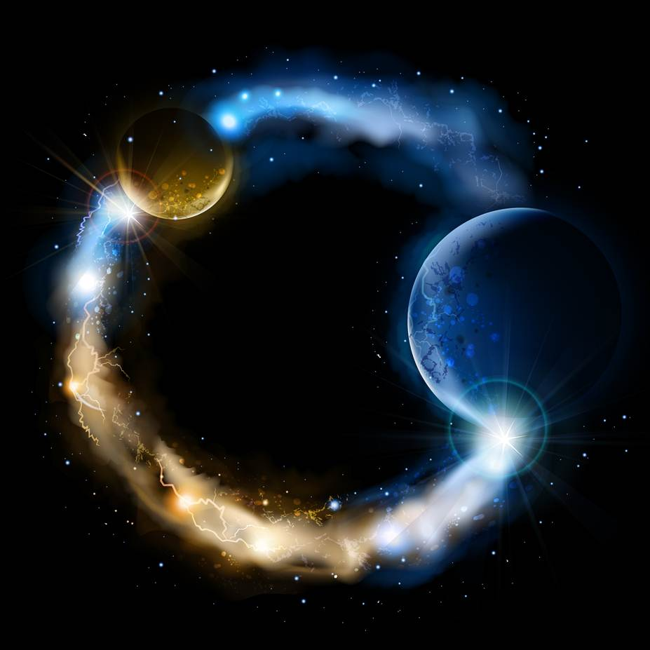
ETERNALISM MODULE 28
Ethics
Abide
and
Abound
Chapter 30: Deadly Virtues Proofs

Slide 2
SUMMARY: FALSE CHRIST-LIKE LOVE
Mother Teresa:
(1) Selfless (2) Self-Sacrificial (3) Unconditional
“Our Love for one another will be: selfless, generous, tender, personal, and respectful ... beyond likes and dislikes, friendship and enmity, worthiness and unworthiness, [unconditional] … always inspiring, encouraging, trusting, wholehearted, and [self-] sacrificial unto the death of the cross.” (Total Surrender, p.86)
“Love, in order to survive, must be nourished by sacrifices, especially the sacrifice of self. / Charity to be fruitful, must cost us. / This love should flow from self-sacrifice, and it must be felt to the point of hurting. / He wants us to love one another, to give ourselves to each other until it hurts. / Give until it hurts, until you feel the pain.“
(No Greater Love / In My Own Words / Total Surrender)

Slide 3
CORRUPT DIVINE LOVE IN 3 STEPS
“I LOVE YOU”
Eliminate the “I” in “I Love You”
… How?
1
Selflessness
“I Love You” … becomes … “(X) Loves You”
Eliminate the “You” in “I Love You”
… How?
2
Unconditional Love
“I Love You” … becomes … “I Love (Y)”
Eliminate the “beneficial, value laden” nature of love itself and turn it into a “sacrificial, duty laden” relationship.
… How?
3
Self-Sacrifice
“I Love You” becomes “I Sacrifice Myself for You”
All Three Taken Together
(1) Selflessness (2) Unconditional Love (3) Self-Sacrifice
“I Love You”… becomes …
“(X) (Dutifully Sacrifices Itself for) (Y)” (to the utmost)

Slide 4
Existential Proof: Tulips
Sunshine
Water
Constant Care
Minerals

Slide 5
Selflessness
Three Deadly Virtues

Slide 6

Selflessness
Self-Sacrifice
Three Deadly Virtues

Slide 7
Selflessness
Self-Sacrifice
Unconditional Love
Three Deadly Virtues

Slide 8
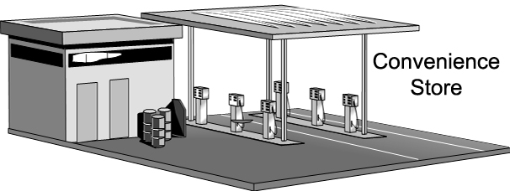

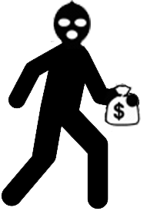

Existential Proof: Convenience Store
Free Gas
Free Food
Free Service
Open 24/7
No Matter What
Selflessness …
Short-term and long-term financial well-being of the store is of no concern
Self-Sacrifice …
Suffer irreparable loses while willingly emptying shelves and gas tank
Unconditional Love …
Provide selfless and self-sacrificial services to everyone including thieves and competitors

Slide 9
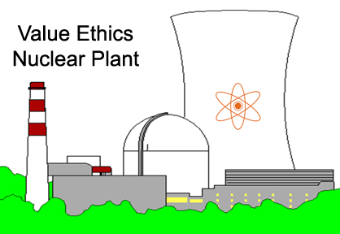
Existential Proof: Nuclear Power Plant
Annual salary: 20% above average salary in the surrounding area.
Annual Bonus: 15% of annual salary
Strong Work Ethic / High Morale / Low Turn Over
Uncompromising Safety Standards / Well defined Performance Criteria
Rigorous Background Checks / Highly Qualified Applicants Only
Cost of Production = 10¢ A Kilowatt
Consumer Price = 17¢ A Kilowatt
Net Profit = 7¢ A Kilowatt
1ST Quarter: Implement Selflessness Policy
2nd Quarter: Implement Self-Sacrifice Policy
a) Eliminate all Profits / Sell Energy at Cost = 10¢ a Kilowatt
b) Freeze all Wages / Hiring / Incentives / Expansion
a) Suffer Loss, Sell Energy Below Cost = 6¢ a Kilowatt
b) Lay Offs, Wage Cuts 40%, Drop All Benefits and Incentives
3rd Quarter: Implement Unconditional Love Policy
a) Drop All Performance Criteria, Standards, Qualifications
b) Affirmative Action, Hire 1 Terrorist per 100 employees

Slide 10
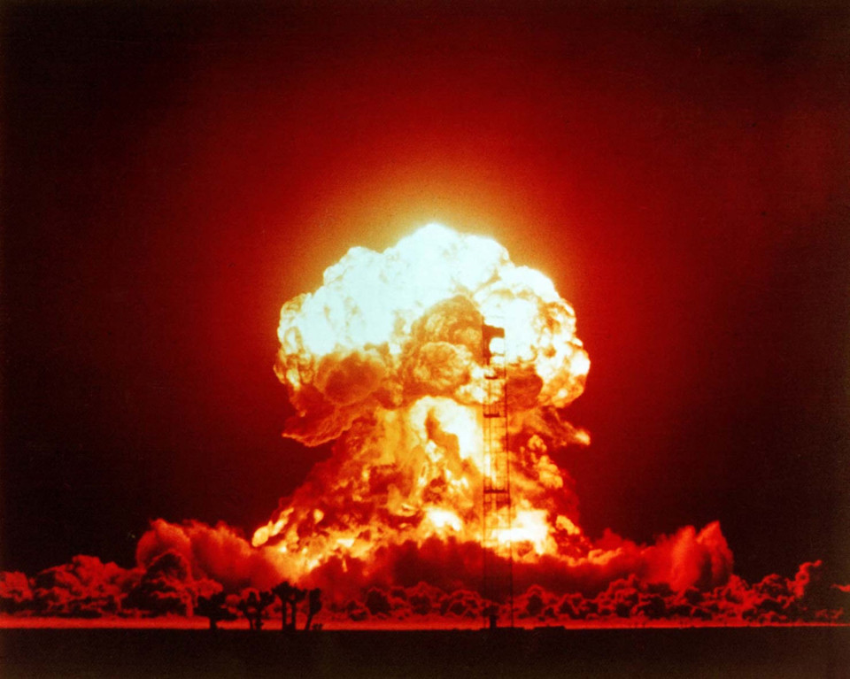
4th Quarter Projection

Slide 11
Existential Proof: Parenthood
What would it mean to your daughter to apply
These Three Deadly Virtues On A Date?
Imagine the look and horror on the parents face when their teenage daughter joyfully announces to them that she is going to live up to their Heavenly Ideal of Christian Love and go on a
(1) selfless, (2) self-sacrificial and (3) unconditional love date
That her one all consuming desire is to be a true victim of his love—to satiate his infinite thirst for love and sacrifice and to give of herself to the Hungry One as his tool or instrument to do with as he pleases, blindly, lovingly, trustingly and without counting the cost.
Would any sane parent let their daughter out of the house?
Mother Teresa: “Jesus, my own Jesus—I am only Thine—I am so stupid—I do not know what to say—but do with me whatever You wish—as You wish—as long as you wish. I love you not for what you give, but for what You take Jesus—why can’t I be a perfect Loreto Nun—a real victim of Your love.” (Come Be My Light, p. 97-98)

Slide 12
VALUE ETHICS
FALSE IDEOLOGY
Righteousness and Happiness are Not Compatible
Renounce Wickedness To Gain Happiness
LIFE
SELF
GOOD
HAPPINESS
LOVE
OTHERS
RIGHT
DUTY
WICKEDNESS NEVER WAS HAPPINESS
HAPPINESS NEVER WAS RIGHTEOUSNESS
Bait and Switch
LOVE
OTHERS
RIGHT
DUTY
LIFE
SELF
GOOD
HAPPINESS
Wickedness and Happiness
are Not Compatible
Renounce Happiness for Righteousness
TRUE IDEOLOGY
DUTY ETHICS

Slide 13
VALUE ETHICS
TRUE IDEOLOGY
Renounce Wickedness To Gain Happiness
Righteousness is the Eternal Means to Happiness
LIFE
SELF
GOOD
HAPPINESS
LOVE
OTHERS
RIGHT
DUTY
WICKEDNESS NEVER WAS HAPPINESS
HAPPINESS IS THE ULTIMATE END THEREOF
No Bait and Switch
LIFE
SELF
GOOD
HAPPINESS
LOVE
OTHERS
RIGHT
DUTY
Wickedness and Happiness
are Not Compatible
Renounce Wickedness To Gain Happiness
TRUE IDEOLOGY
VALUE ETHICS

Slide 14
Philosophical and Theological Proofs:
Joseph Smith: “Happiness is the object and design of our existence; and will be the end thereof, if we pursue the path that leads to it; and this path is virtue, uprightness, faithfulness, holiness, and keeping all the commandments of God.” (Teachings of the Prophet Joseph Smith, p.255–256)
Joseph Smith: “And as God has designed our happiness—and the happiness of all His creatures, he never has—He never will institute an ordinance or give a commandment to His people that is not calculated in its nature to promote that happiness which He has designed, and which will not end in the greatest amount of good and glory to those who become the recipients of his law and ordinances.” (Teachings of the Prophet Joseph Smith, p.255–256)
President John Taylor: “It is ‘Life and the pursuit of happiness’ that ought to occupy the attention of all intellectual beings … and with those things that we consider will best promote not only our temporal, but our eternal happiness.” (JD 11:87)
Elder Boyd K. Packer: “There are spiritual and physical laws to obey if we are to be happy.”
("The Plan of Happiness", Ensign April 2015)
The Great Plan of Happiness Not
The Great Plan of Duty, Love, etc.

Slide 15
Questions?

