Slide 1
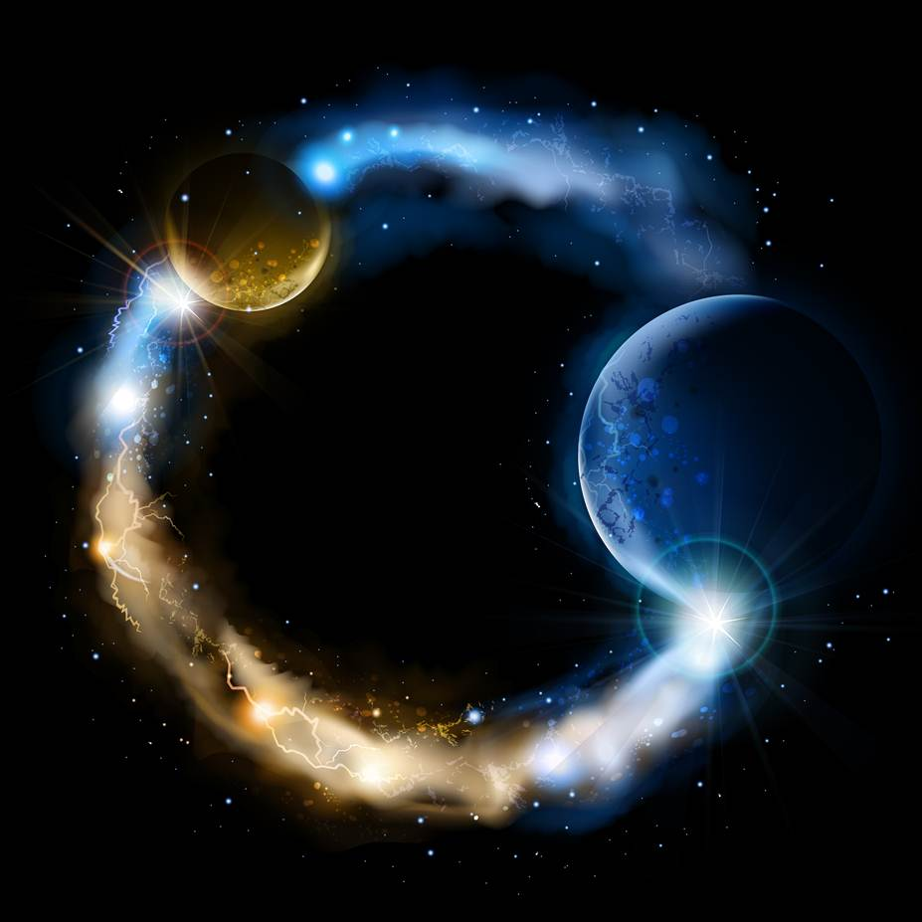
ETERNALISM MODULE 26
Ethics
Abide
and
Abound
Chapter 28: Selflessness

Slide 2
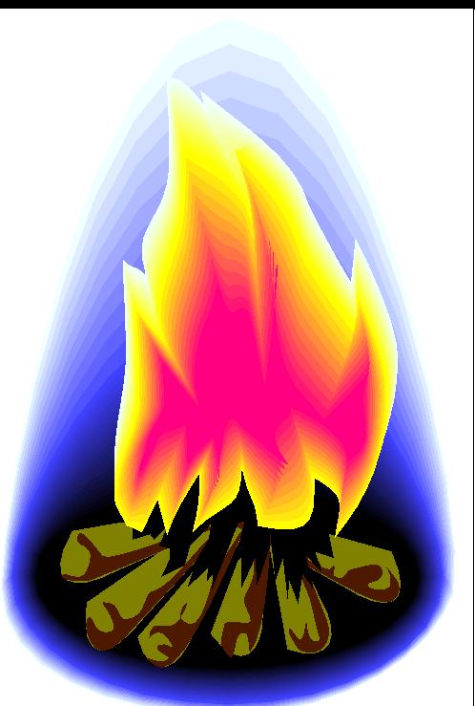
SELF-FULL
THREE BOYS GO CAMPING
Selfishness
Unselfishness
Selflessness
Eats the Entire Box
Shares cookies with friends
Refuses to Eat Any
The undue regard for the SELF at the expense or exclusion of OTHERS.
The due regard for SELF and OTHERS at the expense or exclusion of neither SELF nor OTHERS.
The undue regard for
OTHERS at the expense
or exclusion of SELF.
Victor: Self
Victim: Others
No Victor
No Victim
Victor: Others
Victim: Self
Self-full (adjective): To describe a person that is concerned about bettering one's self without disregarding others. (urbandictionary.com)

Slide 3

UNDERSHOOTING
THE MARK
THE GOSPEL TARGET
OVERSHOOTING
THE MARK
A Religious Vow of:
Selfishness
Unselfishness
Selflessness
CARNALITY
WORLDLINESS
FALSE
DOCTRINE
CHRIST-LIKE PERFECTION
Life, Joy, Happiness
DEADLY VICES
Death, Sorrow, Misery
DEADLY VIRTUES
Death, Sorrow, Misery
All Taking No Giving
Self-full
Christ-Like
Give and Take
All Giving No Taking
Destroy the Wicked Who
Are Not religiously Inclined
Destroy the Righteous Who
Are Religiously Inclined

Slide 4


VALUE ETHICS: SELF-FULL GIVE and TAKE
PLANT
LIFE
HUMAN
LIFE
Giving: Nectar, Fragrance, etc.
Giving: Love, Friendship, etc.
Ground Cover
Common Courtesies
All plant giving is
rooted in taking
All human giving is
Rooted in taking
Taking: Roots
Taking: Life Needs
Which has primacy the flower or the root?

Slide 5
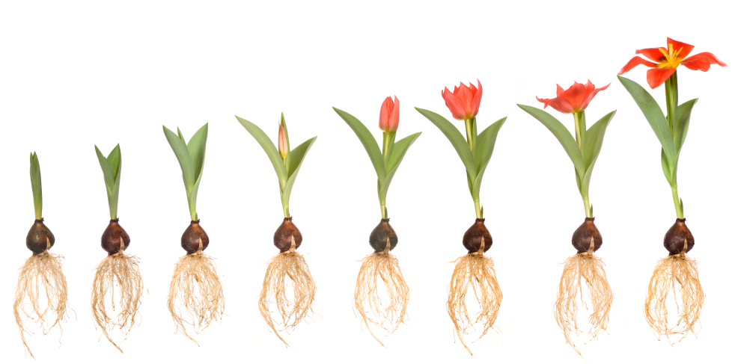
CHRIST-LIKE LOVE
Self-full Give and Take, Grow in Grace
SELF
OTHERS
D&C 84:38 And he that receiveth my Father receiveth my Father’s kingdom; therefore all that my Father hath shall be given unto him.

Slide 6
GIVE, SAID THE LITTLE STREAM
Elder Neal A. Maxwell: “In my Primary days, we sang ‘Give, Said the Little Stream’ (Children’s Songbook 236) certainly sweet and motivating but not exactly theologically drenched. Today’s children, as you know, sing the more spiritually focused ‘I’m Trying to Be like Jesus,’ (Children’s Songbook 78–79). ("Remember How Merciful the Lord Hath Been", Ensign, May 2004)
SELF
OTHERS
OTHERS
SELF
VALUE ETHICS
DUTY ETHICS

Slide 7

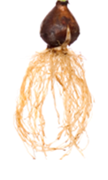

OVERSHOOTING SELFLESSNESS: LOVE AS PURE GIVING
“Give, said the little stream, Give, Oh! give, give oh! give … Singing, singing all the day, Give a - way, Oh! give a - way …
Beautiful but Short-Lived
Eternalism’s Alternate Ending: “Give, said the dry stream bed, Give, Oh! give, ‘Till you’re dead!”
UNDERSHOOTING SELFISHNESS: LOVE AS PURE TAKING
“Take, said the little stream, Take, Oh! take, take oh! take … Singing, singing all the day, Take a - way, Oh! take a - way …
Ugly and Obnoxious
THE TARGET UNSELFISHNESS: LOVE AS GIVE AND TAKE
“Give and take, said the little stream, Give and take, Oh! oh! give and take … Singing, singing all the day, Give and take all – day”
Beautiful and Long-Lived

Slide 8
DUTY ETHICS: Self Must Be Entirely Done Away
Duty Ethics
C. S. Lewis: “The moment you have a self at all, there is a possibility of putting yourself first—wanting to be God, in the centre—wanting to be God, in fact … And out of that hopeless attempt has come … the long terrible story of man trying to find something other than God which will make him happy.” (Mere Christianity, p. 49)
OTHERS
SELF
First Presidency Statement: “Man is a child of God, formed in the divine image and endowed with divine attributes, and even as the infant son of an earthly father and mother is capable in due time of becoming a man, so the undeveloped offspring of celestial parentage is capable, by experience through ages and aeons, of evolving into a God.” (Improvement Era, Nov. 1909, 75–81)
VALUE ETHICS: Primacy of Self
Value Ethics
Joseph Smith: “Every man lives for himself.” (TPJS, pg. 12)
SELF
OTHERS
President Brigham Young: “Every good that man performs is, firstly, for his own benefit and eternal welfare, if he continues in well doing, and secondly, for the common good of others. … First and foremost is to secure our own salvation and do right pertaining to ourselves, and then extend the hand of right to save others. (JD 9:313, 4:114)
President Brigham Young: “When I labor in the kingdom of God, I labor for my own dear self, I have self continually before me; the object of my pursuit is to benefit my individual person; and this is the case with every person who ever was or ever will be exalted.” (JD 14:101)
Elder Jeffrey R. Holland: The personal value, the sacred splendor of every ONE of YOU, is the very reason there is a plan for salvation and exaltation. CONTRARY to the parlance of the day, this IS about YOU. NO, don’t turn and look at your neighbor. I AM TALKING TO YOU!” (General Conference, Oct. 2010)

Slide 9
DUTY ETHICS: Good for Nothing
Duty Ethics
Anders Nygren: “Love towards God does not seek to gain anything. It most certainly does not seek to gain anything other than God. But neither does it seek to gain even God Himself or His love. The very thought of gaining anything, even of gaining God’s love, is fundamentally alien to it. It is a free—and in that sense spontaneous—surrender of the heart to God.” (Agape and Eros, p. 94)
OTHERS
SELF
VALUE ETHICS: Good for “The Whole Pile”
Value Ethics
D&C 84:38: “And he that receiveth my Father receiveth my Father’s kingdom; therefore all that my Father hath shall be given unto him.”
SELF
OTHERS
President Brigham Young: “For whose benefit are we laboring? For our own. All my preaching, laboring, and toils in this kingdom have been for myself, to get into the Celestial Kingdom of God. I have been laboring for that and nothing else.” (JD 13:315)
President Brigham Young: “I used to tell the people, and I tell them the same now, I do not go in for a few millions, I go in for the pile, and I calculate to have it. ‘How are you going to get it?’ By serving God with all my heart and being a Saint indeed, and when the earth and its fullness are given into the hands of the Saints, I shall go in for my share—the whole pile. I used to say, ‘Why, brother Joseph is the greatest speculator I have heard of in modern times—he is going to have the whole earth.’” (JD 16:29)

Slide 10
SELFLESS SCRIPTURES?
Others
Self
Self
Others
1 Cor. 13:4-5 Charity ... Seeketh not her own [absolutely … in any way whatsoever].
1 Cor. 13:4-5 Charity ... Seeketh not her own [if it be at the unjust expense of others].
1 Cor. 10:24 Let no man seek his own [ever], but every man another’s wealth [always].
1 Cor. 10:24 Let no man seek his own [at the unjust expense of others], but every man another’s wealth [as part of his own Self-full life].
Philippians 2:3-4 ... but in lowliness of mind let each esteem other better than themselves [unconditionally]. Look not every man on his own things [ever], but every man also on the things of others.
Philippians 2:3-4 … but in lowliness of mind let each esteem other better than themselves [self-fully]. Look not every man on [exclusively] his own things, but every man also on the things of others.

Slide 11
SELFULL SCRIPTURES: Charity Seeketh Not Her Own, or Does it?
Paul an Altruist?
Hebrews 11:6 … for he that cometh to God must believe that he is, and that he is a rewarder of them that diligently seek him.
2 Timothy 4:7-8: I have fought a good fight, I have finished my course, I have kept the faith: Henceforth there is laid up for me a crown of righteousness, which the Lord, the righteous judge, shall give me at that day: and not to me only, but unto all them also that love his appearing.
John an Altruist?
2 John 1:8 Look to yourselves, that we lose not those things which we have wrought, but that we receive a full reward.
Alma an Altruist?
Alma 41:14: Therefore, my son, see that you are merciful unto your brethren; deal justly, judge righteously, and do good continually; and if ye do all these things then shall ye receive your reward.
King Benjamin an Altruist?
Mosiah 4:27 …And again, it is expedient that ye should be diligent, that thereby ye might win the prize; therefore, all things must be done in order.
Mosiah 1:7 And now, my sons, I would that ye should remember to search them diligently, that ye may profit thereby; and I would that ye should keep the commandments of God, that ye may prosper in the land according to the promises which the Lord made unto our fathers.

Slide 12
SELFULL SCRIPTURES: Charity Seeketh Not Her Own, or Does it?
Abraham an Altruist?
Abraham 1:1-2 I, Abraham ... finding there was greater happiness and peace and rest for me, I sought for the blessings of the fathers.
Joseph Smith and Hyrum Smith Altruists?
D&C 135:6 They lived for Glory; They died for Glory; And Glory is their eternal reward.
Christ an Altruist?
Mathew 19:27-29: Then answered Peter and said unto him, Behold, we have forsaken all, and followed thee; what shall we have therefore? And Jesus said unto them, Verily I say unto you ... every one that hath forsaken houses, or brethren, or sisters, or father, or mothers, or wife, or children, or lands, for my name's sake, shall receive an hundredfold, and shall inherit everlasting life.
D&C 58:28 And inasmuch as men do good they shall in nowise lose their reward.
D&C 59:23 But learn that he who doeth the works of righteousness shall receive his reward, even peace in this world and eternal life in the world to come.

Slide 13
VALUE ETHICS
A Crown of Glory
DUTY ETHICS
A Crown of Thorns
President Brigham Young: "It is for my own benefit, it is for your benefit; it is for my own wealth and happiness, and for your wealth and happiness that we pay Tithing and render obedience to any requirement of Heaven … I would not give the ashes of a rye straw for the man who feels that he is making sacrifices for God. We are doing this for our own happiness, welfare and exaltation, and for nobody else’s.“ (JD Vol. 16, p. 114)
Matthew 25:40 “And the King shall answer and say unto them, Verily I say unto you, Inasmuch as ye have done it unto one of the least of these my brethren, ye have done it unto me.”
Matthew 7:12 “Therefore all things whatsoever ye would that men should do to you, do ye even so to them…”

Slide 14
Questions?

