Slide 1
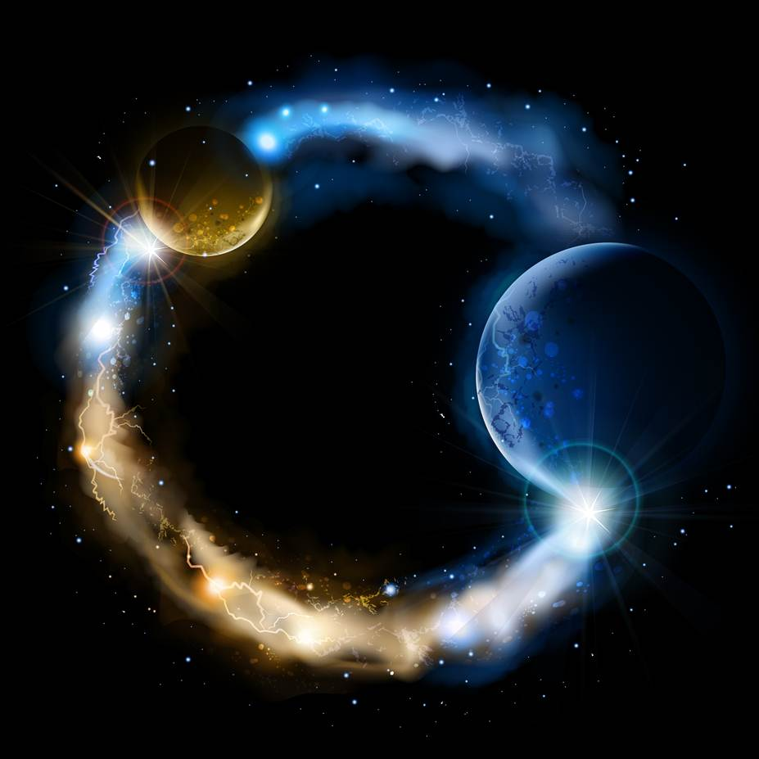
ETERNALISM MODULE 24
Ethics
Abide
and
Abound
Chapter 26: Deadly Virtues
Case 5: Conditional Examples

Slide 2
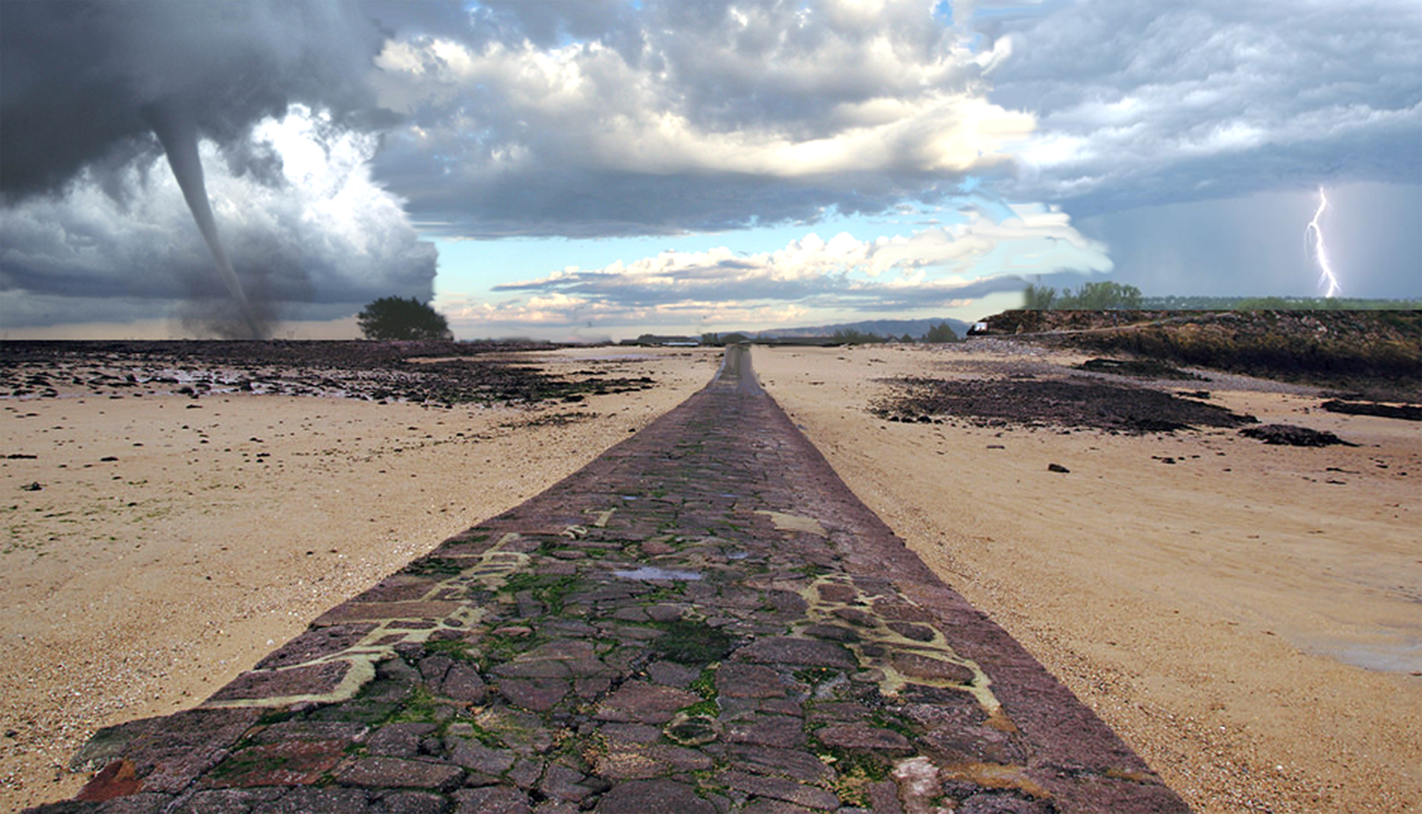
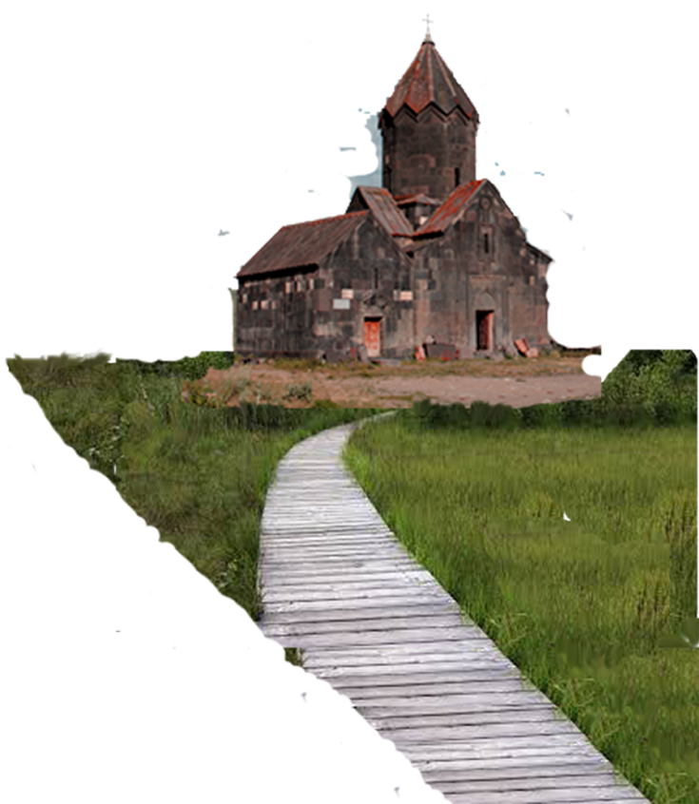

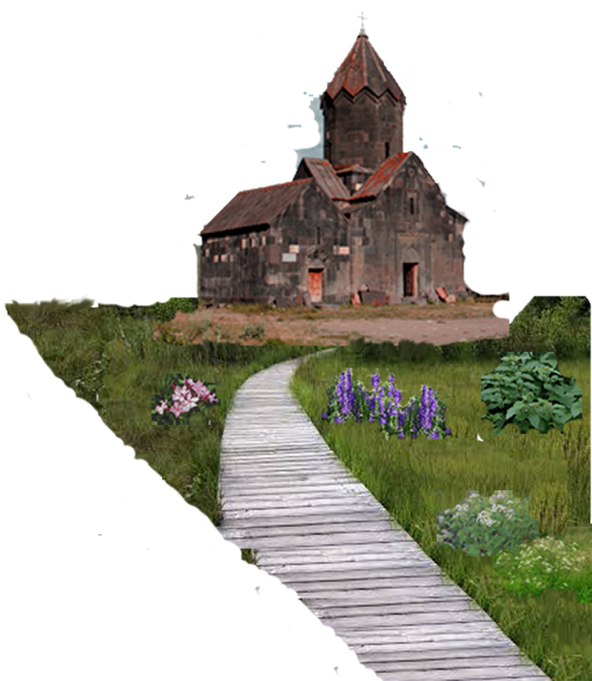


We all know what a Deadly Vice is but what is a Deadly Virtue?
DEADLY VICES WORLDLINESS
Tree of Life
Oleander
Nightshade
Thistles
Thorns
Foxglove
DEADLY VIRTUES FALSE DOCTRINES
Cactus
Snakeroot
Hemlock
Elder Boyd K. Packer: “A virtue when pressed to the extreme may turn into a vice. Unreasonable devotion to an ideal, without considering the practical application of it, ruins the ideal itself.”

Slide 3
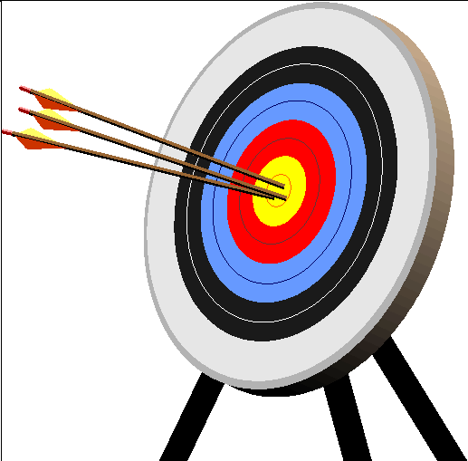
UNDERSHOOTING
THE MARK
Deadly Vices
THE GOSPEL TARGET
OVERSHOOTING
THE MARK
Deadly Virtues
CARNALITY
WORLDLINESS
Death, Sorrow, Misery
CHRIST-LIKE PERFECTION
Life, Joy, Happiness
FALSE RELIGIOUS
DOCTRINE
Death, Sorrow, Misery
TELESTIAL D&C 76:82 These are they who received not the gospel of Christ, neither the testimony of Jesus.
CELESTIAL D&C 76:94: They who dwell in his presence are the church of the Firstborn; and they see as they are seen, and know as they are known, having received of his fulness and of his grace;
TERRESTRIAL D&C 76:75 These are they who are honorable men of the earth, who were blinded
by the craftiness of men.
Destroy the WICKED who
are not religiously inclined
Destroy the RIGHTEOUS who
are religiously inclined

Slide 4
DISTORTION OF DEFINITIONS
President Ezra Taft Benson: “A state of confusion is an effective environment for Satan. There is much confusion today. He employs several methods to create it. One is the distortion of definitions.” (“Satan’s Thrust—Youth,” Ensign, Dec. 1971)
FALSE
DOCTRINE
CORRUPT IMPLICATION
Free
GRACE
Saved No Matter What - Romans 3:23-24
Blind
OBEDIENCE
Obey No Matter What - 2 Corinthians 2:9
Blind
FAITH
Believe No Matter What - 2 Corinthians 5:7
Unconditional
LOVE
Love No Matter What - Matthew 5:43-48
Selfless
SERVICE
Serve No Matter What - 1 Corinthians 13:4-5
Self
SACRIFICE
Sacrifice No Matter What - Matthew 10:39
Original
SIN
Evil No Matter What - Jeremiah 17:9

Slide 5
MAJOR OR MINOR PROBLEM?
FALSE
DOCTRINE
(3)
Free
GRACE
(4)
Blind
OBEDIENCE
(4)
Blind
FAITH
Minor Problem
Major Problem
(10)
Unconditional
LOVE
0
5
10
(10)
Selfless
SERVICE
(10)
Self
SACRIFICE
(0)
Original
SIN
ALTRUISM = “THE GOSPEL OF OTHERS” = OVERSHOOTING THE MARK
Christ-Like Love Falsely Portrayed As “Otherism”
(1) Selflessness (2) Self-Sacrifice (3) Unconditional

Slide 6
THREE DEADLY VIRTUES
1. Unconditional Love: SHARPLY CONDEMNED
Elder Russell M. Nelson: “While divine love can be called perfect, infinite, enduring, and universal, it cannot be characterized as unconditional. The word does not appear in the scriptures … These arguments [suggesting God’s love is unconditional] are used by anti-Christ’s to woo people with deception.”(Elder Nelson, “Divine Love”, 2003 Ensign)
LIFE
LOVE
Elder Christofferson: “…the word unconditional can convey mistaken impressions about divine love, such as, God tolerates and excuses anything we do because His love is unconditional, or God makes no demands upon us because His love is unconditional, or all are saved in the heavenly kingdom of God because His love is unconditional.” (“Abide in My Love”, 2016 October General Conference)
2. Self-Sacrifice: DENIED BY DEFINITION
True to the Faith: “To sacrifice is to give up something we value for the sake of something of greater worth. As Latter-day Saints, we have the opportunity to sacrifice worldly things for the Lord and His Kingdom” (Sacrifice, p. 149)
HAPPINESS
DUTY
3. Selflessness: STILL WIDELY AFFIRMED
Within Our Reach: “Charity ‘seeketh not her own.’ There is no ‘because I want’ in a charitable person. This may seem hard for us to comprehend, but nevertheless it is true. Not ‘my will,’ not ‘my wants,’ not ‘my desires,’ but ‘thy will,’ ‘thy wants,’ ‘thy desires’.” (David M. Call, “Within Our Reach”, p. 53)
OTHERS
SELF

Slide 7
UNDERSHOOTING
THE MARK
THE GOSPEL TARGET
OVERSHOOTING
THE MARK
A Religious Vow of:
Disobedience
Obedience
Blind Obedience
CARNALITY
WORLDLINESS
FALSE
DOCTRINE
CHRIST-LIKE PERFECTION
Life, Joy, Happiness
DEADLY VICES
Death, Sorrow, Misery
DEADLY VIRTUES
Death, Sorrow, Misery
Destroy the Wicked Who
Are Not religiously Inclined
Destroy the Righteous Who
Are Religiously Inclined

Slide 8
UNDERSHOOTING
THE MARK
THE GOSPEL TARGET
OVERSHOOTING
THE MARK
A Religious Vow of:
Covetousness
Wealth
Poverty
CARNALITY
WORLDLINESS
FALSE
DOCTRINE
CHRIST-LIKE PERFECTION
Life, Joy, Happiness
DEADLY VICES
Death, Sorrow, Misery
DEADLY VIRTUES
Death, Sorrow, Misery
Destroy the Wicked Who
Are Not religiously Inclined
Destroy the Righteous Who
Are Religiously Inclined

Slide 9
UNDERSHOOTING
THE MARK
THE GOSPEL TARGET
OVERSHOOTING
THE MARK
A Religious Vow of:
Cohabitation
Temple Marriage
Celibacy
CARNALITY
WORLDLINESS
FALSE
DOCTRINE
CHRIST-LIKE PERFECTION
Life, Joy, Happiness
DEADLY VICES
Death, Sorrow, Misery
DEADLY VIRTUES
Death, Sorrow, Misery
Destroy the Wicked Who
Are Not religiously Inclined
Destroy the Righteous Who
Are Religiously Inclined

Slide 10
Deadly Primacy Issues: Unconditional
LOVE
OTHERS
RIGHT
DUTY
LIFE
SELF
GOOD
HAPPINESS
President Russell M. Nelson: “In today’s world trembling with terror and hatred, our knowledge of divine love is of utmost importance... While divine love can be called perfect, infinite, enduring, and universal, it cannot be characterized as unconditional. The word does not appear in the scriptures … The full flower of divine love and our greatest blessings from that love are conditional—predicated upon our obedience to eternal law.”
(“Divine Love”, Feb. 2003 Ensign)
Divine Love Is A Verb: Actionable
William Shakespeare: “They do not love that do not show their love.” (Two Gentlemen of Verona", Act 1, Scene II)
John 15:10 “If ye keep my commandments, [then] ye shall abide in my love; even as I have kept my Father's commandments, and abide in his love.”
D&C 95:12 “If you keep not my commandments, [then] the love of the Father shall not continue with you, therefore you shall walk in darkness.”

Slide 11




CONDITIONAL
UNCONDITIONAL
Must Be Worthy
Worthy or Unworthy
To be born (mortal life)?
Unconditional love undermines all gospel standards and principles. The entire list is undone by the equivalent of “Free Grace”.
To have the Light of Christ?
To be baptized?
To receive the Holy Ghost?
To receive the Aaronic Priesthood?
To receive the Melchizedek Priesthood?
How is it Possible that:
To receive one’s Endowments?
Light and truth forsake … But God’s love doesn’t?
To fulfill a church mission?
Holy Ghost will not dwell … But God’s love does?
To be married in the Temple?
To enter paradise in the spirit world?
All blessings predicated … But God’s love isn’t?
To come forth in the first resurrection?
To come forth in any resurrection?
God cannot look upon sin with the least degree
… Except when it comes to Love?
To enter the Celestial Kingdom?
To receive exaltation (eternal life)?
God’s Love?

Slide 12
CONDITIONAL
UNCONDITIONAL
Must Be Worthy
Worthy or Unworthy
To be born (mortal life)?
Life is Conditional
Hence Love is Conditional
To have the Light of Christ?
To be baptized?
“…many verses affirm that the higher levels of love of the father and the Son feel for each of us – and certain divine blessings stemming from that love – are conditional.”
(Elder Nelson, “Divine Love”, 2003 Ensign)
To receive the Holy Ghost?
To receive the Aaronic Priesthood?
To receive the Melchizedek Priesthood?
To receive one’s Endowments?
The Tree of Life (God’s Love)
is Conditional
To fulfill a church mission?
To be married in the Temple?
To enter paradise in the spirit world?
1 Nephi 11:21-22 And the angel said unto me…Knowest thou the meaning of the tree which thy father saw? And I answered him, saying: Yea, it is the love of God…
To come forth in the first resurrection?
To come forth in any resurrection?
To enter the Celestial Kingdom?
To receive exaltation (eternal life)?
John 14:15 If ye love me, [then]
keep my commandments.
God’s Love (actionable)…

Slide 13
Questions?

