Slide 1
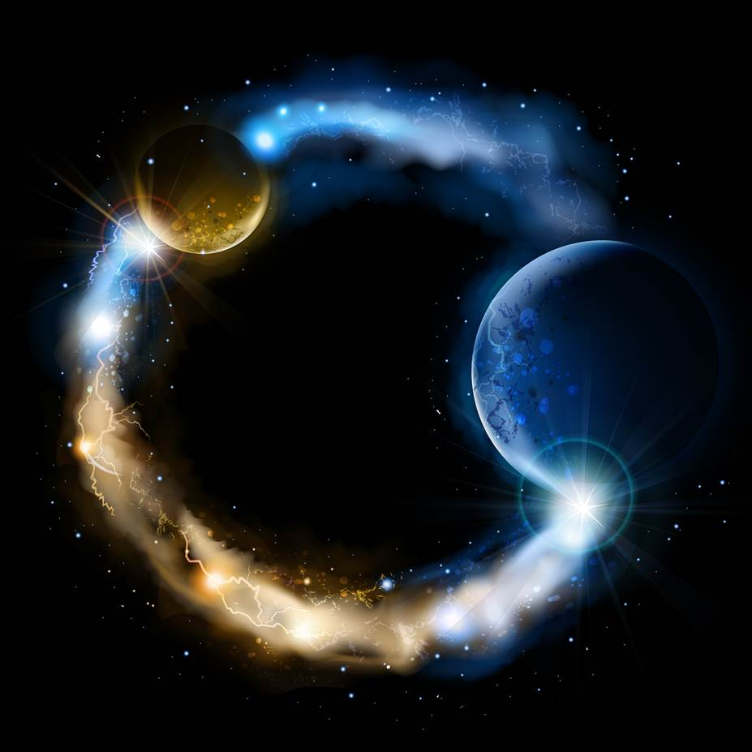
ETERNALISM MODULE 23
Ethics
Abide
and
Abound
Chapter 25: Good Love Bad Love

Slide 2
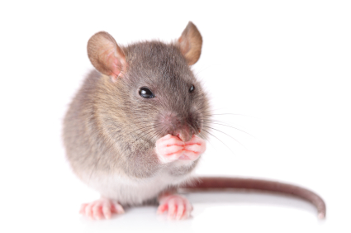
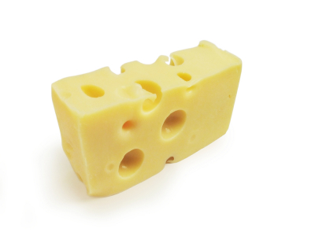
INTRINSICISM
“THE FORGOTTEN MOUSETRAP”
CHEESE
THE GOOD
MOUSETRAP
THE EVIL
Whatever promotes, sustains and enhances the LIFE of the Mouse is THE GOOD
Whatever threatens, hampers, or diminishes the LIFE of the Mouse is THE EVIL

Slide 3
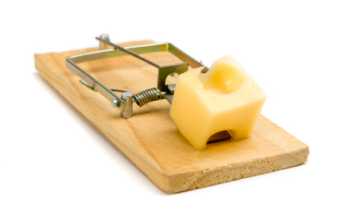
What do we do now?
Hmmm!
…CHEESE IS GOOD…
All Good is from God…
THINK I’LL HAVE A
NIBBLE
The death trap is set into
a deadly package deal!
Something GOOD …
Beneath it something EVIL

Slide 4
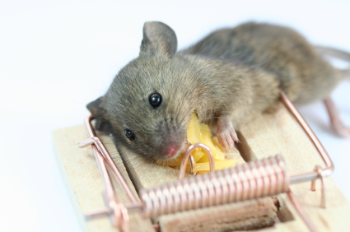
I DON’T FEEL SO
GOOD
SNAP!!!
The death trap is set into
a deadly package deal!
Something GOOD …
Beneath it something EVIL …

Slide 5
Does Christ Hate?
Does Satan Love?
Joseph Fielding McConkie: “Everyone is pleased to speak of God’s love; rare are the mentions of his wrath or displeasure.” ("The First Vision and Religious Tolerance", Nov 5, 2005)
Elder George Q Cannon: “The Lord Jesus was undoubtedly selected for the great mission of redeeming the world, because of His great qualities and His peculiar fitness as one of the Godhead. It is written of Him: ‘Thou lovest righteousness, and hatest wickedness; therefore God, thy God, hath anointed thee with the oil of gladness above thy fellows.’” (JD:26:185)
Elder Amasa Lyman: “There is no remarkable difference between us and Jesus, if he was anointed because he loved righteousness. What is the difference? … Jesus was anointed and preferred before others, from the simple fact that he loved righteousness better than others, and hated iniquity more.” (JD:7: 297; Psalms 45:7; Heb. 1:9)
Elder Orson Pratt: “…let us hate that which has the appearance of evil, and do that because we know it to be the feeling of God, angels, and of all good men.” (JD:8:312)

Slide 6
Amos 5:15: Hate the evil, and love the good, and establish judgment in the gate.
What things should go on the Love List?
What things should go on the Hate List?
LOVE
HATE
Good
Light
Sweet
Life
Pleasure
Joy
Happiness
Righteousness
Justice
Peace
Charity
Benevolence
Truth
Evil
Darkness
Bitter
Death
Pain
Sorrow
Misery
Wickedness
Injustice
War
Enmity
Malevolence
Falsehood

Slide 7
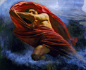
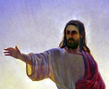
GOOD and BAD LOVE
GOOD and BAD HATE
Satanic Love and Hatred
Christ-Like Love and Hatred
Hate
Love
Love
Hate
Good
Light
Sweet
Life
Pleasure
Joy
Happiness
Righteousness
Justice
Peace
Charity
Benevolence
Truth
Evil
Darkness
Bitter
Death
Pain
Sorrow
Misery
Wickedness
Injustice
War
Enmity
Malevolence
Falsehood
Good
Light
Sweet
Life
Pleasure
Joy
Happiness
Righteousness
Justice
Peace
Charity
Benevolence
Truth
Evil
Darkness
Bitter
Death
Pain
Sorrow
Misery
Wickedness
Injustice
War
Enmity
Malevolence
Falsehood

Slide 8
Hierarchy of Values and Emotional Response
Love and Hate are an emotional response to our hierarchy of values.
What I perceive to be “For Me” or “Against Me” and to what “Intensity”
FOR ME
LOVE
Hierarchy of Values
Emotional Response
INTENSITY
INTENSITY
LIGHT
LIKE
INNOCUOUS
INDIFFERENCE
DARKNESS
INTENSITY
INTENSITY
DISLIKE
AGAINST ME
HATE

Slide 9
Christ-Like Love and Hatred
FOR ME
Righteousness
LOVE
Hierarchy of Values
Emotional Response
INTENSITY
INTENSITY
LIGHT
LIKE
INNOCUOUS
INDIFFERENCE
DARKNESS
INTENSITY
INTENSITY
DISLIKE
AGAINST ME
Wickedness
HATE

Slide 10
Christ-Like Love and Hatred
Psalms 45:7: “Thou lovest righteousness, and hatest wickedness: therefore God, thy God, hath anointed thee with the oil of gladness above thy fellows.”
Proverbs 6:16-19: “These six things doth the LORD hate: yea, seven are an abomination unto him: A proud look, a lying tongue, and hands that shed innocent blood, An heart that deviseth wicked imaginations, feet that be swift in running to mischief, A false witness that speaketh lies, and he that soweth discord among brethren.”
Proverbs 8:13: “The fear of the LORD is to hate evil: pride, and arrogancy, and the evil way, and the forward mouth, do I hate.”
Jeremiah 44:4: “Howbeit I sent unto you all my servants the prophets, rising early and sending them, saying, Oh, do not this abominable thing that I hate.”
Zechariah 8:17 “And let none of you imagine evil in your hearts against his neighbour; and love no false oath: for all these are things that I hate, saith the LORD.”

Slide 11
Christ-Like Love and Hatred
Psalms 11:5 “The LORD trieth the righteous: but the wicked and him that loveth violence his soul hateth.”
Psalms 5:5 “Thou hatest all workers of iniquity.”
Romans 9:13-14 “As it is written, Jacob have I loved, but Esau have I hated. What shall we say then? Is there unrighteousness with God? God forbid.”
Helaman 15:3-4 “Yea, the people of Nephi hath he loved, and also hath he chastened them; yea, in the days of their iniquities hath he chastened them because he loveth them. But behold my brethren, the Lamanites hath he hated because their deeds have been evil continually, and this because of the iniquity of the tradition of their fathers.”
… because of their love and of their hatred to sin (Alma 26:34)
… teach them an everlasting hatred against sin and iniquity (Alma 37:32)
… a righteous man hateth lying (Proverbs 13:5)
… Ye that love the LORD, hate evil (Psalms 97:10)
… I hate the work of them that turn aside (Psalms 101:3)
… I hate every false way (Psalms 119:104; 128)
… I hate vain thoughts: but thy law do I love (Psalms 119:113)
… I hate and abhor lying: but thy law do I love (Psalms 119:163)
… for the wickedness of their doings I will drive them out of mine house, I will love them no more (Hosea 9:15)
… “The way of the wicked is an abomination unto the LORD: but he loveth him that followeth after righteousness” (Proverbs 15:9)

Slide 12
SATAN-LIKE LOVE AND HATRED
Isaiah 5:20 “Woe to them that call evil good, and good evil; that put darkness for light, and light for darkness; that put bitter for sweet, and sweet for bitter!”
Hate
Love
Good
Light
Sweet
Life
Pleasure
Joy
Happiness
Righteousness
Justice
Peace
Charity
Benevolence
Truth
Evil
Darkness
Bitter
Death
Pain
Sorrow
Misery
Wickedness
Injustice
War
Enmity
Malevolence
Falsehood

Slide 13
Satan-Like Love and Hatred
FOR ME
Wickedness
LOVE
Emotional Response
Hierarchy of Values
INTENSITY
INTENSITY
DARKNESS
LIKE
INNOCUOUS
INDIFFERENCE
INTENSITY
INTENSITY
LIGHT
DISLIKE
AGAINST ME
Righteousness
HATE

Slide 14
Bad Love = Love of Wickedness
… For behold, ye do love money, and your substance, and your fine apparel, and the adorning of your churches,
more than ye love the poor and the needy, the sick and the afflicted (Mormon 8:37)
… loved Satan more than God, (Moses 5:28)
… lovers of pleasures more than lovers of God, (2 Tim. 3:4)
… lovest that lucre more than him, (Alma 11:24)
… loved the praise of men more than the praise of God, (John 12:43)
… loved murder (Jarom 1:6)
… loved the vain things of the world (Alma 1:16)
… loved darkness rather than light, because their deeds were evil (John 3:19)
… loved the wages of unrighteousness (2 Peter 2:15)
… loved many strange women (1 Kings 11:1)
… loveth and maketh a lie (D&C:63:17, Revelation 22:15, D&C:76:103)
… loveth to oppress (Hosea 12:7)
… love to have others suffer (D&C:121:13)
… love of glory and the vain things of the world (Alma 60:32)
… love darkness rather than light, and their deeds are evil (D&C: 29:45)
… loveth transgression that loveth strife (Proverbs 17:19)
… loveth pleasure … loveth wine and oil shall not be rich (Proverbs 21:17)
… Is it not for you to know judgment? Who hate the good, and love the evil (Micah 3:1-2)

Slide 15
Bad Hatred = Hatred of Righteousness
… For every one that doeth evil hateth the light, neither cometh to the light, lest his deeds should be reproved, (John 3:20)
… Evil shall slay the wicked: and they that hate the righteous shall be desolate, (Psalms 34:21)
Elder James E. Faust: “Satan has had great success with this gullible generation. As a consequence, literally hosts of people have been victimized by him and his angels.” (Ensign, Nov. 1987)
D&C 10:20-21: “Verily, verily, I say unto you, that Satan has great hold upon their hearts; he stirreth them up to iniquity against that which is good; And their hearts are corrupt, and full of wickedness and abominations; and they love darkness rather than light, because their deeds are evil.”
Two Sides of the Same Value Coin
Elder Lynn G. Robbins: “Many gospel principles come in pairs, meaning one is incomplete without the other. … When Satan is successful in dividing doctrinal pairs, he begins to wreak havoc upon mankind.” (“Be 100 Percent Responsible", BYU Devotional, Aug.22, 2017)
“A Time To Love, And A Time To Hate.” (Ecclesiastes. 3:8)

Slide 16
HIERARCHY OF VALUES
LOVE AND HATRED
LOVE
“For Me”
LOVE
“For Me”
WHAT YOU ONCE PASSIONATELY
LOVED
3
2
1
0
1
2
3
3
2
1
0
1
2
3
LIKE
LIKE
Indifference
“Whatever”
Indifference
“Whatever”
DISLIKE
DISLIKE
Intensity Meter
HATE
“Against Me”
HATE
“Against Me”
“A Time To Love, And A Time To Hate” (Ecclesiastes 3:8)

Slide 17
HIERARCHY OF VALUES
LOVE AND HATRED
LOVE
“For Me”
LOVE
“For Me”
YOU CAN BECOME COMPLETELY INDIFFERENT TO
3
2
1
0
1
2
3
3
2
1
0
1
2
3
LIKE
LIKE
Indifference
“Whatever”
Indifference
“Whatever”
DISLIKE
DISLIKE
Intensity Meter
HATE
“Against Me”
HATE
“Against Me”
“A Time To Love, And A Time To Hate” (Ecclesiastes 3:8)

Slide 18
HIERARCHY OF VALUES
LOVE AND HATRED
LOVE
“For Me”
LOVE
“For Me”
OR CAN NOW PASSIONATELY
HATE
3
2
1
0
1
2
3
3
2
1
0
1
2
3
LIKE
LIKE
Indifference
“Whatever”
Indifference
“Whatever”
DISLIKE
DISLIKE
Intensity Meter
HATE
“Against Me”
HATE
“Against Me”
“A Time To Love, And A Time To Hate” (Ecclesiastes 3:8)

Slide 19
HIERARCHY OF VALUES
LOVE AND HATRED
Saul of Tarsus
LOVED “Self-Righteousness”
WHAT HE ONCE PASSIONATELY
HATED
LOVED “Christians”
3
2
1
0
1
2
3
3
2
1
0
1
2
3
LIKE
LIKE
Indifference
“Whatever”
Indifference
“Whatever”
DISLIKE
DISLIKE
Intensity Meter
HATED
“Self-Righteousness”
HATED
“Christians”
“A Time To Love, And A Time To Hate” (Ecclesiastes 3:8)

Slide 20
HIERARCHY OF VALUES
LOVE AND HATRED
Saul of Tarsus = Paul
LOVED “Self-Righteousness”
HE NOW PASSIONATELY
LOVED
LOVED “Christians”
3
2
1
0
1
2
3
3
2
1
0
1
2
3
LIKE
LIKE
Indifference
“Whatever”
Indifference
“Whatever”
DISLIKE
DISLIKE
Intensity Meter
HATED
“Self-Righteousness”
HATED
“Christians”
“A Time To Love, And A Time To Hate” (Ecclesiastes 3:8)

Slide 21
CHRIST-LIKE LOVE AND HATRED
Psalms 45:7 “Thou lovest righteousness, and hatest wickedness: therefore God, thy God, hath anointed thee with the oil of gladness above thy fellows.”
LOVES
Righteousness
3
2
1
0
1
2
3
3
2
1
0
1
2
3
Indifference
“Whatever”
Indifference
“Whatever”
Intensity Meter
HATES Wickedness
“A Time To Love, And A Time To Hate” (Ecclesiastes 3:8)

Slide 22
SATAN-LIKE LOVE AND HATRED
John 3:20 “For every one that doeth evil hateth the light…”
LOVES Wickedness
3
2
1
0
1
2
3
3
2
1
0
1
2
3
Indifference
“Whatever”
Indifference
“Whatever”
Intensity Meter
HATES Righteousness
“A Time To Love, And A Time To Hate” (Ecclesiastes 3:8)

Slide 23
CHRIST-LIKE SATAN-LIKE LOVE AND HATRED
Matthew 6:24 No man can serve two masters: for either he will hate the one, and love the other; or else he will hold to the one, and despise the other.
LOVES Wickedness
LOVES Righteousness
3
2
1
0
1
2
3
3
2
1
0
1
2
3
Indifference
“Whatever”
Indifference
“Whatever”
Intensity Meter
HATES Wickedness
HATES Righteousness
“A Time To Love, And A Time To Hate” (Ecclesiastes 3:8)

Slide 24
CHRIST-LIKE SATAN LIKE LOVE AND HATRED
WHAT IS SATAN TO
DO WITH THOSE RIGHTEOUS SOULS DETERMINED TO
BE CHRIST-LIKE?
LOVES Wickedness
LOVES Righteousness
3
2
1
0
1
2
3
3
2
1
0
1
2
3
Indifference
“Whatever”
Indifference
“Whatever”
Intensity Meter
HATES Wickedness
HATES Righteousness
“A Time To Love, And A Time To Hate” (Ecclesiastes 3:8)

Slide 25
CHRIST-LIKE SATAN LIKE LOVE AND HATRED
FALSE IDEOLOGY
CHANGE WHAT IT MEANS
TO BE CHRIST-LIKE
LOVES Wickedness
LOVES Righteousness
3
2
1
0
1
2
3
3
2
1
0
1
2
3
Indifference
“Whatever”
Indifference
“Whatever”
Intensity Meter
HATES Wickedness
HATES Righteousness
“A Time To Love, And A Time To Hate” (Ecclesiastes 3:8)

Slide 26
THE ABSOLUTISM OF CHRIST-LIKE LOVE
ALL-LOVING
ALL-FORGIVING
GOD IS LOVE
ALL-LOVING GOD
ALL-FORGIVING GOD
LOVE IS GOD
LOVES Righteousness
3
2
1
0
1
2
3
3
2
1
0
1
2
3
Indifference
“Whatever”
Indifference
“Whatever”
You Should
Hate-Hate
AND
Love-Love
With All Your Soul
All Hatred
is Dark, Evil, And
Very Wicked…Not At All Christ-Like
HATES Righteousness
HATRED

Slide 27
THE ABSOLUTISM OF CHRIST-LIKE LOVE
ALL-LOVING
ALL-FORGIVING
GOD IS LOVE
ALL-LOVING GOD
ALL-FORGIVING GOD
LOVE IS GOD
LOVES Righteousness
3
2
1
0
1
2
3
3
2
1
0
1
2
3
Indifference
“Whatever”
Indifference
“Whatever”
You Should
Hate-Hate
AND
Love-Love
With All Your Soul
All Hatred
is Dark, Evil, And
Very Wicked…Not At All Christ-Like
HATRED
HATES Righteousness

Slide 28
THE ABSOLUTISM OF CHRIST-LIKE LOVE
ALL-LOVING
ALL-FORGIVING
GOD IS LOVE
ALL-LOVING GOD
ALL-FORGIVING GOD
LOVE IS GOD
LOVES Righteousness
3
2
1
0
1
2
3
3
2
1
0
1
2
3
Indifference
“Whatever”
Indifference
“Whatever”
You Should
Hate-Hate
AND
Love-Love
With All Your Soul
All Hatred
is Dark, Evil, And
Very Wicked…Not At All Christ-Like
HATES Righteousness
HATRED

Slide 29
THE ABSOLUTISM OF CHRIST-LIKE LOVE
GOD IS LOVE
ALL-LOVING GOD
ALL-FORGIVING GOD
LOVE IS GOD
3
2
1
0
1
2
3
3
2
1
0
1
2
3
Revelation 3:15-16 I know thy works, that thou art neither cold nor hot: I would thou wert cold or hot. So then because thou art lukewarm, and neither cold nor hot, I will spue thee out of my mouth.
Indifference
“Whatever”
Indifference
“Whatever”
You Should
Hate-Hate
AND
Love-Love
With All Your Soul
All Hatred
is Dark, Evil, And
Very Wicked…Not At All Christ-Like

Slide 30
THE ABSOLUTISM OF CHRIST-LIKE LOVE
ALL-LOVING
ALL-FORGIVING
GOD IS LOVE
ALL-LOVING GOD
ALL-FORGIVING GOD
LOVE IS GOD
LOVES Righteousness
3
2
1
0
1
2
3
3
2
1
0
1
2
3
Indifference
“Whatever”
Indifference
“Whatever”
You Should
Hate-Hate
AND
Love-Love
With All Your Soul
All Hatred
is Dark, Evil, And
Very Wicked…Not At All Christ-Like
HATES Righteousness
HATRED

Slide 31
THE ABSOLUTISM OF CHRIST-LIKE LOVE
ALL-LOVING
ALL-FORGIVING
GOD IS LOVE
ALL-LOVING GOD
ALL-FORGIVING GOD
LOVE IS GOD
LOVES Righteousness
3
2
1
0
1
2
3
3
2
1
0
1
2
3
Indifference
“Whatever”
Indifference
“Whatever”
You Should
Hate-Hate
AND
Love-Love
With All Your Soul
All Hatred
is Dark, Evil, And
Very Wicked…Not At All Christ-Like
HATES Righteousness
HATRED

Slide 32
THE ABSOLUTISM OF CHRIST-LIKE LOVE
ALL-LOVING
ALL-FORGIVING
GOD IS LOVE
ALL-LOVING GOD
ALL-FORGIVING GOD
LOVE IS GOD
LOVES Righteousness
3
2
1
0
1
2
3
3
2
1
0
1
2
3
Indifference
“Whatever”
Indifference
“Whatever”
You Should
Hate-Hate
AND
Love-Love
With All Your Soul
All Hatred
is Dark, Evil, And
Very Wicked…Not At All Christ-Like
HATES Righteousness
HATRED

Slide 33
THE ABSOLUTISM OF CHRIST-LIKE LOVE
GOD IS LOVE
ALL-LOVING GOD
ALL-FORGIVING GOD
LOVE IS GOD
LOVES Wickedness
LOVES Righteousness
3
2
1
0
1
2
3
3
2
1
0
1
2
3
Indifference
“Whatever”
Indifference
“Whatever”
HATES Wickedness
HATES Righteousness

Slide 34
SELECTIVE CHRISTIANITY
Elder Jeffrey R. Holland: In this regard, there is sometimes a chance for a misunderstanding, especially among young people who may think we are not supposed to judge anything, that we are never to make a value assessment of any kind. We have to help each other with that because the Savior makes it clear that in some situations we have to judge, we are under obligation to judge—as when He said, “Give not that which is holy unto the dogs, neither cast ye your pearls before swine” (Matthew 7:6). That sounds like a judgment to me. The unacceptable alternative is to surrender to postmodern moral relativism, which, pushed far enough, declares that ultimately nothing is eternally true or especially sacred and, therefore, no one position on any given issue matters more than any other. And in the gospel of Jesus Christ that simply is not true. ("Conviction with Compassion", New Era July 2013)
Joseph Fielding McConkie: “When the dialogue between Christ and the woman from Canaan was read recently in a religion class at Brigham Young University, a number of the students were uneasy with the account of Christ’s behavior (see Matthew 15:21–28). A number of attempts were made to excuse or justify it. One student suggested that in calling the Gentiles “dogs,” Christ was really using a term of endearment. Such an explanation does not fit well in the context of the story. Finally a young woman expressed the thought that troubled many of her classmates; with tears in her eyes, she exclaimed, “But Jesus was so unchristian!“
("The First Vision and Religious Tolerance", Nov 5, 2005)

Slide 35
Questions?

