Slide 1
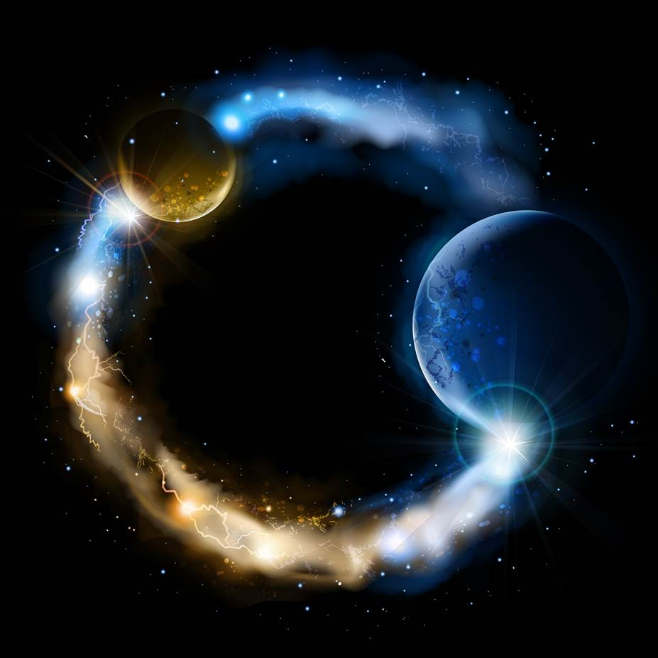
ETERNALISM MODULE 22
Ethics
Abide
and
Abound
Chapter 24: Emotions

Slide 2
Emotion
Mind
Alma 32:12 “Use boldness, but not overbearance; and also see that ye bridle all your passions…”
Heart
Hymn 336 “School thy feelings, O my brother; Train thy warm, impulsive soul. Do not its emotions
smother, But let wisdom’s voice control. School thy feelings; there is power In the cool, collected
mind. Passion shatters reason’s tower, Makes the clearest vision blind.”
“[Most Greek Philosophers] held that emotions are not simply blind surges of affect … rather they are discriminating responses closely connected with beliefs about how things are and what is important … if one really accepts or takes in a certain belief, one will experience emotion … the pursuit of intellectual reasoning apart from emotion will actually prevent a full rational judgment—for example by preventing access to one’s grief, or one’s love, that is necessary for the full understanding of what has taken place when a loved one dies. Emotions can, of course, be unreliable—in much the same way beliefs can … they are not self-certifying sources of ethical truth.” (Nussbaum, Love’s Knowledge, p. 41-42)
Reason = Cognition of Facts
Emotion = Response to Values
Declarative Statements
“Knowing What Is the Case”
Difference
Between
Evaluative Responses
“Responding to What Is at Stake”
— Knowing Your Spouse Has Just Died —
— Experiencing the Grief-Stricken Loss of Value —

Slide 3
Two Judgements
Nathaniel Branden: “If we pause to consider any emotional response from love to fear to rage, we can notice that implicit in every response is a dual value judgment. Every emotion reflects the judgment of ‘for me’ or ‘against me’—and also ‘to what extent.’ Thus, emotions differ according to their content and according to their intensity. Strictly speaking, these are not two separate value judgments; they are integral aspects of the same judgment and are experienced as one response … Every emotion contains an inherent action tendency; that is, an impetus to perform some action related in that particular emotion. The emotion of fear is a person’s response to that which threatens his or her values; it entails the action tendency to avoid or flee from the feared object.” (The Psychology of Romantic Love, p. 62-63)
(1) Factual Judgement
The world is full of things
simply called “Matters of Fact”
(2) Value Judgement
We evaluate these
things as being
for me
against me
neutral to me

Slide 4
Hierarchy of Values
Values are the things that we must ACT upon to gain or keep. We then sort these things into a hierarchy scale according to the relative amount these are for me, neutral, or against me.
(1) Factual Judgement
The world is full of things
simply called “Matters of Fact”
“For Me” with
What Intensity
20
13
golfing
GOOD
7
Innocuous: Neither
“For Me” Nor
“Against Me”
2
marriage
0
(2) Value Judgement
We evaluate these
things as being
for me
against me
neutral to me
2
EVIL
7
immorality
“Against Me” with
What Intensity
13
20
smoking

Slide 5
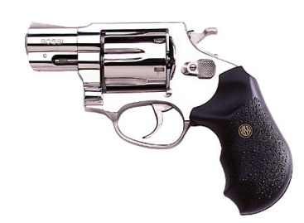
THINKING
What?
(Identify)
VALUING
So What?
(Evaluate)
ACTING
Now What?
(Actuate)
?
?
?
Is owning a gun a good thing or a bad thing?
Is it of value to me or of no value to me?

Slide 6
THINKING
What?
(Identify)
VALUING
So What?
(Evaluate)
ACTING
Now What?
(Actuate)
?
Self-Defense
Owning a gun is a good thing and is of
value to me for purposes of self-defense.

Slide 7
THINKING
What?
(Identify)
VALUING
So What?
(Evaluate)
ACTING
Now What?
(Actuate)
Self-Defense
Buy One
Values are that which
we act to gain and/or keep

Slide 8
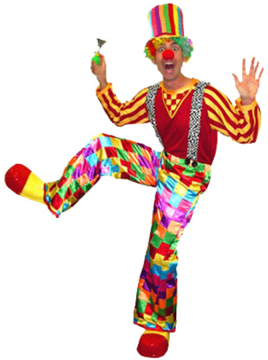
THINKING
What?
(Identify)
VALUING
So What?
(Evaluate)
ACTING
Now What?
(Actuate)
?
?
?
Is hiring a clown a good thing or a bad thing?
Is it of value to me or of no value to me?

Slide 9
THINKING
What?
(Identify)
VALUING
So What?
(Evaluate)
ACTING
Now What?
(Actuate)
?
Negative Value
This guy would drive me nuts as a co-worker!

Slide 10
THINKING
What?
(Identify)
VALUING
So What?
(Evaluate)
ACTING
Now What?
(Actuate)
?
Negative Value
No Hire
Values are that which
we act to gain and/or keep

Slide 11
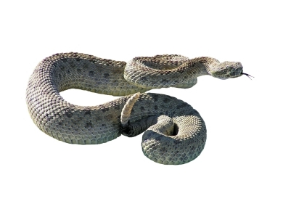
Emotions are lightning quick RESPONSES what I perceive to be
For Me or Against Me
+
VALUE
JUDGEMENT
=
EMOTIONAL
RESPONSE
PERCEPTION
EXAMPLE: MOTHER AND SMALL CHILD ON A NATURE HIKE
CHILD
SLITHERY CREATURE
Curiosity…“FOR ME”
CHILD
EXCITEMENT -> MOVES TOWARD RATTLE SNAKE
MOTHER
RATTLE SNAKE
DEADLY…“AGAINST ME”
MOTHER
FEAR -> GRABS CHILD
AND MOVES AWAY FROM RATTLE SNAKE
"Woe unto you, scribes and Pharisees, hypocrites ... Ye serpents, ye generation of vipers, how can ye escape the damnation of hell?" (Matthew 23:29,33)
FACTUAL JUDGEMENT
PERCEPTION
+
=
VALUE JUDGEMENT
For Me,
Against Me
EMOTIONAL RESPONSE
MIND
HEART

Slide 12
Emotions are Lightning Quick Calculators of What I Perceive to Be “For Me” or “Against Me”
INFORMATION
PERCEPTION
+
VALUE
JUDGEMENT
=
EMOTIONAL
RESPONSE
GET A RAISE
“For me”
JUBILANT
MIND
HEART
ANGER, SHOCK
DISMAY, ETC.
GET FIRED
“Against me”
MIND
HEART

Slide 13
Mind and Heart, An Emotional Rollercoaster
Mosiah 25:7-11
7. And now, when Mosiah had made an end of reading the records [of Zeniff], his people who tarried in the land [of Zarahemla] were struck with wonder and amazement.
8. For they knew not what to think; for when they beheld those that had been delivered out of bondage they were filled with exceedingly great joy.
9. And again, when they thought of their brethren who had been slain by the Lamanites they were filled with sorrow, and even shed many tears of sorrow.
10. And again, when they thought of the immediate goodness of God, and his power in delivering Alma and his brethren out of the hands of the Lamanites and of bondage, they did raise their voices and give thanks to God.
11. And again, when they thought upon the Lamanites, who were their brethren, of their sinful and polluted state, they were filled with pain and anguish for the welfare of their souls.
Alma 62:1-2
1. AND now it came to pass that when Moroni had received this epistle [from Pahoran the Chief Judge] his heart did take courage, and was filled with exceedingly great joy because of the faithfulness of Pahoran, that he was not also a traitor to the freedom and cause of his country.
2. But he did also mourn exceedingly because of the iniquity of those who had driven Pahoran from the judgment–seat, yea, in fine because of those who had rebelled against their country and also their God.
D&C 9:8-9
8 But, behold, I say unto you, that you must study it out in your mind; then you must ask me if it be right, and if it is right I will cause that your bosom shall burn within you; therefore, you shall feel that it is right.
9 But if it be not right you shall have no such feelings, but you shall have a stupor of thought that shall cause you to forget the thing which is wrong; therefore, you cannot write that which is sacred save it be given you from me.

Slide 14
Man’s Three Dimensions
Thoughts, Emotions, Actions
(1) Ability to Think … Correctly or Incorrectly
Rational Man
Persuaded by Reason
Fallible Man
Mistaken
(2) Capacity to Enjoy … Appropriately or Inappropriately
Rational Man
Moved by Emotions
Fallible Man
Misapplied
(3) Power to Act … Rightly or Wrongly
Rational Man
Guided by Principles
Fallible Man
Misguided

Slide 15
DESCRIPTIVE TRUTHS
Correspondence
of Truth
PRESCRIPTIVE TRUTHS
“If ye know these things, happy
are ye if ye do them.”
(John 13:17)
Conformance of Correct Desires
“Truth Is…Knowledge of…Reality”
(D&C 93:24-25)
MISTAKEN
MISGUIDED
MISPLACED
FACTS
VALUES
METAPHYSICS
Mind and Reason
EPISTEMOLOGY
Life
VALUE ETHICS
(Perception, Conception)
?
Gap
Gap
BEING
x is real
IS
KNOWING
x is true
OUGHT
DOING
x is good
SPIRITUAL CREATION
GOD THE CREATOR
(Father…A Divine Person)
Ayn Rand: “When men abandon reason, they find not only that their emotions cannot guide them, but that they can experience no emotions save one: terror.” (Philosophy: Who Needs It? p9)
SPIRITUAL REVELATION
GOD THE REVELATOR
(Holy Ghost…A Divine Person)
SPIRITUAL SALVATION
GOD THE REDEEMER
(Son…A Divine Person)
HOLY SPIRIT
(A Divine Substance)

Slide 16
WARNING
Emotion is not the same as Reason, Truth, Spirit, or Sincerity
President Howard W. Hunter: “Let me offer a word of caution. … I think if we are not careful … , we may begin to try to counterfeit the true influence of the Spirit of the Lord by unworthy and manipulative means. I get concerned when it appears that strong emotion or free-flowing tears are equated with the presence of the Spirit. Certainly the Spirit of the Lord can bring strong emotional feelings, including tears, but that outward manifestation ought not to be confused with the presence of the Spirit itself.” (The Teachings of Howard W. Hunter, p184. Preach My Gospel chap. 4)
Elder Orson F. Whitney: “We claim that the Christian world is in a state of apostasy, and though thousands and millions of them are perfectly sincere—just as sincere in their belief as we are in ours—still, it devolves upon me as a servant of God to preach what I know to be the truth, and you can take your choice whether you accept or reject it.” (JD 26:265)
Elder Heber C. Kimball: “Get the spirit of the Lord, and stop your whining, every one of you.” (JD 5:136)

Slide 17
EMOTIONAL CONTROL
“No matter what his emotions, a sane man retains the power to face facts. If an emotion is overwhelming, he retains the power to recognize this and to defer cognition until he can establish a calmer mood.” (Leonard Peikoff, Objectivism: The Philosophy of Ayn Rand, p.62)
“Emotions don’t settle upon you like a fog. They are not foisted upon you by others. No matter how comfortable it might make you feel saying it – others don’t make you mad. You make you mad. You make you scared, annoyed, or insulted. You and only you create your emotions. Once you’ve created your upset emotions, you have only two options: You can act on them or be acted on by them. That is, when it comes to strong emotions, you either find a way to master them or fall hostage to them.” (Crucial Conversations, p.104-105)
“From the beginning of time, the forces of evil have tried to get the forces of good to lose control of their emotions. If we lose emotional control, then we are easily manipulated by the evil force. The evil forces would have us selfishly destroy all our most precious relationships by losing control of our emotions...”
(Nicholeen Peck, "Getting Through The Hard Times: Parenting Help", Meridian Magazine, September 2, 2010)

Slide 18
Questions?

