Slide 1
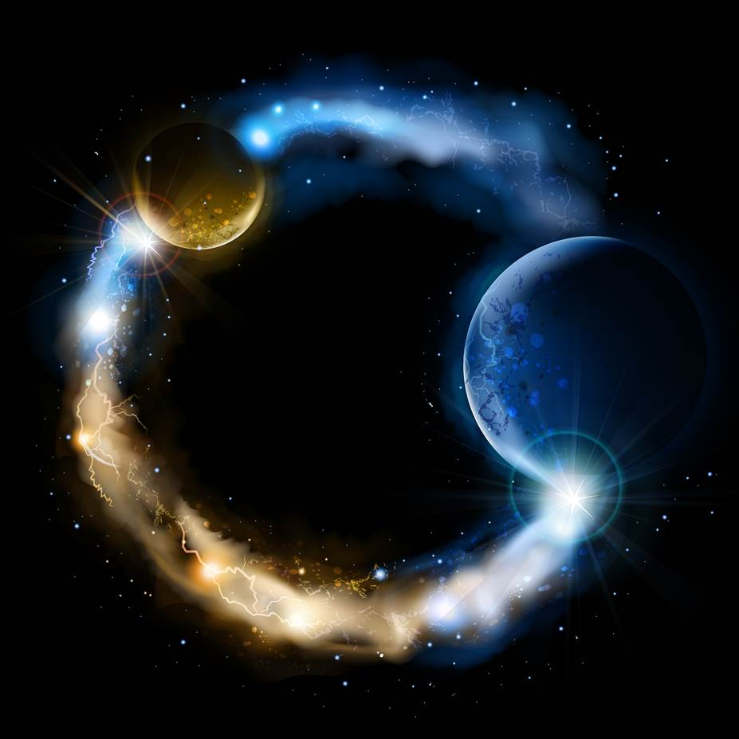
ETERNALISM MODULE 21
Ethics
Abide
and
Abound
Chapter 23: Life vs Love

Slide 2
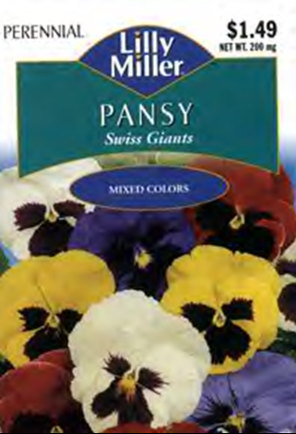
VALUE ETHICS NEED NOT BE
DIFFICULT TO UNDERSTAND
LIFE
LOVE
LOVE
LIFE
We can learn a great deal about value ethics and the importance of a life oriented morality from this small packet of flower seeds.

Slide 3
THE LIFE OF THE PANSY
IS ITS STANDARD OF VALUE
VALUE: is that which one acts to gain and, or keep.
GOOD-EVIL: Whatever values sustain, promote or otherwise enhance the life of the pansy, (sunshine, minerals, and, or moisture) is the good and “ought” to be pursued. While whatever threatens or is otherwise detrimental to the life of the pansy (weeds, insects, defoliant chemicals) is the evil and “ought” to be avoided.

Slide 4
ITS LIFE REQUIREMENTS ARE EVEN
PRINTED ON BACK OF THE PACKET
PANSY, Swiss Giants Mix – Viola wittrockiana
Perennials live more than two years and
typically bloom one year after planting
Type … Perennial
Height … 6-8”
Planting Depth … 1/8”
Seed Spacing … 2 seeds per pot or cell
Days To Sprout … 10-21
Spacing After Thinning … 6”
Planting: Start seeds indoors in August. Place flat or pots in a dark room (or cover with black plastic) and keep temperature at 70F until sprouts appear. Where winters are mild, transplant seedlings in the fall into soil enriched with compost. Where winters are cold, move seedlings into a cold frame and then transplant outdoors in early spring.
Growing: Mulch around plants to keep roots cool and moist. Water when the top 1-inch layer of soil is dry. Fertilize monthly. Remove faded blossoms (plus a few leaves) to prolong flowering. Protect over wintering plants with a layer of mulch.

Slide 5
RIGHT AND WRONG DEFINED
BY THE LIFE OF THE PANSY
VIRTUE: is the action by which one gains and, or keeps one’s VALUES.
RIGHT-WRONG: Whatever actions the pansy takes to ultimately promote its own good (turn toward the sun, dig their roots deeper) are right actions (virtues) and whatever actions are ultimately detrimental to its own good (seedlings landing in a dry gravel pit) are wrong actions (vices).

Slide 6
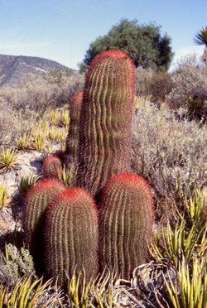
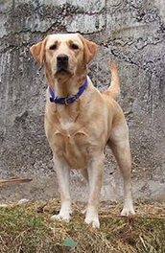
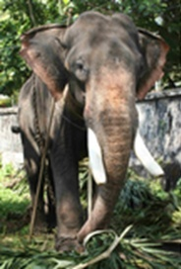
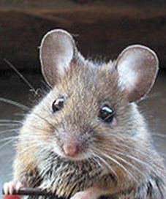
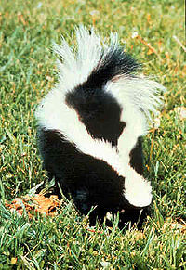
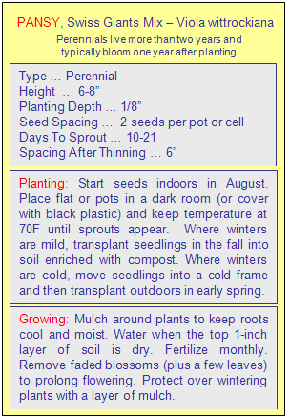
LIFE OF EVERY ORGANISM
IS ITS STANDARD OF VALUE
PANSY
CACTUS
DOG
ELEPHANT
MOUSE
SKUNK
MANKIND
Elephant
AS LIFE’S REQUIREMENTS DIFFER
SO DOES THE GOOD-RIGHT CODE

Slide 7
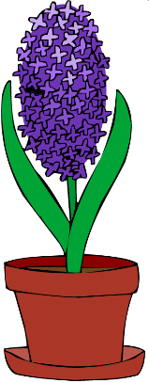
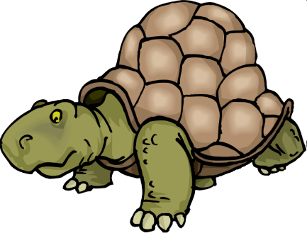
LIFE AS STANDARD (EXISTENTIAL PROOF)
Experiment: Place a Plant, a Mushroom Spore, a Door Knob, and a Turtle In a Dark Closet Without Food, Water or Sunshine for 30 Days and Observe the Results.
A DARK CLOSET
MUSHROOM SPORE ON A SHELF
PLANT ON A SHELF
TURTLE ON
THE FLOOR
DOORKNOB IN
THE CORNER

Slide 8
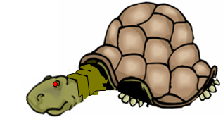
ONE MONTH LATER
LIFE AND DEATH ISSUE…NOT LOVE AND HATE!
A DARK CLOSET
PLANT ON A SHELF
DEATH
MUSHROOM SPORE ON A SHELF
LIFE
TURTLE ON
THE FLOOR
DEATH
DOORKNOB IN
THE CORNER
UNCHANGED

Slide 9
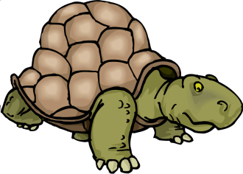
Continually Confronted With Life or Death Alternatives
STANDARD OF VALUE = Life of the Organism
MORAL CODE = Meeting the needs of the organism
Brigham Young’s Existential Proof
President Brigham Young: “Many men and women who have obeyed the Gospel, and have not received from the Lord these striking testimonies, will say, ‘Well, I really do not know that I can tell whether the Gospel is true or not.’ To all such I say, then you are no philosopher at all, for upon the rational principles of common philosophy you can tell whether it is true or not. Does it contain the seeds of life? Does it promote the plants and yield the fruits of life, or does it produce the plants and yield the fruits of death? You can ask these questions and readily answer them for yourselves.” (JD 14:112)
Values
Virtues
Food
Water
Shell
TURTLE
Minerals
Values
Virtues
Water
Sunlight
FLOWER
Christ’s Existential Proof
Minerals
Matthew 7:18-20 “A good tree cannot bring forth evil fruit, neither can a corrupt tree bring forth good fruit. Every tree that bringeth not forth good fruit is hewn down, and cast into the fire. Wherefore by their fruits ye shall know them. (see also Alma 41, 3 Nephi 27, Moroni 7, Mormon 3)
Values
Virtues
Low Moisture
No Sunlight
MUSHROOM

Slide 10
Revelatory Proof: Book of Life, Book of Love
Love
Life
Life
Love
1 John 4:8 He that loveth not knoweth not God; for God is love [exclusively].
1 John 4:8 He that loveth not knoweth not God; for God is love [proportionately…as well as many other attributes such as Justice, Truth, Power, Glory, Intelligence, etc.]
“God loves us not because we are lovable, but because He is love [exclusively].”
(Rich Mullins: A Devotional Biography: An Arrow Pointing to Heaven)
President Brigham Young: “We are not in opposition to anything in earth or hell, except the principle of death. God has introduced life, and it is the principle of life that we are after.” (JD 7:56)
“God doesn't necessarily want us to be happy. He wants us to be lovable.” (William Nicholson, Shadowlands)
Exodus 32:33 And the Lord said unto Moses, Whosoever hath sinned against me, him will I blot out of my book.
Revelation 20:15 And whosoever was not found written in the book of life was cast into the lake of fire.
Omar Khayyam: (1048-1122, Persian Philosopher, Poet)
“So I be written in the Book of Love
I do not care about the Book above.
Erase my name or write it as you will,
So I be written in the Book of Love.”
Revelation 20:12 And I saw the dead, small and great, stand before God; and the books were opened: and another book was opened, which is the book of life: and the dead were judged out of those things which were written in the books, according to their works. (see D&C 128:6-7)

Slide 11
Means and Ends
Mosiah 3:17 “And moreover, I say unto you, that there shall be no other name given nor any other way nor means whereby salvation can come unto the children of men, only in and through the name of Christ, the Lord Omnipotent.”
John 5:39 “Search the scriptures; for in them ye think ye have eternal life: and they are they which testify of me.”
D&C 14:7 “And, if you keep my commandments and endure to the end you shall have eternal life, which gift is the greatest of all the gifts of God.“
Goal Desired (Potential Salvation)
Ends
Potential Destination
Tier-1
Tier-2
Tier-3
Chosen Method (Christ)
Means
Ends
Actual Arrival
Goal Achieved (Actual Eternal Life)

Slide 12
What is the central END described in The Book of Mormon?
LIFE
LIFE DEATH
Primacy of
Existence
LOVE
2 Ne. 2:27 “Wherefore, men are free according to the flesh;
and all things are given them which are expedient unto man. And
they are free to choose liberty and eternal life, through the great Mediator of all men, or to choose captivity and death, according to the captivity and power of the devil; for he seeketh that all men might be miserable like unto himself.”
LIFE is the Standard of VALUE for all living organisms not LOVE. It is as if Lucifer’s whole intent today is to divert our attention away from LIFE and DEATH issues and onto issues of LOVE and HATE.
What is the central MEANS described in The Book of Mormon?
2 Nephi 25:26 And we talk of Christ, we rejoice in Christ, we preach of Christ, we prophesy of Christ, and we write according to our prophecies, that our children may know to what source they may look for a remission of their sins.

Slide 13
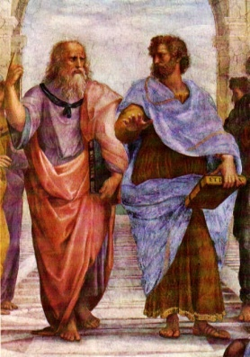
— RAISING THE LIFE BAR —
ETERNAL LIFE
Eternal Happiness
HIGHEST
MORMONISM, ETERNALISM
MEDIUM
GOOD LIFE
Mortal Happiness
ARISTOTLE, OBJECTIVISM
LIFE
At Any Cost
LOW
SURVIVAL OF THE FITTEST

Slide 14
Questions?

