Slide 1
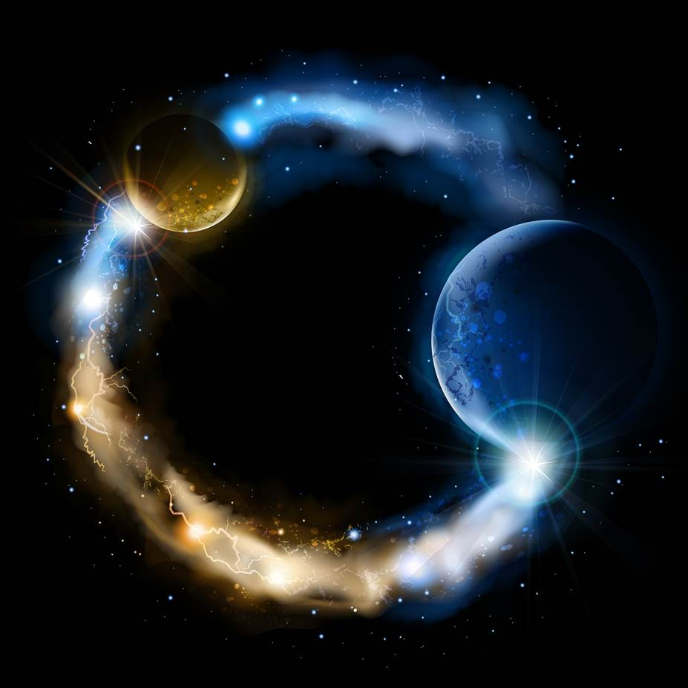
ETERNALISM MODULE 20
Ethics
Abide
and
Abound
Chapter 22: Happiness vs Duty

Slide 2
Which Has Primacy Virtues or Values?
VALUE
A VALUE is the GOOD which we desire to gain or keep.
VIRTUE
A VIRTUE is the RIGHT action by which we gain or keep it.
Virtues are right actions that preserve good.
Vices are wrong actions that destroy good.
Which Has Primacy Good or Right?
GOOD
Only by knowing the value of that which is good for us can we know what action is right and wrong to do in order to gain that good.
RIGHT
Which Has Primacy Ends or Means?
ENDS
Only by knowing the end goal can we know the means to get us there.
MEANS

Slide 3
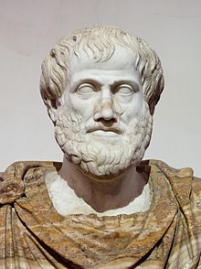
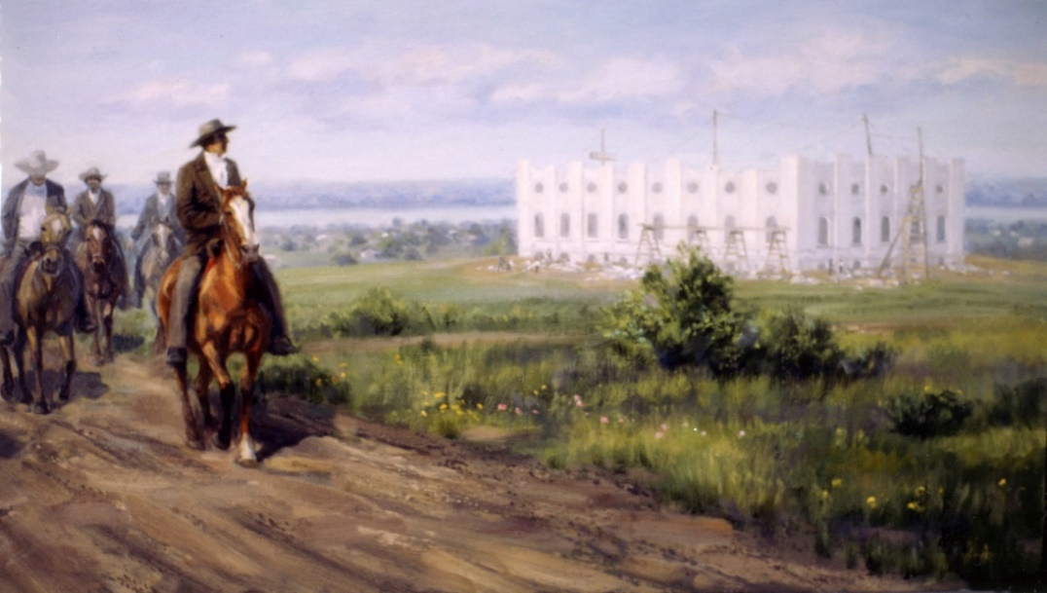
VALUE ETHICS: Life, Joy, Happiness
Happiness
Duty
ARISTOTLE: VALUE ETHICS
“All advice to do things or not to do them is concerned with happiness,
and with the things that make for or against it; whatever creates or increases happiness or some part of happiness, we ought to do; whatever destroys or hampers happiness, or gives rise to its opposite, we ought not to do.” (Rhetoric, 1360b4)
JOSEPH SMITH: VALUE ETHICS
“Happiness is the object and design of our existence and will be the end thereof, if we pursue the path that leads to it; and this path is virtue, uprightness, faithfulness, holiness, and keeping all the commandments of God. …
And as God has designed our happiness—and the
happiness of all His creatures, he never has—He never will institute an ordinance or give a commandment to His people that is not calculated in its nature to promote that happiness which He has designed, and which will not end in the greatest amount of good and glory to those who become the recipients of his law and ordinances.” (Teachings of the Prophet Joseph Smith, p. 255-257)

Slide 4
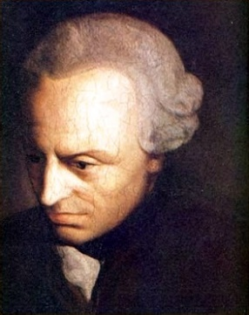
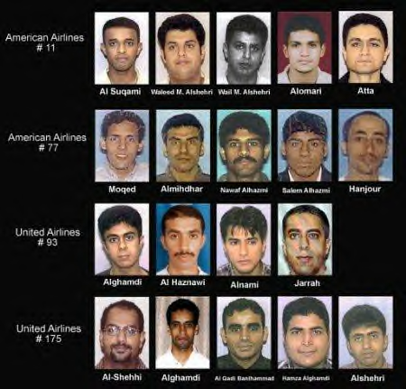
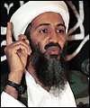
DUTY ETHICS: A Morality That Cannot Be Lived
Duty
Happiness
IMMANUEL KANT: DUTY ETHICS
"Kant argued that it was not the consequences of actions that make them right or wrong but the motives of the person who carries out the action." (wikipedia.org)
“The majesty of duty has nothing to do with enjoyment of life; it has its special law and its special tribunal” (Critique of Practical Reason, Pt. I,I, 3)
“Pure practical reason does not require that we should renounce all claim to happiness, but only that the moment duty is in question we should take no account of happiness” (Fundamental Principles of the Metaphysic of Morals, II)
"Man requires a master, therefore, to curb his will, and to compel him into submission to a universal will which may secure the possibility of universal freedom.“ (1784, Sixth Thesis)
BIN LADEN: DUTY ETHICS
“To kill Americans and their allies, both civil and military, is an individual duty of every Muslim who is able, in any country where this is possible,” (Bin Laden 1998 … Al-Quds al-Arabi)

Slide 5
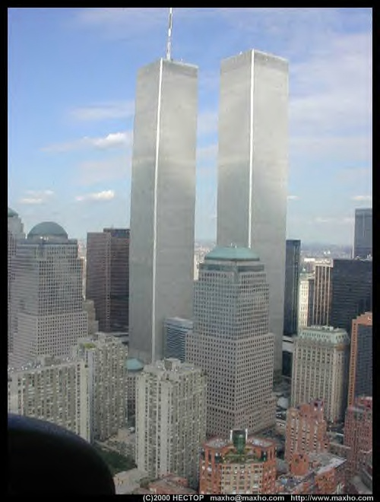
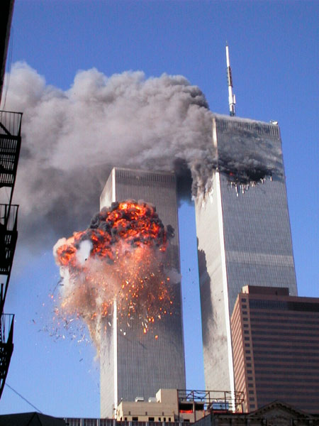
VALUE ETHICS
DUTY ETHICS
LIFE, JOY, HAPPINESS
DEATH, SORROW, MISERY
Aristotle: “Evil destroys even itself, and if it is complete becomes unbearable.” (Ethics, 1126a12)
Elder Boyd K. Packer: “He [Christ] does not have to be spiteful or vengeful in order that punishment will come from the breaking of the moral code. The laws are established of themselves.” ("Why Stay Morally Clean", April 1972)

Slide 6
Happiness Ultimate Good and Reward
Conditions
Happiness is the ultimate goal. It is a moral need that makes up part of our identity. Moral needs have primacy over Duties (chosen obligations)
Happiness
Moral Needs
President Lorenzo Snow: “Every principle that is revealed from the heavens is for our benefit, for our life, for our salvation, and for our happiness,” (JD 4: 183…See also D&C 59:3-4)
Duty
Commandments
Chosen Obligations
Happiness
Consequences
Duties have primacy over wants. As chosen obligations Duties are a necessary means to achieving your Good Life. Happiness is the reward for a life well-Lived.
Moral Fulfillment
The Good Life
Ends
Desired Goal
Only by knowing the end goal can we know the conditional means to get us there.
Long Term Goal
Means
John 5:39 Search the scriptures; for in them ye think ye have eternal life: and they are they which testify of me.
Christ
Chosen Method (Vehicle)
Ends
Long Term Arrival
Achieved Goal
Only by choosing the correct vehicle can we actually arrive.

Slide 7
Questions?

