Slide 1
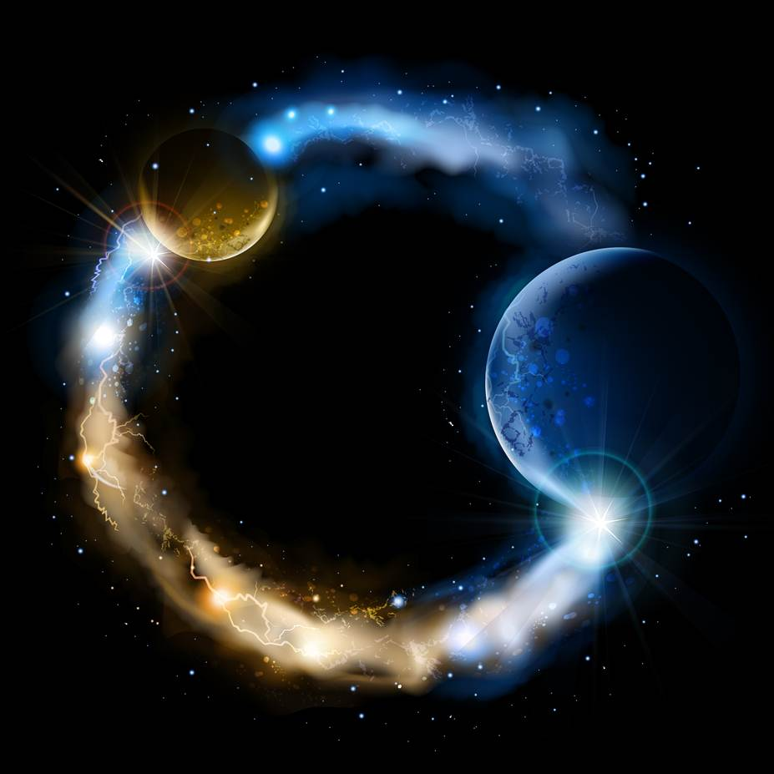
ETERNALISM MODULE 18
Epistemology
Abide
and
Abound
Chapter 20: Divine Attributes

Slide 2
The Nature of Mankind
Historical Christianity
(Depraved Parentage)
The Restoration
(Divine Parentage)
“Original sin according to Catholic theology, is ‘the hereditary stain with which we are born on account of our origin or descent from Adam.’”
(Catholic Encyclopedia, vol.11, pp.312-315)
First Presidency: “The Church of Jesus Christ of Latter-day Saints, basing its belief on divine revelation, ancient and modern, proclaim man to be the direct and lineal offspring of Deity. God Himself is an exalted man, perfected, enthroned, and supreme.” (Messages of the First Presidency” Vol. 4, p.206)
John Calvin: “Original sin, therefore, appears to be a hereditary, depravity and corruption of our nature, diffused through all the parts of the soul, rendering us obnoxious to the divine wrath and producing in us those works which the scripture calls 'works of the flesh’.” (Calvin Op. ii. 3I sq. edition of 1559)
President Brigham Young: “I wish you to understand that sin is not an attribute in the nature of man, but it is an inversion of the attributes God has placed in him.”
(JD 10:251)
President Brigham Young: “God has made His children like Himself to stand erect, and has endowed them with intelligence and power and dominion over all His works, and given them the same attributes which He himself possesses.” (JD 11:122)
Immanuel Kant: “Out of wood so crooked and perverse as that which man is made of, nothing absolutely straight can ever be wrought.” (Sixth Thesis)

Slide 3
The Nature of Faith
Historical Christianity
The Restoration
Calvinism: “Reformed theologians teach that sin so affects human nature that they are unable even to exercise faith in Christ by their own will.”
(Wikipedia.org Calvinism)
President Brigham Young: “God…has endowed us with glorious faculties, with Godlike attributes like those which are incorporated in his own nature, and he has placed us upon this earth to honor them, and to sanctify ourselves and the earth preparatory to enjoying it in its celestial state. “…man possesses the germ of all the attributes and power that are possessed by God his Heavenly Father.“ (JD 10:251,265)
“Faith is a gift of God, a supernatural virtue infused by him.“ (Catechism of the Catholic Church, #153)
Elder H. W. Naisbitt: “Now, the Gospel has been given us to do away with sin and death; it has been given to develop in us the attributes and characteristics of our Father in heaven from faculties we already possess.” (JD 21:108)
“By contrast, supernatural faith is not granted to everybody indiscriminately, since it is a special gift which Christ has obtained by his death in order to bestow it upon his elect people. It is a divine blessing, unmerited and without which nobody can enter heaven…” (Truth for Today "On Faith")
Elder Dieter F. Uchtdorf: "The scriptures describe a number of Christlike attributes we need to develop during the course of our lives. They include knowledge and humility, charity and love, obedience and diligence, faith and hope.“
("Developing Christlike Attributes", General Conference, October 2008)

Slide 4
What Is Faith? (Two Very Different Answers)
Apostate Christianity
Declares Faith to Be:
The Restoration
Declares Faith To Be:
A supernatural gift of God
man will accept
An inherent gift of God
man can develop
Beyond Man’s
Comprehension
Consequence of Man’s
Comprehension
VIRTUE
Injected to the Depraved Soul
ATTRIBUTE
Inherited from Divine Parentage
External
Foreign
Attribute
Internal
Native
Attribute
Exclusively
Christian
Inclusively
Human
A False, Dead, and Damning Faith
A True, Living, and Saving Faith
“Something Wicked this Way Comes”
“Something Blessed inside of us”

Slide 5
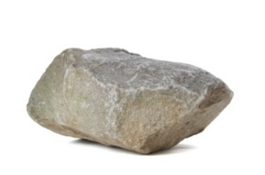
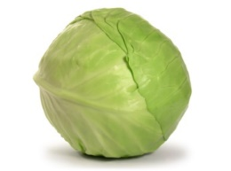


Mankind’s Dominion
Genesis 1:26 And God said, Let us make man in our image, after our likeness: and let them have dominion over the fish of the sea, and over the fowl of the air, and over the cattle, and over all the earth, and over every creeping thing that creepeth upon the earth.
D&C 93:36 The glory of God is intelligence…
President Brigham Young: “The intelligence we possess is from our Father and our God. Every attribute that is in His character is in His children in embryo. It is their duty to improve and develop those attributes.” (JD 12:105)
First Presidency: “He [God] made the tadpole and the ape, the lion and the elephant, but He did not make them in His own image, nor endow them with godlike reason and intelligence.” (Origin of Man, Nov. 1909 Improvement Era 75-81)
Which entities are in his image (capable of attributes of faith, hope, charity)?
MINERAL
VEGETABLE
ANIMAL
RATIONAL ANIMAL
NOTHING
(dumb as a rock)
SENSORY RESPONSE
(only in the present)
INSTINCTUAL PERCEPTION
(only in the present)
CONCEPTUAL CONSCIOUSNESS
(past, present, future)
Donald G. Bloesch: “The true God lies beyond the confines of man’s perception and conception.”
(Essentials of Evangelical Theology, Vol. 1, p. 26)

Slide 6
Rational Intelligence
Faith, Hope, and Charity are abstract CONCEPTS. “Abstract thinking is a level of thinking about things that is removed from the facts of the ‘here and now’, and from specific examples of the things or concepts being thought about. Abstract thinkers are able to reflect on events and ideas, and on attributes and relationships separate from the objects that have those attributes or share those relationships.” (http://www.projectlearnet.org)
Hugh Nibley: “The philosopher William James defines intelligence as the “ability to react to an absent stimulus.” (B of M, Part One, p. 350)
Animal Instinct vs Rational Intelligence
Ability to React Instinctively
to Past and Present Stimulus
Memory + Perception
Ability to React Intelligently to
Past, Present and Future Stimulus
Memory + Perception + Conception

Slide 7

Faith and Hope, Divine Attributes of the Soul
Hebrews 11:1 “NOW faith is the substance [assurance] of things hoped for, the evidence of things not seen.”
Alma 32:21 “And now as I said concerning faith—faith is not to have a perfect knowledge of things; therefore if ye have faith ye hope for things which are not seen, which are true.”
Moroni 7:40,42 “And again, my beloved brethren, I would speak unto you concerning hope. How is it that you can attain unto faith, save ye shall have hope? … Wherefore, if a man have faith he must needs have hope; for without faith there cannot be any hope.”
OUR SPIRITUAL DNA
Divine Attributes of the Soul
HOPE
FUTURE
EXPECTATIONS
PAST
ASSURANCES
PAST
ASSURANCES
FUTURE
EXPECTATIONS
FUTURE
EXPECTATIONS
PAST
ASSURARANCES
PAST
ASSURANCES
FUTURE
EXPECTATIONS
FAITH
No past assurances (FAITH) without future expectations (HOPE)…
No future expectations (HOPE) without past assurances (FAITH)…

Slide 8

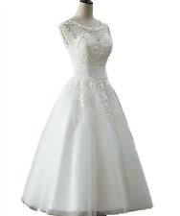
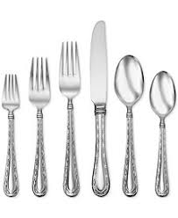
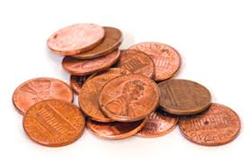
FALSE HOPE
TRUE HOPE
Wishing Well: A well or pool of water supposed to grant the wish of one who tosses a coin into it.
Hope Chest: Used to accumulate expensive domestic items in anticipation of future married life.
Wish: Most commonly denoting a desire for something not attainable by one’s own effort, felt in the mind but not impelling to action; a passive or inactive desire.
Hope: An attainable desire. To look forward with confidence or expectation. An active desire based on positive evidence.
We may wish that:
* Every day were Saturday (present)
* Or we hadn’t done what we did (past)
* Or we were young once again (future)
* Or others may die (evil)
* Or that others may change (others)
* Or we didn't have to exert ourselves any more than
the bare minimum (self)
Hope has an earnestness about it. We put our own special and expensive stock into it, with the expectation that at some point in the future it will benefit ourselves, after our actions have been achieved. Hoping is based on Primacy of Reality.
Wishing lacks credibility, which is why we do not put much stock (merely pennies, nickels, and dimes) into a wishing well. In short, it is just plain folly. Wishing is based on the primacy of consciousness.

Slide 9
Opposing Governing Spirits: Spirit of Charity or Spirit of Enmity
Moroni 10:20 Wherefore, there must be faith; and if there must be faith there must also be hope; and if there must be hope there must also be charity.
1 Cor 13:13 And now abideth faith, hope, charity, these three; but the greatest of these is charity.
Charity: Benevolent goodwill toward or love of humanity. (Merriam-Webster Dictionary)
Enmity: The state or feeling of being actively opposed or hostile to someone or something. (Google Search)
Brigham Young: “Light, intelligence, good, that which is of God, creates, fashions, forms, builds up, brings into existence, beautifies, makes excellent, glorifies, extends and increases. But that is not the easy road to power; it is easier to doubt than to believe, to tear down … to set a fire than to put one out, so that ‘that which is not of God burns, destroys, cuts down, ruins … Light and intelligence lead people to the fountain of truth; while the opposite principle says, ‘Don’t believe a word, don’t do a thing; burn up and destroy.’” (Brother Brigham Challenges the Saints, p. 49)
Christ a being of True Faith, Hope, Charity …
Buildeth Up
Lucifer a Being of False Faith, Wishes, Enmity …
Teareth Down
charity = the pure love of Christ (agape)
governs all your comings and goings
enmity = the impure hostility of Lucifer
governs all your comings and goings

Slide 10
Faith , Hope, Charity
Attributes of the Human Soul
1. FAITH IS A LIFE MOVING PRINCIPLE (As Opposed to Doubt)
Faith Consists In Past Assurances and Future Expectations which Incite Us to Act With a Continual Trust and Confidence.
… not a supernatural theological virtue
2. HOPE IS A LIFE ENDURING PRINCIPLE (As Opposed to Despair)
Hope Consists In the Joyful, Earnest and Steadfast Anticipation of a Future Expectation which Maketh an Anchor to the Soul both Sure and Steadfast.
… not a supernatural theological virtue
3. CHARITY IS A LIFE GOVERNING PRINCIPLE (As Opposed to Enmity)
Charity Consists In the Pure Love of Christ (Holy Spirit) Sanctifying Your Present Disposition While Guiding and Governing Life’s Choices.
… not a supernatural theological virtue

Slide 11






FAITH AND HOPE AS POWER
INCREASING POWER
Ralph Waldo Emerson: “That which we persist in doing becomes easier to do, not that the nature of the thing has changed but that our power to do has increased.”
PERFECT KNOWLEDGE
Alma 32:34 And now, behold, is your knowledge perfect? Yea, your knowledge is perfect in that thing, and your faith is dormant; and this because you know…
Alma 32:35 O then, is not this real? I say unto you, Yea, because it is light; and whatsoever is light, is good, because it is discernible, therefore ye must know that it is good;
Present Actions
Places To Go
People To See
Things To Do
Alma 32:36 Behold I say unto you, Nay; neither must ye lay aside your faith, for ye have only exercised your faith to plant the seed that ye might try the experiment to know if the seed was good.
John A Widtsoe: “Without faith, the chemist would not fill his test tube, the astronomer would not look through his telescope, the business man would not replenish his stock, the painter would leave his brush on the palette. All would stagnate. Success does not wait on blunderers or fearful ones. The fruits of faith are confidence, courage, certainty, progress—all vital elements of success.”
(An Understandable Religion, pg. 101-102)
Hope
Future Expectations Keep You Going
Past Assurances Get you Going
Faith
“Leap of Faith” Seeing Is Believing
Believing Is Foreseeing “Look Before You Leap”
DOUBT
DESPAIR
CRIPPLING FEARS

Slide 12
Does God Exercise Faith?
Alma 32:21 And now as I said concerning faith—faith is not to have a perfect knowledge of things; therefore if ye have faith ye hope for things which are not seen, which are true.
1. Faith is not to have a perfect knowledge of things.
2. God knows all things.
(omniscient = perfect knowledge)
Therefore … God is not a being of faith?
2 Nephi 9:20 O how great the holiness of our God! For he knoweth all things, and there is not anything save he knows it.
?
How can God both be omniscient and exercise Faith?
Joseph Smith ”The attributes of God are listed as: Knowledge; Faith or Power; Justice; Judgment; Mercy, and Truth.” (Mormon Doctrine p.263, summary of Lectures on Faith, pp. 42-49).
1. An attribute of God is listed as faith.
2. God created the Heaven and Earth.
3. The Heaven and Earth were created by power of faith.
Therefore … God is a being of faith?
Genesis 1:1 In the beginning God created the heaven and the earth.
Hebrews 11:3 Through faith we understand that the worlds were framed by the word of God, so that things which are seen were not made of things which do appear.

Slide 13
GOD IS A BEING OF FAITH
Sufficient Knowledge Precedes Faith
Knowledge
(sufficient)
Faith
Knowledge
(perfect)
Isaiah 14:24,27: “The Lord of hosts hath sworn, saying, Surely as I have thought, so shall it come to pass; and as I have purposed, so shall it stand … For the Lord of hosts hath purposed, and who shall disannul it? and his hand is stretched out, and who shall turn it back?
(Quoted in Lectures on Faith, p.42)
Faith Precedes A Perfect Knowledge
RATIONAL FAITH (Tier 1-2) Is Based Upon:
(1) past assurances + (2) future expectations = (3) power to act
Seeing Is Believing (evidence)
Believing Is Foreseeing
Being of Faith (Imperfect Knowledge)
PERFECT KNOWLEDGE (Tier 2-3) Is Based Upon:
(4) Foreseeing Is Foreordaining
Power to Act In Advance
(Omnipotence)
(5) Foreordaining Is Foreknowing
A Perfect Knowledge
(Omniscience)
=

Slide 14
Questions?

