Slide 1
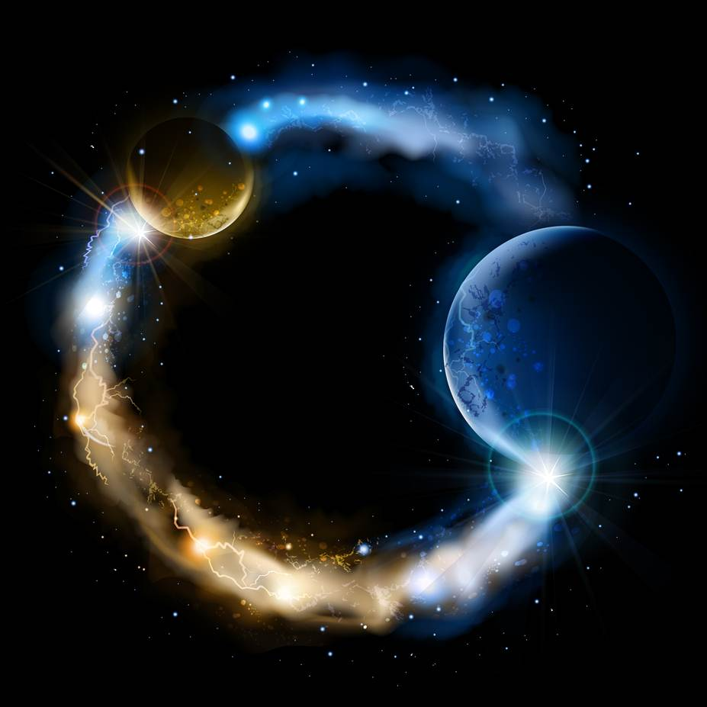
ETERNALISM MODULE 17
Epistemology
Abide
and
Abound
Chapter 19: Faith Defined
Case 4: True Faith Examples

Slide 2
What is faith?
Two very different answers.
Elder Orson Pratt: “Faith is of two kinds, namely false and true. (“The True Faith”, #3)
Why is it essential to understand faith?
Hebrews 11:6 “Without faith it is impossible to please him [God].”
Elder Orson Pratt: “Faith alone will not save men: neither will faith and works save them, unless they are of the right kind. Indeed the faith and works of the greatest portion of mankind will be the very cause of their damnation. True faith and righteous works are essential for salvation; and without both of these, no man ever was, or ever can be saved.” (“The True Faith”, #11)
What are the characteristics of TRUE FAITH verses FALSE FAITH?
RESTORED GOSPEL
TRADITIONAL CHRISTIANITY
Elder Orson Pratt: Faith or belief is the result of evidence presented to the mind. Without evidence, the mind cannot have faith in anything. (“The True Faith”, #2)
Webster College Dictionary Faith: belief that is not based on proof [evidence].
Mortimer Adler: “Faith consists of beliefs voluntarily espoused, beliefs that are totally beyond the reach of evidence and rational processes. ‘I believe,’ said an early Christian, Tertullian, ‘because it is absurd’ - that is, nonrational.” (Adler’s Philosophical Dictionary)
Elder Orson Pratt: “A false faith is the result of giving credence to false evidence; a true faith, the result derived from true evidence.” (Elder Orson Pratt “The True Faith”, #3)

Slide 3
BLIND FAITH: Declaring War on Reason and the Human Mind
St. Thomas Aquinas: “To those who have faith, no explanation is necessary; to those who do not, no explanation is possible.” (attributed)
St. Augustine: “I do not know in order to believe. I believe in order to know.” (Tractate 27” Chap 6: 60–72)
Martin Luther: “It is impossible to harmonize faith and reason … You must abandon your reason, know nothing of it, annihilate it completely or you will never enter heaven … You must leave reason to itself for it is the born enemy of faith … There is nothing so contrary to faith as law and reason.”
(Three Reformers, p. 33-34)
Martin Luther: “Reason is the whore of the Devil. It can only blaspheme and dishonour everything God has said or done … throw dung in her face to make her ugly. She is and she ought to be drowned in baptism.” (E29, 241; E15 142)
Martin Luther: “Usury, drunkenness, adultery – these crimes are self-evident and the world knows that they are sinful; but that bride of the Devil, ‘Reason,’ stalks abroad, the fair courtesan, and wishes to be considered wise, and thinks that whatever she says comes from the Holy Ghost. She is the most dangerous harlot the Devil has.” (E29 241)

Slide 4
INCOMPREHENSIBLE FAITH: Mired in Mystery
Donald G. Bloesch: “In seeking understanding, faith must be on guard against making its cardinal doctrines too clear and distinct (á la Descartes), since this serves to undercut or deny the mystery in revelation. … Revelation overthrows and disrupts human reason, while at the same time placing it on a new foundation. (Essentials of Evangelical Theology, Vol. II, p. 267-269)
Karl Barth: “Faith is not, therefore, a standing, but a being suspended and hanging without ground under our feet.” (Essentials of Evangelical Theology, Vol. I, p. 226)
Heart
Mind
Donald G. Bloesch: “The essence of piety is neither knowing nor doing but feeling.” (Essentials of Evangelical Theology, Vol. II, p. 54)
Martin Luther: “Rage acts as a stimulant to my whole being. It sharpens my wits, puts a stop to the assault of the Devil and drives out care. Never do I write or speak better than when I am in a rage. If I wish to compose, write, pray and preach well, I have to be in a rage.”
(Table Talk, 1210)

Slide 5
KNIGHT OF FAITH
KNIGHT OF REASON
Søren Kierkegaard: “It is easy to see, though it scarcely needs to be pointed out, since it is involved in the fact that the reason is set
Elder Orson Pratt: “Faith or belief is the result of evidence presented to the mind. Without evidence, the mind cannot have faith in
aside, that Faith is not a form of knowledge … Without risk there is no faith, and the greater the risk the greater the faith … [to understand faith] is to understand that faith cannot be understood ... must not be understood … and this absurdity, held fast in the passion of inwardness, is faith, the earnestness of facing the absurd.” (Pap., X 2 A 371; Postscript pp. 182-188)
anything … The weakness or strength of faith will, therefore, in all cases, be in proportion to the weakness or strength of the impressions, produced upon the mind by evidence … Faith most generally inspires the heart to actions or works of a nature similar and suitable to the belief.” (Elder Orson Pratt, “True Faith”, #4, #5, #13)
Faith
Reason
Revelation
Observation
Heart
Mind
Reason
Faith
Observation
Revelation
Mind
Heart

Slide 6
Who is the True Knight of Faith?
Faith
Reason
Soren Kierkegaard: “…absurdity, held fast in the passion of inwardness, is faith, the earnestness of facing the absurd.”
Heart
Mind
The Stronger the Opposing Evidence the Greater the Faith.
I Believe Because it Is Absurd
and Can’t Possibly Be True
I Believe Because it Is Based
on Sound Rational Evidence
- 100%
Opposing Evidence
0%
Supporting Evidence
+ 100%
Sons of
PERDITION
(D&C 76:25-49)
Sons of
GOD
(Moroni 7:26)
strong
weak
weak
strong
PERFECT
ABSURDITY
Willfulness
PERFECT
IGNORANCE
Lawfulness
PERFECT
KNOWLEDGE
Willful Faith
Blind Faith
Rational Faith
The Stronger the Supporting Evidence the Greater the Faith
Reason
Faith
Mind
Heart
Elder Orson Pratt: “Without evidence, the mind cannot have faith in anything.”

Slide 7
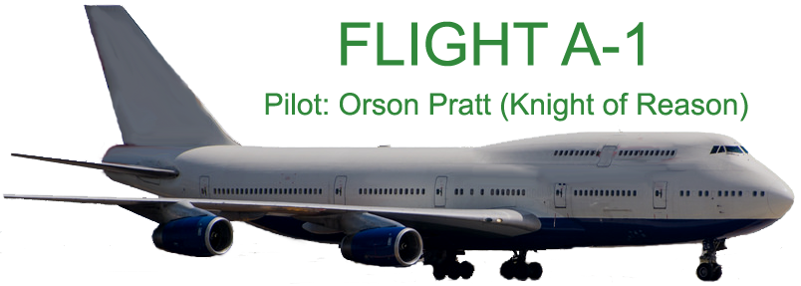
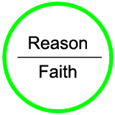
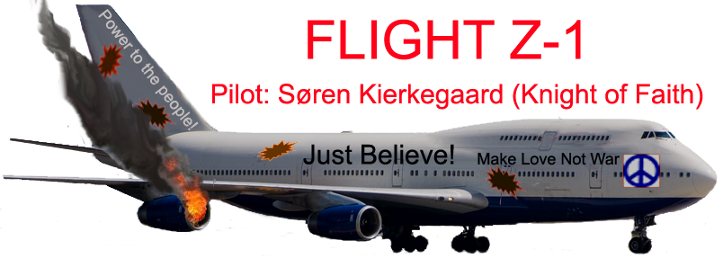
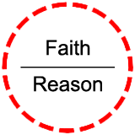

Slide 8

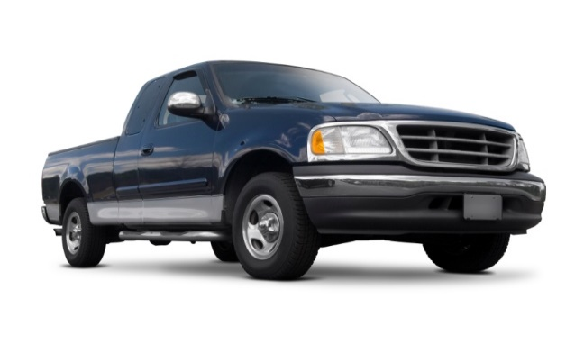

Your Second Philosophical Walk
Existential Proof
Obvious Absurdity, Death Wish
of Blind or Willful Faith
Which Couple (A, B or C) Has the
Greater Faith When Crossing a Busy Street?
COUPLE C
Look and Leap Into Traffic
COUPLE B
Leap of Blind Faith
COUPLE A
Look Before They Leap
- 100%
Opposing Evidence
0%
Supporting Evidence
+ 100%
strong
weak
weak
strong
PERFECT
ABSURDITY
Willfulness
PERFECT
IGNORANCE
Lawfulness
PERFECT
KNOWLEDGE
Willful Faith
Blind Faith
Rational Faith

Slide 9
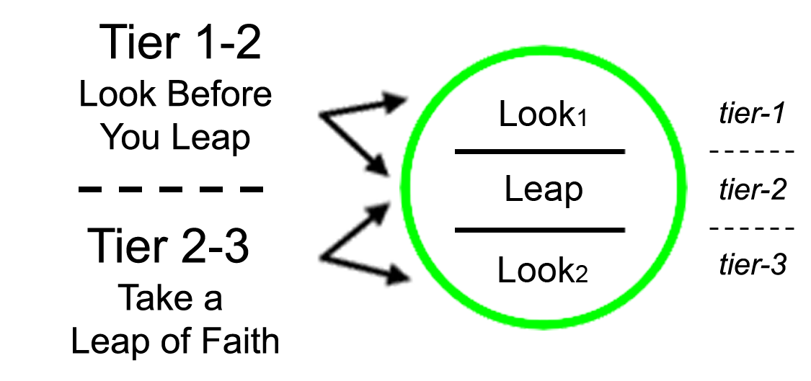
What about “Leaps of Faith”?
Elder Boyd K. Packer: “I returned to Elder Lee and told him that I saw no way to move in the direction I was counseled to go. He said, ‘The trouble with you is you want to see the end from the beginning.’ I replied that I would like to see at least a step or two ahead. Then came the lesson of a lifetime: ‘You must learn to walk to the edge of the light, and then a few steps into the darkness; then the light will appear and show the way before you.’ Then he quoted these 18 words from the Book of Mormon: ‘Dispute not because ye see not, for ye receive no witness until after the trial of your faith’ (Ether 12:6).” (Ensign Aug 2013 “Move Forward in Faith”)
Look
Leap
Which has Primacy: Look or Leap?
Leap
Look

Slide 10
Questions?

