Slide 1
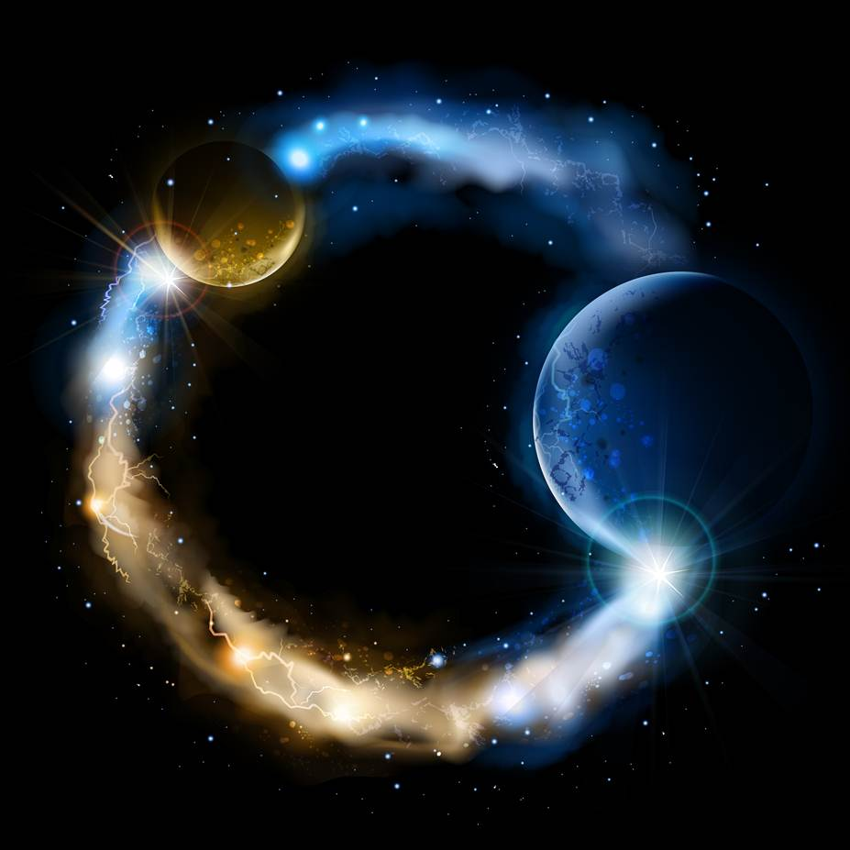
ETERNALISM MODULE 16
Epistemology
Abide
and
Abound
Chapter 17: Truth Attacked
Chapter 18: Fallacies

Slide 2
PRAGMATISM
Pragmatism is a philosophical tradition that rejects the idea that the function of thought is to describe, represent, or mirror reality. (Wikipedia.org: pragmatism)
“The Pragmatists declared that philosophy must be practical and that practicality consists of dispensing with all absolute principles and standards—that there is no such thing as objective reality or permanent truth—that truth is that which works … and its validity can be judged only by its consequences and whatever one wishes to be true, is true, whatever one wishes to exist, does exist, provided it works or makes one feel better. There are no fixed laws of logic, only mutable ‘conventions,’ without any basis in reality. …There is no objectivity—the object is created by the thought and action of the subject.”
(The Ayn Rand Lexicon, Pragmatism)

Slide 3

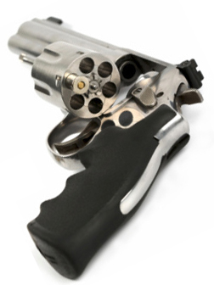
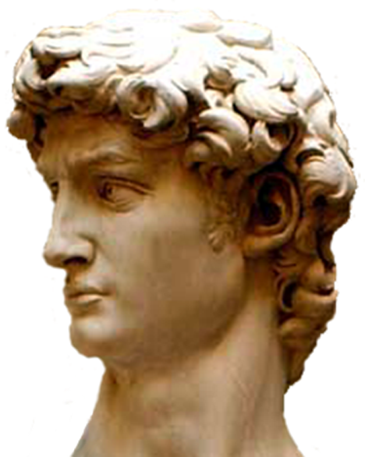
I’ll try out my PRIMACY OF CONSCIOUSNESS theory in
a game of “Russian Roulette” and see if it is the TRUTH!
WARNING:
DO NOT TRY
THIS
THE PRAGMATIC
THEORY OF TRUTH
AT WORK

Slide 4
THE PRAGMATIC THEORY OF TRUTH AT WORK
Click = Truth!
WARNING:
DO NOT TRY THIS
Click = Truth!
Click = Truth!
Click = Truth!
Click = uh …
Boom!

Slide 5
RELATIVISM (Truth is relative…it changes with time and place)
Elder D. Todd Christofferson: “Relativism means each person is his or her own highest authority. ... To those who believe anything or everything could be true, the declaration of objective, fixed, and universal truth feels like coercion—'I shouldn’t be forced to believe something is true that I don’t like.’” ("Free Forever, to Act for Themselves", October 2014)
SKEPTICISM (Ignorance…truth may exist but is unknowable)
Ayn Rand (mocking the skeptics): “…reality perceived by man’s mind is a distortion. The distorting mechanism is man’s conceptual faculty…[Kant’s] argument, in essence, ran as follows: man is limited to a consciousness of a specific nature, which perceives by specific means and no others, therefore his consciousness is not valid: man is blind, because he has eyes – deaf, because he has ears – deluded, because he has a mind – and the things he perceives do not exist, because of the fact that he perceives them.”
(The Ayn Rand Lexicon: Kant, Immanuel)
SUBJECTIVISM (truth varies from person to person)
“The subjectivist denies that there is any such thing as ‘the truth’…On his view truth varies from consciousness to consciousness…” (Leonard Peikoff, The Objectivist, Jan 1971, p9)
DOGMATISM (Unfounded certitude)
Elder Boyd K. Packer: “A virtue when pressed to the extreme may turn into a vice. Unreasonable devotion to an ideal, without considering the practical application of it, ruins the ideal itself.” ("Covenants", Oct. 1990 Ensign)

Slide 6
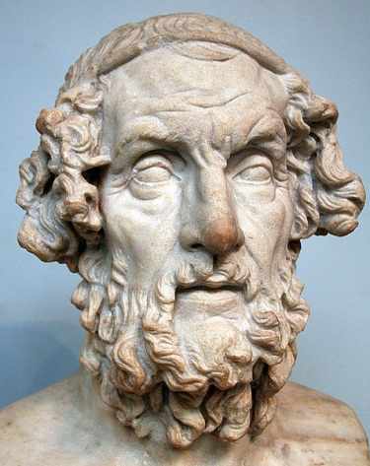
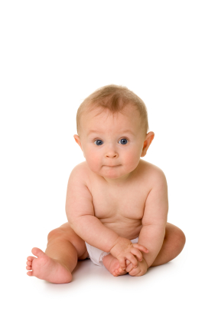
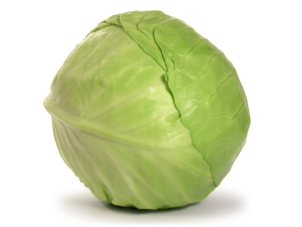
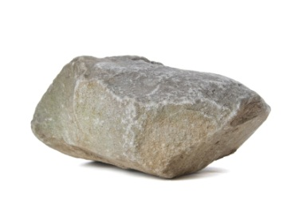

Cratylus’ believed that no knowledge is possible, because by the time you attempt to categorize anything it has already changed. Since nothing true can be said of all things that change, words themselves are meaningless. Cratylus advocated giving up speech altogether, only communicating by wiggling his little finger.
Aristotle: “For such a man, (an extreme skeptic who believes knowledge is impossible on any level), as such, is from the start no better than a vegetable.” (Metaphysics Book IV, Part IV).
Mineral
Vegetable
Animal
Mankind
“Dumb as a Rock”
“Cabbagehead” idiot
Perceptual Level
Instinct Tool of Survival
Conceptual Level
Reason Tool of Survival

Slide 7
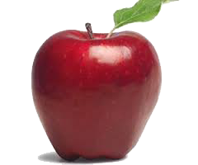
REALITY: Objective Standard of True and False
TIER 1 STATUS:
Existence
TIER 2 STATUS:
Consciousness
REALITY
Objective
Standard
of Truth
Reality
Reason
Mind
NOTHING WHATSOEVER STANDS BETWEEN
YOU AND THE STANDARD OF TRUTH
Thought
When what I think corresponds with the way
things are in reality … then I think truly.
D&C 93:24 “And truth is knowledge of things as they are, and as they were, and as they are to come.”

Slide 8


FALLACIES: Mixing up sources of truth with the standard of truth
TIER 2 STATUS:
Existence
TIER 1 STATUS:
Consciousness
Competing Gods, Feelings, Authorities, Scriptures and Prophets … All vying for your allegiance!
REALITY
Objective
Standard
of Truth
Reality
Reason
Mind
Thought
Scriptures
Prophets
Primacy of
Consciousness
God, Faith
and Heart
Subjective
Standards
of Truth
Expert
Opinion
God
Conformity
With Revered
Authority
Feelings
NUMEROUS VALID and INVALID SOURCES OF TRUTH
D&C 93:24 “And truth is knowledge of things as they are, and as they were, and as they are to come.”

Slide 9
FALLACIES: Mixing up sources of truth with the standard of truth
TIER 1 STATUS:
Existence
TIER 2 STATUS:
You
TIER 3 STATUS:
Sources
REALITY
Objective
Standard
of Truth
Reality
Reason
Mind
Thought
Scriptures
Prophets
Numerous VALID
and INVALID Sources of Truth
Expert
Opinion
God
Feelings
D&C 93:24 “And truth is knowledge of things as they are, and as they were, and as they are to come.”

Slide 10
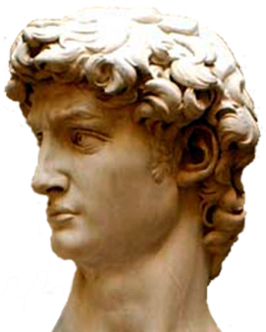
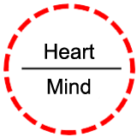
Fallacies: Emotionalism, Irrationalism … Appeal to Emotions
Conformity with Feelings
WILLFULNESS
Subjective Standard
What I Feel
REALITY
Standard
of Truth
Emotional Faculty
Rational Faculty
Giving the emotional faculty primacy over the rational faculty. Personal feelings take over all five branches of philosophy and become the standard by which we judge:
(1) real or unreal; (2) true or false; (3) good or evil; (4) just or unjust (5) beautiful or ugly
Star Wars: “Luke … let go … follow your feelings.”
Hymn 336: “School thy feelings, O my brother; Train thy warm, impulsive soul. Do not its emotions smother, But let wisdom’s voice control. School thy feelings; there is power In the cool, collected mind. Passion shatters reason’s tower, Makes the clearest vision blind.”
D&C 93:24 “And truth is knowledge of things as they are, and as they were, and as they are to come.”

Slide 11
Fallacies: Argumentum ad Populum … Appeal to Popular Opinion
Conformity with Majority
WILLFULNESS
Subjective Standard
REALITY
Standard
of Truth
Rational Faculty
Claiming that truth is what the majority believe it to be. Using opinion polls rather than reality as the standard of truth. Thinking wide spread acceptance of a view must make it true.
It must be true since so many people believe it.
It must be good since so many people want it.
It must be right since so many people do it.
D&C 93:24 “And truth is knowledge of things as they are, and as they were, and as they are to come.”

Slide 12
Fallacies: Argumentum ad Verecundiam … Appeal to Authority
Conformity with Authority
WILLFULNESS
Subjective Standard
REALITY
Standard
of Truth
Expert Opinion
Authority Figure
Credible Source
Rational Faculty
A famous person such as an athlete says it is true. A parent says … “It’s true because I said so.”
It must be true since my favorite teacher said it was.
It must be good since my best friend loves it.
It must be right since a popular role model is doing it.
D&C 93:24 “And truth is knowledge of things as they are, and as they were, and as they are to come.”

Slide 13
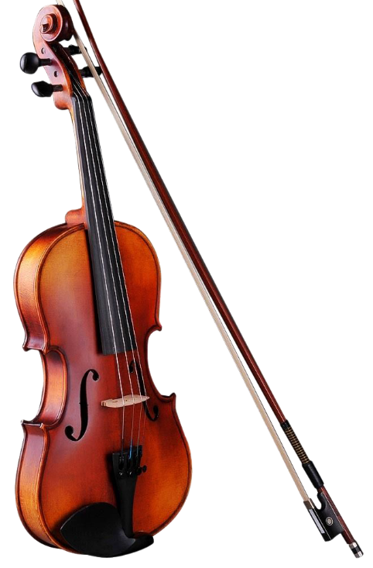
Fallacies: Argumentum ad Verecundiam … Appeal to Authority
Interpreted Authority
WILLFULNESS
Subjective Standard
REALITY
Standard
of Truth
Holy Scriptures
Rational Faculty
“The Bible Says It – I Believe It – That Settles It”
Elder George Q. Cannon: “It has frequently been remarked by those who scoff at it [the Bible] that it is like a fiddle, every kind of a tune can be played upon it. It requires something more than the Bible to guide man to eternal life. It requires divine inspiration, it requires the Holy Ghost, it requires the Priesthood, as it existed in ancient days, to be restored.” (JD 14:54)
D&C 93:24 “And truth is knowledge of things as they are, and as they were, and as they are to come.”

Slide 14
Fallacies: Argumentum ad Verecundiam … Appeal to Authority
Blind Obedience
WILLFULNESS
Subjective Standard
REALITY
Standard
of Truth
Prophets
Rational Faculty
Elder Dallin H. Oaks: “We don't believe in infallibility of our leaders. What we believe in is the organization the church has set in place. With multiple prophets, seers, and revelators, and with a council system.”(Press conference with the First Presidency, January 16, 2018)
President Brigham Young: “I could give you, thus saith the Lord; but the faith we have embraced is so reasonable, rational and consistent, and so easily proved, that I am not under the necessity of saying, thus saith the Lord. If I wanted you to believe a mass of folly and nonsense, such as others wish you to believe, then it would be necessary to say, thus saith the Lord, to operate upon the fears of the more ignorant and superstitious of mankind. The truth always stands upon its own foundation, and speaks for itself.” (JD 10:340)
D&C 93:24 “And truth is knowledge of things as they are, and as they were, and as they are to come.”

Slide 15
BLIND OBEDIENCE AND BLIND FAITH
ARE DESTRUCTIVE OF A RATIONAL FAITH
Joseph Smith: “We have heard men who hold the priesthood remark that they would do anything they were told to do by those who preside over them even if they knew it was wrong; but such obedience as this is worse than folly to us; it is slavery in the extreme; and the man who would thus willingly degrade himself, should not claim a rank among intelligent beings, until he turns from his folly. A man of God would despise the idea. Others, in the extreme exercise of their almighty authority have taught that such obedience was necessary, and that no matter what the saints were told to do by their presidents, they should do it without any questions. When Elders of Israel will so far indulge in these extreme notions of obedience as to teach them to the people, it is generally because they have it in their hearts to do wrong themselves.” (Millennial Star, Vol. 14, No 38, pg. 593-594)

Slide 16
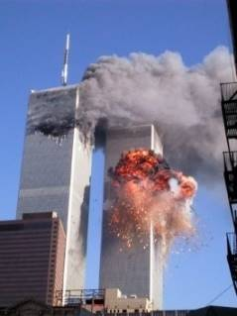
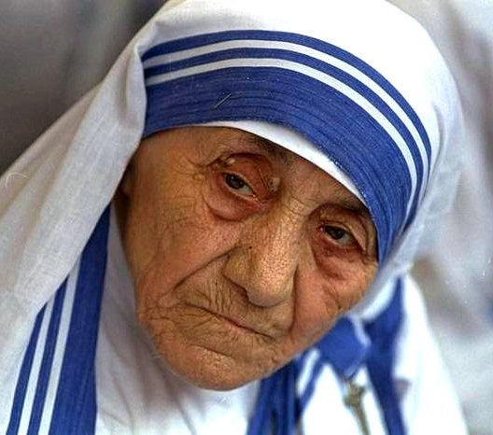
Fallacies: Argumentum ad Verecundiam … Appeal to Authority
Absolutism
of God
Blind Obedience
WILLFULNESS
Subjective Standard
REALITY
Standard
of Truth
Rational Faculty
Mother Teresa: “Believe in Him, trust in Him with a blind and absolute confidence because He is Jesus.” (No Greater Love, p.87)
“A Missionary of Charity is just a little instrument in the hands of God. We must try to keep it always like that—being just a small instrument in his hands. Very often I feel like a little pencil in God’s hand. He does the writing; he does the thinking; he does the movement—I have only to be a pencil and nothing else.” (Total Surrender, p.126)
“I will renounce my will, my inclinations, my whims and fancies and offer myself as a willing slave to the will of God. Yes, my children, this is what I pray for daily, for each one, that you may become a slave to the will of God” (Total Surrender, p.32)
D&C 93:24 “And truth is knowledge of things as they are, and as they were, and as they are to come.”

Slide 17
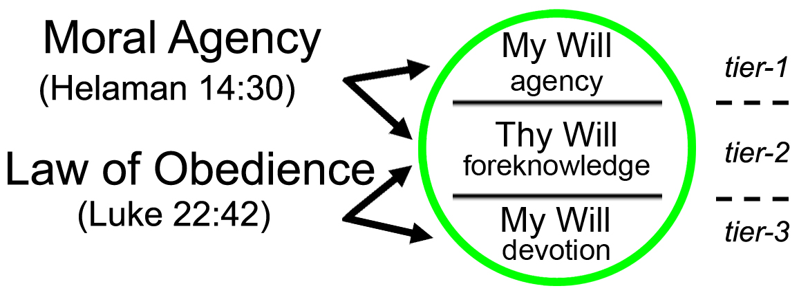
GOD’S FREE MAN
“Agency is a precious gift from God; it is essential to His plan for His children. In Satan's rebellion against God, Satan ‘sought to destroy the agency of man’ (Moses 4:3).” (LDS.org topics: Satan)
President John Taylor: “I was not born a slave! I cannot, will not be a slave. I would not be a slave to God! I’d be his servant, friend, His son. I’d go at His behest; but would not be His slave. I’d rather be extinct than be a slave! … But stop! I’m God’s free man: I will not, cannot be a slave!” (The Life of John Taylor, p.424)
President Joseph F. Smith: “When our leaders speak it is for us to obey; when they direct we should go; when they call we should follow. Not as beings who are enslaved or in thralldom; we should not obey blindly, as instruments or tools [such as pencils]. No Latter-day Saint acts in this manner; no man or woman who has embraced the Gospel has ever acted in this way.” (JD 12:329)
Luke 22:42 ”nevertheless not my will, but thine, be done.”
Helaman 14:30 “…for behold, ye are free; ye are permitted to act for yourselves; for behold, God hath given unto you a knowledge and he hath made you free.”

Slide 18
Questions?

