Slide 1
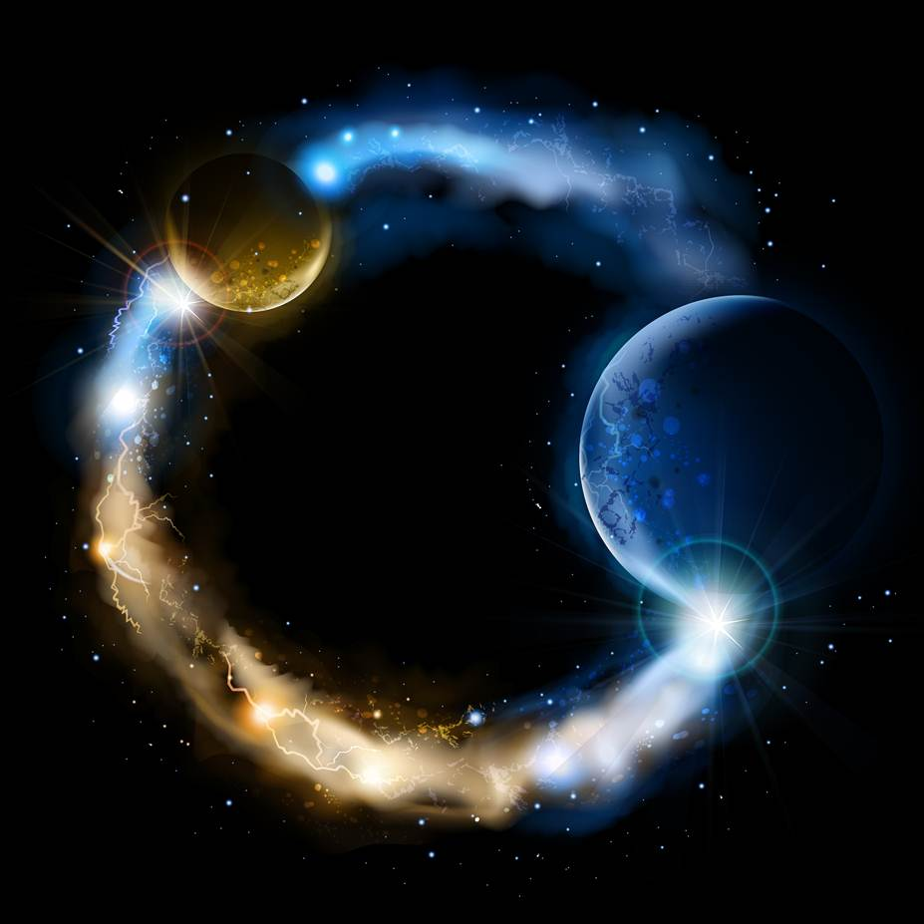
ETERNALISM MODULE 15
Epistemology
Abide
and
Abound
Chapter 16: Truth Defined

Slide 2
What is Truth?
President Brigham Young: “The mind would ask at once, what is truth? It is anything, principle, or fact that actually has an existence.” (JD 1: 116)
Mortimer J. Adler: “For all who think reality exists independently of the mind and that reality is what it is regardless of how we think about it, the definition of truth is the agreement of thought with reality. What makes descriptive judgments true is that it corresponds to the way things are.” (Truth in Religion, p.21)

Slide 3


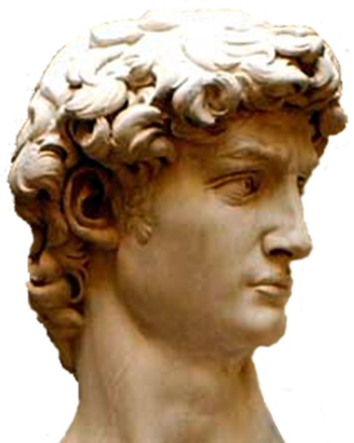
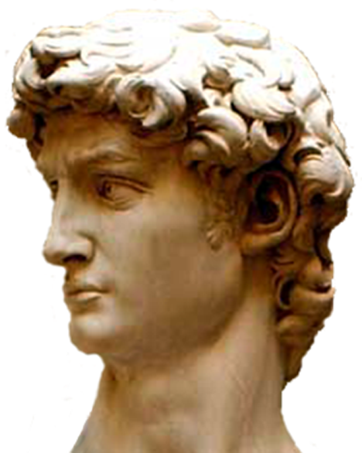
This is a microscope
This is a telescope
Assertion is
TRUE
Assertion is
FALSE
MICROSCOPE
CORRESPONDENCE
NO CORRESPONDENCE
Aristotle‘s Definition of Truth
Aristotle: “When I assert that that which is, is, or that that which is not, is not, my assertion is true. When I assert that that which is, is not, or that that which is not, is, my assertion is false.” (Six Great Ideas, p. 33)

Slide 4


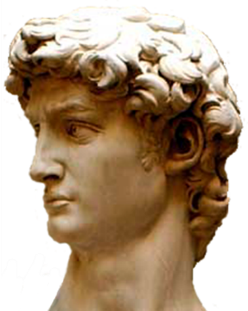
1.
CORRESPONDENCE
2.
CORRESPONDENCE
is-apple
is-not-apple
TRUE
TRUE
is-apple
is-not-apple
Aristotle’s Correspondence Theory of Truth: When I assert that
1. that which is, is,
2. or that that which is not, is not,
my assertion is true.
3. When I assert that that which is, is not,
4. or that that which is not, is,
my assertion is false.
3.
NO CORRESPONDENCE
4.
NO CORRESPONDENCE
is-not-apple
is-apple
FALSE
FALSE
is-apple
is-not-apple

Slide 5
The Restored Gospel’s Definition of Truth
D&C 93:24 “And truth is … things as they are, and as they were, and as they are to come.”
?
1. TRUTH IS …
2. REALITY
METAPHYSICAL
D&C 93:24 “And truth is knowledge of things as they are, and as they were, and as they are to come.”
1. TRUTH IS …
2. KNOWLEDGE OF …
3. REALITY
EPISTEMOLOGICAL

Slide 6
Christ’s Definition of Truth Confirms Reality…
Not God as the Standard of Truth
Absolutism of Reality
Primacy of Existence
Absolutism of God
Primacy of Consciousness
Does D&C 93:24 describe truth as: Correspondence with God’s will?
OR
Correspondence with reality?
REALITY
GOD
GOD
REALITY
Reality … as Standard of Truth
Life … as Standard of Value
God … as Standard of Perfection
God … as Standard of Truth
God … as Standard of Value
God … as Standard of Perfection

Slide 7
Why is Truth Important?
President Brigham Young: “All truth is for the salvation of the children of men—for their benefit and learning—for their furtherance in the principles of divine knowledge; and divine knowledge is any matter of fact—truth; and all truth pertains to divinity.” (JD Vol.7, p.284)
Joseph Smith: “A man is saved no faster than he gets knowledge, for if he does not get knowledge, he will be brought into captivity by some evil power in the other world, as evil spirits will have more knowledge, and consequently more power than many men who are on the earth.” (History of the Church, 4:588)
John 8:32 “And ye shall know the truth, and the truth shall make you free.”

Slide 8
TWO DISTINCT QUESTIONS
Mortimer J. Adler: “In the literature devoted to the consideration of truth, there are two quite distinct questions that are often confused. One is the question: What is truth? … The other is: By what means or criteria can we determine whether this or that proposition is true or false?” (Truth in Religion, p. 21)
WHAT IS TRUTH?
The Standard
IS IT TRUE?
The Test
Definition
Validation
Validation
Definition
Mortimer J. Adler: “The definition of truth as correspondence or agreement of thought with reality does not immediately yield an answer to the second question [What is True?] … if a true proposition is one that accurately describes the way things really are, then if we act upon it, our action should work successfully … This is the pragmatic theory of how to determine whether our judgment about the truth of a proposition is correct or not.”
(Truth in Religion, p. 22)

Slide 9
PRIMACY OF REALITY
What is Truth? DEFINITION = CORRESPONDENCE
D&C 93:24: “And truth is knowledge of things as they are, and as they were, and as they are to come.”
TRUTH IS … KNOWLEDGE OF … REALITY
Is it True? = THREE TESTS
(1) PRAGMATIC TEST … Application of Existential Proof
That which works in reality passes this test.
Pragmatic
Test
Tier-1
(2) COHERENCE TEST … Application of Philosophical Proof
That which coheres with other truths passes this test.
Coherence
Test
Tier-2
(3) REVELATORY TEST … Application of Theological Proof
That which is confirmed by the Holy Ghost passes this test.
Revelatory
Test
Tier-3

Slide 10
THREE TESTS
PRAGMATIC TEST
Abraham 3:24-25: “… And we will prove them herewith, to see if they will do all things whatsoever the Lord their God shall command them.”
COHERENCE TEST
Mortimer J. Adler: “The test of coherence is governed by the principle of incompatibility. If the human mind is confronted with an incompatibility between its prior judgments and a new judgment, it must seek intrinsic coherence or compatibility by choosing between its earlier judgments and the new one. (Truth in Religion, p. 23-24; 32; Adler’s Philosophical Dict. p. 192)
REVELATORY TEST
D&C 9:7-8 (see also Moroni’s Promise): “Behold, you have not understood; you have supposed that I would give it unto you, when you took no thought save it was to ask me. But, behold, I say unto you, that you must study it out in your mind; then you must ask me if it be right, and if it is right I will cause that your bosom shall burn within you; therefore, you shall feel that it is right.

Slide 11
ZEROING IN ON TRUTH
Does it work in reality?
Does it cohere philosophically?
PRAGMATIC TEST OF TRUTH
COHERENCE TEST OF TRUTH

Slide 12
ZEROING IN ON TRUTH
Does it work in reality?
Does it cohere philosophically?
Does the spirit confirm it?
PRAGMATIC TEST OF TRUTH
COHERENCE TEST OF TRUTH
Does your knowledge CORRESPOND with existence?

Slide 13
Two Doors to the Temple of Truth
Elder George G. Bywater: “We may say, the works of God and the word of God both constitute the avenues of human information, and that whoever ignores the one deprives himself of much of the benefits which flow from accepting the other; that there are two doors which open to the temple of truth, and they are both indispensably necessary to engage man’s full capacity and to endow him with the principles of knowledge, and with the purposes of his being here upon the earth, together with his origin and final destiny.” (JD 23:146)
Science
Religion
Works of God = OBSERVATION
Word of God = REVELATION
President Brigham Young: “The idea that the religion of Christ is one thing, and science is another, is a mistaken idea, for there is no true religion without true science, and consequently there is no true science without true religion.” (JD 17:52)
Elder Russel M. Nelson: “In the Church, we embrace all truth, whether it comes from the scientific laboratory or from the revealed word of the Lord." (Twitter National March for Science April 22, 2017)

Slide 14
Truth of Thought
Inward Understanding
Truth of Speech
Outward Communication
Knowing the Truth vs
Believing something False
Speaking the Truth vs
Telling a Lie
Epistemological Issues: Knowing, Believing, Proving
Ethical Issues: Honesty, Dishonesty, Integrity
In a court of opinion you claim to know the truth.
In a court of law you swear to tell the truth.
A Falsehood (Epistemology) is not the same as a Lie (Ethics).
Can you think of something False?
………………….…………………………..YES (Epistemology)
Can you think of a Lie?
………………….…………………………………………...YES (Epistemology)
Can you be honest while saying something False?
……………………..…………….YES (Ethics)
Can you be honest while saying a Lie?
……………………………………………………..NO (Ethics)
Do you have to know the truth in order to say a Lie?
…………..…………………..NO (Ethics)
Jacob 4:13 “Behold, my brethren, he that prophesieth, let him prophesy to the understanding of men; for the Spirit speaketh the truth and lieth not [truth of speech]. Wherefore, it speaketh of things as they really are, and of things as they really will be [truth of thought]; wherefore, these things are manifested unto us plainly, for the salvation of our souls.”

Slide 15
Questions?

