Slide 1
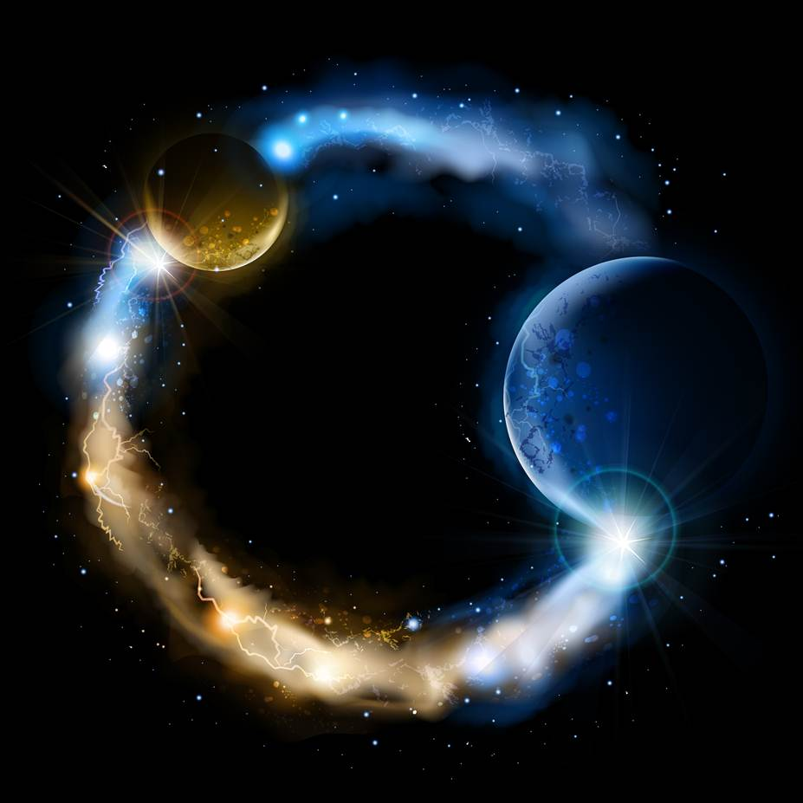
ETERNALISM MODULE 14
Epistemology
Abide
and
Abound
Chapter 15: Proofs
Case Study 3: God Evidence

Slide 2
All Kinds of Proofs
Existential Proof
=
Exposing Reality
Coherence, Axioms
No Contradictions
Philosophical Proof
=
Theological Proof
Holy Ghost,
Confirmation
=

Slide 3
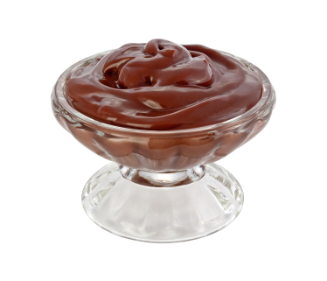
Existential Proof
This Pudding Might Be Lined with Arsenic
(1) A Scientific Proof
Break it down In the chemistry lab testing for Arsenic.
Reality Has the Final Say
(2) An Existential Proof You Simply Eat It. If you live it wasn’t lined with arsenic.
In Either Case the
Proof Is In the Pudding

Slide 4
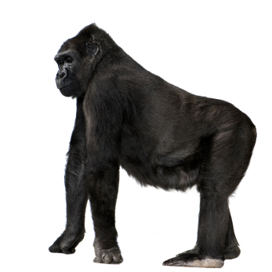
An Existential Proof is Testing Your
Hypothesis Against Reality
Reality Has the Final Say
REALITY IS THE 800 lb
GORILLA IN THE ROOM
THAT CAN’T
BE IGNORED
Existential Proof
REALITY
800 lb Gorilla

Slide 5
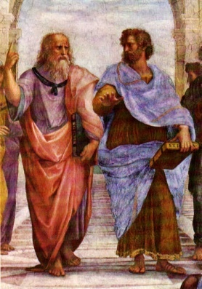
Your First Philosophical Walk
Primacy of Consciousness or Primacy of Existence?
Who is Right – Plato or Aristotle?
*
Over the next several days as you are going about your daily activities make a list of any frustrations that you may encounter. Nothing personal … just ordinary, run-of-the-mill, frustrations that are part of our everyday life:
Name
Cosmo
1
2
3
4
5
6
7
8
9
10
11
12
Long lines at the Cougar Eat
Broken Vending Machines
Rising Cost of Tuition
Rest Rooms Closed for Cleaning
Broken Promises
Health Problems
Oil Spills
Burnt Toast
Disappointing Grade
Parking Ticket
Plato and Aristotle In Athens
With Plato Pointing to the Heavens Above
and Aristotle to the Earth Below
Rising Gas and Food Prices
Waiting for Stop Lights Every Other Block
* This Short and Insightful Exercise Amounts to an Existential Proof of Who Is Right and Who Is Wrong – Plato or Aristotle, that is, the Primacy of Consciousness or the Primacy of Existence?

Slide 6
If reality makes demands on you, and results in any frustration whatsoever, then Aristotle was right and Plato was wrong. On the other hand, if reality has never made any demands on you and you have never experienced a single frustration in your entire life, then, Plato was right and Aristotle was wrong.
True Beliefs
Existence
Consciousness
Reality
God
Reality Has the Final Say
Existential Proof
Your List of Frustrations Proves That Aristotle Was Right and Plato Was Wrong
Consciousness
Existence
God
Reality
REALITY
800 lb Gorilla
False Beliefs

Slide 7

Philosophical Proof
Temple
THREE invincible axioms, like sentinels standing guard over the temple of man’s mind:
Man’s
Mind
Existence
Identity
Consciousness
“Axiomatic concepts are the guardians of man’s mind and the foundation of reason—the keystone, touchstone and hallmark of reason—and if reason is to be destroyed, it is axiomatic concepts that have to be destroyed.”
(Ayn Rand, Introduction to Objectivist Epistemology, p.60)

Slide 8
Theological Proof
Elder Dallin H. Oaks: “Our Heavenly Father gave us powers of reason, and we are expected to use them to the fullest. But he also gave us the Comforter, who he said would lead us into truth and by whose power we may know the truth of all things. … For Latter-day Saints, evaluation also has a spiritual dimension. This is because of our belief in Moroni’s declaration that “by the power of the Holy Ghost ye may know the truth of all things” (Moroni 10:5). That promise assures spiritually sensitive readers a power of discernment that will help them evaluate the meaning of what they learn.“ ("Reading Church History", CES Symposium, 16 August 1985)
Existential Proof
Philosophical Proof
Theological Proof
Existential
Proof
Tier-1
Temple
Philosophical
Proof
REALITY
800 lb Gorilla
Restored
Gospel
Tier-2
Man’s
Mind
Theological
Proof
Existence
Consciousness
Identity
Tier-3

Slide 9
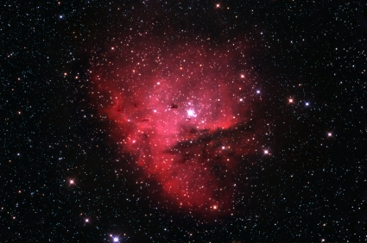
Eternalism’s Framework
GOD OUTSIDE THE BOX
GOD INSIDE THE BOX
APOSTASY
RESTORATION
creatio ex nihilo
creatio ex materia
ABSOLUTISM OF GOD
ABSOLUTISM OF REALITY
Christian, Judaic, Islamic
Eternalism: Latter-day Saint Theology
PRIMACY OF CONSCIOUSNESS
PRIMACY OF EXISTENCE
GOD THE GREAT LAW MAKER
GOD THE GREAT LAW ABIDER
GREAT AND POWERFUL OZ
ALMIGHTY LION KING
CONFORMITY WITH GOD’S WILL
CONFORMITY WITH ETERNAL LAWS

Slide 10
Mysticism: Mysticism is the acceptance of allegations without evidence or proof, either apart from or against the evidence of one’s senses and one’s reason. Mysticism is the claim to some non-sensory, non-rational, non-definable, non-identifiable means of knowledge… (The Ayn Rand Lexicon, Mysticism, p.322)
Would our Existential Proof Convince or Impress the Mystic?
First: Your limited experience within this natural world proves nothing and speaks not at all to the powers and possibilities of a supernatural realm wherein all things are possible to them that just believe.
Second: Your rational conclusions based on earthly observations only prove your lack of faith in the greater truths that come through mystical visions, heavenly manifestations, purification rites and supernatural revelations.

Slide 11

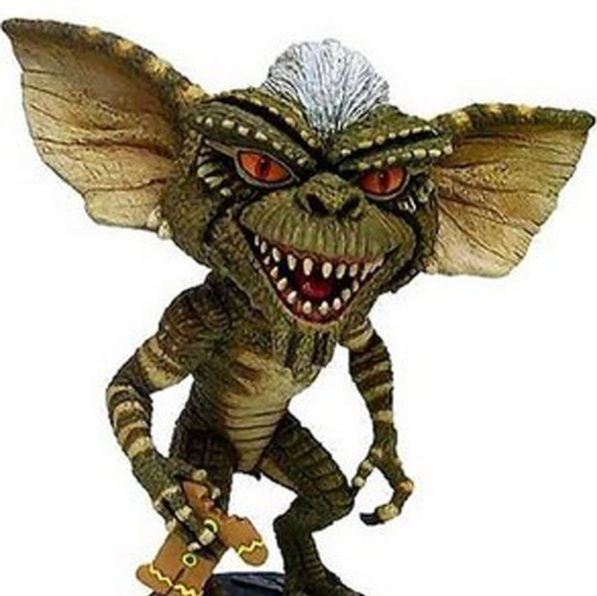

Burden of Proof Is Upon Who Makes Assertions
Mystic
Realist
There is a
Gremlin in the
room. Prove
that there Isn’t!
Proof requires evidence.
There’s no evidence possible for a non-existent entity.
Mouse Droppings
There is a mouse in the house. Here is proof!
Leonard Peikoff: “No one can think or perceive for another man. If reality, without your help, does not convince a person of the self-evident, he has abdicated reason and cannot be dealt with any further.” (Objectivism: The Philosophy of Ayn Rand”, p.11)
Evidence means nothing to true Gremlin believers. “To him that believes no proof is necessary. To him that does not believe no proof is possible.”

Slide 12
SCALE OF EVIDENCE
Does God use proofs
or does He require blind belief?
A
R
B
I
T
R
A
R
Y
K
N
O
W
L
E
D
G
E
Possible
Greater Evidence
Probable
Greater Evidence
Certain
Slight
Evidence
Strong
Evidence
Incontestable
Evidence
Places It Beyond
the Arbitrary
Places It Beyond
a Reasonable Doubt
Places It Beyond a
Shadow of a Doubt
Alma 32:33-34 “And now, behold, because ye have tried the experiment, and planted the seed [word of God], and it swelleth and sprouteth, and beginneth to grow, ye must needs know that the seed is good. And now, behold, is your knowledge perfect? Yea, your knowledge is perfect in that thing, and your faith is dormant; and this because you know…”
Malachi 3:10 “Bring ye all the tithes into the storehouse, that there may be meat in mine house, and prove me now herewith, saith the LORD of hosts, if I will not open you the windows of heaven, and pour you out a blessing, that there shall not be room enough to receive it.”
John 7:17 “If any man will do his will, he shall know of the doctrine, whether it be of God, or whether I speak of myself.”
…Matthew 7:18-20, Abraham 3:25, Moroni 10:3-5 (Moroni’s Promise), etc.

Slide 13
Questions?

