Slide 1
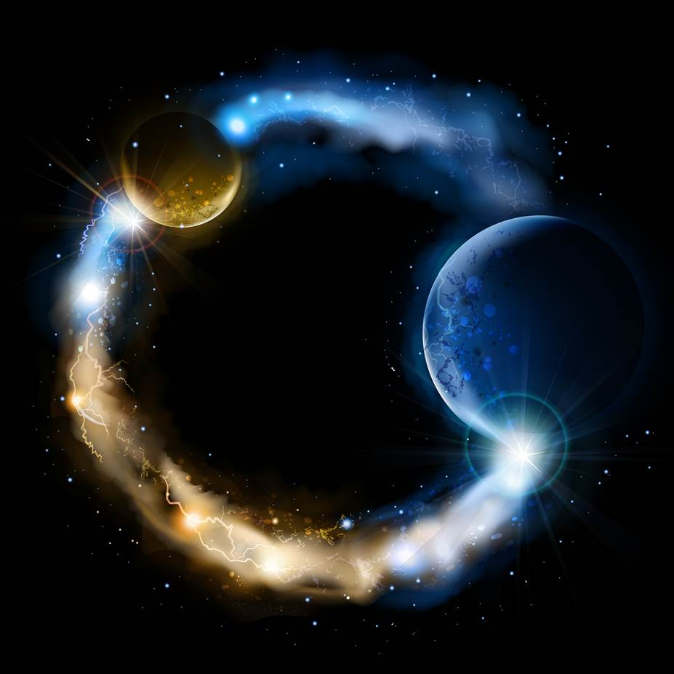
ETERNALISM MODULE 13
Epistemology
Abide
and
Abound
Chapter 14: Overview

Slide 2
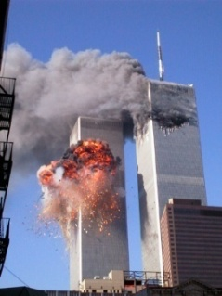
Three E’s of Eternalism
Eternal Life, Joy
& Happiness
ETERNAL LAWS
Metaphysics
ETERNAL TRUTHS
Epistemology
ETERNAL LIVES
Value Ethics
RESTORATION
Absolutism of Reality
Primacy of Existence
Life
Love
Self
Others
Good
Right
Happiness
Duty
Reason
Faith
Observation
Revelation
Mind
Heart
Correct Principles Harmonize with Above
Eternal Life, Joy
& Happiness
Reality
God
Joseph Smith: “It is necessary for us to have an understanding of God himself in the Beginning. If we start right, it is easy to go right all the time; but if we start wrong, we may go wrong, and it will be a hard matter to get right” (King Follett Discourse, TPJS 343)
Aristotle
Plato
God
Reality
Faith
Reason
Revelation
Observation
Heart
Mind
APOSTASY
Absolutism of God
Primacy of Consciousness
False Principles Harmonize with Below
Love
Life
Others
Self
Right
Good
Duty
Happiness
Metaphysics
Epistemology
Duty Ethics
Denies Law of Identity
Negative Theology
Greater the Contradiction
the Greater the Faith
Embraces a Morality Impossible to Live
Everlasting Death,
Sorrow & Misery

Slide 3
Three E’s of Eternalism
Eternal Life, Joy
Happiness
ETERNAL LAWS
Metaphysics
ETERNAL TRUTHS
Epistemology
ETERNAL LIVES
Value Ethics
RESTORATION
Absolutism of Reality
Primacy of Existence
Life
Love
Self
Others
Good
Right
Happiness
Duty
Reason
Faith
Observation
Revelation
Mind
Heart
Correct Principles Harmonize with Above
Eternal Life, Joy
& Happiness
Reality
God
Aristotle: “The least initial deviation from the truth is multiplied later a thousand fold.” (On the Heavens, 271, 9)
Aristotle
Plato
Elder Deiter Uchtdorf: “The difference between happiness and misery… often comes down to an error of only a few degrees. (General Conference, April 2008)
God
Reality
Faith
Reason
Revelation
Observation
Heart
Mind
APOSTASY
Absolutism of God
Primacy of Consciousness
False Principles Harmonize with Below
Love
Life
Others
Self
Right
Good
Duty
Happiness
Metaphysics
Epistemology
Duty Ethics
Everlasting Death,
Sorrow, Misery

Slide 4
Epistemology = The study of human knowledge.
Origin: From the Greek epistēmē “knowledge” + logos “word”
President Brigham Young: “As for the multitude of words, they are but of little consequence, the ideas are of far the greatest importance.” (JD, Vol.4, p.20)
DEFINITIONS:
REASON is the power of the mind to think, understand, and form judgments by a process of logic which is the art of non-contradictory identification. (Google Search, Ayn Rand Lexicon p.262)
RATIONAL: Inherent capacity to reason; capable of logical thought. (Dictionary.com)
“In any hour and issue of your life, you are free to think or to evade the effort. But you are not free to escape from your nature, from the fact that reason is your means of survival.”
(Ayn Rand, "For the New Intellectual", p. 146)
President Brigham Young: “I am a witness that ‘Mormonism’ is true upon philosophical principles. Every particle of sense I have, proves it to be sound natural reason...” (Journal of Discourses 2:8)

Slide 5
CSI ETERNAL: Crime Scene Investigation
ARE THESE RATIONAL?
Ayn Rand: “The best way to study philosophy is to approach it as one approaches a detective story: follow every trail, clue and implication, in order to discover who is a murderer and who is a hero.”

Slide 6
Primacy of Reason or Faith
Faith
Reason
Evangelical Essentials: “The man of faith…ventures forth sometimes against all logic and reason out of fidelity to the inward call that comes to him from God…Faith must believe against human thought, feeling, and perception, since reason admits the validity only of that which can be perceived or conceived…In seeking understanding, faith must be on guard against making its cardinal doctrines too clear and distinct…since this serves to undercut or deny
the mystery of revelation.” (Essentials of Evangelical Theology, Vol. 1, p. 226; Vol. 2, p. 268, 269)
EPISTEMOLOGY
An Irrational Faith
Martin Luther: “Reason is the Devil’s greatest whore; by nature and manner of being she is a noxious whore; she is a prostitute, the Devil’s appointed whore; whore eaten by scab and leprosy who ought to be trodden under foot and destroyed, she and her wisdom She would deserve, the wretch, to be banished to the filthiest place in the house, to the closets [i.e. toilet] … Usury, drunkenness, adultery – these crimes are self-evident, and the world knows that they are sinful; but that bride of the Devil, ‘Reason,’ stalks abroad, the fair courtesan, and wishes to be considered wise, and thinks that whatever she says comes from the Holy Ghost. She is the most dangerous harlot the Devil has…” (E15 142-148; E29 241)
self-evident
Elder Bruce R. McConkie: “Knowledge Precedes Faith. Which comes first, faith or knowledge? Answers: Faith is the child of knowledge. It is reserved for those who first have knowledge…and no one can have faith in God or in any gospel truth unless and until he comes to a knowledge of whatever truth is involved.” (A New Witness, p. 166-167)
Reason
Faith
Joseph Fielding McConkie: “Let us consider why the ‘one true church’ doctrine is so offensive to some. If we start with the premise, as the traditional Christian world does, that God is incomprehensible — that no one can know anything about him with certainty — then you can be tolerant with all manner of views about God irrespective of how ridiculous they may be. The only view that you could not tolerate would be one of certainty.”
("The First Vision and Religious Tolerance“ Nov 5, 2005)
EPISTEMOLOGY
A Rational Faith

Slide 7
Primacy of Heart or Mind, Observation or Revelation
Soren Kierkegaard: “It is easy to see, though it scarcely needs to be pointed out, since it is involved in the fact that the Reason is set aside, that Faith is not a form of knowledge … [to understand faith] is to understand that faith cannot be understood ... must not be understood … and this absurdity, held fast in the passion of inwardness, is faith, the earnestness [i.e., willfulness] of facing the absurd.” (Pap., X 2 A 371; Postscript pp. 182-188)
Revelation
Observation
EPISTEMOLOGY
An Irrational Faith
Donald G. Bloesch “The essence of piety is neither knowing nor doing but feeling.” (Essentials of Evangelical Theology, Vol. II, p. 54)
Heart
Mind
Blaise Pascal (1623-1662, French mathematician, religious philosopher): “The heart has its reasons, which reason does not know. We feel it in a thousand things. It is the heart which experiences God, and not the reason. This, then, is faith: God felt by the heart, not by the reason.” (Pascal, Pensées, IV, #277, p. 222)

Slide 8
Primacy of Heart or Mind, Observation or Revelation
Elder Dallin H. Oaks: “In the sequential relationship between reason and revelation, it is important that reason have what we can call ‘the first word’ and that revelation have ‘the last word.’ In this sequence, reason can ‘study it out’ and formulate a proposed solution. In addition, as we seek confirmation or other guidance from revelation, reason can serve as a threshold check to screen out revelation that is counterfeit and to provide a tentative authentication of revelation that is genuine. This is necessary because, just as there is reasoning that is faulty, so also there is revelation that is spurious.” (A New Witness, p. 166-167)
Observation
Revelation
EPISTEMOLOGY
A Rational Faith
President Russel M. Nelson: “good inspiration is based upon good information”.
(“Revelation for the Church, Revelation for Our Lives”, April 2018)
Mind
Heart
D&C 8:2-3: Yea, behold, I will tell you in your mind and in your heart, by the Holy Ghost, which shall come upon you and which shall dwell in your heart. Now, behold, this is the spirit of revelation.”
D&C 9:8-9: But, behold, I say unto you, that you must study it out in your mind; then you must ask me if it be right, and if it is right I will cause that your bosom shall burn within you; therefore, you shall feel that it is right. But if it be not right you shall have no such feelings, but you shall have a stupor of thought that shall cause you to forget the thing which is wrong; therefore, you cannot write that which is sacred save it be given you from me.
“The Prophet Joseph Smith observed that the word of the Lord ‘has such an influence over the human mind—the logical mind—that it is convincing without other testimony’ (HC 5:526). Joseph Smith further remarked, ‘sudden strokes of ideas’ from the Holy Ghost attend a flow of pure intelligence (TPJS, p. 151); ‘the answer comes into my mind with such a logical sequence of thought and ideas, and accompanied by such a burning feeling within, that I know it is of God.’”
(Encyclopedia of Mormonism, Vol. 3, p. 1209, Religious Experience)

Slide 9
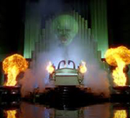
THE LION KING
Rational Faith
Absolutism of Reality
RESTORATION
Reality
God
Reason
Faith
Observation
Revelation
Mind
Heart
=
→
→
→
creatio ex materia
Absolutism
of Reality
Absolutism
of Reason
Rational
Revelation
Absolutism
of Mind
Primacy of Existence
Eternalism
LAWFULNESS
CORRECT PRINCIPLES GOVERN
WILLFULNESS
INNER EMOTIONS GOVERN
Blind Faith
Absolutism of Consciousness
THE GREAT & POWERFUL OZ
APOSTASY
God
Reality
Faith
Reason
Revelation
Observation
Heart
Mind
=
→
→
→
creatio ex nihilo
Absolutism
of God
Absolutism
of Faith
Mystical
Revelation
Absolutism
of Heart
Primacy of Consciousness
Traditional Christian, Judaic, Islamic

Slide 10
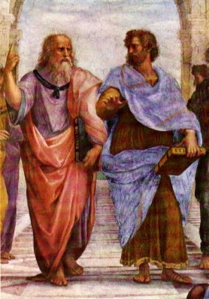
HOMEWORK: Your First Philosophical Walk
With Plato and Aristotle
Over the next several days as you are going about your daily activities, make a list of any frustrations that you may encounter. Nothing personal … just ordinary, run-of-the-mill, frustrations that are part of our everyday life:
Name
Cosmo
1
2
3
4
5
6
7
8
9
10
11
12
Plato and Aristotle In Athens
With Plato Pointing to the Heavens Above
and Aristotle to the Earth Below

Slide 11
Questions?

