Slide 1
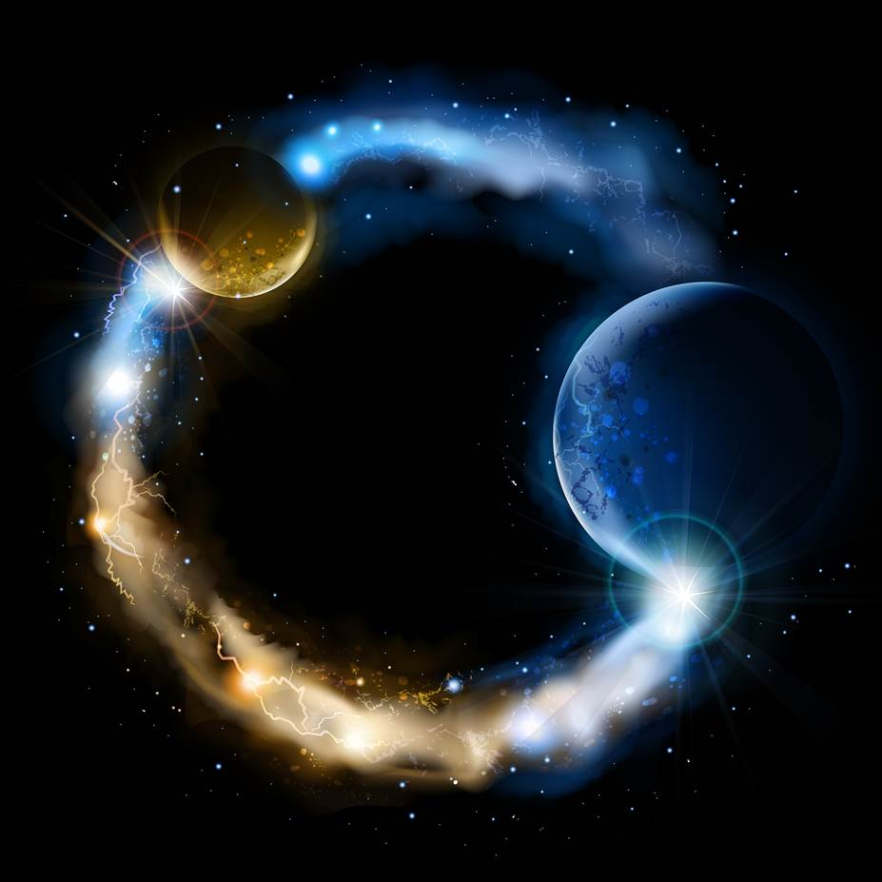
ETERNALISM MODULE 12
Metaphysics
Abide
and
Abound
Chapter 13: Metaphysics Summary

Slide 2
THE ABSOLUTISM OF REALITY
1. Creatio ex Materia
2. Matter Indestructible
3. Unchangeable Eternal Laws
4. Law of Identity
5. Law of Causality
6. Lawful Miracles

Slide 3
Creatio ex Materia - True
Ayn Rand (Objectivism): “Creation” does not (and metaphysically cannot) mean the power to bring something into existence out of nothing. “Creation” means the power to bring into existence an arrangement (or combination or integration) of natural elements that had not existed before. (Philosophy Who Needs It, 31)
Abraham 3:24 “And there stood one among them that was like unto God, and he said unto those who were with him: We will go down, for there is space there, and we will take of these materials, and we will make an earth whereon these may dwell;”
Joseph Smith: “You ask the learned doctors why they say the world was made out of nothing; and they will answer, "Don't the Bible say he created the world?" And they infer, from the word create, that it must have been made out of nothing. Now, the word create came from the word baurau, which does not mean to create out of nothing; it means to organize—the same as a man would organize materials and build a ship. Hence we infer that God had materials to organize the world out of chaos—chaotic matter, which is element, and in which dwells all the glory. Element had an existence from the time He had. The pure principles of element are principles which can never be destroyed: they may be organized and re-organized, but not destroyed. They had no beginning, and can have no end.” (Journal of Discourses 6:6)
Creatio ex Nihilo - False

Slide 4
Matter Indestructible - True
Ayn Rand (Objectivism): “Matter is indestructible, it changes its forms, but it cannot cease to exist.”
(For the New Intellectual, 147)
“To grasp the axiom that existence exists, means to grasp the fact that nature, i.e., the universe as a whole, cannot be created or annihilated, that it cannot come into or go out of existence.
(Philosophy Who Needs It, 30)
President Brigham Young: “As to the word annihilate, as we understand it, there is no such principle as to put a thing which exists, entirely out of existence, so that it does not exist in any form, shape, or place whatever.” (JD:1:352)
D&C 93:29-34 “Man was also in the beginning with God. Intelligence, or the light of truth, was not created or made, neither indeed can be … For man is spirit. The elements are eternal, and spirit and element, inseparably connected, receive a fulness of joy; And when separated, man cannot receive a fulness of joy.”
Matter Destructible - False

Slide 5
Unchangeable Eternal Laws - True
President John Taylor: “Permit me to say there are eternal laws that exist with the Gods in the eternal worlds, and from which they cannot depart, and to which they are bound in all their acts.” (JD:21:15)
Elder Orson Pratt: “There are some things that cannot be performed, although we had the power of working great and mighty miracles; indeed, the great God Himself who has power to control the heavens over our heads, and the earth upon which we stand has not the power to do that which would be naturally impossible, or in opposition to the great, necessary, and fundamental truths of nature, which are eternally unalterable, and cannot be otherwise than they are.” (JD:3:300)
President Brigham Young: “Well, I will say that our religion is nothing more nor less than the true order of heaven—the system of laws by which the Gods and the angels are governed. Are they governed by law? Certainly. There is no being in all the eternities but what is governed by law.” (JD:14:280)
President Wilford Woodruff: “The God of heaven abides a law, all the hosts of heaven abide laws; they are exalted and glorified by law. All the creations of God are governed by law.” (JD:12:279)
Changeable Natural Laws- False

Slide 6
Law of Identity - True
Ayn Rand (Objectivism): Whether its basic constituent elements are atoms, or subatomic particles, or some yet undiscovered forms of energy, [the universe] is not ruled by a consciousness or by will or by chance, but by the law of identity. All the countless forms, motions, combinations and dissolutions of elements within the universe–from a floating speck of dust to the formation of a galaxy to the emergence of life–are caused and determined by the identities of the elements involved.”
(Philosophy Who Needs It, 30)
Elder Erastus Snow: “It is just as impossible for God to add two and two together and make ten of it as it is for me or you. Mathematical truths are as true with God and angels as they are with man. I understand that what has exalted to life and salvation our Father in heaven and all the Gods of eternity will also exalt us, their children. And what causes Lucifer and his followers to descend to the regions of death and perdition will also lead us in the same direction; and no atonement of our Lord and Saviour Jesus Christ can alter that eternal law, any more than he can make two and two to mean sixteen.” (JD:7:354)
Mysticism - False

Slide 7
Law of Causality - True
Ayn Rand (Objectivism): “The law of causality is the law of identity applied to action. All actions are caused by entities. The nature of an action is caused and determined by the nature of the entities that act; a thing cannot act in contradiction to its nature.” (For the New Intellectual, 188)
President Brigham Young: “A great many think there are results without causes; there is no such thing in existence; there is a cause for every result that ever was or ever will be, and they are all in the providences and in the work of the Lord.” (JD:13:33)
President John Taylor: “We understand in part the things of earth; when we see things as God sees them, we shall then understand the philosophy of the heavens: the mysteries of eternity will be unfolded and the operations of mind, matter, spirit, purposes and designs, causes and effects and all the stupendous operations of God will be developed and they will be found to accord with the strictest principles of philosophy, even the philosophy of the heavens.” (JD:10:117-118)
Elder Heber C. Kimball: “The same cause will produce the same effect now as thirty years ago. God is the same, the Gospel is the same, baptism is the same, repentance is the same; none of these principles have changed in the least.” (JD:10:45)
Mysticism - False

Slide 8
Lawful Miracles - True
Elder George Q. Cannon: “It was no suspension of law on the part of our Savior, that caused Him to gather from the elements the bread and the fishes necessary to feed the multitude. It was no suspension of law that caused Him to open the eyes of the blind, or to cause the sick to be healed. It was no suspension of law that caused Him to ascend in the sight of His disciples after His resurrection when He visited them. I know that miracles are said to be a suspension of law; but instead of their being a suspension of law, they are due to a knowledge of a higher law, to a comprehension of greater laws, by the knowledge of which, what are called miracles are wrought. ” (JD:25:150)
Elder James E. Talmage: “Miracles cannot be in contravention of natural law, but are wrought through the operation of laws not universally or commonly recognized.” (Jesus The Christ, p.342)
President Brigham Young: “There is no miracle to any being in the heavens or on the earth, only to the ignorant. To a man who understands the philosophy of all the phenomena that transpire, there is no such thing as a miracle.” (JD 13:33)
Carl Sagan: “What would beings who are thousands of years ahead of us be capable of? Or millions? As a philosopher in our part of the world once said: 'The artifacts of a sufficiently advanced extraterrestrial civilization would be indistinguishable from magic'.”(Contact, p.191)
Supernatural Miracles - False

Slide 9
INTERPRETING
SCRIPTURE
God
Reality
Faith
Reason
Heart
Mind
Mind
Heart
Reason
Faith
Reality
God
ABSOLUTISM OF GOD
ABSOLUTISM OF REALITY
?
“Jesus said unto him, If thou canst believe, [absolutely] all things are possible to him that believeth.” (Mark 9:23)
“Jesus said unto him, If thou canst believe, all things [real] are possible to him that believeth.” (Mark 9:23)
“For with God [absolutely] nothing shall be impossible.” (Luke 13:37)
“For with God nothing [lawful] shall be impossible.” (Luke 13:37)
“If ye have [blind] faith as a grain of mustard seed, ye shall say unto this mountain, Remove hence to yonder place; and it shall remove; and [absolutely] nothing shall be impossible unto you.” (Matthew 17:20)
“If ye have [rational] faith as a grain of mustard seed, ye shall say unto this mountain, Remove hence to yonder place; and it shall remove; and nothing [lawful] shall be impossible unto you.” (Matthew 17:20)
Doubt, Heart, Believe, Desire = Absolutely, Blindly, Mystically or Lawfully, Rationally, Really
Mark 11:23-24 “Whosoever shall say unto this mountain, Be thou removed, and be thou cast into the sea; and shall not doubt in his heart but shall believe that those things which he saith shall come to pass; he shall have whatsoever he saith. Therefore I say unto you, What things soever ye desire, when ye pray, believe that ye receive them, and ye shall have them.”

Slide 10
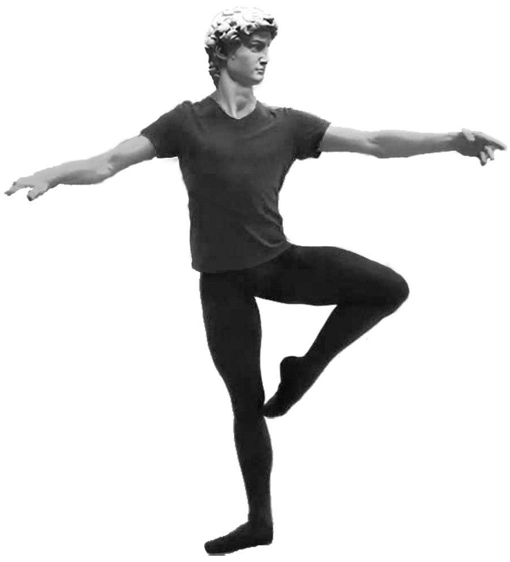
BUILDING PHILOSOPHY MAN
Component Hierarchy of Facts
AESTHETICS
“X is Beautiful”
POLITICS
“X is Just”
AESTHETICS: CELEBRATED FACTS
CREATING
POLITICS: PROTECTED FACTS
GOVERNING
VALUE ETHICS
“X is Good”
ETHICS: PURSUED FACTS
VALUING, ACTING, DESIRING
METAPHYSICS
“X is Real”
METAPHYSICS
“X is Real”
EPISTEMOLOGY
“X is True”
EPISTEMOLOGY: DISCOVERED FACTS
KNOWING
EPISTEMOLOGY
“X is True”
EPISTEMOLOGY: DISCOVERED FACTS
KNOWING
ONTOLOGICAL FRAMEWORK
CORRESPONDENCE
DEFINITION OF TRUTH
METAPHYSICS: SELF-EXISTING FACTS
REALITY, EXISTENCE
PRIMACY OF EXISTENCE
GOD INSIDE THE BOX
METAPHYSICS: SELF-EXISTING FACTS
REALITY, EXISTENCE
AXIOMS: SELF-EVIDENT FACTS
IRREDUCIBLE, INESCAPABLE, INVINCIBLE
AXIOMS
AXIOMS: SELF-EVIDENT FACTS
IRREDUCIBLE, INESCAPABLE, INVINCIBLE
Existence Identity Consciousness

Slide 11
REALITY ALWAYS HAS THE FINAL SAY
(Sponge Bob, S1E20 “The HookyMermaidMan II”, 2:30-4:34)

Slide 12
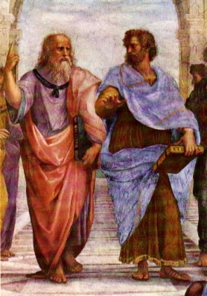
HOMEWORK: YOUR FIRST PHILOSOPHICAL WALK
Over the next several days as you are going about your daily activities make a list of any frustrations that you may encounter. Nothing personal … just ordinary, run-of-the-mill, frustrations that are part of our everyday life:
Name
1
2
3
4
5
6
7
8
9
10
11
12
Plato and Aristotle In Athens
With Plato Pointing to the Heavens Above
and Aristotle to the Earth Below

Slide 13
Questions?

