Slide 1
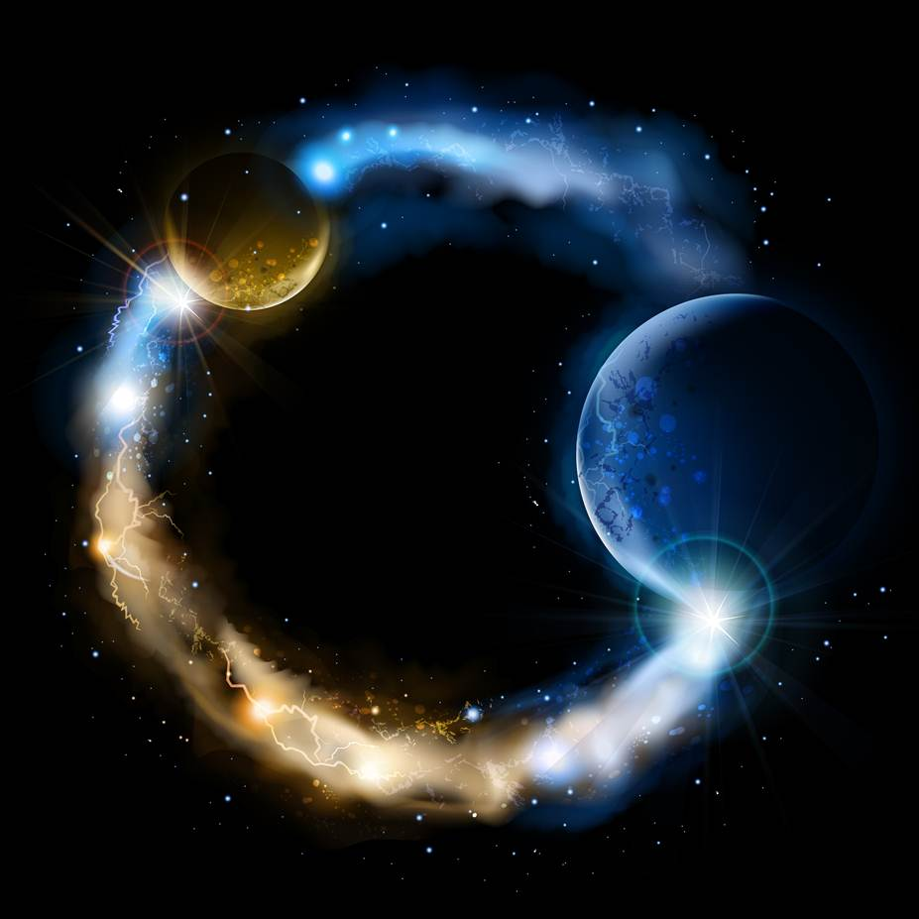
ETERNALISM MODULE 11
Metaphysics
Abide
and
Abound
Chapter 12: LDS Cosmology
Omni

Slide 2


Three Divine Beings In One Eternal Godhead
1
2
3
4
5
FULNESS
Light & Truth
GLORY
FATHER
SON
HOLY GHOST
FATHER
SON
HOLY GHOST
HOLY SPIRIT
THREE DIVINE BEINGS
ONE DIVINE NATURE
THREE DISTINCT PERSONAGES
+
ONE DIVINE SUBSTANCE
=
ONE ETERNAL GODHEAD
Infinite, Eternal
Infinite, Eternal
Omnipotence
Omniscience
Omnipresence
The Holy Spirit is a Divine Substance and the power by which the Godhead operates throughout the immensity of space and by which it is omnipotent, omniscient and omnipresent.

Slide 3
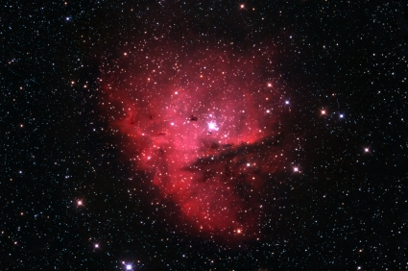
The Key to Unraveling the Mysteries
of Eternalism and God’s Divine Nature
THE HOLY SPIRIT
Not a Divine Being
But a Divine Substance
HOLY SPIRIT

Slide 4
The Holy Spirit a Divine Substance
Elder Parley P. Pratt: “There is a divine substance, fluid or essence, called spirit, widely diffused among these eternal elements. This spiritual substance is the most refined, subtle, and powerful element in the universe. It is the light, life, power, and principle of all things. This divine element, or spirit, is the immediate, active or controlling agent in all holy miraculous powers ... By this Divine Spirit all things were formed … and all in accordance with the laws of nature, it being perfectly natural for the subordinate elements to obey the supreme, all-controlling, all-pervading element, under the directing power of Deity.”
(Key to the Science of Theology, p64, p67)
Elder Charles W. Penrose: “As I have previously explained, God is not every where present personally, but He is omnipresent in the power of that spirit—the Holy Spirit—which animates all created things … This Spirit which pervades all things which is the light and life of all things, by which our Heavenly Father operates, by which He is omnipotent, never had a beginning and never will have an end. It is the light of truth; it is the spirit of intelligence … Now, this Spirit always existed; it always operated, but it is not, understood, and cannot be comprehended except through organisms. … If you see a man you behold its most perfect earthly manifestation. And if you see a glorified man, … who has passed through the various grades of being, who has overcome all things who has been raised from the dead, who has been quickened by this Spirit in its fulness, there you see manifested, in its perfection, this eternal, beginningless, endless spirit of intelligence. Such a Being is our Father and our God, and we are following in His footsteps.” (JD 26:21-25)

Slide 5
“THE METAPHYSICALLY GIVEN”

Slide 6
1: SPACE IS BOUNDLESS AND FILLED WITH MATTER
Matter
Matter
Matter
Matter
Matter
Matter
Matter
Matter
Matter
Matter
Matter
Matter
Matter
Matter
Matter
Matter
Matter
Matter
Matter
Matter
Matter
Matter
President Brigham Young: “Eternity is without bounds, and is filled with matter; and there is no such place as empty space.” (JD 7:2)
Matter
Matter
Matter
Matter
Matter
Matter
Matter
Matter
Matter
Matter
Matter
Matter
Matter
Matter
Matter
Matter
Matter
Matter
Matter
Matter
Matter
Matter
Matter
Matter
Matter
Matter

Slide 7
2: PRIMARY ELEMENTS ETERNAL (Uncreated and Indestructible)
Matter
Matter
Matter
Matter
Matter
Matter
Matter
Matter
Matter
Matter
Matter
Matter
Matter
Matter
Matter
Matter
Matter
Matter
Elder Charles W. Penrose: “When you go right down to the primary elements, they never had a beginning, they will never have an end. For in their primal condition they are not ‘created’.” (JD 26:27)
Matter
Matter
Matter
Matter
Matter
Matter
Matter
Matter
Matter
Matter
Matter
Matter
Matter
Matter
Matter
Matter
Matter
Matter
Matter
Matter
Matter
Matter
Matter
Matter

Slide 8
3. TWO KINDS OF PRIMAL MATTER (2 Nephi 2:14)
THINGS WHICH ACT
Acting Matter
Acting Matter
Intelligent, Animate, Spirit Matter
Acting Matter
Acting Matter
Acting Matter
Acting Matter
Acting Matter
Acting Matter
Elder John A. Widtsoe: “For the purpose of perfecting the plan, a council of the Gods, or perfected intelligences was called. It was decided to organize an earth from available materials, and place the spirits on it, clothed with bodies of the grosser elements. (Joseph Smith as Scientist, p. 102)
Non-Acting Matter
Non-Acting Matter
Non-Acting Matter
Non-Acting Matter
Non-Acting Matter
Non-Acting Matter
Non-Acting Matter
Non-Acting Matter
Non-intelligent, Inanimate, Gross Matter
THINGS WHICH ARE ACTED UPON

Slide 9
4: SPIRIT A MATERIAL, TANGIBLE SUBSTANCE
THINGS WHICH ACT
Spirit Matter
Spirit Matter
Intelligent, Animate, Spirit Matter
Spirit Matter
Spirit Matter
Spirit Matter
Elder Erastus Snow: “We read about material and immaterial things … but in truth there is no such thing as immaterial substance.” (JD 19:272)
Spirit Matter
Spirit Matter
Elder Charles W. Penrose: ”Spirit is a substance, it is not immaterial; it may have some properties that are different from that which we see and handle, which we call matter, but it is a reality, a substantial reality.” (JD 26:22)
ENERGY Matter
Spirit Matter
Spirit Matter
Spirit Matter
Spirit Matter
Spirit Matter
Spirit Matter
Spirit Matter

Slide 10
5. SPIRIT MATTER IS LIGHT AND LIFE WITHIN ALL THINGS
THINGS WHICH ACT
Intelligent, Animate, Spirit Matter
Spirit Matter
Spirit Matter
Spirit Matter
Spirit Matter
Spirit Matter
Spirit Matter
Spirit Matter
Spirit Matter
D&C 88:13 The light which is in all things, which giveth life to all things, which is the law by which all things are governed, even the power of God who sitteth upon his throne, who is in the bosom of eternity, who is in the midst of all things.

Slide 11
6: ALL MATTER IS CAPACITATED TO RECEIVE INTELLIGENCE
President Brigham Young: “[All] Matter is capacitated to receive intelligence … matter can be organized and brought forth into intelligence, and to continue to increase in that intelligence.” (JD 7:2-3)
Spirit Matter
Non-Acting Matter
There is no immaterial substance…Hence no Mind-Body dichotomy

Slide 12
7: LIGHT AND TRUTH FORSAKE THAT EVIL ONE
D&C 93:29; 88:40 “Intelligence, or the light of truth, was not created or made, neither can be … light and truth forsake that evil one.”
EVIL
Spirit Matter
Spirit Matter
Spirit Matter
Spirit Matter
Spirit Matter

Slide 13
8: SPIRIT MATTER (intelligence) ATTRACTS LIKE SUBSTANCE
D&C 88:40 Intelligence cleaveth unto intelligence; light cleaveth unto light.
Spirit Matter
Non-Acting
Matter
Spirit Matter
Non-Acting
Matter
Non-Acting
Matter
Spirit Matter
Spirit Matter
Spirit Matter

Slide 14
9: SPIRIT MATTER IS WHAT MAKES THE UNIVERSE LAWFUL
Elder Orson Pratt: “Portions of this Spirit, we say, exist throughout every part of space, and they perform all the work of governing, and keeping that perfect harmony which we behold in all nature. All nature is by these means made to submit to the great law of oneness. (JD 2: 340)
Spirit Matter
Spirit Matter
Spirit Matter
Spirit Matter
Spirit Matter
Spirit Matter
Spirit Matter
Spirit Matter
Spirit Matter
Spirit Matter

Slide 15
Metaphysics
WITHDRAW HOLY SPIRIT AND ALL THINGS WOULD COME UNDONE
Elder Orson Pratt: “Cause this oneness, this union among the particles of the Spirit, to cease, and you would soon see all things go into confusion. Take away this Spirit, and you would immediately see some things going up, others down; some moving horizontally; one portion of the earth would divide from the other; one part would be flying here and another there.” (JD:2:340)
Matter
Matter
Matter
Matter
Matter
Matter
Matter
Matter

Slide 16
POWER BY WHICH GOD IS OMNIPOTENT
Elder Parley P. Pratt: “There is a divine substance, fluid or essence, called spirit, widely diffused among these eternal elements … It is the light, life, power, and principle of all things … the supreme, all-controlling, all-pervading element, under the directing power of Deity.” (KTST, p. 64, 67)
THE OMNIPOTENCE OF GOD

Slide 17
POWER BY WHICH GOD IS OMNISCIENT
President Brigham Young: “God is here; his influence fills immensity. He has his messengers throughout all the works of his hands. He watches every one of his creatures: their acts, their affections, and thoughts are all known to him; for his intelligence and power fill immensity. Not that his person does, but his Spirit does.” (JD 7:159)
THE OMNISCIENCE OF GOD

Slide 18
POWER BY WHICH GOD IS OMNIPRESENT
Elder Charles W. Penrose: “As I have previously explained, God is not everywhere present personally, but He is omnipresent in the power of that spirit – the Holy Spirit – which animates all created things.” (JD 26:23)
THE OMNIPRESENCE OF GOD

Slide 19
ONE ETERNAL SPIRIT, INFINITE NUMBER OF GODS
Elder Orson Pratt: “Well, these three are called one, are they not? Yes, they are called one. Jesus prays that all his disciples may be made one, as he and the Father are one. If ever that prayer is answered, then, in one sense of the word, there would only be one God, but, in another sense of the word, there would not only be three, but a great many personal beings called gods.” (JD 19:319)
ONE DIVINE SUBSTANCE AND AN INFINITE NUMBER OF DIVINE BEINGS

Slide 20
Theological Confusion: Three Gods In One
John 17:3 “And this is life eternal, that they might know thee the only true God, and Jesus Christ, whom thou hast sent.
Elder B.H. Roberts: “‘I and my Father are one,’ refers to a moral union—to a perfect union of purpose and will—not to a unity or identity of substance, or essence.” (Seventy’s Year Book, No. III, p, 215)
TRADITIONAL CHRISTIANITY
Holy Ghost, Holy Spirit Confounded
ABSOLUTISM
OF GOD
Divine Personage
Holy Ghost
+
Divine Substance
Holy Spirit
=
ONE THING
NON-ABSOLUTISM
OF GOD
=
LDS DOCTRINE OF DEITY
Distinct Holy Ghost, Holy Spirit
TWO THINGS, NOT ONE

Slide 21
CAUTION: Feeling the Spirit is not the same as Emotion
Conflicting Definitions on “Feeling”:
Physical Sensation: (hot/cold, rough/smooth, electric shock, heartburn)
Physiological State: (hormonal, fight/flight, frozen with fear, burning with lust)
Emotional: (joy, sorrow, anger, shame, peace, love)
Spiritual Sensation: (burning in bosom, enlightened mind)
President Howard W. Hunter: “Let me offer a word of caution. … I think if we are not careful … , we may begin to try to counterfeit the true influence of the Spirit of the Lord by unworthy and manipulative means. I get concerned when it appears that strong emotion or free-flowing tears are equated with the presence of the Spirit. Certainly the Spirit of the Lord can bring strong emotional feelings, including tears, but that outward manifestation ought not to be confused with the presence of the Spirit itself.” (The Teachings of Howard W. Hunter, p184. Preach My Gospel chap. 4)
President Gordon B. Hinckley: “The things of God are understood by the Spirit of God. That Spirit is real. To those who have experienced its workings, the knowledge so gained is as real as that which is acquired through the operation of the five senses.” (Teachings of Presidents of the Church: Gordon B. Hinckley Chapter 7)

Slide 22
Questions?

