Slide 1
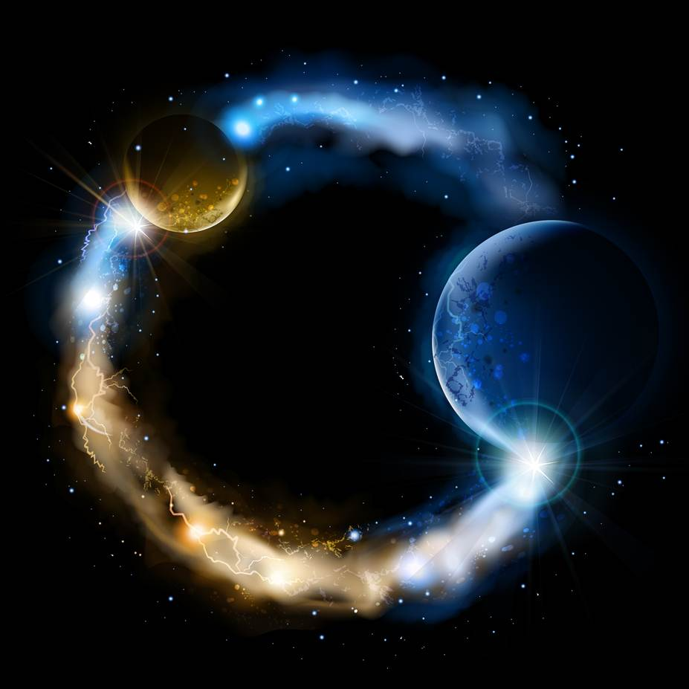
ETERNALISM MODULE 10
Metaphysics
Abide
and
Abound
Chapter 12: Holy Spirit

Slide 2


Three Divine Beings In One Eternal Godhead
Joseph Smith: “WE believe in God, the Eternal Father, and in His Son, Jesus Christ, and in the Holy Ghost.” (Article of Faith 1)
Encyclopedia of Mormonism (GODHEAD): “Latter-day Saints believe in God the Father; his Son, Jesus Christ; and in the Holy Ghost. These three Gods form the Godhead, which holds the keys of power over the universe. Each member of the Godhead is an independent personage, separate and distinct from the other two, the three being in perfect unity and harmony with each other.”
THREE DISTINCT PERSONAGES
WITHIN ONE ETERNAL
+
+
=
GODHEAD
FATHER
SON
HOLY GHOST

Slide 3
An Everlasting Covenant Made In Heaven
Joseph Smith: “[An] Everlasting covenant was made between three personages before the foundation of this earth, and relates to their dispensation of things to men on the earth; these personages, according to Abraham’s record, are called God the first, the Creator; God the second, the Redeemer; and God the third, the witness or Testator.” (Teachings of the Prophet Joseph Smith, p. 190)
God The First
God The Second
God The Third
FATHER
The Creator
SON
The Redeemer
HOLY GHOST
The Revelator

Slide 4
Holy Ghost’s Unique Role as a Spirit Personage
D&C 130:22: “The Father has a body of flesh and bones as tangible as man’s; the Son also; but the Holy Ghost has not a body of flesh and bones, but is a personage of Spirit. Were it not so, the Holy Ghost could not dwell in us.”
Elder Heber C. Kimball: “Well, let me tell you, the Holy Ghost is a man; he is one of the sons of our Father and our God.” (JD 5:179)
President Brigham Young: “The Holy Ghost, we believe, is one of the characters that form the Trinity, or the Godhead. Not one person in three, nor three persons in one; but the Father, Son, and Holy Ghost are one in essence, as the hearts of three men who are united in all things. He is one of the three characters we believe in, whose office it is to administer to those of the human family who love the truth.” (JD 6:95)

Slide 5
Is there a difference between the Holy Ghost and the Holy Spirit?

Slide 6
President Joseph F. Smith: “The question is often asked, Is there any difference between the Spirit of the Lord and the Holy Ghost? The terms are frequently used synonymously. We often say the Spirit of God when we mean the Holy Ghost; we likewise say the Holy Ghost when we mean the Spirit of God. The Holy Ghost is a personage in the Godhead, and is not that which lighteth every man that comes into the world. It is the Spirit of God which proceeds through Christ to the world that enlightens every man that comes into the world and that strives with the children of men, and will continue to strive with them, until it brings them to a knowledge of the truth and the possession of the greater light and testimony of the Holy Ghost.”
(The Mormon Doctrine of Deity, p. 288)
D&C 131:7-8 “There is no such thing as immaterial matter. All spirit is matter, but it is more fine or pure, and can only be discerned by purer eyes; We cannot see it; but when our bodies are purified we shall see that it is all matter.”
≠
Light of Christ
GLORY OF GOD
HOLY GHOST
A Divine Personage
HOLY SPIRIT
A Divine Substance

Slide 7
THE LIGHT OF CHRIST
LDS Topics: “The Light of Christ should not be confused with the Holy Ghost. It is not a personage, as the Holy Ghost is…The Light of Christ is the divine energy, power, or influence that proceeds from God through Christ and gives life and light to all things. The Light of Christ influences people for good and prepares them to receive the Holy Ghost. One manifestation of the Light of Christ is what we call a conscience.
The Light of Christ proceedeth forth from the presence of God to fill the immensity of space. It is the light which is in all things, which giveth life to all things, which is the law by which all things are governed. This power is an influence for good in the lives of all people. In the scriptures, the Light of Christ is sometimes called the Spirit of the Lord, the Spirit of God, the Spirit of Christ, or the Light of Life. (LDS.ORG Topics, Light of Christ)

Slide 8
THE LIGHT OF CHRIST
President John Taylor: “He [God] says it is the same light that enlightens the understanding of men. What, have we a mental light and a visual light, all proceeding from the same source? Yes, so says the scripture, and so says science when rightly comprehended.” (JD 28:327)
Elder Parley P. Pratt: “This is the true light which in some measure illuminates all men … It is … in its higher degrees, the intellectual light of our inward and spiritual organs, by which we reason, discern, judge, compare, comprehend, and remember the subjects without our reach. Its inspiration constitutes … reason in man.” (KTST, p. 327)
D&C 84:45-46: “For the word of the Lord is truth, and whatsoever is truth is light, and whatsoever is light is Spirit, even the Spirit of Jesus Christ. And the Spirit giveth light to every man that cometh into the world;

Slide 9
Matter and Communication System
Elder John A Widtsoe: “God is a person, of form and dimension. Therefore, He cannot, personally, be everywhere present at the same time. But, from His abode issues an influence, filling all space, and permeating every created thing, animate and inanimate. This influence or medium is called the Holy Spirit. It is not to be confused with the Holy Ghost, the third member of the Godhead. Through the Holy Spirit messages are conveyed from the Father to every creature, and from every creature to the Father. It is the means by which all of God’s creations are ever before His eyes and under His control. It is the means of man’s constant access to his Father. (An Understandable Religion, pg. 45)
Elder John A Widtsoe: “We know that God is a personage in whose image man is made; that He has a body of spiritual substance; and that His divine attributes are reflected In man’s nature ... But He, of Himself, is not everywhere present. Even we poor, mundane, men and women operate through agents—machines or messengers. We use the telegraph or telephone, and now, the radio, to transmit our thoughts to far away places. We need not go there in person. About such a conception there is nothing really mysterious. This is the key to the misunderstanding which has vexed and is vexing many a seeker after God. He and His power have been confused, until the worship due Him has been given to His power. (An Understandable Religion, pg. 17)

Slide 10
Baptism of Fire, A Physical, Material, Spiritual Cleansing
Elder Marion G. Romney: “Statements in the scriptures such as “the Holy Ghost fell on [him]” (Acts 11:15), “filled with the Holy Ghost” (Luke 1:15), “the gift of the Holy Ghost” (Acts 2:38), “receive … the Holy Ghost” (John 20:22), baptized by “fire and the Holy Ghost” (D&C 20:41) do not always refer to his person, but to his power, influence, and gifts.” (The Holy Ghost" April 1974 General Conference)
D&C 39:6 “And this is my gospel—repentance and baptism by water, and then cometh the baptism of fire and the Holy Ghost, even the Comforter, which showeth all things, and teacheth the peaceable things of the kingdom.”
John 3:3-7 “Jesus answered and said unto him, Verily, verily, I say unto thee, Except a man be born again, he cannot see the kingdom of God. Nicodemus saith unto him, How can a man be born when he is old? can he enter the second time into his mother's womb, and be born? Jesus answered, Verily, verily, I say unto thee, Except a man be born of water and of the Spirit, he cannot enter into the kingdom of God. That which is born of the flesh is flesh; and that which is born of the Spirit is spirit. Marvel not that I said unto thee, Ye must be born again.”

Slide 11
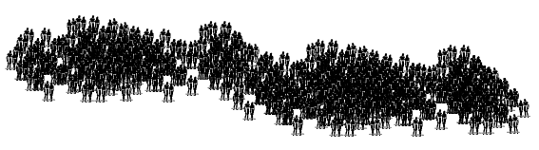
300 Lamanite and Nephite Dissenters Unaware
of Having Undergone a Literal Baptism of Fire
Helaman 5:20-22 “And it came to pass that Nephi and Lehi did proceed from thence to go to the land of Nephi. And it came to pass that they were taken by an army of the Lamanites and cast into prison; yea, even in that same prison in which Ammon and his brethren were cast by the servants of Limhi. And after they had been cast into prison many days without food, behold, they went forth into the prison to take them that they might slay them.”

Slide 12
300 Lamanite and Nephite Dissenters Unaware
of Having Undergone a Literal Baptism of Fire
Helaman 5:23 “And it came to pass that Nephi and Lehi were encircled about as if by fire, even insomuch that they durst not lay their hands upon them for fear lest they should be burned. Nevertheless, Nephi and Lehi were not burned; and they were as standing in the midst of fire and were not burned.”

Slide 13

300 Lamanite and Nephite Dissenters Unaware
of Having Undergone a Literal Baptism of Fire
Helaman 5:27-28; 42 “And behold, they that were in the prison were Lamanites and Nephites who were dissenters. And it came to pass that they were overshadowed with a cloud of darkness, and an awful solemn fear came upon them … And it came to pass that they all did begin to cry unto the voice of him who had shaken the earth; yea, they did cry even until the cloud of darkness was dispersed.”

Slide 14
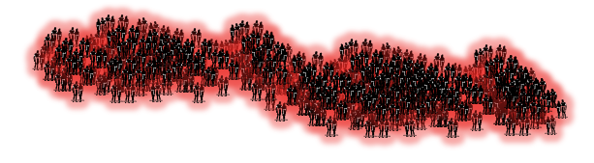
300 Lamanite and Nephite Dissenters Unaware
of Having Undergone a Literal Baptism of Fire
Helaman 5:43-45 “And it came to pass that when they cast their eyes about, and saw that the cloud of darkness was dispersed from overshadowing them, behold, they saw that they were encircled about, yea every soul, by a pillar of fire. … and they were filled with that joy which is unspeakable and full of glory. And behold, the Holy Spirit of God did come down from heaven, and did enter into their hearts, and they were filled as if with fire, and they could speak forth marvelous words.”

Slide 15
300 Lamanite and Nephite Dissenters Unaware
of Having Undergone a Literal Baptism of Fire
Helaman 5:49-50 “And there were about three hundred souls who saw and heard these things; and they were bidden to go forth and marvel not, neither should they doubt. And it came to pass that they did go forth, and did minister unto the people, declaring throughout all the regions round about all the things which they had heard and seen, insomuch that the more part of the Lamanites were convinced of them, because of the greatness of the evidences which they had received.”

Slide 16
1
Light of Christ Present for Everyone
2
Holy Spirit / Light of Christ Decreased & Increased
Holy Spirit encircles Nephi & Lehi, darkness on the mob as the
Light of Christ is withdrawn
3
Holy Spirit / Light of Christ Baptism of Fire and the Holy Ghost
Darkness dispersed as the Holy Spirit encircles all

Slide 17
Questions?

