Slide 1
ETERNALISM MODULE 09
Tools
Abide
and
Abound
Chapter 11: Resolving Mixed
Premises
Case Study 2: Three-Tier Primacy

Slide 2
What do we do with apparent contradictions?
D&C 29:30-33
30 But remember that all my judgments are not given unto men; and as the words have gone forth out of my mouth even so shall they be fulfilled, that the first shall be last, and that the last shall be first in all things whatsoever I have created by the word of my power, which is the power of my Spirit.
31 For by the power of my Spirit created I them; yea, all things both spiritual and temporal—
32 First spiritual, secondly temporal, which is the beginning of my work; and again, first temporal, and secondly spiritual, which is the last of my work—
33 Speaking unto you that you may naturally understand; but unto myself my works have no end, neither beginning.

Slide 3
What do we do with apparent contradictions?
First last? Last first? First temporal? First spiritual?
“That awkward moment when you finish a math problem and your answer isn’t even one of the choices.” (moonlight-path.tumblr)

Slide 4
Gospel Primacy Issues
Clearing up the fog of putting first things first
Horse
Cart
Tier 1
Tier 2
Going to Market
Going to Market
WHICH IS IT?
It All Depends
Cart
Horse
Tier 1
Tier 2

Slide 5
Gospel Primacy Issues
Clearing up the fog of putting first things first
END: Transport
Vegetables
Horse
Cart
Tier 1
Tier 2
MEANS: Horse
Going to Market
WHICH IS IT?
It All Depends
Cart
Horse
Tier 1
Tier 2

Slide 6
Gospel Primacy Issues
Clearing up the fog of putting first things first
Horse
Cart
Tier 1
Tier 2
Going to Market
WHICH IS IT?
It All Depends
END: Display and
Sell Vegetables
Cart
Horse
Tier 1
Tier 2
MEANS: Cart
At Market

Slide 7
3-Tier Thinking (Horse and Cart)
Putting First Things First and First Things Last
Horse
Cart
Beginning of
My Work
Tier 1
Tier 2
Going to Market
Horse1
Cart
Horse2
Going to
Market
Tier 1
Tier 2
Tier 3
Beginning of My Work
Last of
My Work
At the
Market
Cart
Horse
Tier 2
Tier 3
At the Market
Last of My Work

Slide 8
3-Tier Thinking (Spiritual and Temporal)
D&C 29:30-33 “…that the first shall be last, and that the last
shall be first in all things in all things whatsoever I have created… ”
Spiritual and Temporal work at two different times and in two different contexts
Tier 1-2: Pre-Mortal Work:
First Spiritual,
Secondly Temporal
Beginning of
My Work
First1
(Spiritual Beginning)
Tier 1
Tier 2
Tier 3
Last
(Temporal)
First2
(Spiritual End)
Tier 2-3: Salvation Work:
First Temporal
Secondly Spiritual
Last of
My Work

Slide 9
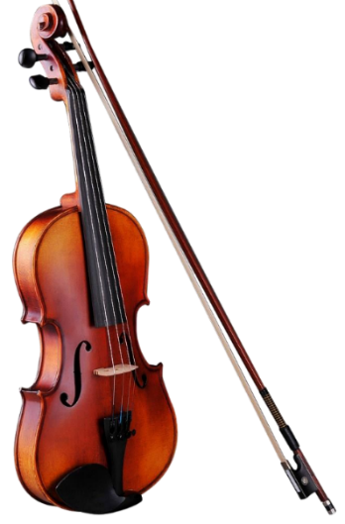
Isn’t the Bible enough to eliminate mixed-premises?
Geoffrey Thomas: “The Scriptures are sufficient to make the man of God perfect…What lies before us? What duties, challenges, and sacrifices will we be called upon to accept? The Bible will completely equip us for them.” (“Is the Bible enough?”, www.opc.org))
Wayne Grudem: "The sufficiency of Scripture means that…Scripture contains everything we need for salvation…This is what the leaders of the Reformation called sola scriptura - Scripture alone. Scripture is the only absolute authority for our faith and for Christian practice.“ (“The Bible is enough.”, Wayne Grudem blog))
Joseph Smith: ...there was in the place where we lived an unusual excitement on the subject of religion....which created no small stir and division amongst the people, some crying, "Lo, here!" and others, "Lo, there!"...for a scene of great confusion and bad feeling ensued — priest contending against priest, and convert against convert; so that all their good feelings one for another, if they ever had any, were entirely lost in a strife of words and a contest about opinions. (Joseph Smith History 1:5-9)
Elder George Q. Cannon: “It has been frequently remarked by those who scoff at [the Bible] that it is like a fiddle, every kind of a tune can be played upon it. It requires something more than the Bible to guide man to eternal life. It requires divine inspiration, it requires the Holy Ghost, it requires the Priesthood, as it existed in ancient days, to be restored.” (JD 14:54)

Slide 10
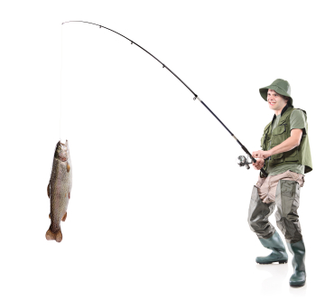
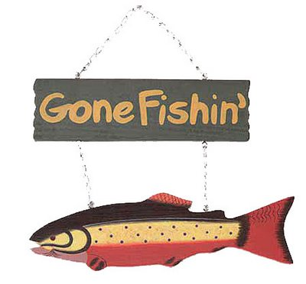
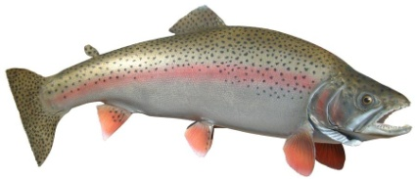
Lao Tzu: "Give a Man a Fish, Feed Him
For a Day. Teach a Man to Fish, Feed Him
For a Lifetime."
True Beliefs
False Beliefs
Primacy Issues
Faith
Reason
Husband
Wife
Reason
Faith
Family
Self
Reality
God
Might
Right
Love
Life
Mercy
Justice
Self
Others

Slide 11
Lao Tzu: "Give a Man a Fish, Feed Him
For a Day. Teach a Man to Fish, Feed Him
For a Lifetime."
SO WHAT?
WHAT?
True Beliefs
False Beliefs
Primacy Issues
Eternal
Life
Everlasting Death
Faith
Reason
Husband
Wife
Reason
Faith
Family
Self
Reality
God
Might
Right
Love
Life
Mercy
Justice
Self
Others

Slide 12
WHEN FISHING …
An Old English Proverb: “A fish rots from the head down”
Tier 1 … Is the Head of the Fish
Tier 2 … Is the Tail of the Fish
Check … the Danger is Always Tier 1 … the Head of the Fish
NOW WHAT?
Everlasting Death
True Beliefs
Tier 1
Tier 2
False Beliefs
Primacy Issues
Eternal
Life
Faith
Reason
Husband
Wife
Reason
Faith
Family
Self
Reality
God
Might
Right
Love
Life
Mercy
Justice
Self
Others

Slide 13
PRACTICE: MAN AND SABBATH
Concentrate on your skills as a fisherman, without letting the fish distract you. Ask two questions:
Which philosophical branch does the issue belong?
Which philosophical branch has primacy?
Tier 1
Tier 2
Man
Sabbath
Sabbath
Man
Tier 1
Tier 2
Christ
Pharisees
Tier 1
Tier 2
Man
Sabbath
METAPHYSICS
POLITICS
Sabbath
Man
Tier 1
Tier 2
POLITICS
METAPHYSICS
WORSHIP ON THE SABBATH (FOR YOUR OWN GOOD)
WORSHIP OF THE SABBATH (BECAUSE IT IS THE LAW)

Slide 14
Defenders of the Faith
The tragedy of harboring mixed premises is that one can never really be confident about anything in life. Principled thinking means taking a philosophical and theological stand against mixed premises.
Popular Opinion
Principled Thinking
This may require us to swim upstream against the current of popular opinion, political correctness, and theological correctness.

Slide 15
Questions?

