Slide 1
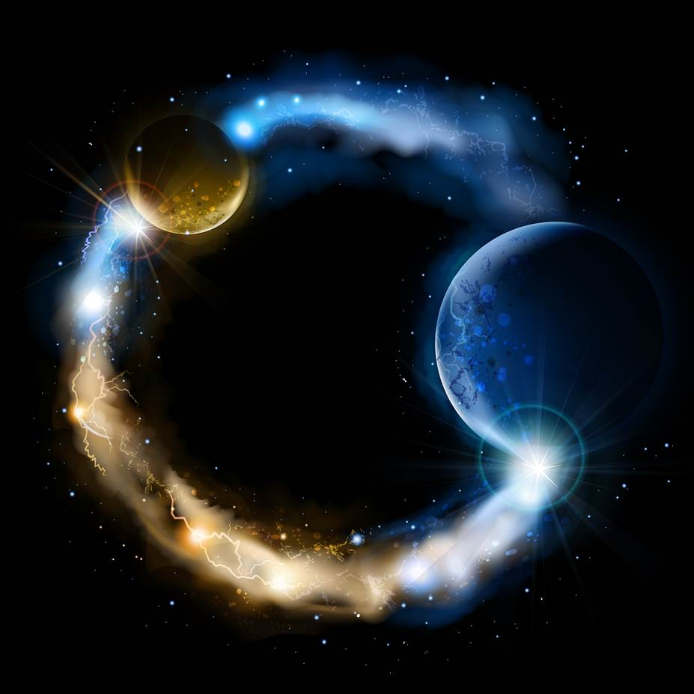
ETERNALISM MODULE 08
Tools
Abide
and
Abound
Chapter 10: Mixed Premises

Slide 2
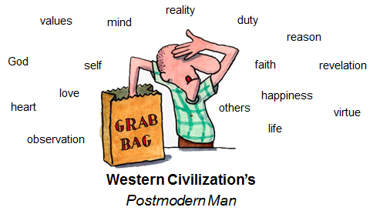
MIXING CONTRARY PHILOSOPHICAL PREMISES
PREMISE DEFINITION: A statement or proposition from which another is inferred or follows as a conclusion. (Oxford Dictionary)
“A double minded man Is unstable in all his ways.” (James 1:8)

Slide 3
OUR PHILOSOPHICAL BARREL OF MONKEYS
Ethics
… HAPPINESS or DUTY
8
7
… GOOD or RIGHT
6
… SELF or OTHERS
Three Major Branches
of Philosophy
5
… LIFE or LOVE
Epistemology
Eight Primacy Issues
4
… MIND or HEART
3
… OBSERVATION or REVELATION
2
… REASON or FAITH
Metaphysics
1
… REALITY or GOD
Bottom of the Barrel Is The 3 Axioms
Ontological
Framework
Existence
Consciousness
Identity
ONTOLOGICAL
FRAMEWORK

Slide 4
Two Rival Clans Warring Over the
Hearts, Minds and Souls of Man
OBSERVATION
3
MIND
4
REVELATION
3
HEART
4
REASON
2
LIFE
5
FAITH
2
Absolutism of
REALITY
Absolutism of
GOD
LOVE
5
1
1
HAPPINESS
8
SELF
6
DUTY
8
OTHERS
6
GOOD
7
RIGHT
7
The Alpha Male with His Family or Clan of Principles
The Alpha Male with His Family or Clan of Principles

Slide 5
DUTY is an end in itself and is its own reward. It is the moral obligation to do what is …
RIGHT based on a moral code of virtues that direct my conduct regardless of consequences, to bless, serve, and benefit …
OTHERS as the primary beneficiary of my morality and actions out of a charitable …
LOVE as my ideal standard of value, being divinely inspired, touched and moved in my …
HEART through my inner feelings that govern the spiritual life of a believer whose …
REVELATION is founded solely in the Bible as containing all the word of God and whose …
FAITH in God is their primary tool of survival through blind faith and obedience in a transcendent …
GOD that created reality ex nihilo, in the primacy of consciousness, and in an …
ONTOLOGICAL FRAMEWORK representative of God-outside-the-box. Thereby resting any hope of a DUTIFUL Reward, ultimately upon their blind obedience and blind faith in a transcendent, incorporeal and incomprehensible God who defies the three …
Existence
Consciousness
Identity
AXIOMS by creating existence out of nothing, becoming a willful law unto Himself, and performing supernatural miracles that defy the law of identity.

Slide 6
HAPPINESS is the reward I receive for adhering to the …
GOOD a moral code of values needed to guide and benefit my …
SELF as the primary beneficiary of my own moral actions to thereby sustain my own …
LIFE the conditions of which constitute my standard of value, being discovered by my …
MIND through the powers of …
OBSERVATION reduced to a set of principles to govern the life of a rational creature whose …
REASON is their primary tool of survival with a rational faith in an objective …
REALITY that is independent of mind, within the primacy of existence, and in an …
ONTOLOGICAL FRAMEWORK representative of God-inside-the-box. Thereby resting all my hopes of HAPPINESS as a reward, ultimately, upon the ROCK OF REALITY and a set of irreducible, invincible and inescapable …
Existence
Consciousness
Identity
AXIOMS representative of our philosophical starting points and the bottom of our philosophical barrel: Existence, Consciousness and Identity.

Slide 7
Mixed Premises
“A Double Minded MAN Is Unstable In All HIS Ways” (James 1:8)
“A Double Minded CIVILIZATION Is Unstable In All ITS Ways”
A
P
O
S
T
A
S
Y
Duty Ethics
Duty Ethics
S
P
L
I
T
P
E
R
S
O
N
A
L
I
T
Y
Value Ethics
Value Ethics
R
E
S
T
O
R
A
T
I
O
N
7
7
7
7
6
6
6
6
5
5
5
5
Traditional
Christianity
Today
Many
LDS
Today
4
4
4
4
Epistemology
Epistemology
Epistemology
Epistemology
3
3
3
3
2
2
2
2
Metaphysics
Metaphysics
Metaphysics
Metaphysics
1
1
1
1
WESTERN
CIVILIZATION
WESTERN
CIVILIZATION
Religious and
Moral Worlds
Siding With
Plato
Scientific and
Practical Worlds
Siding With
Aristotle
ONTOLOGICAL
FRAMEWORK
ONTOLOGICAL
FRAMEWORK
ONTOLOGICAL
FRAMEWORK
ONTOLOGICAL
FRAMEWORK

Slide 8
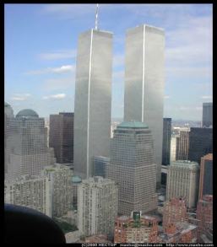
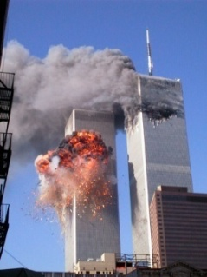
Three E’s of Eternalism
Eternal Life, Joy
& Happiness
ETERNAL LAWS
Metaphysics
ETERNAL TRUTHS
Epistemology
ETERNAL LIVES
Value Ethics
RESTORATION
Absolutism of Reality
Primacy of Existence
Life
Love
Self
Others
Good
Right
Happiness
Duty
Reason
Faith
Observation
Revelation
Mind
Heart
Correct Principles Harmonize with Above
Eternal Life, Joy
& Happiness
Reality
God
The Tragedy of
Mixed Premises
A BIG error in the beginning leads
to a MONSTROUS error in the end.
Aristotle
Plato
God
Reality
Faith
Reason
Revelation
Observation
Heart
Mind
APOSTASY
Absolutism of God
Primacy of Consciousness
False Principles Harmonize with Below
Love
Life
Others
Self
Right
Good
Duty
Happiness
Metaphysics
Epistemology
Duty Ethics
Denies Law of Identity
Negative Theology
Greater the Contradiction
the Greater the Faith
Embraces a Morality Impossible to Live
Everlasting Death,
Sorrow & Misery

Slide 9
Three E’s of Eternalism
Eternal Life, Joy
& Happiness
ETERNAL LAWS
Metaphysics
ETERNAL TRUTHS
Epistemology
ETERNAL LIVES
Value Ethics
RESTORATION
Absolutism of Reality
Primacy of Existence
Life
Love
Self
Others
Good
Right
Happiness
Duty
Reason
Faith
Observation
Revelation
Mind
Heart
Correct Principles Harmonize with Above
Eternal Life, Joy
& Happiness
Reality
God
A Junk Heap of
Contradictions
A Junk Heap of
Contradictions
A BIG error in the beginning leads
to a MONSTROUS error in the end.
Aristotle
Plato
God
Reality
Faith
Reason
Revelation
Observation
Heart
Mind
APOSTASY
Absolutism of God
Primacy of Consciousness
False Principles Harmonize with Below
Love
Life
Others
Self
Right
Good
Duty
Happiness
Metaphysics
Epistemology
Duty Ethics
Denies Law of Identity
Negative Theology
Greater the Contradiction
the Greater the Faith
Embraces a Morality Impossible to Live
Everlasting Death,
Sorrow & Misery

Slide 10
Three E’s of Eternalism
Eternal Life, Joy
& Happiness
ETERNAL LAWS
Metaphysics
ETERNAL TRUTHS
Epistemology
ETERNAL LIVES
Value Ethics
RESTORATION
Absolutism of Reality
Primacy of Existence
Life
Love
Self
Others
Good
Right
Happiness
Duty
Reason
Faith
Observation
Revelation
Mind
Heart
Correct Principles Harmonize with Above
Eternal Life, Joy
& Happiness
Reality
God
Mark 9:23, Luke 1:37, 18:27: “Jesus said unto him, If thou canst believe, all things are possible to him that believeth … For with God nothing shall be impossible … And he said, The things which are impossible with men are possible with God.”
Aristotle
Plato
God
Reality
Faith
Reason
Revelation
Observation
Heart
Mind
APOSTASY
Absolutism of God
Primacy of Consciousness
False Principles Harmonize with Below
Love
Life
Others
Self
Right
Good
Duty
Happiness
Metaphysics
Epistemology
Duty Ethics
Denies Law of Identity
Negative Theology
Greater the Contradiction
the Greater the Faith
Embraces a Morality Impossible to Live
Everlasting Death,
Sorrow & Misery

Slide 11
Three E’s of Eternalism
Eternal Life, Joy
& Happiness
ETERNAL LAWS
Metaphysics
ETERNAL TRUTHS
Epistemology
ETERNAL LIVES
Value Ethics
RESTORATION
Absolutism of Reality
Primacy of Existence
Life
Love
Self
Others
Good
Right
Happiness
Duty
Reason
Faith
Observation
Revelation
Mind
Heart
Correct Principles Harmonize with Above
Eternal Life, Joy
& Happiness
Reality
God
Mark 9:23, Luke 1:37, 18:27: “Jesus said unto him, If thou canst believe, all things are possible to him that believeth … For with God nothing shall be impossible … And he said, The things which are impossible with men are possible with God.”
Aristotle
Plato
God
Reality
Faith
Reason
Revelation
Observation
Heart
Mind
APOSTASY
Absolutism of God
Primacy of Consciousness
False Principles Harmonize with Below
Love
Life
Others
Self
Right
Good
Duty
Happiness
Metaphysics
Epistemology
Duty Ethics
Denies Law of Identity
Negative Theology
Greater the Contradiction
the Greater the Faith
Embraces a Morality Impossible to Live
Everlasting Death,
Sorrow & Misery

Slide 12
Three E’s of Eternalism
Eternal Life, Joy
& Happiness
ETERNAL LAWS
Metaphysics
ETERNAL TRUTHS
Epistemology
ETERNAL LIVES
Value Ethics
RESTORATION
Absolutism of Reality
Primacy of Existence
Life
Love
Self
Others
Good
Right
Happiness
Duty
Reason
Faith
Observation
Revelation
Mind
Heart
Correct Principles Harmonize with Above
Eternal Life, Joy
& Happiness
Reality
God
D&C 131:6; Hebrews 6:4-6: “It is impossible for a man to be saved in ignorance … For it is impossible for those who were once enlightened, and have tasted of the heavenly gift … If they shall fall away, to renew them again unto repentance.” Mormon 7:3 Know ye that ye must come unto repentance, or ye cannot be saved.
Aristotle
Plato
God
Reality
Faith
Reason
Revelation
Observation
Heart
Mind
APOSTASY
Absolutism of God
Primacy of Consciousness
False Principles Harmonize with Below
Love
Life
Others
Self
Right
Good
Duty
Happiness
Metaphysics
Epistemology
Duty Ethics
Denies Law of Identity
Negative Theology
Greater the Contradiction
the Greater the Faith
Embraces a Morality Impossible to Live
Everlasting Death,
Sorrow & Misery

Slide 13
Three E’s of Eternalism
Eternal Life, Joy
& Happiness
ETERNAL LAWS
Metaphysics
ETERNAL TRUTHS
Epistemology
ETERNAL LIVES
Value Ethics
RESTORATION
Absolutism of Reality
Primacy of Existence
Life
Love
Self
Others
Good
Right
Happiness
Duty
Reason
Faith
Observation
Revelation
Mind
Heart
Correct Principles Harmonize with Above
Eternal Life, Joy
& Happiness
Reality
God
“For it is Impossible … “
Aristotle
Plato
“Nothing Shall Be Impossible … ”
God
Reality
Faith
Reason
Revelation
Observation
Heart
Mind
APOSTASY
Absolutism of God
Primacy of Consciousness
False Principles Harmonize with Below
Love
Life
Others
Self
Right
Good
Duty
Happiness
Metaphysics
Epistemology
Duty Ethics
Denies Law of Identity
Negative Theology
Greater the Contradiction
the Greater the Faith
Embraces a Morality Impossible to Live
Everlasting Death,
Sorrow & Misery

Slide 14
Three E’s of Eternalism
Eternal Life, Joy
& Happiness
ETERNAL LAWS
Metaphysics
ETERNAL TRUTHS
Epistemology
ETERNAL LIVES
Value Ethics
RESTORATION
Absolutism of Reality
Primacy of Existence
Life
Love
Self
Others
Good
Right
Happiness
Duty
Reason
Faith
Observation
Revelation
Mind
Heart
Correct Principles Harmonize with Above
Eternal Life, Joy
& Happiness
Reality
God
Mixed Premises Result
in Mixed Emotions
Aristotle
Plato
God
Reality
Faith
Reason
Revelation
Observation
Heart
Mind
APOSTASY
Absolutism of God
Primacy of Consciousness
False Principles Harmonize with Below
Love
Life
Others
Self
Right
Good
Duty
Happiness
Metaphysics
Epistemology
Duty Ethics
Denies Law of Identity
Negative Theology
Greater the Contradiction
the Greater the Faith
Embraces a Morality Impossible to Live
Everlasting Death,
Sorrow & Misery

Slide 15
Three E’s of Eternalism
Eternal Life, Joy
& Happiness
ETERNAL LAWS
Metaphysics
ETERNAL TRUTHS
Epistemology
ETERNAL LIVES
Value Ethics
RESTORATION
Absolutism of Reality
Primacy of Existence
Life
Love
Self
Others
Good
Right
Happiness
Duty
Reason
Faith
Observation
Revelation
Mind
Heart
Correct Principles Harmonize with Above
Eternal Life, Joy
& Happiness
Reality
God
Suppress It All With Prescription Drugs
Aristotle
Plato
God
Reality
Faith
Reason
Revelation
Observation
Heart
Mind
APOSTASY
Absolutism of God
Primacy of Consciousness
False Principles Harmonize with Below
Love
Life
Others
Self
Right
Good
Duty
Happiness
Metaphysics
Epistemology
Duty Ethics
Denies Law of Identity
Negative Theology
Greater the Contradiction
the Greater the Faith
Embraces a Morality Impossible to Live
Everlasting Death,
Sorrow & Misery

Slide 16
Three E’s of Eternalism
Eternal Life, Joy
& Happiness
ETERNAL LAWS
Metaphysics
ETERNAL TRUTHS
Epistemology
ETERNAL LIVES
Value Ethics
RESTORATION
Absolutism of Reality
Primacy of Existence
Life
Love
Self
Others
Good
Right
Happiness
Duty
Reason
Faith
Observation
Revelation
Mind
Heart
Correct Principles Harmonize with Above
Eternal Life, Joy
& Happiness
Reality
God
“A study conducted by U.S. Department of Health and Human Services found that Utah led the U.S. in the nonmedical use (abuse) of prescription drugs in 2004 and 2005, with 6.5 percent of the population using drugs without a doctor’s order.”
(TurningPoint Rehab Center Home Page)
Aristotle
Plato
God
Reality
Faith
Reason
Revelation
Observation
Heart
Mind
APOSTASY
Absolutism of God
Primacy of Consciousness
False Principles Harmonize with Below
Love
Life
Others
Self
Right
Good
Duty
Happiness
Metaphysics
Epistemology
Duty Ethics
Denies Law of Identity
Negative Theology
Greater the Contradiction
the Greater the Faith
Embraces a Morality Impossible to Live
Everlasting Death,
Sorrow & Misery

Slide 17
Three E’s of Eternalism
Eternal Life, Joy
& Happiness
ETERNAL LAWS
Metaphysics
ETERNAL TRUTHS
Epistemology
ETERNAL LIVES
Value Ethics
RESTORATION
Absolutism of Reality
Primacy of Existence
Life
Love
Self
Others
Good
Right
Happiness
Duty
Reason
Faith
Observation
Revelation
Mind
Heart
Correct Principles Harmonize with Above
Eternal Life, Joy
& Happiness
Reality
God
“Utah ranks fifth in the nation for overdose deaths…Utah had one of the highest rates of suicide deaths between 2011 and 2013, with 20.6 per 100,000 population, compared to the national rate of 12.5” (Deseret News, June 17, 2015)
Aristotle
Plato
God
Reality
Faith
Reason
Revelation
Observation
Heart
Mind
APOSTASY
Absolutism of God
Primacy of Consciousness
False Principles Harmonize with Below
Love
Life
Others
Self
Right
Good
Duty
Happiness
Metaphysics
Epistemology
Duty Ethics
Denies Law of Identity
Negative Theology
Greater the Contradiction
the Greater the Faith
Embraces a Morality Impossible to Live
Everlasting Death,
Sorrow & Misery

Slide 18
Three E’s of Eternalism
Eternal Life, Joy
& Happiness
ETERNAL LAWS
Metaphysics
ETERNAL TRUTHS
Epistemology
ETERNAL LIVES
Value Ethics
Self
Others
Self
Others
Good
Right
Good
Right
Happiness
Duty
Life
Love
Happiness
Duty
RESTORATION
Absolutism of Reality
Primacy of Existence
Life
Love
Observation
Revelation
Observation
Revelation
Mind
Heart
Reason
Faith
Mind
Heart
Reason
Faith
Correct Principles Harmonize with Above
Correct Principles Harmonize with Above
Eternal Life, Joy
& Happiness
Reality
God
Reality
God
SCIENCE, REASON, PRACTICAL
RELIGION, FAITH, MORAL
A Junk Heap of
Contradictions
Confused State
Of Our Times
Aristotle
Plato
This Philosophical
Contest Ended Up Being a Split Decision
At War
God
Reality
God
Reality
Faith
Reason
Faith
Reason
Heart
Mind
Revelation
Observation
Heart
Mind
Revelation
Observation
APOSTASY
Absolutism of God
Primacy of Consciousness
False Principles Harmonize with Below
False Principles Harmonize with Below
Love
Life
Others
Self
Right
Good
Duty
Happiness
Metaphysics
Epistemology
Duty Ethics
Denies Law of Identity
Negative Theology
Greater the Contradiction
the Greater the Faith
Embraces a Morality Impossible to Live
Everlasting Death,
Sorrow & Misery

Slide 19
A WAR BETWEEN
SCIENCE AND RELIGION
Two Realities
NO WAR BETWEEN
SCIENCE AND RELIGION
One Reality
GOD OUTSIDE THE BOX
Traditional Christian, Judaic, Islamic
GOD INSIDE THE BOX
LDS Eternalism
Moral
Duty
Self
Science
Reason
Life
Life
Science
Duty
Practical
Right
GOD
Mind
Good
Love
Mind
Practical
GOD
Religion
MAN
MAN
Good
Happiness
Reason
Faith
Faith
Heart
Happiness
Religion
Moral
Heart
Love
GET OUT OF THE BOX
GET ALONG WITH THE BOX
Others
Right
Asceticism and Transcendence
Abide and Abound
Revelation 3:15-16: I know thy works, that thou art neither cold nor hot: I would thou wert cold or hot. So then because thou art lukewarm, and neither cold nor hot, I will spue thee out of my mouth.

Slide 20
Questions?

