Slide 1
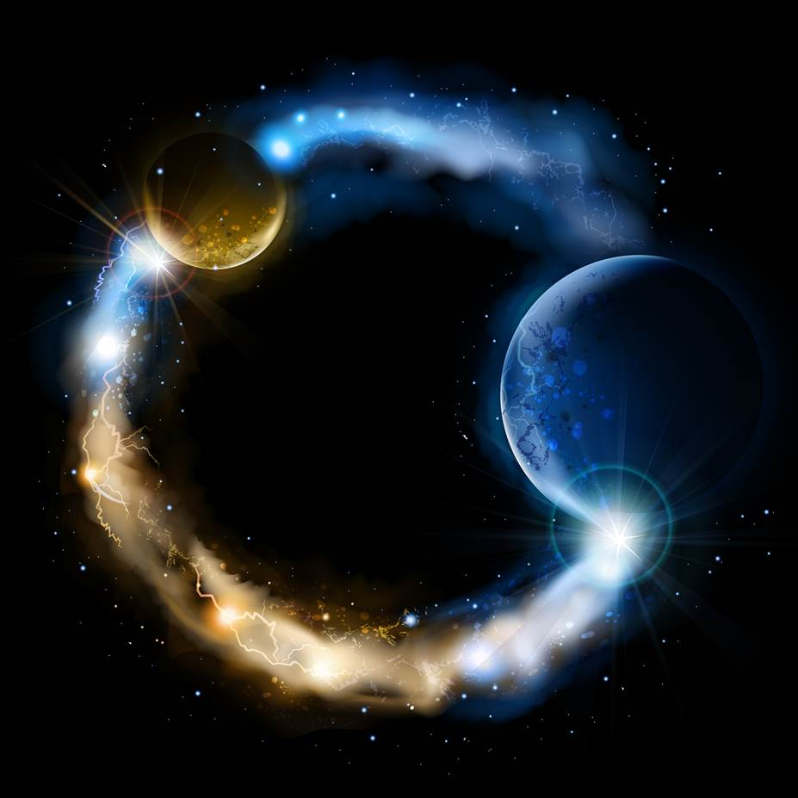
ETERNALISM MODULE 07
Metaphysics
Abide
and
Abound
Chapter 9: Plato vs Aristotle
Case Study 1: Primacy of Consciousness Examples

Slide 2
For over 2,500 Years, Western Civilization has been torn apart and divided into two camps
PLATO vs. ARISTOTLE
Consciousness
Existence
Existence
Consciousness
ALL OVER WHICH HAS PRIMACY: CONSCIOUSNESS or EXISTENCE?
Whose bucket is upside down and whose
bucket is right side up? How can we know?

Slide 3
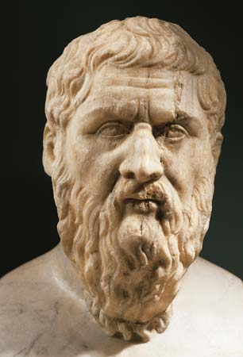
PLATO (c. 428-348 BC)
“For Plato, there were two worlds, not one – the sensible world of changing physical things that we apprehend by means of our senses and the world of intelligible objects that we apprehend by means of our intellects or minds…the world of ideas had for him a superior grade of reality. The
physical things that we perceive through our senses come into being and pass away … continually in flux, changing in one way or another. They have no permanence … The world of changing physical things is thus for Plato a mere shadow of the much more real world of ideas. When we pass from the realm of sense experience to the realm of thought, we ascend to a higher reality…” (Six Great Ideas, Mortimer J. Adler, p.8)
“The Platonist school begins by accepting the primacy of consciousness…by assuming that reality must conform to the content of consciousness…that the presence of any notion in man’s mind proves the existence of a corresponding referent in reality.” (Ayn Rand Lexicon, p368)
Consciousness
Existence

Slide 4
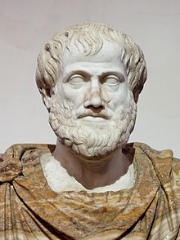
ARISTOTLE (384-323 BC):
Was Plato’s student for some twenty years. Aristotle turned this thinking on its head. Aristotle said existence had primacy over consciousness. Reality set the terms by which consciousness had to abide.
“Aristotle is the champion of this world, the champion of nature, as against the supernaturalism of Plato. Denying Plato’s World of Forms, Aristotle maintains that there is only one reality: the world of particulars in which we live, the world men perceive by means of their physical senses. Universals, he holds, are merely aspects of existing entities, isolated in thought by a process of selective attention… the physical world, in his view,
is not a shadowy projection controlled by a divine dimension, but…is an orderly, intelligible, natural realm open to the mind of man.”
(Leonard Peikoff, “Objectivsm: The Philosophy of Ayn Rand”, p21)
Existence
Consciousness

Slide 5
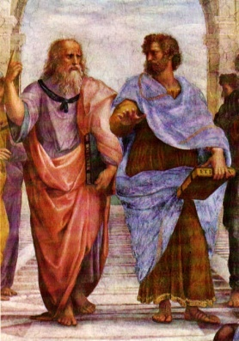
Consciousness Definition: “Consciousness is the faculty of awareness – the faculty of perceiving that which exists.” (Ayn Rand Lexicon, p92)
The Primacy of Consciousness
The Primacy of
Existence
PLATO
ARISTOTLE
False Belief
True Belief
Unprincipled
Willfulness
A Law Unto
Themselves
Principled
Lawfulness
Abide and
Abound
Outcome
Lawfulness
Outcome
Willfulness
Everlasting Death
Eternal Life
This Philosophical Contest Ended Up with a House Divided
Traditional Religious and Moral Worlds Siding With Plato
Philosophical War between:
(1) Religion and Science
(2) Faith and Reason
(3) The Moral and Practical
Scientific and
Practical Worlds Siding
With Aristotle

Slide 6
Tragically the traditional Christian, Judaic and Islamic religions have all
thrown their allegiance in with the Absolutism of God
GOD
REALITY
PLATO
ARISTOTLE
REALITY
GOD
creatio ex materia
creatio ex nihilo
The Absolutism of God
Primacy of Consciousness
The Absolutism of Reality
Primacy of Existence
D&C 93:29-34 “Man was also in the beginning with God. Intelligence, or the light of truth, was not created or made, neither indeed can be … For man is spirit. The elements are eternal, and spirit and element, inseparably connected, receive a fulness of joy; And when separated, man cannot receive a fulness of joy.”
Fourth Lateran Council (of 1215):
God…who by his almighty power at the beginning of time created from nothing both spiritual and corporeal creatures.
René Descartes (1596-1650): “Cogito ergo sum“…”I think, therefore I am.”
Joseph Smith “Hence we infer that God had materials to organize the world out of chaos - chaotic matter, which is element, and in which dwells all the glory. Element had an existence from the time He had. The pure principles of element are principles which can never be destroyed; they may be organized and re-organized, but not destroyed. They had no beginning and can have no end.”
(King Follett Discourse, 7 April 1844…Teachings of the Prophet Joseph Smith p351-352)
George Berkeley (1685-1753): If a tree falls in a forest and no one is around to hear it, does it make a sound? "The objects of sense exist only when they are perceived.”

Slide 7
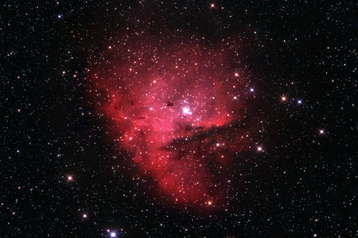
Eternalism
God Inside the Box
Abide and Abound (D&C 88:66)
creatio ex materia
Francis Bacon: “Nature to be commanded must be obeyed.”

Slide 8
THEOLOGICAL
LANGUAGE:
PHILOSOPHICAL
LANGUAGE:
ONTOLOGICAL FRAMEWORK:
RESTORATION
Reality
God
=
Existence
Consciousness
=
creatio ex materia
Absolutism
of Reality
Primacy of
Existence
God Inside
The Box
Three Philosophical and Doctrinal Equivalents
APOSTASY
God
Reality
Consciousness
Existence
=
=
creatio ex nihilo
Absolutism
of God
Primacy of
Consciousness
God Outside
The Box

Slide 9
Eternalism’s
Ontological Framework
God Inside the Box
Eternalism’s
Ontological Framework
God Inside the Box
Eternalism
The Philosophy of Heaven and Earth
President John Taylor: “Permit me to say there are eternal laws that exist with the Gods in the eternal worlds, and from which they cannot depart, and to which they are bound in all their acts … All beings, all things, from the Great Creator to the minutest form of life are governed by the law of their existence.” (JD 21:15; 26:349-350)
Elder Kenneth Johnson: “It is important to understand that natural laws were not determined on the basis of popularity. They were established and rest on the rock of reality.” (April 2008 General Conference)
Elder D. Todd Christofferson: “His [God’s] commandments are the voice of reality.”(April 2010 General Conference)

Slide 10
Our First True Philosophical Primacy Issue
Pertains to the Nature of God
Elder Bruce R. McConkie: “The greatest truth known to man is that there is a God in heaven who is infinite and eternal, that he is our Father in heaven, that he has a body of flesh and bones as tangible as man’s, that he is a literal person, and that if we believe and obey his laws we can gain the exaltation that he possesses. Now that is the greatest truth and the most glorious concept known to the human mind and the reverse of it is the greatest heresy in Christendom.” (The Seven Deadly Heresies, BYU Fireside, Jun1, 1980)
RESTORATION
Reality
God
True
Beliefs
ABSOLUTISM OF REALITY
PRIMACY OF EXISTENCE
LAWFULNESS
Eternal Life

Slide 11
Our First False Philosophical Primacy Issue
Pertains to the Nature of God
Elder Bruce R. McConkie: “This first and chief heresy of a now fallen and decadent Christianity—and truly it is the father of all heresies—swept through all of the congregations of true believers in the early centuries of the Christian Era; it pertained then and it pertains now to the nature and kind of being that God is … This new God, no longer a personal Father, no longer a personage of tabernacle, became an incomprehensible three-in-one spirit essence that filled the immensity of space. The adoption of this false doctrine about God effectively destroyed the true worship among men and ushered in the age of universal apostasy.” (The Seven Deadly Heresies, BYU Fireside, Jun1, 1980)
APOSTASY
God
Reality
False
Beliefs
ABSOLUTISM OF GOD
PRIMACY OF CONSCIOUSNESS
WILLFULNESS
Everlasting Death

Slide 12
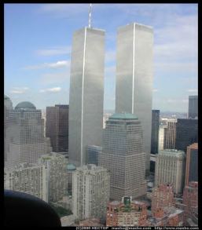
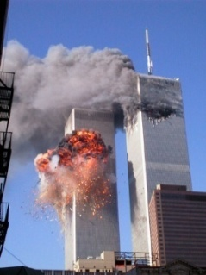
Three E’s of Eternalism
Eternal Life, Joy
& Happiness
ETERNAL LAWS
Metaphysics
ETERNAL TRUTHS
Epistemology
ETERNAL LIVES
Value Ethics
RESTORATION
Absolutism of Reality
Primacy of Existence
Life
Love
Self
Others
Good
Right
Happiness
Duty
Reason
Faith
Observation
Revelation
Mind
Heart
Correct Principles Harmonize with Above
Eternal Life, Joy
& Happiness
Reality
God
Our First True Philosophical Primacy Issue
is the Greatest Truth Known to Man
A BIG error in the beginning leads
to a MONSTROUS error in the end.
Aristotle
Plato
Our First False Philosophical Primacy Issue is
the Greatest Heresy In Traditional Christendom
God
Reality
Faith
Reason
Revelation
Observation
Heart
Mind
APOSTASY
Absolutism of God
Primacy of Consciousness
False Principles Harmonize with Below
Love
Life
Others
Self
Right
Good
Duty
Happiness
Metaphysics
Epistemology
Duty Ethics
Denies Law of Identity
Negative Theology
Greater the Contradiction
the Greater the Faith
Embraces a Morality Impossible to Live
Everlasting Death,
Sorrow & Misery

Slide 13
Questions?

