Slide 1
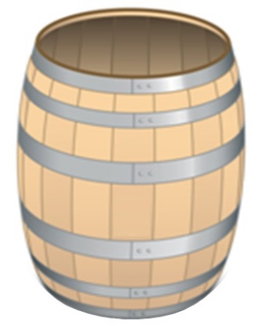
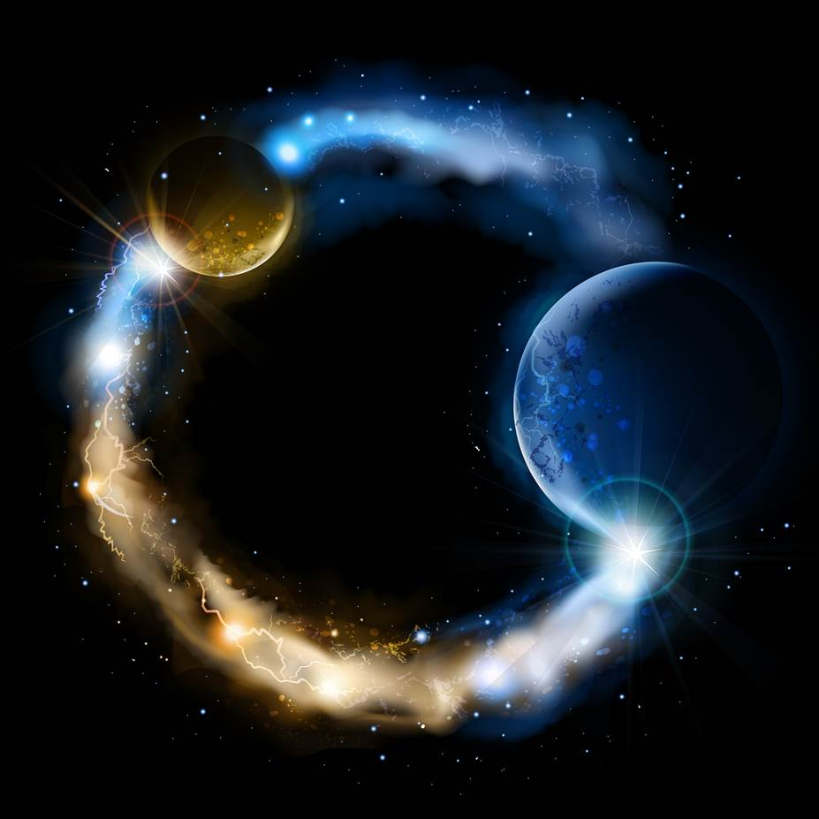
ETERNALISM MODULE 05
Tools
Abide
and
Abound
Chapter 7: Axioms

Slide 2
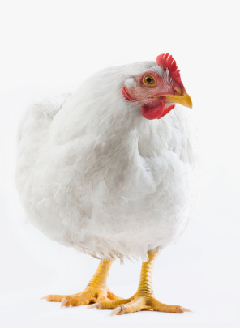
Definition of Axiom
A self-evident truth that requires no proof. A universally accepted principle or rule. A proposition in logic or mathematics that is assumed without proof for the sake of studying the consequences that follow from it. (Dictionary.com)
Fixed principles upon which we can ALWAYS take a righteous stand.
INFINITE REGRESS: A never-ending series of causation; a sequence of reasoning that can never come to an end.
Chicken
Egg
Tier 1
Tier 2
Tier 1
Tier 2
Egg
Chicken
President Brigham Young … ‘think, brethren, think,’ but do not think so far that you cannot think back again… (JD 3: 247)

Slide 3
Axioms are Irreducible, Invincible, Inescapable starting points
“An axiomatic concept is the identification of a primary fact of reality, which cannot be analyzed, reduced to other facts or broken into component parts. It is implicit in all facts and in all knowledge. It is the fundamentally given and directly perceived or experienced, which requires no proof or explanation, but on which all proofs and explanations rest.” (See Lexicon, Objectivism From A to Z, p. 43-46)
“Axiomatic concepts are starting points of knowledge…on which all proofs depend … they must be used and accepted by everyone, including those who attack them.”
(Objectivism The Philosophy of Ayn Rand, p7-9)
“An axiom is a proposition that defeats its opponents by the fact that they have to accept it and use it in the process of any attempt to deny it.” (See Lexicon, Objectivism From A to Z, p. 43-46)

Slide 4
Joseph Smith:
“How many things are necessary for us to understand, respecting the Deity and our relation to him, in order that we may exercise faith in him for life and salvation? Three. What are they?
EXISTENCE AXIOM
First, that God does exist;”
secondly, correct ideas of his character, his perfections and attributes;
IDENTITY AXIOM
CONSCIOUSNESS AXIOM
and thirdly, that course which we pursue is according to his mind and will.” (Lectures On Faith, Lecture 3, Q&A)

Slide 5
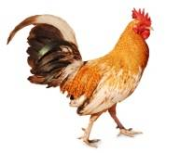
Three Axioms of Eternalism
Existence = Exists
Consciousness = Conscious
Identity (A = A)
Axiomatic concepts are epistemological starting points. They sum up the essence of all human cognition: Something exists of which I am conscious; I must discover its identity. Consciousness requires identification.
Implicit in All Facts and in All Knowledge
“It Is … It Is Something … And I’m Aware of it”

Slide 6
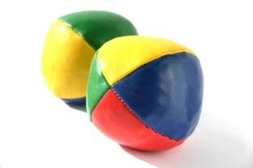
Implicit in All Facts and in All Knowledge
All Perceptual Objects
(1) “It is” (Existence)
(2) “I’m aware of it” (Consciousness)
(3) “It is something with attributes” (Identity)
(1) “It is” (Existence)
(2) “I’m aware of it” (Consciousness)
(3) “It is something with attributes” (Identity)
(1) “It is” (Existence)
(2) “I’m aware of it” (Consciousness)
(3) “It is something with attributes” (Identity)

Slide 7
Implicit in All Facts and in All Knowledge
All Knowledge, Thoughts, Actions
Every Thought
Ex: GOD
(1) “It is” (Existence)
(2) “I’m aware of it” (Consciousness)
(3) “It is something with attributes” (Identity)
Every Feeling
Ex: LOVE
(1) “It is” (Existence)
(2) “I’m aware of it” (Consciousness)
(3) “It is something with attributes” (Identity)
Every Action
Ex: RUNNING
(1) “It is” (Existence)
(2) “I’m aware of it” (Consciousness)
(3) “It is something with attributes” (Identity)

Slide 8
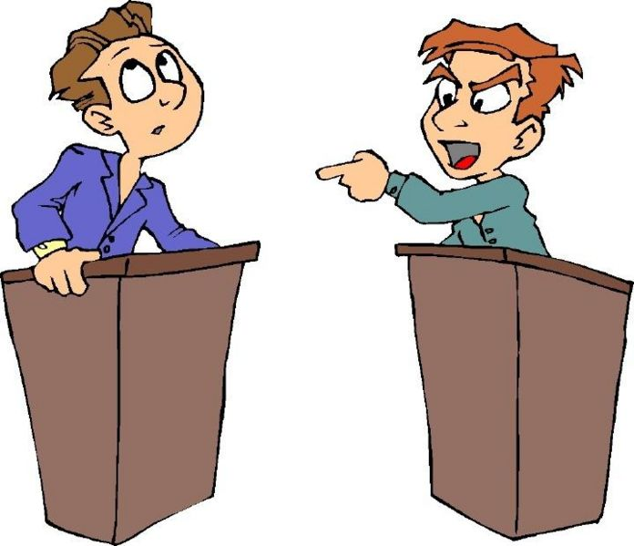
“You can’t prove that you exist or that you’re conscious or that anything is what it is!!!”
Axioms are:
Irreducible
Invincible
Inescapable
Adam
Bob
Who Is Bob Arguing With?
Aristotle’s Affirmation Through Denial: An axiom is a proposition that defeats its opponents by the fact that they have to accept it and use it in the process of any attempt to deny it.

Slide 9
Existence, consciousness, identity are presupposed by every statement
and by every concept, including the concept of disagreement.
Example: Person A (Adam) showing Person B (Bob) that no one can object to the axioms without actually using the axioms in their objections. Adam does this by arguing the absurd.
EXISTENCE
ADAM: Your objection to the self-evident has no validity. There is no such thing as disagreement. People agree about everything.
BOB: That's absurd. People disagree constantly, about all kinds of things.
ADAM: How can they? There's nothing to disagree about. After all nothing exists.
BOB: Nonsense. All kinds of things exist. You know that as well as I do.
ADAM: Ah! THAT'S ONE! You must accept the existence axiom to even utter the term 'disagreement'.
CONSCIOUSNESS
ADAM: But to continue, I still claim that disagreement is unreal. How can people disagree, since they are all unconscious beings unable to hold ideas at all?
BOB: Of course people hold ideas. They are conscious beings - you know that.
ADAM: THAT'S TWO! You must be conscious in order to disagree.
IDENTITY
ADAM: But even so, why is disagreement about ideas a problem? Perhaps all of the people who disagree about the very same point are both equally right?
BOB: That's impossible. If two ideas contradict each other, they can't both be right.
ADAM: THAT'S THREE! Contradictions can't exist in reality. All things have identity.

Slide 10
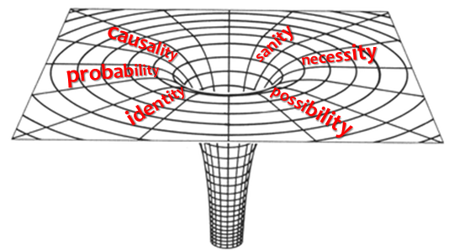
“Axiomatic concepts are the guardians of man’s mind and the foundation of reason—the key-stone, touchstone and hallmark of reason—and if reason is to be destroyed, it is axiomatic concepts that have to be destroyed…By debunking these axiomatic concepts you debunk all philosophies along with any quest for wisdom ‘in one fell swoop’. In short, without these axiomatic concepts philosophy becomes fruitless and pointless as it has no way to get off the ground.”(See Lexicon, Objectivism From A to Z, p. 43-46)
AXIOMS SAVE US FROM BEING SUCKED INTO A PHILOSOPHICAL BLACK HOLE
Stolen Concept Fallacy
Fallacy
Noun, a mistaken belief, based on unsound argument.
“Stolen Concept” = Attempting to use a concept as a proof against itself.

Slide 11
Eternalism’s
Philosophical Barrel
s
P
c
o
i
l
t
i
e
t
h
i
t
c
s
s
e
A
Ethics
M
y
e
g
t
o
a
l
p
o
h
m
y
e
s
t
i
s
c
i
p
s
E

Slide 12
The contents represent all five branches of philosophy
s
P
c
o
i
l
t
i
e
t
h
i
t
c
s
s
e
A
Ethics
M
y
e
g
t
o
a
l
p
o
h
m
y
e
s
t
i
s
c
i
p
s
E

Slide 13
+ it contains all our philosophical
primacy issues
s
P
c
o
i
l
t
i
e
t
h
i
t
c
s
s
e
A
Ethics
M
y
e
g
t
o
a
l
p
o
h
m
y
e
s
t
i
s
c
i
p
s
E

Slide 14
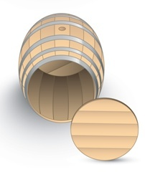
What is the bottom of the barrel?
s
P
c
o
i
l
t
i
e
t
h
i
t
c
s
s
e
A
Ethics
?
M
y
e
g
t
o
a
l
p
o
h
m
y
e
s
t
i
s
c
i
p
s
E

Slide 15
What is the bottom of the barrel?
Philosophical Axioms Are the Bottom of the Philosophical Barrel.
Existence
Consciousness
Identity
Philosophical Axioms

Slide 16
What is the bottom of the barrel?
Every credible philosophy or theology (including Eternalism) must start somewhere. No philosophy can hold water without these philosophical axioms. If you knock the bottom of the barrel out by denying any one of these three axioms, all philosophy (including all of your primacy issues) all fall away.
Irreducible in the sense that these axioms are the very bottom of the barrel. There is nothing beneath it to lend it support.
Invincible in the sense that they have their own built in self-defense. Epistemologically it is impossible to knock the bottom of the barrel out without reaffirming its validity.
Existence
Consciousness
Identity
Inescapable in that they are necessarily presupposed in every thought, word, feeling, action, belief or testimony being born.

Slide 17
Three Basic Axioms of Eternalism are
Irreducible, Invincible and Inescapable
You cannot say that Jesus is the Christ or the Book of Mormon is true without these axioms being used.
Existence
Consciousness
Identity

Slide 18
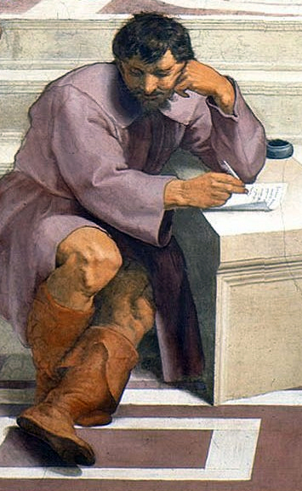
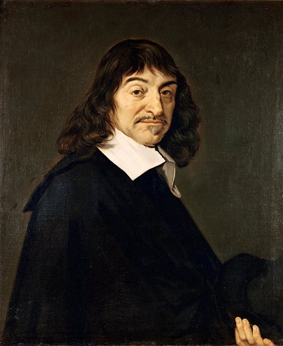
PRACTICE!
Heraclitus: “Nothing exists. Everything is change. No man ever steps in the same river twice“.
An attack on the existence of the river, is also an attack on the existence of everything else. If you destroy the river by changing it to “flux” you also must destroy everything else that changes, including the man because the contents of his mind also change. "How can something change if it doesn’t first exist?"
René Descartes (1596-1650): “Cogito ergo sum“…”I think, therefore I am.”
In order to even utter the word “I” what assumptions are present?
Let’s replace a few words with their full meaning:
“I” = “I exist” … Otherwise who is doing the talking?
“Think” = “Conscious” … Otherwise who is doing the thinking?
“I am” = “I exist” … Was already implied in the premise.
“I exist, I am conscious, therefore I exist.”
PROBLEM: Tautology (Circular Reasoning): A logical fallacy in which the premise is identical to the conclusion.

Slide 19
PRACTICE!
Actual
Potential
Potential
Actual
Tier 1
Tier 2
Tier 1
Tier 2

Slide 20
PRACTICE!
Actual
Potential
Potential
Actual
Tier 1
Tier 2
Tier 1
Tier 2
Actual has primacy over Potential

Slide 21
Questions?

