Slide 1
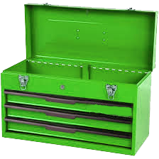
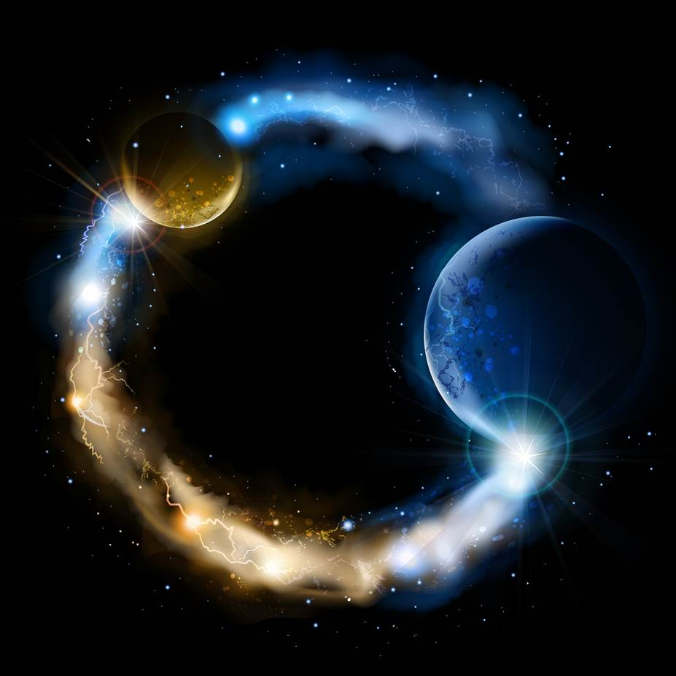
ETERNALISM MODULE 04
Tools
Abide
and
Abound
Chapter 6: Turning Upside Down

Slide 2
Three E’s of Eternalism
Eternal Laws
Eternal Truths
Eternal Lives
Life
Love
Self
Others
Good
Right
Happiness
Duty
Reality
God
Reason
Faith
Observation
Revelation
Mind
Heart
Life
Love
Self
Others
Good
Right
Happiness
Duty
METAPHYSICS
EPISTEMOLOGY
VALUE ETHICS
METAPHYSICS
EPISTEMOLOGY
DUTY ETHICS
God
Reality
Revelation
Observation
Heart
Mind
Right
Good
Faith
Reason
Heart
Mind
Love
Life
Others
Self
Right
Good
Duty
Happiness
Absolutism
of God
Absolutism
of Faith
Absolutism
of Others
True
Beliefs
Three A’s of the Apostasy

Slide 3
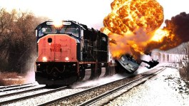
THE
RESTORATION
ETERNALISM EXPRESS
Eternal Life,
Joy, Happiness
Braden
Channel
Dustin
Jake
Kerrie
Ryan
Reality
God
Reason
Faith
Observation
Revelation
Mind
Heart
Life
Love
Self
Others
Good
Right
Happiness
Duty
Aesthetics
Politics
Metaphysics
Epistemology
Ethics
Politics
God
Reality
Faith
Reason
Revelation
Observation
Heart
Mind
Love
Life
Others
Self
Right
Good
Duty
Happiness
Aesthetics
ROCK OF
REALITY
THE GREAT
APOSTASY
Everlasting Death Sorrow, Misery

Slide 4
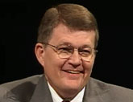
The Restoration Changes Everything
Richard N. Williams: “You and I have the blessed privilege of living in the full light of day - the dispensation of the fullness of times. This, as they say, changes everything. The scripture in Isaiah 29:14 and repeated in 2 Nephi 27:26
Concerning the ‘marvelous work and a wonder’ of the restoration is well known to all of us. We are not as familiar with the verse that follows. I quote from 2 Nephi 27:27, where the prophet spoke of those who are not enlightened nor made joyful at the news of the restoration of the fullness of the gospel. These people respond: ‘Surely, your turning of things upside down shall be esteemed as the potter's clay.’ This is a powerful metaphor. The implications of the restored gospel are dramatic and far-reaching.” (“Faith, Reason, Knowledge, and Truth” FARMS Review: Volume -20, Issue – 1, Pages: 99-112)
The restored gospel of Jesus Christ will turn the Philosophical and Religious worlds upside down.
Tool:

Slide 5
“Was Christ turning things upside down
perceived as a good thing or a bad thing?”
Jewish Worship
Christ’s Teachings
Sabbath
Man
Man
Sabbath
Mark 2:27 “And he said unto them, The sabbath was made for man, and not man for the Sabbath.”
Apostate Jews view Christ turning things upside down in the negative Sense. They would have to shed some sacred cows if they would be able to accept Christ.
Restoration
Sacred cow (idiom): Something considered (perhaps unreasonably) immune from question or criticism.” (Wikipedia.org)
False Beliefs
True Beliefs

Slide 6
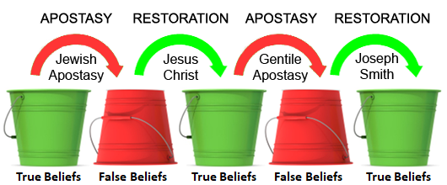
“Was Joseph Smith turning things upside down
perceived as a good thing or a bad thing?”
Joseph Smith: “I intend to lay a foundation that will revolutionize the whole world.”
(History of the Church, Vol. VI, p. 365; TPJS, p. 366)
Joseph Fielding McConkie: "Are not the creeds spoken of in the First Vision simply a refill of the same prescription that killed the church in the meridian of time?”
("The First Vision and Religious Tolerance“ Nov 5, 2005)
President Brigham Young: “We will turn the world right side up, for it is now wrong side up, and we want to turn it over, prepare it, and present it to Him who owns it, in a more goodly form and attitude than it has been for many centuries.”
(Journal of Discourses, Vol. 8, p. 203)

Slide 7
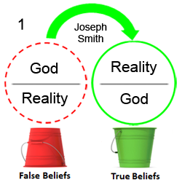
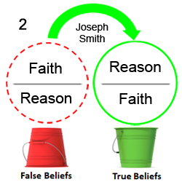
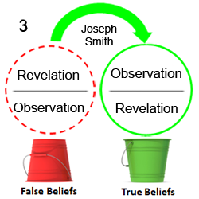
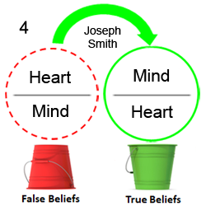
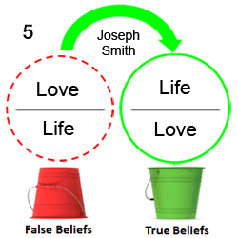
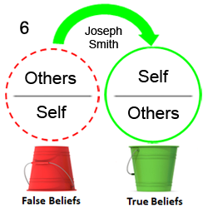
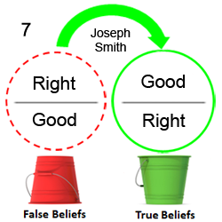
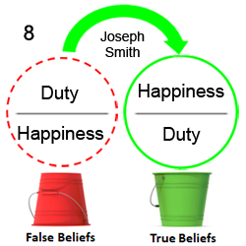

Slide 8
“Does preaching the gospel bring peace or conflict?”
Christ (The Prince of Peace): “Think not that I am come to send peace on earth: I came not to send peace, but a sword. For I am come to set a man at variance against his father, and the daughter against her mother, and the daughter in law against her mother in law. And a man’s foes shall be they of his own household.” (Matthew 10:34-36)
WARNING: The gospel truth is like a hand grenade with the pin pulled. It needs to be handed off with extreme care.
Joseph Fielding McConkie: “Any time we declare something to be true, we have picked a fight with that which is untrue.”
("The First Vision and Religious Tolerance“ Nov 5, 2005)

Slide 9
Questions?

