Slide 1
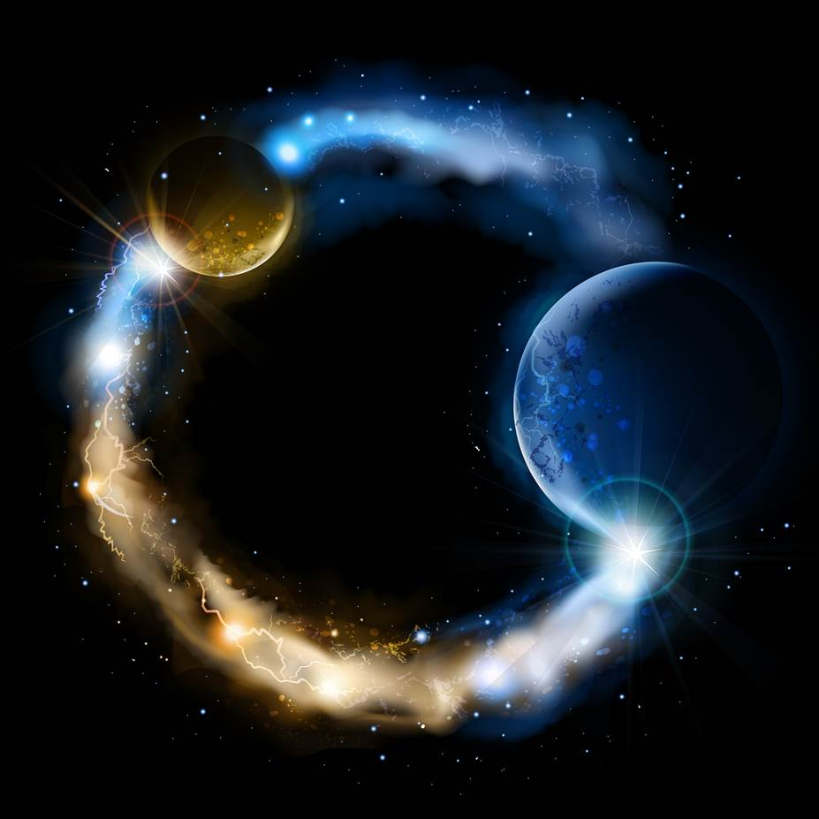
ETERNALISM MODULE 03
Tools
Abide
and
Abound
Chapter 3: Thinking Systematically
Chapter 4: Primacy
Chapter 5: Philosophical Checkup

Slide 2
5 Branches of Philosophy
Metaphysics = The study of existence.
Origin: From the Greek metá "after" or "beyond“ + physiká “physics”
Epistemology = The study of human knowledge.
Origin: From the Greek epistēmē “knowledge” + logos “word”
Ethics = The study of human conduct.
Origin: From the Greek ethos “habit"
Politics = The study of relations between humans in society.
Origin: From the Greek politikos “citizen"
Aesthetics = The study of beauty.
Origin: From the Greek aisthetikos “sense perception"

Slide 3
5 Branches of Philosophy
President Brigham Young: “Well, then, we ought, in the first place, to train ourselves to believe correctly, to think correctly [Epistemology], and to practice correctly [Ethics], and instill correct principles into the minds of the rising generation [Politics].” (Journal of Discourses 13:250)
Politics
Aesthetics
X is Just
X is Beautiful
Ethics
X is Good
Epistemology
=
X is True
Metaphysics
X is Real

Slide 4
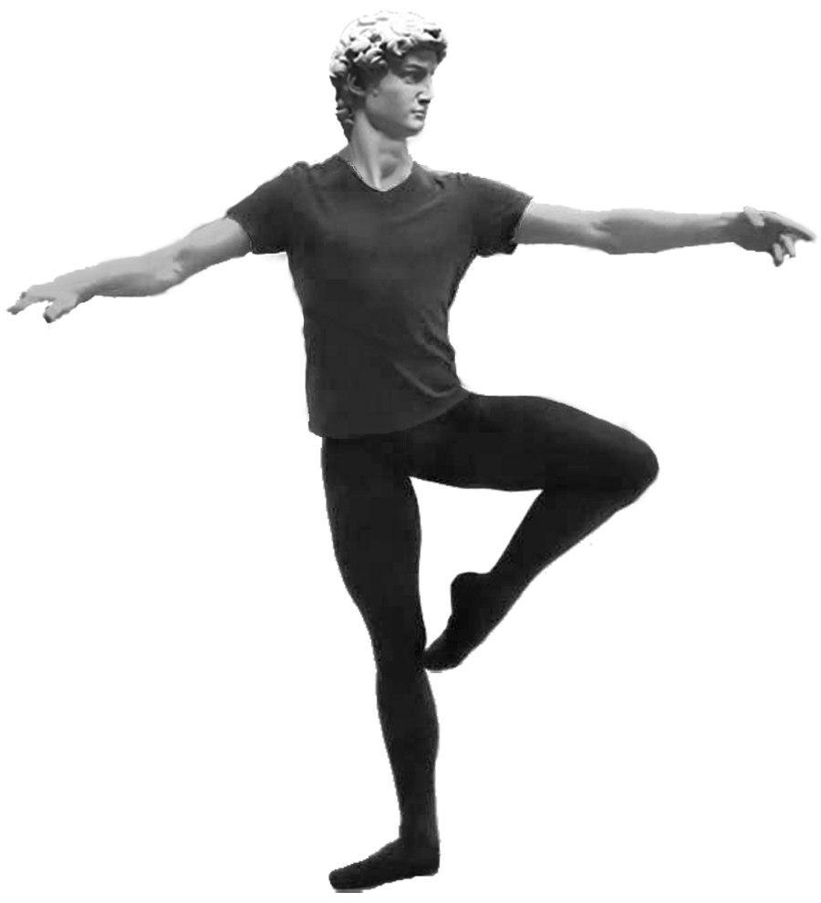
Politics
BUILDING PHILOSOPHY MAN
Component Hierarchy of Facts
CONCEPTUAL NATURE OF MAN
REASON, UNIT ECONOMY
AESTHETICS
“X is Beautiful”
POLITICS
“X is Just”
AESTHETICS: CELEBRATED FACTS
CREATING
POLITICS: PROTECTED FACTS
GOVERNING
VALUE ETHICS
“X is Good”
ETHICS: PURSUED FACTS
VALUING, ACTING, DESIRING
METAPHYSICS
“X is Real”
EPISTEMOLOGY
“X is True”
EPISTEMOLOGY: DISCOVERED FACTS
KNOWING
METAPHYSICS: SELF-EXISTING FACTS
BEING
AXIOMS
AXIOMS: SELF-EVIDENT FACTS

Slide 5
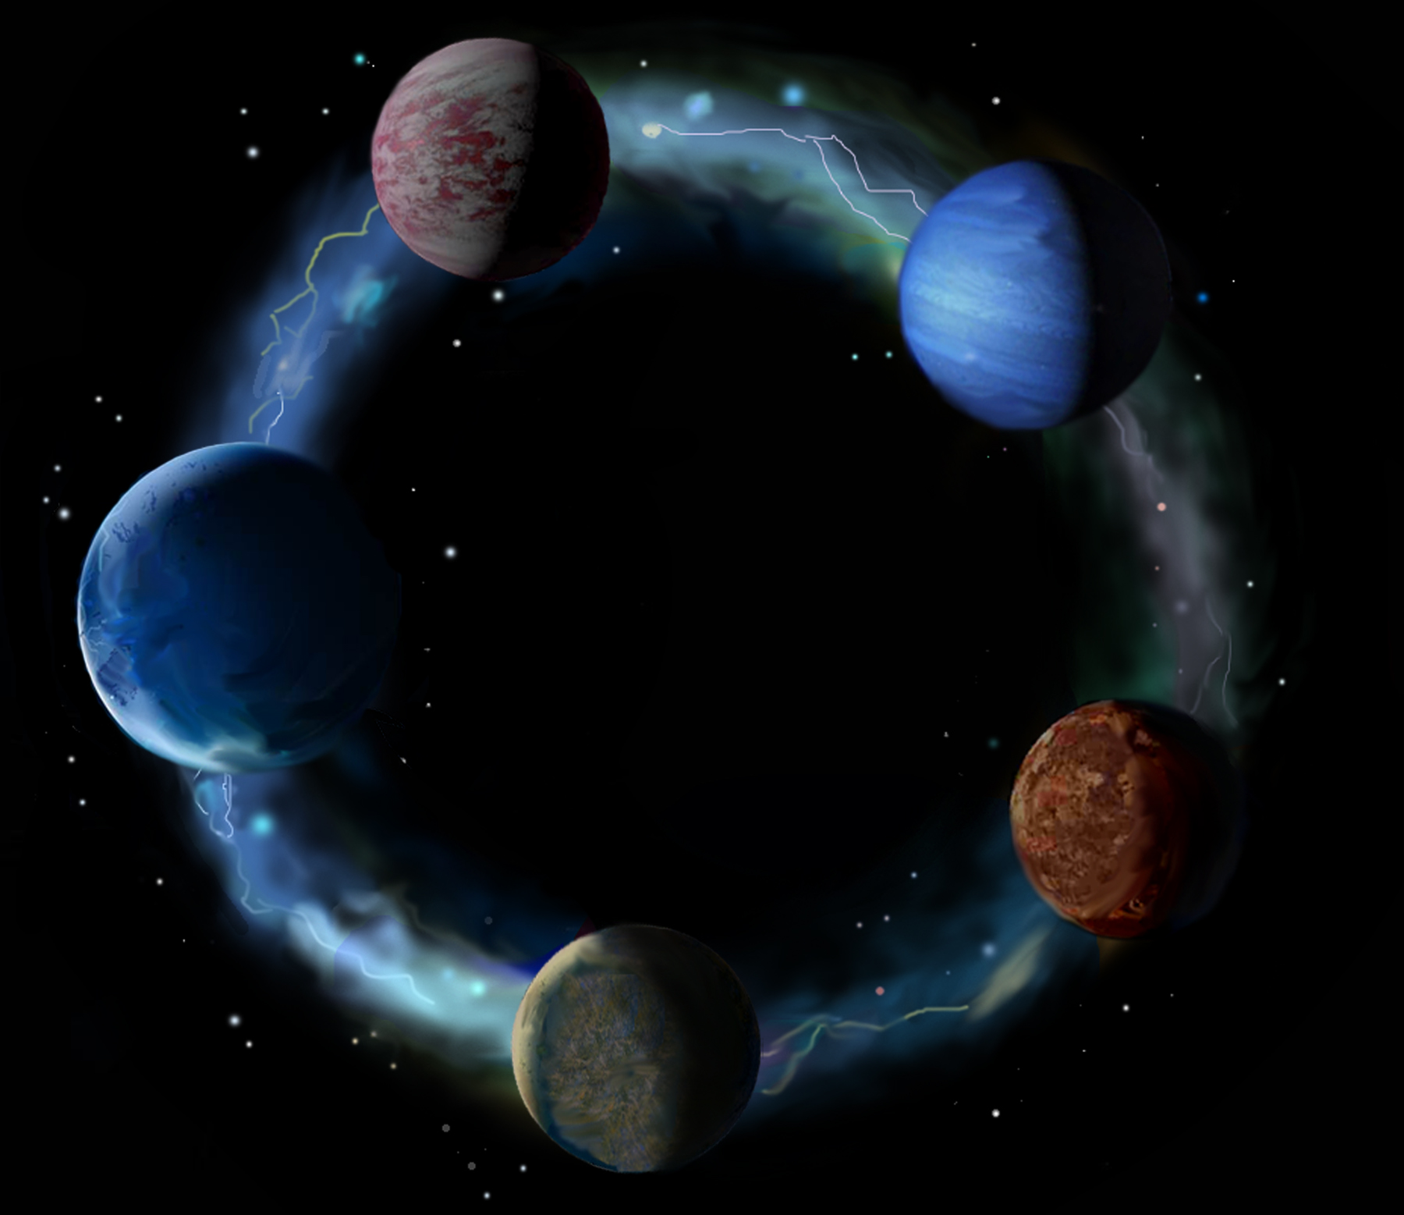
Eternal
Truths
2
Eternal
Lives
EPISTEMOLOGY
3
We start here with the nature of existence and God
Which Make
Possible
VALUE
ETHICS
Which Give
Rise To
The Five
Within The
Dominion of
E’s of
Eternal
Laws
1
METAPHYSICS
Eternalism
Organized In
Accordance With
Eternal
Kingdoms
POLITICS
4
ETERNAL ROUND
Amidst the
Glory of
All truth interconnected into one complete whole
AESTHETICS
Eternal
Creations
5

Slide 6
GOSPEL PRIMACY ISSUES
Putting First Things First
Primacy: The state or position of being ‘prime’ or first in order, rank, importance, or authority; the first or chief place; pre-eminence, precedence, superiority. (Oxford Dictionary)
Which Has
Primacy the Cart
or the Horse?
Tier 1
Tier 2
Horse
Cart
Cart
Horse
Tier 1
Tier 2
Practical
Impractical
Which Has
Primacy the Shoes
or the Socks?
Tier 1
Tier 2
Socks
Shoes
Tier 1
Tier 2
Shoes
Socks
Practical
Impractical

Slide 7
GOSPEL PRIMACY ISSUES
K of God
All Else
All Else
K of God
Putting First Things First: RELIGIOUS REALM
Matthew 6:33: “Seek ye first the kingdom of God, and his righteousness; and [then] all these things shall be added unto you.”
Which has primacy
the Kingdom of
God or all else?
Tier 1
Tier 2
K of God
All Else
All Else
K of God
Tier 1
Tier 2
True Piety
Idolatry
Alma 42:25: “What, do ye suppose that mercy can rob justice? I say unto you, Nay; not one whit. If so, God would cease to be God.”
Which has primacy
justice or mercy?
Tier 1
Tier 2
Justice
Mercy
Tier 1
Tier 2
Mercy
Justice
Lawful
Willful

Slide 8
EXAMPLES
Note that the companion primacy word is sometimes out of order, sometimes hidden.
FIRST
Matthew 6:33 “Seek ye first the kingdom of God, and his righteousness; and [then] all these things shall be added unto you.”
IF
D&C 11:5 “Therefore, if you will ask of me [then] you shall receive; if you will knock [then] it shall be opened unto you.”
NOT
D&C 11:21 “Seek not to declare my word, but first seek to obtain my word, and then shall your tongue be loosed; then, if you desire, you shall have my Spirit and my word, yea, the power of God unto the convincing of men.
THEN
D&C 6:7 “Seek not for riches but [first] for wisdom, and behold, [then] the mysteries of God shall be unfolded unto you, and then shall you be made rich. Behold, he that hath eternal life is rich.

Slide 9
1
Cart / Horse
2
Shoes / Socks
3
Justice / Mercy
4
K of God / All Else
(Name)
Cart
Horse
Horse
Cart
Shoes
Socks
Socks
Shoes
Mercy
Justice
Justice
Mercy
K of God
All Else
All Else
K of God
(Date)
Alma 42:25: “What, do ye suppose that mercy can rob justice? I say unto you, Nay; not one whit. If so, God would cease to be God.”
Impractical
Impractical
Willfulness
Idolatry
5
Body / Spirit
6
Spiritual / Temporal
7
Sabbath / Man
8
Faith / Miracles
Matthew 6:33: “Seek ye first the kingdom of God, and his righteousness; and all these things shall be added unto you.”
Body
Spirit
Spirit
Body
Spiritual
Temporal
Temporal
Spiritual
Sabbath
Man
Man
Sabbath
Faith
Miracle
Miracle
Faith
9
God / Reality
10
Reason / Faith
11
Revelation / Observation
12
Heart / Mind
God
Reality
Reality
God
Reason
Faith
Faith
Reason
Revelation
Observation
Observation
Revelation
Heart
Mind
Mind
Heart
13
Life / Love
14
Others / Self
15
Right / Good
16
Happiness / Duty
Life
Love
Love
Life
Others
Self
Self
Others
Good
Right
Right
Good
Happiness
Duty
Duty
Happiness

Slide 10
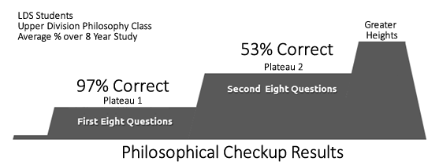
President Kimball: “We [Latter-day Saints] have paused on some plateaus long enough … We have been diverted, at times, from fundamentals on which we must now focus in order to move forward as a person or as a people.

Slide 11
1
Cart / Horse
2
Shoes / Socks
3
Justice / Mercy
4
K of God / All Else
(Name)
Cart
Horse
Horse
Cart
Shoes
Socks
Socks
Shoes
Mercy
Justice
Justice
Mercy
K of God
All Else
All Else
K of God
(Date)
Alma 42:25: “What, do ye suppose that mercy can rob justice? I say unto you, Nay; not one whit. If so, God would cease to be God.”
Impractical
Impractical
Willfulness
Idolatry
5
Body / Spirit
6
Spiritual / Temporal
7
Sabbath / Man
8
Faith / Miracles
Matthew 6:33: “Seek ye first the kingdom of God, and his righteousness; and all these things shall be added unto you.”
Body
Spirit
Spirit
Body
Spiritual
Temporal
Temporal
Spiritual
Sabbath
Man
Man
Sabbath
Faith
Miracle
Miracle
Faith
2 Nephi 9:39: “Remember, to be carnally-minded is death, and to be spiritually-minded is life eternal.
Carnally Minded
Worldliness
Perversion
Adulterous
9
9
10
10
11
11
12
God / Reality
Reason / Faith
Revelation / Observation
12
Heart / Mind
1 John 2:15: “Love not the world, neither the things that are in the world…”
God
Reality
Reality
God
Reason
Faith
Faith
Reason
Revelation
Observation
Observation
Revelation
Heart
Mind
Mind
Heart
Mark 2:27: “And he said unto them, The sabbath was made for man, and not man for the sabbath”
METAPHYSICS
EPISTEMOLOGY
EPISTEMOLOGY
EPISTEMOLOGY
13
13
14
14
15
15
16
D&C 63:9 “But, behold, faith cometh not by signs, but signs follow those that believe. …an evil and adulterous generation seeketh after a sign (Matt. 12:38)”
Life / Love
Others / Self
Right / Good
16
Happiness / Duty
Life
Love
Love
Life
Others
Self
Self
Others
Good
Right
Right
Good
Happiness
Duty
Duty
Happiness
ETHICS
ETHICS
ETHICS
ETHICS

Slide 12
Questions?

