Slide 1
ETERNALISM MODULE 02
Prerequisite
Abide
and
Abound
Chapter 2: Hostility to Philosophy
Chapter 3: Thinking Systematically

Slide 2
“Philosophies of Men Mingled with Scripture”
Colossians 2:8 “Beware lest any man spoil you through philosophy and vain deceit, after the tradition of men, after the rudiments of the world, and not after Christ.”
Elder Lance B. Wickman: “These false doctrines—philosophies of men mingled with scripture—had so invested their minds that they were deep in the swamp of fraudulent persuasions.”(Wisdom and Great Treasures of Knowledge, BYU Devotional Aug. 17, 2004)
Elder Hartman Rector, Jr.“…we are not called to preach the philosophies of men mingled with scripture or our own ideas or the mysteries of the kingdom, nor are we called to bring forth new doctrine. The president of the Church will do that. But we are to stick to the basic fundamental principles of the gospel.”
("You Shall Receive The Spirit", Ensign Jan 1974)

Slide 3
What is philosophy?
phi·los·o·phy
noun
The study of the fundamental nature of knowledge, reality, and existence...
Man + Universe

Slide 4
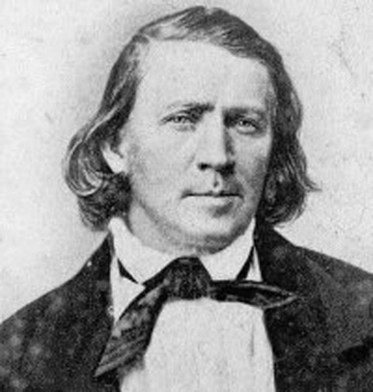
Brigham Young on Becoming Philosophers
President Brigham Young: “This people have embraced the philosophy of eternal lives, and in view of this we should cease to be children and become philosophers, understanding our own existence, its purpose and ultimate design...” (Journal of Discourses, 9:190-191)
President Brigham Young: “There is no true philosophy in existence which is not embraced in the Gospel, it belongs to the Gospel, it is a part of the Gospel…” (Journal of Discourses 18:359)
President Brigham Young: “I was led to reflect that there is no act, no principle, no power belonging to the Deity that is not purely philosophical…”
(Journal of Discourses, 8:115)
President Brigham Young: “I am a witness that ‘Mormonism’ is true upon philosophical principles. Every particle of sense I have, proves it to be sound natural reason…”
(Journal of Discourses, 2:8)

Slide 5
John Taylor on Becoming Philosophers
President John Taylor: “We understand in part the things of earth; when we see things as God sees them, we shall then understand the philosophy of the heavens: the mysteries of eternity will be unfolded and the operations of mind, matter, spirit, purposes and designs, causes and effects and all the stupendous operations of God will be developed and they will be found to accord with the strictest principles of philosophy, even the philosophy of the heavens...” (Journal of Discourses 10:117-118)

Slide 6
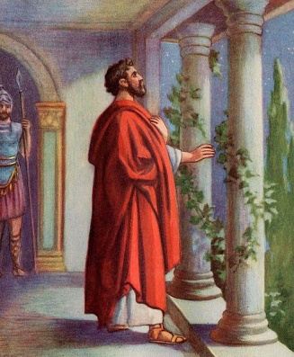
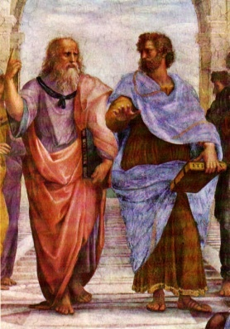
Admonition of the
Apostles Paul, Peter and
the Philosopher Aristotle
Apostle Paul in Rome
Plato & Aristotle In Athens
Apostle Paul: “Study to shew thyself approved unto God, a workman that needeth not to be ashamed, rightly dividing the word of truth.” (2 Timothy 2:15)
Apostle Peter: “But sanctify the Lord God in your hearts: and be ready always to give an answer to every man that asketh you a reason of the hope that is in you with meekness and fear” (1 Peter 3:15)
Aristotle: “If it is a disgrace when a man cannot defend himself in a bodily way, it would seem odd not to think him disgraced when he cannot defend himself with reason.” (Rhetoric, Chap. 1, 1355 b)

Slide 7
First Presidency: “The great religious leaders of the world such as Mohammed, Confucius, and the Reformers, as well as philosophers including Socrates, Plato, and others, received a portion of God's light. Moral truths were given to them by God to enlighten whole nations and to bring a higher level of understanding to individuals.” ("God’s Love for All Mankind" First Presidency Statement, Feb. 15, 1978)
Aristotle?
President Brigham Young: “Every true philosopher, so far as he understands the principles of truth, has so much of the Gospel, and so far he is a Latter-day Saint, whether he knows it or not.” (JD 18:359)
Plato and Aristotle In Athens

Slide 8
Everyone has a Philosophy
(whether they know it or not)
“As a human being, you have no choice about the fact that you need a philosophy. Your only choice is whether you define your philosophy by a conscious, rational, disciplined process of thought…or let your subconscious accumulate a junk heap of unwarranted conclusions.”
(Ayn Rand, Philosophy: Who Needs It?, introduction)
“Philosophy, in Ayn Rand's view, is the fundamental force shaping every man and culture.”
(Leonard Peikoff, “Objectivism: The Philosophy of Ayn Rand”, pp1-2)
1 Thessalonians 5:21 “’Prove all things, hold fast to that which is good.’ Only if you are unafraid of the truth can you find it.” (Man's Search For Happiness, LDS Published Video)
President David O. McKay: “You are going out to teach people the true philosophy of life, the restored Gospel of Jesus Christ, which is the power of God unto salvation. The world is longing for it.” (Temple Annex Address, Sep 1941, BYU Library Collections Manuscript)

Slide 9
Prerequisite 2: (Needed to move forward)
Hostility to philosophy must be set aside and replaced with President Brigham Young’s admonition to “cease to be children and become philosophers”.
Go

Slide 10
Imagine knowledge like a pile of books…
Nature’s default is unordered chaos!

Slide 11
Philosophy is Like a Filing Cabinet
President Brigham Young: “If you are industrious and faithful scholars in the school you have entered into, you shall get lessons one after another, and continue on until you can see and understand the spirit of prophecy and revelation, which can be understood according to a systematic principle…” (JD 3:89)
Thinking systematically
and in correct principles

Slide 12
We will study various tools that
are like drawers to a filing cabinet.
?
Keep things that are alike systematically in the same drawers.
True!
False!

Slide 13
The Restored Gospel and Philosophy
Elder B. H. Roberts: “The New Dispensation is a system of philosophy as well as a religion. Indeed every religion that is worthwhile must be a philosophy. It must give some accounting of things if it is to be of any permanent service in the world. Religion must appeal to the understanding as well as the emotional nature of man. It must measurably satisfy his rational mind as well as fill his spiritual and ethical longings - his thirst for righteousness... (Defender of the Faith p. 382-383)
President Brigham Young: “‘Mormonism’ embraces all truth that is revealed and that is unrevealed, whether religious, political, scientific, or philosophical.” (JD 9:149)

Slide 14
Elder B. H. Roberts: “The reader should understand that Joseph Smith himself made no attempt to create a ‘system’ of philosophy. His philosophical utterances were flung off without reference to any arrangement or orderly sequence…These utterances, were given out at various times, and were often separated by long intervals of time…” (Defender of the Faith p. 382-383)
Elder B. H. Roberts: “My love for the gospel grows out of the partial knowledge I have of the great truths it contains. In it I feel the presence of a marvelous system of truth, a philosophy that gives unity to all history and proper relationship to all existing things; that fills life with a real meaning, and makes existence desirable. And if I could only intelligently grasp these great truths…and reduce them to some orderly system which I am sure they are capable of, I would account myself most happy…It is our present task to put some of these and other independent utterances into something like orderly arrangement that will suggest a system of thought or philosophy in the teachings of the Prophet of the New Dispensation …and which, when they are finally arranged in proper order, will constitute a system of philosophy worthy of the enlightened age in which it was brought forth…” (Defender of the Faith, p. 340, 382-383, 411)

Slide 15
ETERNALISM MISSION STATEMENT:
Thinking systematically and in correct principles:
“It is our present task to reduce these varied and numerous philosophical utterances to an orderly system of philosophy.”

Slide 16
Prerequisites Met
Ready to Move Forward
GO
1:
Be a truth seeker.
2:
Follow President Brigham Young’s
admonition to become philosophers.
GO
3:
Consume knowledge systematically
and in correct principles.
GO

Slide 17
Questions?

