Slide 1
ETERNALISM MODULE 01
Prerequisite
Abide
and
Abound
Preface
Chapter 1: Core Doctrine

Slide 2
COURSE COLOR CODE
RED: “Stop! Danger!” False principles.
Highlighting emphasis of incorrect ideas.
STOP
YELLOW: “Caution.” Unknown or mixed premises.
“I don’t know yet.” or “Some good principles, some bad.”
CAUTION
GREEN: “Good to Go.” Correct principles.
Highlighting emphasis of correct ideas.
GO

Slide 3
www.ChristianEternalism.org
Origin of Eternalism
DISCLAIMER: From the book preface
ORIGIN: Adapted from a university philosophy course, based on the following quotes:
Elder B.H. Roberts: “Eternalism is the term I would select as the best descriptive word for New Dispensation philosophy; for that term best represents its concepts: an eternal universe, with no beginning and no end; eternal intelligence, working in eternal duration, without beginning or ending, and without ultimates. And hence eternal progression running parallel with eternal lives; and an eternal or ‘everlasting gospel,’ offering eternal opportunities for righteousness; eternal existence of mercy, justice, wisdom, truth and love; all accompanied by eternal relations, associations, unions, eternal youth and eternal glory!” (Comprehensive History p. 410-411)

Slide 4
Origin of Eternalism
Elder Widtsoe: “The Gospel may be said to be ‘The philosophy of Eternalism.’ The Gospel is immersed in the ocean of eternity.” (A Rational Theology, p.86)
Elder Maxwell: “For the purpose of this brief discussion, eternalism is defined as that view of man and the universe which not only acknowledges, but exults in, the existence of a Heavenly Father. ... Eternalism focuses on the individual and on those processes in which the individual is taught correct principles and then is given optimum opportunity to govern himself… For those who believe we are all going to be around forever, it is both natural and wise to concern ourselves with such questions and also with such principles which are also going to be around forever.” (Eternalism vs. Secularism, Oct. 1974 Ensign)

Slide 5
What is Eternalism?
Philosophy: in the broadest sense is our view of existence.
Theology: in the broadest sense is our understanding of God.
Eternalism: in the broadest sense is a combination of both.
STOP
So as explained by these Latter-day Saint leaders, both philosophy and theology are important to Latter-Day Saints, because one's view of God is greatly influenced by one's view of existence.
CAUTION
Eternalism then, in the broadest sense, is Latter-day Saint theology explained within a philosophically sound structure.

Slide 6
Eternalism Goals (3 desired outcomes)
1: Increased Testimony
Elder M. Russell Ballard: “If we are to have the courage to speak out and defend the Church, we must first prepare ourselves through study of the truths of the gospel.” ("Men and Women and Priesthood Power", Ensign, September 2014)
2: Clear Thinking
“The Lord has commanded members to take care of their minds and bodies.”(Handbook2 6.1.1 Self-Reliance)
3: Consistent Actions
Elder Boyd K. Packer: “True doctrine, understood, changes attitudes and behavior. The study of the doctrines of the gospel will improve behavior quicker than a study of behavior will improve behavior.”
("Little Children" October General Conference, Ensign, Nov. 1986, p17)

Slide 7
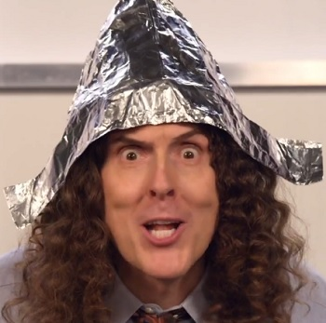
Mysteries?
Mystery: Denotes in the New Testament a spiritual truth that was once hidden but now is revealed and that without special revelation would have remained unknown … On the other hand, there is no spiritual gain in idle speculation about things the Lord has not revealed. (Bible Dictionary: Mystery)
Alternate Definitions
Mystery
STOP
CAUTION
Idle Speculation
Truth No Longer Hidden
Having two or more possible meanings.

Slide 8
Why Eternalism?
President Hinckley: “The war (in heaven) goes on. It is waged across the world over the issues of agency and compulsion. It is waged by an army of missionaries over the issues of truth and error. It is waged in our own lives, day in and day out … We are all involved in it… each of us." (“The War We Are Winning,” Ensign, Nov. 1986, p.42-43)
STOP
Elder Ballard: “Gone are the days when a student asked an honest question and a teacher responded, “Don’t worry about it!” Gone are the days when a student raised a sincere concern and a teacher bore his or her testimony as a response intended to avoid the issue. Gone are the days when students were protected from people who attacked the Church. Fortunately, the Lord provided this timely and timeless counsel … “…seek ye diligently and teach one another words of wisdom; yea, seek ye out of the best books words of wisdom; seek learning, even by study and also by faith.” (Address to CES Religious Educators. February 26, 2016)
CAUTION
Elder Packer: “There is no greater protection from the adversary than for us to know the truth-to know the plan!” (Our Father's Plan, 1984, 27)

Slide 9
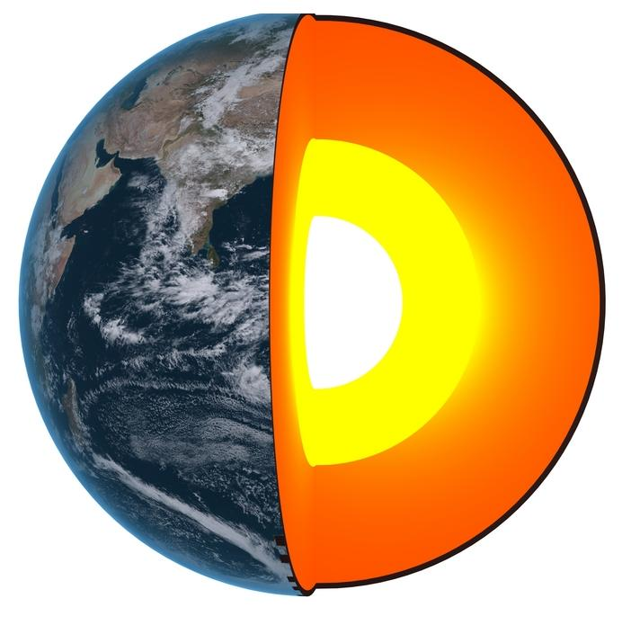
The Plan of Salvation Incorporates
All Levels of Gospel Understanding
1
Basic Gospel
Principles
Levels of Gospel Understanding
Beginner, Intermediate, Advanced
Faith, Repentance, Baptism
1
2
CAUTION
2
Central Doctrinal
Teachings
3
Creation, Fall, Atonement
3
Inner Core
Beliefs
Deep Doctrines
of the Restored Gospel
God, Man, Universe

Slide 10
Elder Neal A. Maxwell: “These same Church members know just enough about the doctrines to converse superficially on them, but their scant knowledge about the deep doctrines is inadequate for deep discipleship. Thus uninformed about the deep doctrines, they make no deep changes in their lives.” (Men and Women of Christ, pp. 2-3)
1
Basic Gospel
Principles
Levels of Gospel Understanding
Beginner, Intermediate, Advanced
D&C 6:11 And if thou wilt inquire, thou shalt know mysteries which are great and marvelous; therefore thou shalt exercise thy gift, that thou mayest find out mysteries, that thou mayest bring many to the knowledge of the truth, yea, convince them of the error of their ways.
Faith, Repentance, Baptism
1
2
CAUTION
2
Central Doctrinal
Teachings
3
Creation, Fall, Atonement
3
Inner Core
Beliefs
Deep Doctrines
of the Restored Gospel
God, Man, Universe

Slide 11
Elder Hugh B. Brown: “I am impressed with the testimony of a man who can stand and say he knows the gospel is true. But what I would like to ask is ‘But, sir, do you know the gospel?’… Mere testimony can be gained with but [superficial] knowledge of the Church and its teachings…But to retain a testimony, to be of service in building the Lord’s kingdom, requires a serious study of the gospel and knowing what it is.”
(The Vision of Mormonism, p.128)
Two big blooming testimonies here…The bigger the testimony, with a shallow root system is an accident waiting to happen. When the heat comes or the wind blows, the roots (doctrine) can’t sustain the flower (testimony).
STOP
“The plain fact of the matter is that you cannot build strong testimonies out of weak doctrine.”
(Joseph Fielding McConkie, The First Vision and Religious Tolerance)
CAUTION

Slide 12
President Spencer W. Kimball: “Stake presidents, bishops, and branch presidents, please take a particular interest in improving the quality of teaching in the Church. I fear that all too often many of our members come to church, sit through a class or meeting, and they return home having been largely uninformed.” (Teachings of Spencer W. Kimball, p.526)
President Spencer W. Kimball: “[Home/visiting teachers (now ministers)] when you go into the homes, there should be no vain babblings or swelling words. You are going to save souls, and who can tell but that many of the fine active people in the Church today are active because you were in their homes and gave them a new outlook, a new vision. You pulled back the curtain. You extended their horizons. You gave them something new.” (Teachings of Spencer W. Kimball, p.526)
President Spencer W. Kimball: “We have paused on some plateaus long enough … We have been diverted, at times, from fundamentals on which we must now focus in order to move forward as a person or as a people.” (Teachings of Spencer W. Kimball, p.176)
What then do we need to do to move forward?

Slide 13
Prerequisite 1: Truth Seekers (buckle up…)
President Harold B. Lee: “We would remind you that the acquiring of knowledge by faith is no easy road to learning. It demands strenuous effort and a continual striving by faith. … In short, learning by faith is no task for a lazy man [or woman]. Someone has said, in effect, that such a process requires the bending of the whole soul, the calling up of the depths of the human mind and linking it with God.” (The Teachings of Harold B. Lee, p.331)
President Brigham Young (On Becoming Profound Theologians):
“We want every branch of science taught in this place that is taught in the world. But our favorite study is that branch which particularly belongs to the Elders of Israel—namely, theology. Every Elder should become a profound theologian—should understand this branch better than all the world.” (JD 6:317)

Slide 14
A Heightened Awareness of
False Traditions and Teachings
Elder Bruce R. McConkie: “I do not know all of the providences of the Lord, but I do know that he permits false doctrine to be taught in and out of the Church and that such teaching is part of the sifting process of mortality.”
(Letter to Professor Eugene England, p7, Feb 19, 1981)
Elder George Q. Cannon: “The Latter-day Saints are in many respects like other people who are not Latter-day Saints. We are apt to entertain views which are not very correct, and which may be the result of our traditions and preconceived ideas.” (JD 21:264)
Joseph Smith: “We would wish the Saints to understand that when they come here, they must not expect perfection, or that all will be harmony, peace, and love; if they indulge these ideas, they will undoubtedly be deceived...” (History of the Church, 4:272)

Slide 15
Questions?

