Slide 1
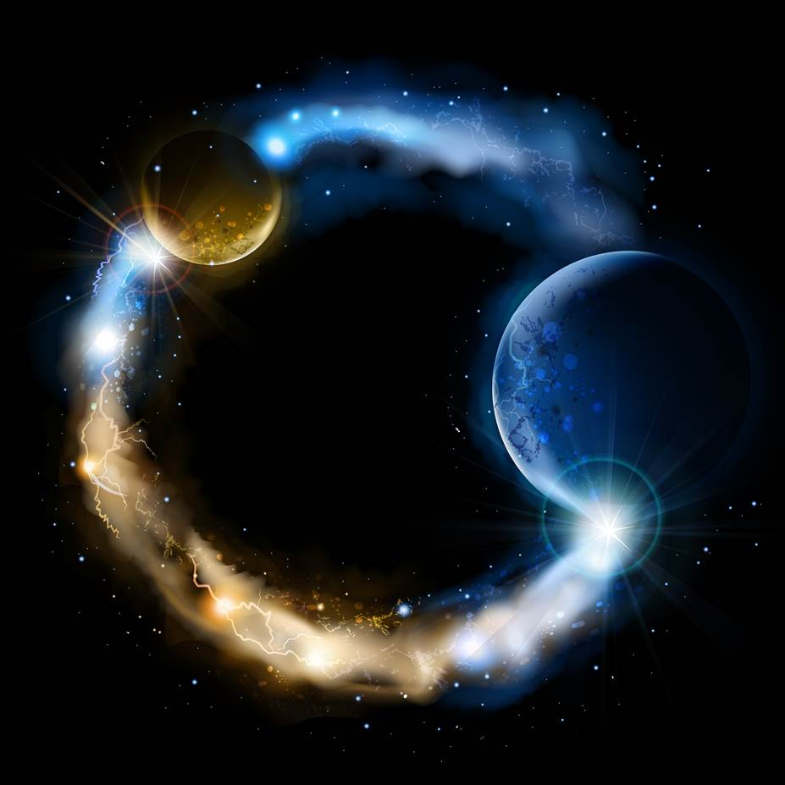
CASE STUDY 2
True Wealth
Abide
and
Abound

Slide 2
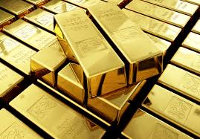
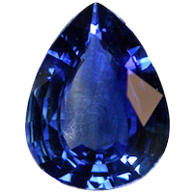
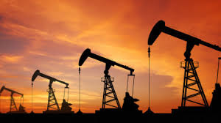
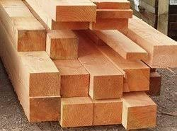
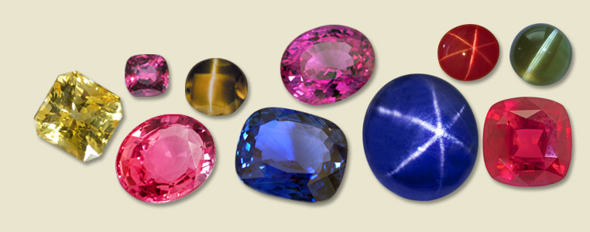
In which branch of philosophy do we find wealth, riches, and treasure?
riches: noun, material wealth. Valuable natural resources. (Google Dictionary)

Slide 3
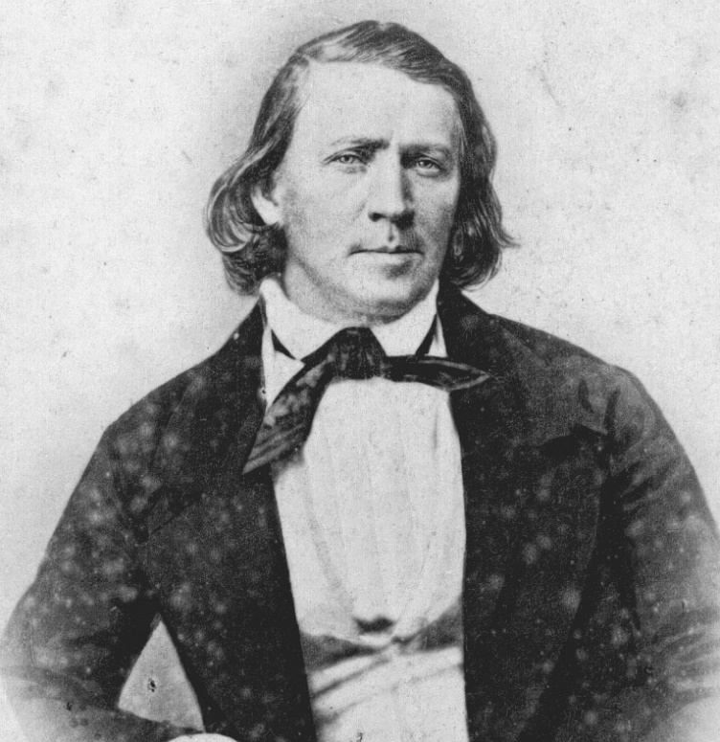
Brigham Young: “Again, we call up the question of riches, wealth…”
“Suppose we could heap to ourselves the treasures of the earth … would it prove we are actually rich? It would not … The possession of these things is not wealth to me. Not that I would cast them away as a thing of naught, or look upon the good things of this earth, and the riches of the
world, as things of naught, but they are not the true riches. … They are to be used, but not abused. They are to be handled with discretion, and looked upon in their true light, without any lustful desires, as the means to feed, clothe, and make us comfortable, that we may be prepared to secure to ourselves eternal riches.” (True and False Riches, JD 1:264)

Slide 4
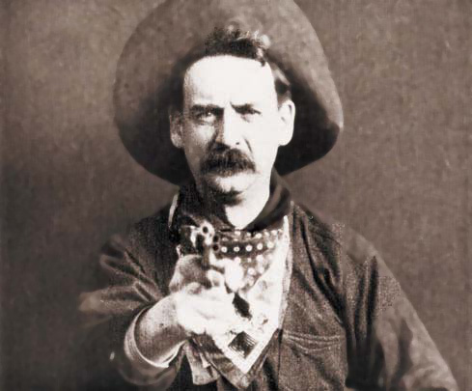
Why are metaphysical riches false?
Brigham Young: “This monarch reigns for a day, a month, a year, or for half a century, according to the will of Him by whom kings sway the scepter of power; and the world say he is a rich man, a powerful and wealthy man. But this is not riches according to the saying of the Savior in the New Testament.”
(True and False Riches, JD 1:264)
Matthew 6: 19-21: “Lay not up for yourselves treasures upon earth, where moth and rust doth corrupt, and where thieves break through and steal: But lay up for yourselves treasures in heaven … For where your treasure is, there will your heart be also.
Brigham Young: “When I have gold and silver in my possession, which a thief may steal, or friends borrow, and never pay me back again, or which may take the wings of the morning, and I behold it no more, I only possess the negative of the true riches.” (True and False Riches, JD 1:264)

Slide 5
Brigham Young: “Where shall we direct our course to find true riches?”
KNOWLEDGE: acquaintance with facts, truths, or principles, as from study or investigation; (Dictionary.com)
WISDOM: knowledge of what is true or right coupled with just judgment as to action; …
In short, wisdom is a disposition to find the truth coupled with an optimum judgement as to what actions should be taken. (Dictionary.com, Wikipedia.com)
D&C 93:28 He that keepeth his commandments receiveth truth and light, until he is glorified in truth and knoweth all things.
2 Nephi 28:30 For behold, thus saith the Lord God: I will give unto the children of men line upon line, precept upon precept, here a little and there a little; and blessed are those who hearken unto my precepts, and lend an ear unto my counsel, for they shall learn wisdom; for unto him that receiveth I will give more; and from them that shall say, We have enough, from them shall be taken away even that which they have.

Slide 6
Brigham Young: “Where shall we direct our course to find true riches?”
D&C 131:6 It is impossible for a man to be saved in ignorance.
Proverbs 3:13-14 Happy is the man that findeth wisdom, and the man that getteth understanding. For the merchandise of it is better than the merchandise of silver, and the gain thereof than fine gold.
Isaiah 33:6 And wisdom and knowledge shall be the stability of thy times, and strength of salvation: the fear of the Lord is his treasure.
Proverbs 19:8 He that getteth wisdom loveth his own soul: he that keepeth understanding shall find good.
D&C 130:18-19 Whatever principle of intelligence we attain unto in this life, it will rise with us in the resurrection. And if a person gains more knowledge and intelligence in this life through his diligence and obedience than another, he will have so much the advantage in the world to come.
D&C 6:7 Seek not for riches but for wisdom, and behold, the mysteries of God shall be unfolded unto you, and then shall you be made rich. Behold, he that hath eternal life is rich.

Slide 7
TRUE RICHES ONLY TO BE FOUND IN ETERNAL LIFE
“…the whole world are gone after the false riches; after that which is not life, after decomposition, after that which perishes, and passes away like the twilight of evening. … there is no such thing as a man being truly rich until he has power over death, hell, the grave, and him that hath the power of death, which is the devil.”
(True and False Riches, JD 1:264)
“I will tell you when you and I may consider ourselves truly rich—When we can speak to the earth—to the native elements in boundless space, and say to them—“Be ye organized, and planted here, or there, and stay until I command you hence;” … The only true riches in existence are for you and I to secure for ourselves a holy resurrection; then we have command of the gold and the silver, and can place it where we please, and in whose hands we please.” (True and False Riches, JD 1:264)
“He does not want to slay His children who love and serve him, He is not a hard master, nor a severe Father, but when He chastens, it is because He wishes to bring His children to understanding, that they may know where the true riches are, and what are the true riches of eternity, and rejoice with Him in His presence, being made equal with Him.” (True and False Riches, JD 1:264)
“Where are the true riches—the pearl of great price? They are here. How can we secure them? By being obedient, for the willing and obedient will eat the good of the land by and by; … The power which belongs to the true riches is gained by pursuing a righteous course, by maintaining an upright deportment towards all men…”
(True and False Riches, JD 1:264)

Slide 8
TRUE RICHES ONLY TO BE FOUND IN ETERNAL LIFE
Brigham Young: “Remember, that true riches — life, happiness, and salvation, is to secure for ourselves a part in the first resurrection, where we are out of the reach of death, and him that hath the power of it; then we are exalted to thrones, and have power to organize element. Yes, they that are faithful, and that overcome, shall be crowned with crowns of eternal glory. They shall see the time when their cities shall be paved with gold; for there is no end to the precious metals, they are in the native element, and there is an eternity of it. If you want a world of the most precious substance, you will have nothing to do but say the word, and it is done. … I presume we do not draw a single breath that there are not particles of these things mingled in it. But we have not the knowledge now to organize them at our pleasure. Until we have that power we are not fully in possession of the true riches…” (True and False Riches, JD 1:264)

Slide 9
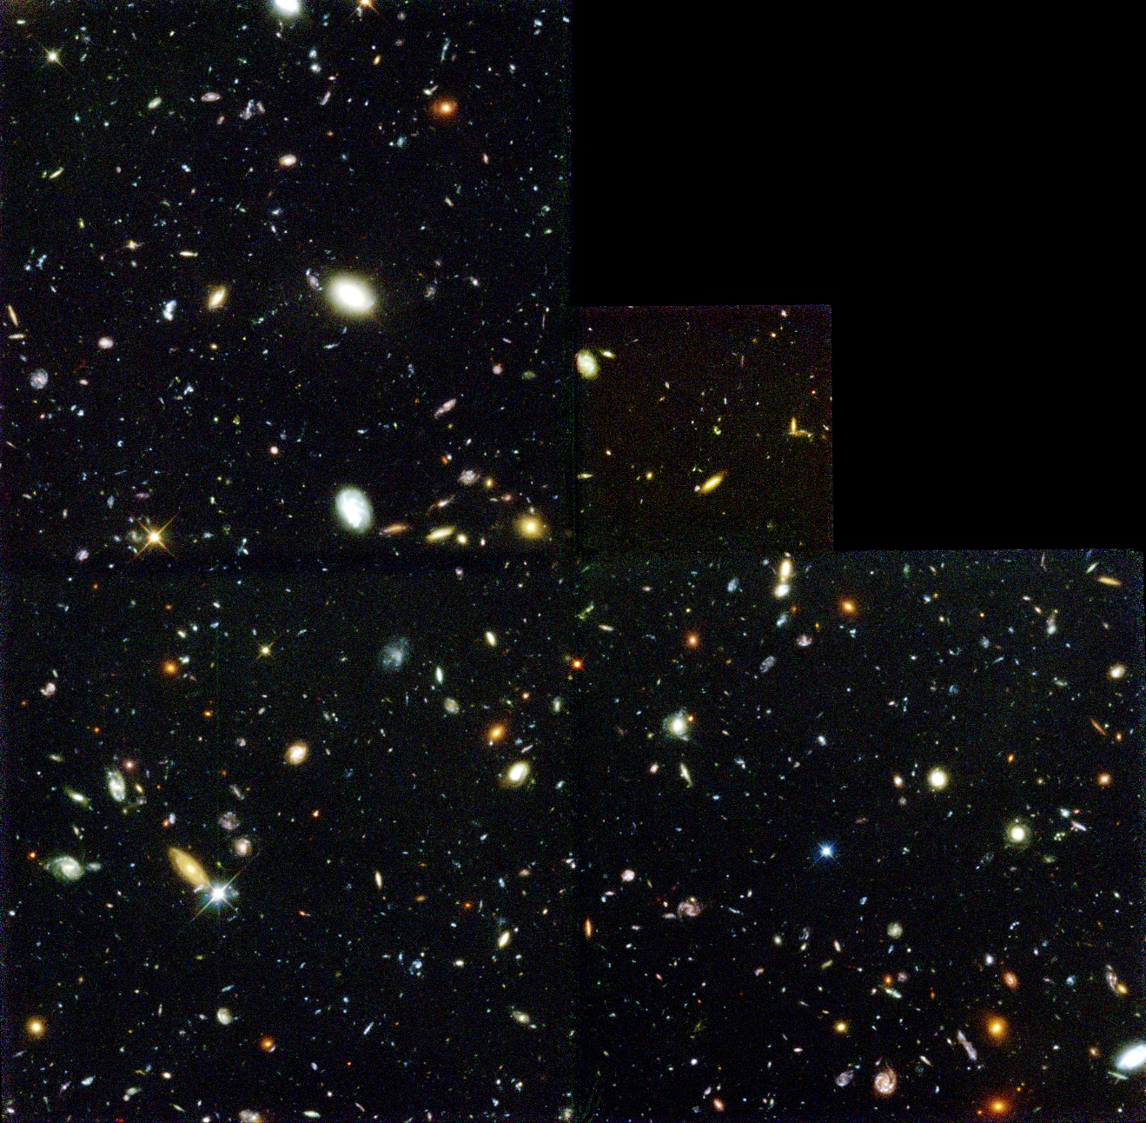
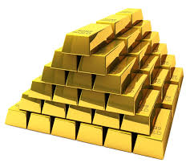
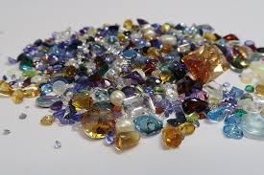
TRUE RICHES ONLY TO BE FOUND IN ETERNAL LIFE
This?
This?
or

Slide 10
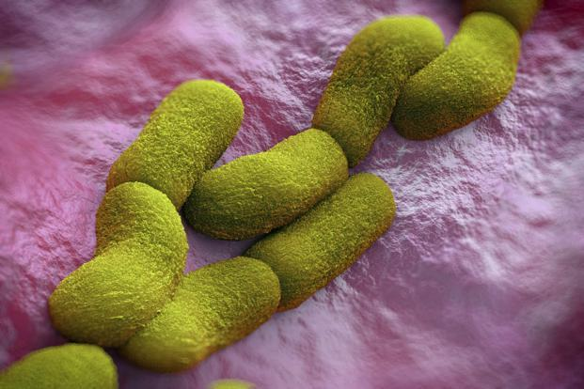
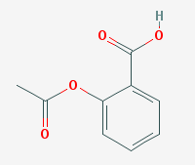
What would you pay for the following knowledge?
Sodium Stearate
Yersinia Pestis
Acetylsalicylic Acid
Joseph Smith: “A man is saved no faster than he gets knowledge, for if he does not get knowledge, he will be brought into captivity by some evil power in the other world, as evil spirits will have more knowledge, and consequently more power than many men who are on the earth.” (History of the Church, 4:588)
Incandescent Light

Slide 11
Questions?

