Slide 1
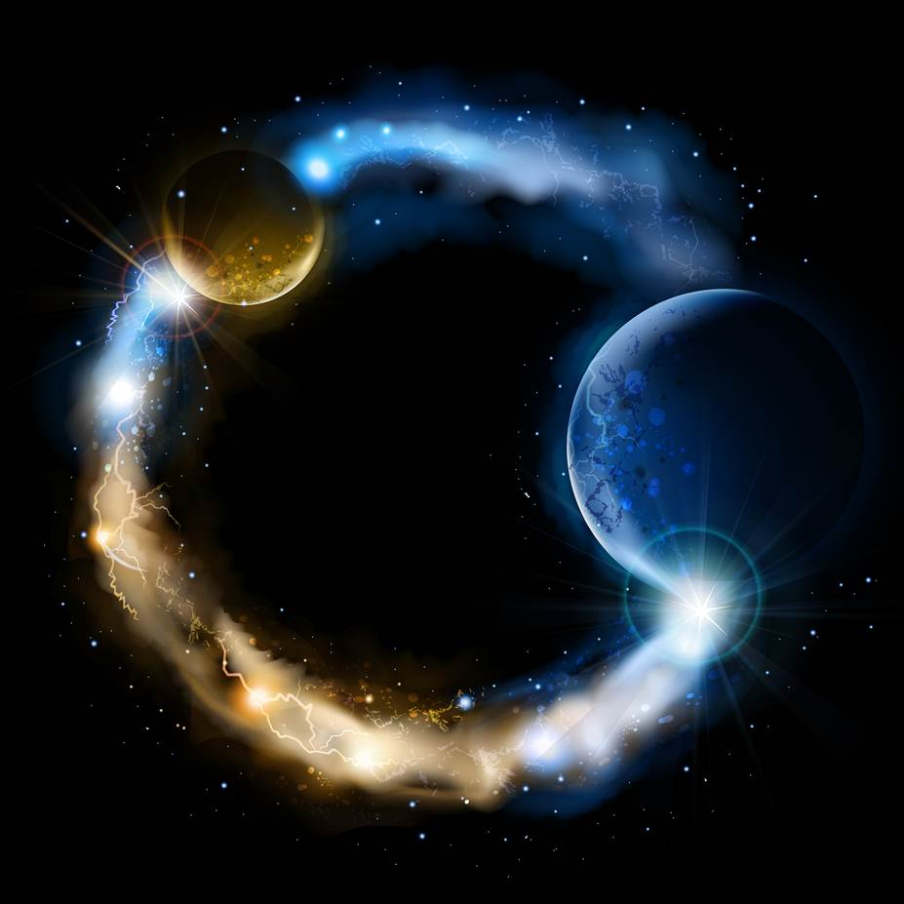
CASE STUDY 1
The Secret
Abide
and
Abound
Case Study 1: Primacy of Consciousness Examples

Slide 2
THE SECRET
The Secret is a best-selling 2006 self-help book and film by Rhonda Byrne. It is based on a claim of a “universal law of attraction”, which states that thoughts can change the world directly. The universal law of attraction claims positive thinking is the key to the universe. What you visualize you materialize, as you create your own reality by what you attract.
“The Creative Process used in The Secret, which was taken from the New Testament in the Bible [Matthew 21:22, Mark 11:24], is an easy guideline for you to create what you want in three simple steps.
Step 1: The first step is to ask. Make a command to the universe. Let the Universe know what you want. The Universe responds to your thoughts.
Step 2: Step two is believe. Believe that it’s already yours. Have what I love to call unwavering faith. Believing in the unseen.
Step 3: Step three, and the final step in the process is to receive. Begin to feel wonderful about it. Feel the way you will feel once it arrives. Feel it now.”
(p.47, p.48, p.52, p.54)

Slide 3
A FEELING UNIVERSE
“This is a feeling universe. If you just intellectually believe something, but you have no corresponding feeling underneath that, you don’t necessarily have enough power to manifest what you want in your life. You have to feel it.” (p.52-53)
“If you have an intuitive or instinctive feeling, follow it, and you will find that the Universe is magnetically moving you to receive what you asked for.” (p.56)
“You have to emit the feeling frequency of having received it, to bring those pictures back as your life. When you do that, the law of attraction will powerfully move all circumstances, people, and events, for you to receive.” (p.49)
And what is the most powerful thing in the Universe?
“There is no greater power in the Universe than the power of love. The feeling of love is the highest frequency you can emit. … In fact, some of the great thinkers of the past referred to the law of attraction as the law of love.” (p.38)

Slide 4
CONSCIOUSNESS CREATES THE UNIVERSE
“Remember that your thoughts are the primary cause of everything.” (p.33)
“Once you begin to understand and truly master your thoughts and feelings, that’s when you see how you create your own reality.” (p.39)
“That the Universe essentially emerges from thought and all of this matter around us is just precipitated thought. Ultimately we are the source of the Universe, and when we understand that power directly by experience, we can start to exercise our authority and begin to achieve more and more. Create anything. Know anything from within the field of our own consciousness, which ultimately is Universal consciousness that runs the Universe.” (p.160)
“…you can’t have a Universe without mind entering into it, and that the mind is actually shaping the very thing that is being perceived.” (p.21)

Slide 5
EXAMPLES
WEIGHT: “To put it in the most basic terms, if someone is overweight, it came from thinking ‘fat thoughts’, whether that person was aware of it or not. A person cannot think ‘thin thoughts’ and be fat.” (p.58)
BILLS: “When I first understood The Secret, every day I would get a bunch of bills in the mail. I thought, ‘How do I turn this around?’ … ‘What if I just visualized checks coming in the mail. Within just one month, things started to change. It is amazing; today I just get checks in the mail. I get a few bills, but I get more checks than bills. … A game I created that helped shift my feelings about my pile of bills was to pretend that the bills were actually checks. I would jump for joy as I opened them and say, ‘More money for me! Thank you. Thank you. I took each bill, imagined it was a check, and then added a zero to it in my mind to make it even more. … I never opened my bills before convincing myself they were checks. … When you make believe, the results come fast!” (p.104-105)
MONEY: “The only reason any person does not have enough money is because they are blocking money from coming to them with their thoughts.” (p.99)
DISEASE: “Disease is held in the body by thought, by observation of the illness, and by the attention given to the illness. … You don’t have to fight to get rid of disease. Just the simple process of letting go of negative thoughts will allow your natural state of health to emerge within you.” (p.139, p.134)
AGING: “Beliefs about aging are all in our minds, so release those thoughts from your consciousness. Focus on health and eternal youth. Don’t listen to society’s messages about diseases and aging. Negative messages do not serve you.” (p.139)

Slide 6
HAVE IT ALL RIGHT NOW
“The law of attraction, the study and practice of the law of attraction, is just figuring out what will help you generate the feelings of having it now. Go test drive that car. Go shop for that home. Get in the house. Do whatever you have to do to generate the feelings of having it now, and remember them.” (p.54)
“If the words ‘I can’t afford it’ have passed your lips, your power to change that is now. Change it with ‘I can afford that! I can buy that!’ Say it over and over. Become like a parrot.” (p.102)
Elder Robert D. Hales: “We live in an age of entitlement. Many believe they should have all that others have – right now. Unable to delay gratification, they go into debt to buy what they cannot afford. … It takes great faith to utter those simple words, ‘we can’t afford it.’” (“Basic Principles of Welfare and Self-Reliance”, p.1)
“Begin right now to shout to the universe, ‘Life is so easy! Life is so good! All good things come to me.’” (p.41)
$$$ “The book has sold 30 million copies worldwide and has been translated into 50 languages. Due partly to an appearance on The Oprah Winfrey Show, the book and film had grossed $300 million in sales by 2009. TV host Oprah Winfrey is a proponent of the book. On The Larry King Show she said that the message of The Secret is the message she's been trying to share with the world on her show for the past 21 years. (Wikipedia.org: The Secret)

Slide 7
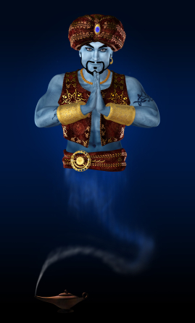
The Science of Wishful Thinking
Perfect Example of Mixed Premises
Two Contradictory Standing Orders
Primacy of Existence
You must Obey the Laws of the Universe
to Coax the Genie out of the Bottle.
Matter
Mind
Reality / Consciousness = Lawfulness
Primacy of Consciousness
Once the Genie Is out of the Bottle You
Can Have Anything You Wish or Desire
Mind
Matter
Consciousness / Reality = Willfulness

Slide 8
THE SCIENCE OF WISHFUL THINKING
“Like Aladdin’s Genie, the law of attraction grants our every command.” (p.68)
“The Universe will start to rearrange itself to make it happen for you…You don’t need to know how the Universe will rearrange itself.” (p.51)
The universe is your personal genie: “Your wish is my command”.
The only difficulty is in knowing how to coax the genie out of the bottle.
The Trick Is to ABSOLUTELY BELIEVE that you can have ANYTHING …
If you do not get what you wished for what is the problem?
It is only because you didn’t ABSOLUTELY BELIEVE or weren’t GRATEFUL enough. The Secret ALWAYS works but you don’t ALWAYS comply.
It has worked for thousands including: “Plato, Shakespeare, Newton, Hugo, Beethoven, Lincoln, Emerson, Edison, Einstein.” (The Secret, p.ix)
So don’t blame us if it doesn’t work for you. Try harder,
stick with it, don’t be so negative and ungrateful!

Slide 9
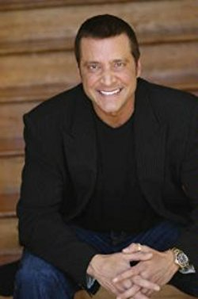
James Arthur Ray
James Arthur Ray was one of several narrators in the film The Secret. He has appeared on CNN's Larry King Live, the Today Show and Oprah.
“followers paid as much as $60,000 a year to attend his seminars, where his best-selling book, ‘Harmonic Wealth: The Secret of Attracting the Life You Want’, was cited as if it were scripture.” (“New York Magazine, Jan 24, 2010)
In September 2009 “James Ray International, the organization he founded in 1992, was named one of America’s 500 fastest-growing companies by Inc. Magazine, with revenues close to $10 million.” (“New York Magazine, Jan 24, 2010)
“He made no secret of his ambition, aiming to become the first self-help billionaire. He bragged about his financial success and promised it to his followers.” (“The Death Dealer” The Verge Article, December 4, 2013)
“Ray is an advocate of the Law of Attraction; his teachings have been described as "including a mix of spirituality, motivational speaking, and quantum physics". (Larry King Live, November 16, 2006)

Slide 10
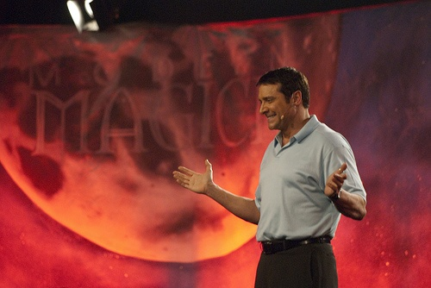
James Arthur Ray
Larry King: We begin with James Ray. What is the law of attraction?
James Ray: Well, Larry, science tells us that every single thing that appears to be
solid is actually energy. Your body is energy. Your car is energy, your house,
everything, money, all of it is energy. … So, the law of attraction says when you're in a certain vibration you're going to attract to you that which you're in vibration or harmonic vibration with.”
James Ray loves to sell the idea of the Universe being an all-powerful grantor of wishes: “If you think about Aladdin and his lamp, Aladdin picks up the lamp, dusts it off, and out pops the Genie. The genie always says one thing: ‘Your wish is my command!’ … Think about that one. Now let’s take this metaphor and apply it to your life. Remember Aladdin is the one who always asks for what he wants. Then you’ve got the Universe at large, which is the Genie.” (The Secret, p.46)
“People hold that for awhile, and they’re really a champion at it. … And yet results aren’t showing. Beneath the surface it’s just about ready to break through, but the person will look just at the surface results and say, ‘This stuff doesn’t work.’ And you know what? The Universe says. ‘Your wish is my command,’ and it disappears.” (The Secret, p.89)

Slide 11
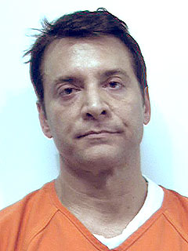
James Arthur Ray
Then on October 8, 2009 the last night of his “Spiritual Warrior” retreat in Sedona, Arizona, reality tragically caught up with Ray and his followers.
“During his ‘Spiritual Warrior’ program, he’d asked participants to shave their heads, spend 36 hours in the desert meditating without food or water, and play the ‘Samurai Game’, in which a white-robed Ray, playing ‘God’, declared people dead, forcing them to remain motionless on the ground.” (“The Death Dealer” The Verge Article, December 4, 2013)
The next day, the attendees were thrust together in the heat and darkness under the dome of the heated sweat lodge. “Outside Ray told them they were about to have an experience unlike any other. According to several attendees, he said, ‘You are not going to die. You might think you are, but you're not going to die.’ Each attendee should listen to his or her body, he said. Anyone could leave if necessary, but those seeking a higher level of consciousness would complete the experience. No one knew how many rounds that might be. Ray told them they ‘needed to surrender to death to survive it.’ Then they entered the lodge.” (“The Death Dealer” The Verge Article, December 4, 2013)
As a result of the nontraditional sweat lodge exercise, three participants died and Eighteen others were hospitalized after suffering burns, dehydration, breathing problems, kidney failure, or elevated body temperature.
“… emergency responders arrived at what one first took for a mass suicide, according to a witness. Many participants were dazed and disoriented, speaking or yelling deliriously. There was vomiting and crying; people frantically doused others with cold water. One man had fallen into the heated rocks, badly burning his arm. Medics performed CPR on at least three unconscious participants.” (“The Death Dealer” The Verge Article, December 4, 2013)

Slide 12
James Arthur Ray
Ray was convicted of three counts of negligent homicide following his arrest on February 3, 2010. He was sentenced to two years in Arizona state prison and was released under supervision on July 12, 2013. (Wikipedia.org: James Arthur Ray)
On November 25, 2013, Ray re-launched his self-help business on CNN’s Piers Morgan Live. He
had stipulated that no other guests could participate in the interview. Morgan asked whether
Ray would return to self-help work, suggesting, ‘You could be in an even better position now to help people who had been through a nightmarish experience.’“ (“The Death Dealer” The Verge Article, December 4, 2013)
Note: As of December 4, 2013, Piers Morgan’s manager, John Ferriter, was James Arthur Ray’s manager and media contact.
In 2016, Ray told CNN that returning to self-help is "exactly where I should be, and absolutely must be." He said to quit now "would be disrespectful to the memory" of those who died. "They're heroes, not victims" Ray said. "Like all of us they were there for a specific reason — something they believed in. So if their memories are going to live beyond the tragedy, to continue to have meaning, I really believe I have a responsibility to tell that over and over.“ (CNN.com, 2016-12-01, Sweat Lodge-James Arthur Ray Victims”)

Slide 13
GOSPEL OF JESUS CHRIST IS NOT A SECRET
President Dieter F. Uchtdorf: "Many have experienced personal misfortune and sadness, they hunger for meaning and purpose in life. Because there is such a great interest in these issues the world is not bashful in offering numerous new answers to every problem we face. People run from one new idea to the next hoping to find something that will answer the burning questions of their souls. They attend seminars and buy books, CDs, and other products. They get caught up in the excitement of looking for something new, but, inevitably, the flame of each new theory fades only to be replaced by another new and improved solution that promises to do what the others before could not. It’s not that these worldly options don’t contain elements of truth, many of them do. Nevertheless, they all fall short of the lasting change we seek in our lives. After the excitement wears off the hollowness remains as we look for the next new idea to unlock the secrets of happiness. In contrast, the gospel of Jesus Christ has the answers to our problems—to all of our problems. The gospel is not a secret, it is not complicated or hidden. It can unlock the door to true happiness. It is not someone's theory or proposition. It does not come from man at all. It springs from the pure and everlasting waters of the Creator of the universe who knows truths we cannot even begin to comprehend, and with that knowledge He has given
us the gospel—a divine gift—the ultimate formula for happiness and success.”
(“The Way of the Disciple”, April 2009 General Conference).

Slide 14
Questions?

